Slide 1
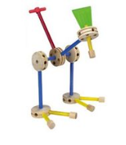
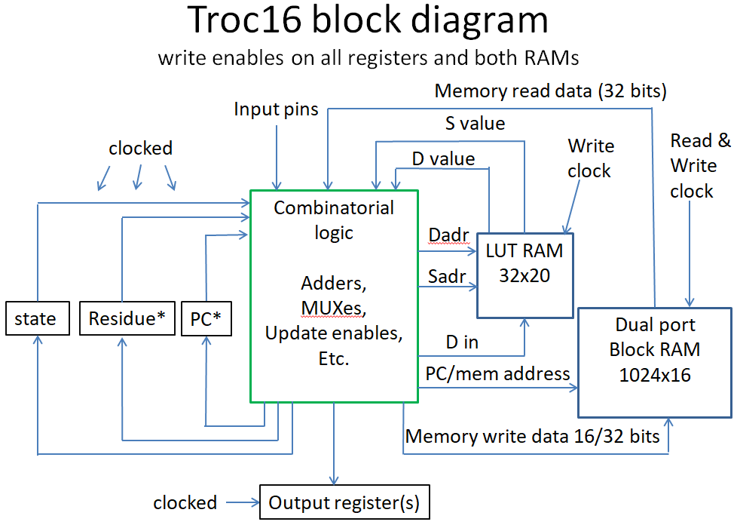
Designing a Digital Computer for experimentation
Jim Brakefield
Notes:
An FPGA contemplating a micro processor. This slide deck expanded from my presentation of 2016. Updated on 08/07/2025 to current status.

Slide 2
Introduction and overview
Why? Computer architecture is in my DNA
Moving on from the 2016 talk:
DIY soft-core Microprocessor using an FPGA “made simple”
Goals
My career was in real-time embedded; code size and deterministic run time mattered
Design process: conjuring up a satisfactory architecture
Progress on subset of the full ISA: runs, not fully tested
What lies ahead: 24-bit full ISA, floating-point, etc.
FPGA slides from the previous presentation attached
Which included a 24-bit RISC ISA implementation
Glossary and references
Notes:
Slides and other files posted to github.jimbrake/troc16_16 and to the event IEEE web page https://events.vtools.ieee.org/m/467923

Slide 3
Goals
Generality: create an RTL (VHDL) template
Efficiency: Register file with single cycle execution
Code density
Variable length instructions: 16, 24 & 32-bits
Variable length immediate values: 5, 12, 16, 24, … bits
Generality again:
Four data sizes: 8, 16, 24 & 32-bits for example
Four data types: unsigned, signed, float, experimental
Adaptable to non-power of two word sizes
With restrictions*, capable of high performance
Continuation of Axiomatic uP Architecture, 2015
Notes:
Instruction and immediate variable sizing does have a cost in complexity and timing that conflicts with efficiency. The x86 shows that it is not a critical issue. *Main restriction is to force 16 or 32 bit instruction alignment by using longer than necessary immediate values or inserting align op-codes.

Slide 4
The Adventure Begins
Monitored usenet.comp.arch & interacted
Refined my goals, learned the fine points of high performance architecture
Posted my axiomatic “mantra” to usenet March 3, 2015
available along with slide deck at meeting webpage
Some ideas came from Mitch Alsup’s My 66000
www.linkedin.com/in/mitch-alsup-8691537/
Considered both stack and RISC architectures
Stack ISAs have shorter instructions
RISC ISAs have greater generality of register use
Had difficulty devising a complete 16-bit stack ISA
Decided to use register tag bits to imply instruction variant (e.g. data type) to save some op-code space
Early on decided on register field immediate encoding
Yields 12-bit immediate on 24-bit instructions (32-bits total)
Notes:
Early on decided on 5-bit register file addresses, e.g. 32 registers and no second register file for floats. 12-bit immediate in 32-bits matches that of risc-v with no compromise on number of 24-bit op-codes

Slide 5
Axiomatic uP Architecture Jim Brakefield 2015
The first priority is low power in the sense of CoreMarks per joule.
The second priority is code density.
The instruction set is open ended, e.g. room for expansion.
20% of the instruction space is unallocated.
An instruction or instruction sequence for in-line loading of any size immediate.
Register size is unspecified, except, that there be reasonable mechanism for doing calculations on data larger than register size.
Load/store instructions shall be able to efficiently load and store data that is shorter than the register size.
8-bit character addressing shall be supported.
Unsigned, signed and floating-point formats shall be defined.
Reasonable means shall be provided to do multi-precision arithmetic.
It is required that code be position independent and thread base independent.
A case instruction or instruction sequence shall be provided.
A lookup-table/dispatch instruction or instruction sequence shall be provided.
Notes:
Culled from original list: (A) Instruction set support for both register and dual-stack based coding (B) What is not specified (C) Underlying assumptions

Slide 6
The Adventure Continued
Initially went for 24 & 32-bit instructions
8-bit op-code of which two bits set instruction size
Over half of the op-code space unused!
Enough for a useful set of 16-bit instructions
Only two register fields
Limited to 32 instructions
24 & 32-bit instructions have 25% unused op-code space, enough to hold future 40 & 48-bit instructions
Unique: residue register to capture overflow
As a distinct register, can be updated separately
A simple small ISA is a good place to start
Can add longer instructions later
Full 16-bit ISA with two register file read ports
Notes:
There is an issue with PC as general purpose register. It is said to conflict with high performance. Residue register to capture carry, overflow, upper half of multiply and remainder of divide. No status register, residue register can be used like any other register. With reasonable limitations as can the PC.

Slide 7
The Residue register
Considered poor design to use status register for zero/carry/overflow signals
Moving these signals to a register file register opens a more general and elegant approach
Capturing the upper half multiply product and divide remainder solves several problems
Provides a general and efficient approach for multi-word arithmetic
IEEE-754 now supports floating-point divide remainder and the residue (round-off portion) of add/subtract/multiply.
Notes:
Have implemented the residue register as a distinct register that is MUX’d into register file outputs due to single write port register file limitation.

Slide 8
TROC Instruction formats Little Endian
16-bit op-code specifies N versus S
sssss ddddd xxxxx1
nnnnn ddddd xxxxx1
nnnnnnnn nnnnnnnn 10000 ddddd xxxxx1
24-bit has immediate enable bit
rrrrr 0 xx sssss ddddd xxxx10
nnnnn 1 xx sssss ddddd xxxx10
32-bit has three additional op-code bits
ttttt xxx rrrrr 0 xx sssss ddddd xxxx00
nnnnn xxx rrrrr 1 xx sssss ddddd xxxx00
Notes:
Little endian dominates, so am using it. Op-code starts at the instruction LSB. R, S, T & D are register address fields. X’s are op-code bits. Register address field locations do not vary among various size instructions. A zero instruction byte is a trap instruction. On 16-bit if nnnnn is 10000 then the additional half word N is used

Slide 9
16-bit TROC instructions
IN, OUT, LDT, STT input/output to port n or M(N..N+1)
BSR, BRZ, BRNZ, BRP, BRM control instructions (PC+N)
MOV move register: S => D
ADD,SUB,MUL,DIV,CMP,AND,OR,XOR basic arithmetic: S op D => D
ADDI,SUBI,MULI,DIVI,CMPI,ANDI,ORI,XORI immediate versions
LDI, LDIS, LDIF, LDIF2 load typed data immediate
SHFTI shift or adjust exponent
EXTCT, INSRT extract/insert field and set type
AOB, SOB add/subtract one and branch not zero
LD, ST load/store D from M(S), use D’s data type
FUNCT 31 functions on D => D: force type, type conversion, etc...
Currently only supports unsigned & signed 16-bit data types
Sign & magnitude versus 2’s complement under evaluation, 2’c complement won
For multiply very little difference in timing or LUT count
Divide not currently implemented
Notes:
Residue is register 28 and PC is register 31. N indicates 2’s complement constant, immediate versions use D register data type. SHFTI, EXTCT, INSRT, FUNCT, AOB and SOB implemented and tested. SHFTI, EXTCT, INSRT and FUNCT incur significate relative LUT counts. Omitted on “base” version and included on “full” version. 24-bit instructions have a full set of indexed or base + offset load/store instructions.

Slide 10
16-bit TROC FUNCT instructions
SETUS set D type to unsigned
SETS set D type to signed
SETFLT set D type to float
SETFLT2 set D type to float2
ABS take the absolute value of D
NABS take the negative absolute value of D
TAG place D’s tag bits into residue
ITAG place residue’s LSB bits into D
LDUS load residue with unsigned from M(D)
LDS load residue with signed from M(D)
LDF load residue with converted float from M(D)
LDF2 load residue with converted float2 from M(D)
ST convert and store Residue to M(D)
CVTUS convert D to unsigned
CVTS convert D to signed
CVTFLT convert D to float
CVTFLT2 convert D to float2
“xxxxx” Room for 14 more functions
Notes:
n = “10000” used for p2INSRT instruction. Tentative additional instructions: sinpi, cospi, atanpi, log base2, power of 2, 1/D, sqrt(D), 1/sqrt(D), …

Slide 11
TROC 24 & 32-bit Op-code list
LDU8, LDU16, LDU24, LDU32,
LD8, LD16, LD24, LD32,
FLD8, FLD16, FLD24, FLD32,
F2LD8, F2LD16, F2LD24, F2LD32,
LEA8, LEA16, LEA24, LEA32,
ST8, ST16, ST24, ST32,
ADD, ADDI, SUB, SUBI,
MUL, MULI, MAC, DIV, DIVI,
AND, ANDI, OR, ORI,
XOR, XORI, CMP, CMPI,
FATAN2PI, FPOW, FPOWI,
INSRT, INSRTI, EXTRCT, EXTRCTI,
ROL, ROLI, SHR, SHRI,
ASR, ASRI, SHL, SHLI,
JMPcc, CALLcc, BRcc, BSRcc,
BBS, BBC, BRccRC, JMPccRC,
MAX, MAXI, MIN, MINI,
EADD, EADDI,
VECT, LOOP, LOOPI (My 66000 instructions)
TRAP, BKPT, ALIGNW, ALIGNC
Three operand only (32-bit inst.)
MMOV, PCND, PCB1, STM, LDM,
MEDIAN, CASE, MUX, MERGE
~32 single operand (24-bit inst.)
LDZCNT, LD1CNT, TRZCNT, TR1CNT
POPCNT, SINPI, COSPI, TANPI,
ASINPI, ACOSPI, ATANPI, …
Notes:
An expansive set of op-codes is shown and not necessarily implemented. This gives a flavor of the op-codes, see the spreadsheet for complete list and their formats. Without tags would need ~four sets of each instruction. BRccRC & JMPccRC are relative/absolute branches on condition code test of register contents. BBS: branch bit set

Slide 12
Variable length immediate values
N or I field is five bits
For troc16_16hwa if N=“10000” then the next 16-bits is the immediate, otherwise the values can be from -15 to +15.
For 24 & 32-bit instructions there are several format choices.
Allocating four bits and the next byte allows a 12-bit signed immediate: snnnnnnn nnnn1
This leaves four codes to indicate the size of the following immediate: 10ss0
And a value from -4 to 7: -4…-1: 11nn0 or 0…7: 0nnn0
Notes:
For TROC16 the type code of the D register implies the type of the ALU immediate. Mixed data type operations may or may not be supported.

Slide 13
Data formats
Unsigned is the usual binary
Signed can be either two’s complement or sign and magnitude with sign at the least significant end
Floats can use zero extension if both the exponent and the mantissa can be zero extended. Implies exponent and mantissa signs in the middle with exponent first.
For floating-point one typically converts between memory format and register format during memory load and store. Tag bits provided for additional exponent and mantissa bits
POSIT & PT-float need 4 additional mantissa bits in register format for 24 & 32-bit floats.
Notes:
The consensus is that 2’s complement works better than sign & magnitude. Zero extend float format: exponent bits, exponent sign, mantissa sign, mantissa; zero extended on both ends on load, truncated on store? Other floating-point formats likely to be used: non-denorm IEEE-754, Alt-754, IEEE-754, POSIT, PT-float, fixed point logarithms.

Slide 14
Example 16-bit data formats
Unsigned, has type code of zero, one-bit sign extension on N
0000 nnnn nnnn nnnn nnnn register format
Sign & magnitude or 2’s complement, has type code of one
010s snnn nnnn nnnn nnnn sign could be at either end
Simple float arranged to support zero extension
10-- eeee sS1.mm mmmm mmmm exponent, sign & mantissa sign
Alt-754 supports gradual underflow & overflow
eeee sS1.mm mmmm mmmm memory format
0000 sS1.mm mm10 0000 underflow, uses # trailing zeros
1111 sS1.mm mmmm 1000 overflow, uses # trailing zeros
11ee eeee sS1.mm mmmm mmmm register format, E adjusted
Notes:
Alt-754 underflow and overflow uses number of trailing zeros in memory format to adjust exponent. One exponent tag bit needed for that. 2nd exponent tag bit for Euclidian distance computation. Consensus for exponent is off-set binary (can use sign extension).

Slide 15
The initial implementation Troc16_16min
Tagged, Register Oriented Computer, 16+ bit instructions, 16-bit data (no tags on min variant)
32-bit memory: both an instruction and the 16-bit immediate, even if not needed
Two port register file
Great LUT counts! multiply instruction included
LUTs LUTram DFF BRAM DSP clock
395 16 50 0.5 1 14.1ns Default
283 16 50 0.5 1 13.0ns Area optimize
512 144 66 0.5 1 10.0ns Fmax optimize
Combinatorial divide adds ~400LUTs & 30ns
Notes:
Targeted AMD/Xilinx Vivado 24.2, Spartan-7, Real Digital Boolean Board. FPGA has 6 input LUTs. TROC16_16min: Unsigned 16-bit data only. Six instruction loop runs, no other test bench. Other FPGA tool chains: Intel/Altera, Latticesemi, Gowin, Microchip/Actel

Slide 16
A better implementation Troc16_16hwa
Half Word Aligned, 2nd half word only if needed
16-bit two port memory: addressed location and next location
Still good LUT count
LUTs LUTram DFF BRAM DSP clock
16 50 0.5 1 14.9ns default opt
307 16 50 0.5 1 14.2ns area opt
Can continue with this design, adding data types and living with two port register file
24-bit load/store instructions possible by limiting base register to Residue or PC (due to 2-port register file)
Notes:
Targeted AMD/Xilinx Vivado 24.2, Spartan-7, Real Digital Boolean Board. Six instruction loop runs, no other test bench.

Slide 17
16-bit implementation with tag bits Troc16_16hwatag
Four tag bits added to each register
Half Word Aligned, 2nd half word only if needed
16-bit two port memory: addressed location and next location
Two port register file
LUT count rising, includes signed & unsigned MUL
Area optimization: improvement in LUT count
LUTs LUTram DFF BRAM DSP clock
443 17 50 0.5 1 15.2ns default
372 17 50 0.5 1 16.2ns area opt
Notes:
Targeted AMD/Xilinx Vivado 24.2, Spartan-7, Real Digital Boolean Board. Six instruction loop runs, no other test bench yet.

Slide 18
16-bit implementation, 4 port register file Troc16_16qphwa
Four port register file (24-bit instructions available)
Four tag bits added to each register
Half Word Aligned, 2nd half word only if needed
16-bit two port memory: addressed location and next location
LUT count rising, includes signed & unsigned MUL
Code improvements: Booleans optimized, T mux removed
LUT LUTR DFF BRAM DSP clock setting target FOM*
337 18 74 0.5 1 14.2ns area 20ns 209
365 18 74 0.5 1 13.7ns default 20ns 200
455 18 80 0.5 1 10.073ns fmax 10ns 218
Notes:
Targeted AMD/Xilinx Vivado 24.2, Spartan-7, Real Digital Boolean Board. Six instruction loop runs, no other test bench yet. *FOM: 10E6/(number-luts * clock ns). Surprise: FOM relatively constant! Currently all instructions take a single clock cycle except load/store take two clock cycles. 25-bit load-store instructions have since been dropped.

Slide 19
Full 16-bit implementation Troc16_16full
All 16-bit instructions, using funct for load/store
24-bit load/store instructions not used
I like having a complete 16-bit only implementation
36 different instructions and 17 funct instructions
LUTs LUTram DFF BRAM DSP clock
698 21 57 0.5 1 18.4ns spartan7
748 80 53 0.5 2 7.8ns zynq US+
Interrupt on illegal or unsupported instructions
Last step before TR24_8234 with byte addressing
Exploration with 16-bit fixed point logarithms
A natural application for TR16_423 type 2 floats
Notes:
Used AMD/Xilinx Vivado 25.1 to target Spartan-7, Spartan US+ and Zynq US+. Six instruction loop runs, no other test bench yet. SHFT, INSRT & EXTRCT responsible for increased LUT counts.

Slide 20
Tracking LUT growth area optimization results
Variant LUTs LUTram DFF BRAM DSP clock
min 283 16 50 0.5 1 13.0ns
hwa 307 16 50 0.5 1 14.2ns
hwatag 372 17 50 0.5 1 16.2ns
qphwa 337 19 74 0.5 1 14.2ns
full 633 21 66 0.5 1 17.3ns
basic 354 21 72 0.5 1 16.7ns
min: unsigned only
hwa: 2nd 16-bits only if needed, half word addressing
hwatag: tag bits added to register file, signed & unsigned
qphwa: Quad port register file, 24-bit instructions
full: complete 16-bit instruction set: 36 inst & 17 funct
basic: no shft, funct, insrt, extrct or divide, has LD/ST
Notes:
Targeted AMD/Xilinx Vivado 24.2, Spartan-7, Real Digital Boolean Board. All instruction’s RTL simulates. SHFT, INSRT & EXTRCT responsible for increased LUT counts. At this time divide, floats and implied coercions not implemented. No 24-bit instructions. Full and basic LUT counts have varied over the course of implementation. Current LUT counts and timing shown

Slide 21
FPGA Implementation
Need list of instructions and their formats (spreadsheet)
Do op-code allocation (VHDL constants)
example:
constant op16_ADD:unsigned(5 downto 0):="000101";-- S + D => D
Write register file VHDL done
Write memory block RAM VHDL done
Write top file: currently troc16_hwa.vhd
Include constant & op-code files
Port map Register file & Memory
Main combinatorial process
Register update process
Notes:
Much of the planning involved refining or reconsidering the instructions and their formats. Necessary instructions, useful instructions. A corporate design process uses benchmarks and simulator to determine utility of each instruction.

Slide 22
Troc16 block diagram write enables on all registers and both RAMs
Memory read data (32 bits)
Input pins
S value
clocked
Write
clock
Read &
Write
clock
D value
Combinatorial logic
Adders,
MUXes,
Update enables,
Etc.
Dadr
LUT RAM
32x20
Sadr
state
Residue*
PC*
Dual port
Block RAM
1024x16
D in
PC/mem address
Memory write data 16/32 bits
clocked
Output register(s)
Notes:
*Residue and PC registers MUXed into LUT RAM outputs as per LUT RAM addresses. Modified 2016 diagram. Dual port block RAM uses two successive addresses. Dual port block RAM necessary for single cycle instruction + immediate value read and for data + tag-bits load/store.

Slide 23
Single clock cycle events
Read instruction, next location out of block RAM
Use D & S fields to read operands from LUT RAM
PC & Residue MUX’d onto LUTRAM outputs
Per instruction, immediate values MUX’d onto S LUTRAM output
Instruction process uses nested case statements, generates register & memory updates
Set update enables
Update PC, LUT RAM, post address (new PC) to block RAM
Notes:
Single cycle implementation much friendlier towards experimentation: can comment code in and out. Generics & conditional generate is the better way to invoke options compared to commenting RTL in and out. Example at: https://opencores.org/projects/alwcpu

Slide 24
Main file (rtoc16_… .vhd)
use ieee.numeric_std.all;
Component declarations
Variable declarations
Register file & Main memory Port maps
Mux PC and Residue onto register-file outputs
Main process
Register updates
Typically three names used:
name,
nameN for next value,
nameWE for update enable
Notes:
Recommended to use unsigned signals as much as possible with ieee.numeric_std.all www.linkedin.com/in/mitch-alsup-8691537/
VHDL data type coercions via signed, unsigned & std_logic_vector functions.

Slide 25
Instruction Processing
Use nest of CASE statements
First set default values for variables
State variable Case (memory load/store, normal)
Op-code size Case (16, 24 & 32-bit instructions)
Op-code Case (32 entries, unsupported instructions commented out)
Example: when op16_ADD | op16_ADDI => ALUout<=SS + DD; LUTwe<='1'; residueN(0)<= ALUout(16); residuewe<='1';
Data type Case (as necessary, for instance AND, OR, XOR, INSRT & EXTRCT are data type invariant)
Notes:
Each op-code updates default values as needed. Loads and store take two clock cycles and thus three states needed. Will need additional states for interrupts & slow operations.

Slide 26
Register update RTL
update: process(clk)
begin
if (rising_edge(clk)) then
state<=stateN;
if pcwe = '1' then pc <= pcN; end if;
if residuewe = '1' then residue <= residueN; end if;
if outwe = '1' then out0 <= S; end if;
-- for now only one output port
end if;
end process; -- register & state updates
Register file and memory also have updates using signals from the main process
Notes:
VHDL-2008 actual RTL

Slide 27
Next steps
Add test bench! Will be a self checking program
Add tag bits to register file: done
Load-immediate for additional data types: done
New data type operators, 2’s complement: done
Four port register file: done, reverted to two port
Revise and document TROC16 ISA done
Instruction save register (ISR)
Necessary for immediate values not fitting into memory path
Burfication
16-bit and 24/32-bit variants diverge:
16-bit to remain half word only, no byte support
New naming: e.g. TR16_42 & TR24-8234
ALU/register size, # of tag bits, # TROC instruction byte sizes
Notes:
ISR is typically the second pipeline stage on pipelined implementations. Trying to stay single-cycle, except for memory read/write and when immediate value not included on instruction memory read. ISR and single cycle combination implies instruction decoder feed from two sources (memory output and ISR). Floating-point ALU has both exponent and mantissa ALUs and rounding is specified in “configuration” internal register.

Slide 28
TR16_42*
Using half word aligned instructions
Half word alignment, 16-bit data only
Immediate values are either -15…15 or full 16-bits
24-bit instructions provide better load/store
Requires three read ports/one write port register file
16-bit single operand instructions func(D) => D
LD and ST replaced AOB & SOB
Many of the full instructions can be provided by two or three basic instructions
No interrupt processing for now
Complete detailed test program, WIP
Set of instructions that exercise each op-code
Notes:
*Tagged Register oriented computer with two byte instructions, 16-bit ALU and four bits of tags: two tag bits for data type & two for extended floating-point exponent, two byte plus immediate half-word if needed instructions.

Slide 29
TR24-8234*
Four port register file: done
Instruction save register (ISR)
16, 24 and 32-bit instructions
With variable length immediate values
24-bit registers with 8-bit tags; 32-bit memory
Need assembler to generate memory initialization
Unless using word aligned instructions
Memory byte write enables
16-bit internal four port register file
Runtime state: configuration, rounding, interrupt enables
Saved PC, interrupts pending, etc.
Hardware config: build date, build name, available settings
Notes:
*Tagged Register oriented computer with two, three & four byte instructions, 24-bit ALU and eight bits of tags. Floating-point ALU has both exponent and mantissa ALUs with details specified in “features” internal register (rounding modes, exception handling, …).

Slide 30
TROC naming codes tenative* TROCnn_tb_{i}b_{d}abc
TROC: Tagged Register Oriented Computer
nn: Width of the ALU** in decimal, also of addresses
t: number of tag bits character-code***
b_{i}: instruction byte size character-code
b_{d}: data byte size character-code
ab…: instruction sizes in “bytes”
Other architectures:
TOOSM: Tagged one operand stack machine
ROC: Register oriented computer (AKA RISC)
ACM: Accumulator computing machine
MAOC: Muli-Accumulator oriented computer (AKA CISC)
Notes:
*Naming code has changed frequently. **Integer ALU one bit larger to capture carry and overflow. ***Character/addressable-unit codes: 1..9 or A…Z character for 1 to 37 size? Naming code can be shortened when additional letters are defaults: byte default is eight; e.g. TROC16_4gg1 shortened to TR16_4g, TROC24_888234 shortened to TR24_8234. One could add another character code for the number of addressing modes?

Slide 31
Some day
Implement assembler (not hard)
Needed to generate memory initialization files
Previously wrote a subroutine for each type of instruction, program was a long set of subroutine calls
Implement compiler: SDCC does register allocation; another example:
https://www.cs.hiroshima-u.ac.jp/~nakano/wiki/wiki.cgi *
Run benchmarks (there are many, these are shock wave)
https://www.researchgate.net/publication/323467921 **
https://helper.ipam.ucla.edu/publications/bdcws2/bdcws2_15049.pdf
Other floats: 16-bit fixed point logarithms
Other word & byte sizes
There is a way to use ordinary DRAM with 36, 42 & 48-bit word sizes***
Harvard architecture with 8-bit aligned instructions and separate 36, 42 or 48-bit data memory
TR36_9234, TR42_9234, TR48_10234***
Notes:
*Nakano uses Flex, Bison & Perl to create gcc compiler. Wirth’s Oberon also a possibility. SDCC? Problem is register allocation. **Also covers several float formats and their encoding. ***DRAM read/written 256 bits at a time. On read 256 bits split into 7x 36, 6x 42 or 5x 48-bit words with minimal waste. Most likely is Harvard architecture with 8-bit aligned instructions and separate 36, 42 or 48-bit data memory.

Slide 32
Retrospective
Was dragging my feet until considered the subset 16-bit ISA
Where to start? Minimal implementation & gratification!
AMD/Xilinx Vivado gives advice and better error locations than previously. Linter sometimes helpful.
Significant LUT count elasticity between area and speed!
Used ~same implementation process as in 2016
Not as concerned with creating temporaries to save LUTs: E.g. Vivado seems to optimize very well*
Majority of the time goes into planning / evaluation
Troc16 seems to have a life of it’s own (low LUT count!)
An alternative to RISC-V? Requires frozen minimum ISA for tool chain & Linux (no divide, no floats, interrupt support)
Notes:
A complete operation code list and their formats helps greatly when doing simplifications or sub setting that will be later supplemented. *E.g. am writing behavioral RTL. Migration to structural RTL and pipelining can occur once design is proven, e.g. passes complete test-bench.

Slide 33
Glossary
ALU: (Arithmetic Logic Unit) device that performs arithmetic or logic on its data inputs
Code density: number derived from comparing the relative binary sizes of a program on different computers or different programming languages
Data: a collection of bits, often called a word or byte, as the object of a program
Instruction: a collection of bits used to specify processing of data
IP: (Intellectual Property) well documented and tested soft core designs
ISA: (Instruction Set Architecture) description of a digital computer from the programmer’s point of view. Precisely describes the operation of each instruction
MUX: multiplexor a device with control input that selects one of its data inputs as its output
Op-code: binary code or its alphanumeric equivalent of a specific instruction, e.g. “ADD” specifies the add instruction in binary
Register: circuit that will hold a binary vector indefinitely until changed
RISC: (Reduced Instruction Set Computer) better characterized as containing a uniform register file with separation of memory load & store from register processing
RTL: (Register Transfer Language) specifies in detail the operation of a digital circuit in terms of logic and registers. Examples are VHDL and System Verilog.
Notes:
Most of these can be found on Wikipedia. A collection of 28 code density papers at: https://github.com/jimbrake/Code-Density-papers

Slide 34
References
Harris & Harris: Digital Design and Computer Architecture: highly recommended book
IEEE-754: Floating-point arithmetic standard
RISC-V: A specific RISC computer ISA widely used in courses at universities
Open source CPUs: github.com/jimbrake/cpu_soft_cores Incomplete list of ~600 CPUs along with web-page, author and various details. Hobby, educational & IP
POSIT: posithub.org/docs/posit_standard-2.pdf
PT-float: www.ac.uma.es/arith2024/program.html See Session 7 for paper and slides
FPGA tool chains: Intel/Altera, Gowin, Latticesemi, Microchip/Actel & AMD/Xilinx each of these companies manufacture FPGA chips and provide “free” software tools to configure their chips via RTL (VHDL or verilog)
www.intel.com/content/www/us/en/products/details/fpga/development-tools.html
www.gowinsemi.com/en/support/home/
www.latticesemi.com/software
www.microchip.com/en-us/products/fpgas-and-plds/fpga-and-soc-design-tools
www.xilinx.com/support/download.html
Notes:
There are many books on computer architecture, usually covering several. Computer Architecture A Quantitative Approach, 1990 by Hennessy & Patterson offers comparisons with an abundance of charts and graphs of various metrics. It is now in it’s 7th edition.

Slide 35
FPGA resources
LUT Lookup table 3 to 6 inputs, 1 to 2 outputs*
Includes carry chain for building adders
DFF D flip-flop 1 to 2 per LUT
IO Tristate transceiver with optional DFFs
RAM Variable aspect ratio, usually dual port
LUT RAM: 16x1, 64x1, 32x2
Small block RAM: 32x18, 32x20, 64x18
Block RAM: 128x36 to 1024x36
Large block RAM: 2Kx72, 4Kx72, 4Kx144
External DRAM: Built-in controller?
Wiring Fabric
Horizontal and vertical wire segments of various lengths
Notes:
From 2016 talk. LUT RAMs typically can have two or more read ports and only one write port. Block RAMs are usually dual port. *The Altera Agilex series has additional features.

Slide 36
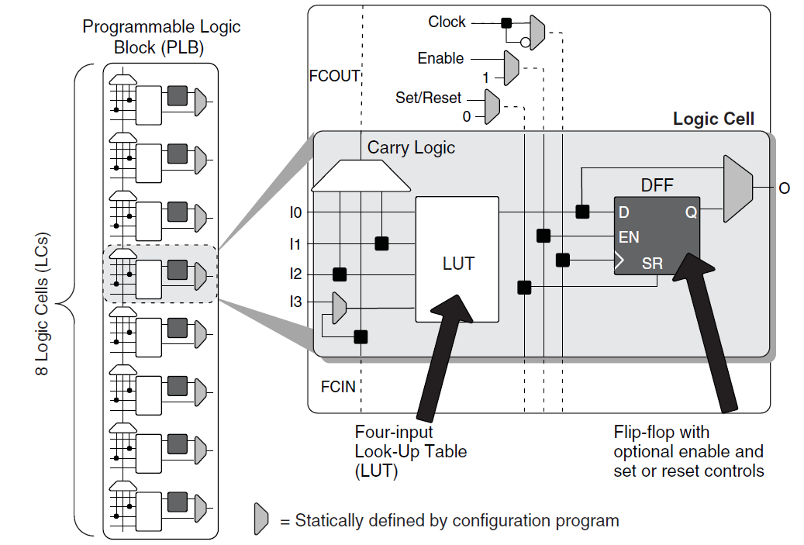
LUT + DFF Lattice Semiconductor iCE40FamilyHandbook.pdf pg6-2
Notes:
From 2016 talk. Most FPGA families show the carry logic after the LUT.

Slide 37
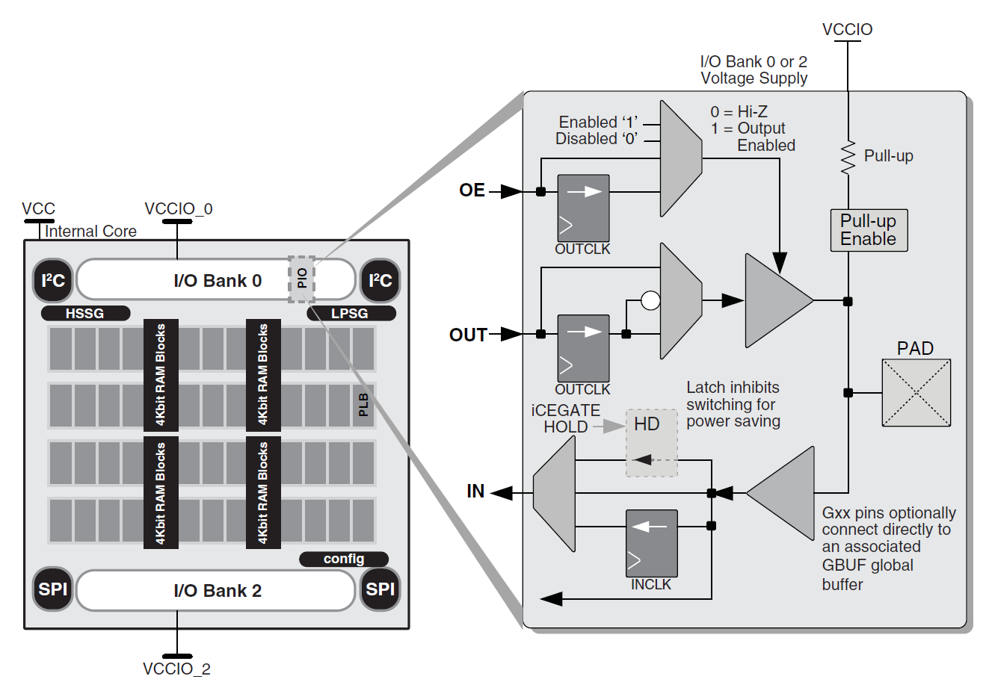
Input – Output pins Lattice Semiconductor iCE40FamilyHandbook.pdf pg6-7
Notes:
From 2016 talk.

Slide 38
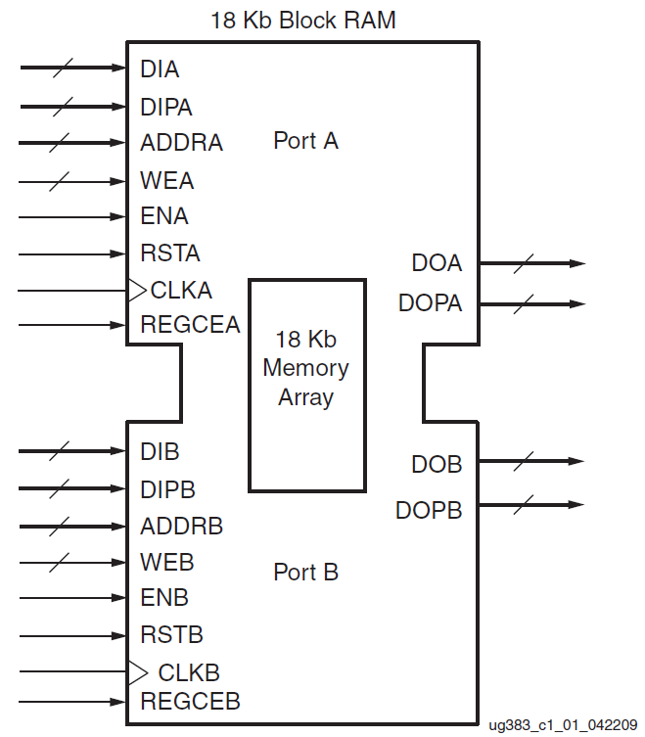
Block RAM Xilinx Spartan-6 FPGA Block RAM Resources User Guide pg12
Notes:
From 2016 talk. DIA and DIB typically 8-bits wide, DIAP and DIBP one bit of “parity”, can be used as ninth bit. For most block RAMs each half can be configured with various power of two data input and output widths. Parity bits can included with widths 8 or more bits wide.

Slide 39
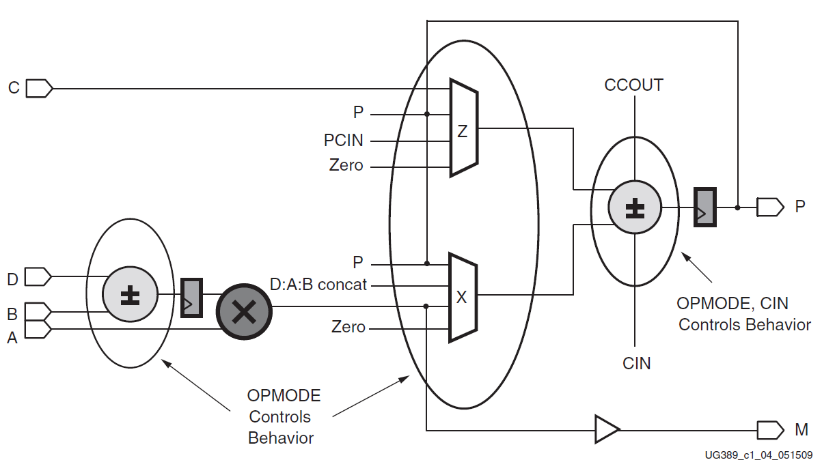
Simplified DSP48A1 slice Xilinx Spartan-6 FPGA DSP48A1 Slice pg 17
Notes:
Modified from 2016 talk. Multiply is anywhere from 16 by 16 to 18 by 27 bit inputs. Final adder is at least as wide as the product (from 32 to 64-bits). Various families have various ways of splitting or combining DSP multipliers. Some offer IEEE 754 32-bit floating add/sub/multiply with no underflow support. Support for shorter floating-point formats varies considerably.

Slide 40
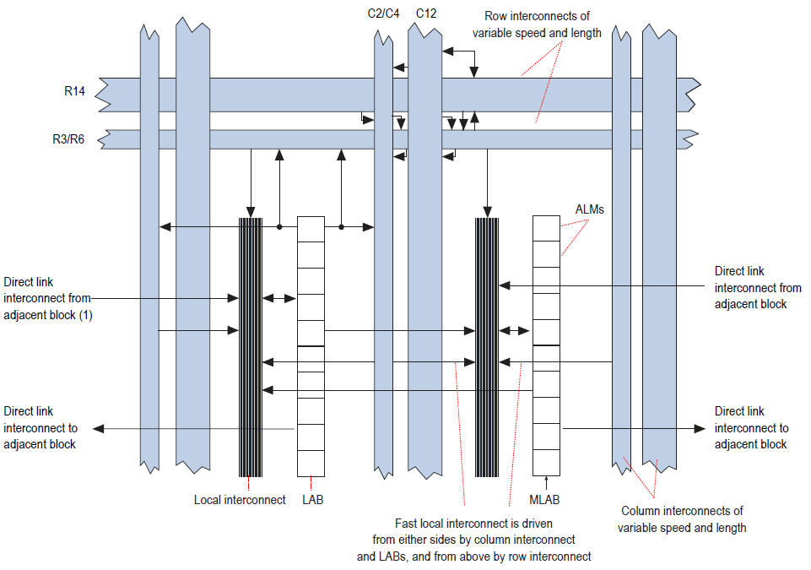
Wiring Fabric Altera CycloneV Device Handbook pg1-2
Notes:
Modified from 2016 talk: ALM is roughly equivalent to Xilinx 6LUT. Can provide two 4LUTs or one 6LUT, up to 4 DFF and two adder bits. Ten ALM per LAB.

Slide 41
ROIS24_24uP
More or less a standard RISC cpu
64 24-bit registers: uses 96 LUTs, quad ported
24 bit instruction with 6-bit op-code and three 6-bit register designators
XXXXXX DDDDDD RRRRRR SSSSSS (DRS)
XXXXXX DDDDDD RRRRRR sNNNNN (DRsN)
XXXXXX DDDDDD sNNNNN NNNNNN (DsNN)
XXXXXX sNNNNN NNNNNN NNNNNN (sNNN)
24-bit by 1024 word block-RAM main memory
IO ports directly connected to LEDs, Switches, Push button, 100MHz clock
Status register: zero, sign, carry, overflow
PC not part of register file
Notes:
From 2016 talk. A three data-size (8, 16, 24), three data-type (unsigned, signed, float) ISA is defined, implementation is incomplete (2017).

Slide 42
rois24_24uP block diagram write enables on all registers and RAMs
Memory read data
Input pins
S value
clocked
R value
Write
clock
Read &
Write
clock
D value
Combinatorial logic
Adders,
MUXes,
Update enables,
Etc.
Dadr
Sadr
LUT RAM
64x24
Radr
state
CCR
PC
Block RAM
1024x24
D in
PC/mem adr
Memory write data
clocked
Output register
Notes:
From 2016 talk. For TROC16 CCR became the Residue register, TROC16 LUTRAM is 32x16 and TROC16 Block RAM is 1024x16.

Slide 43
rois24_24uP instruction set
Register zero always reads as zero
XXXXXX DDDDDD RRRRRRR SSSSSSS (DRS)
Two operands & result registers
Add, add with carry, subtract, subtract with carry,
AND, ANDC(2nd operand complemented), OR, XOR
Call (Jump if D=0; branch to mem[R+S])
XXXXXX DDDDDD RRRRRR sNNNNN (DRsN)
Sign extended 6-bit immediate combined with R value
Addi, adci, andi, ori, xori
Call (Jump if D=0; absolute call/jmp if R=0; return if sN=0)
In, Out
Notes:
From 2016 talk. Big Endian.

Slide 44
rois24_24uP instruction set cont’d
Load and store: DRS & DRsN
Load to D, Store from D
XXXXXX DDDDDD sNNNNN NNNNNN (DsNN)
Conditional branch relative (D is condition code)
Load immediate
Call relative
XXXXXX sNNNNN NNNNNN NNNNNN (sNNN)
Prefix: sNNN will be prefixed to next sN inst
28 instructions currently, room for 64 inst.
Notes:
From 2016 talk

Slide 45
Rois24_24uP minimal program
At 100MHz need more than 24-bits to get blinking lights
Use two registers:
Add one to first register
Add carry to second register
Output second register to LEDs
Branch back to first instruction
Four instruction loop
2nd register increments every 0.67 seconds
Notes:
From 2016 talk

Slide 46
Is it working?
Constraint file
Sets clock speed
Sets IO pin assignment
Evaluation kit usually has a sample constraint file
Simulate/debug
Tools will generate a simple test bench
Need to relay observed signals out to test bench
Program acts as the test script
Performance metrics & goals
Track LUT count, DFFs, Fmax, compile settings
Notes:
From 2016 talk

Slide 47
Insights
A deliberate process:
Get something bare bones working
Minimum instruction set, minimum program
Add instructions
Add to test program
Migrate to block RAM and data-path?*
Data-path logic is harder to debug
Lots of soft-core uPs at www.opencores.org
Notes:
From 2016 talk. *I no longer do data path planning, the tools know best where to place the MUXes and will generate the control signals for you. BTW Ted Fried has excellent examples of micro-coded designs: https://github.com/MicroCoreLabs/Projects/tree/master mcl65, mcl51 & mcl86 are open source 6502, 8051 & 8086

