Slide 1
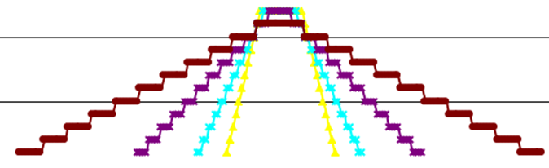
Floating-Point Arithmetic and Brakefield’s Patent US5892697A:
Method and apparatus for handling overflow and underflow in processing floating-point numbers
(see last slide)

Slide 2
Outline
Is my best effort to provide balanced presentation between IEEE 754 and US5892697A
Slides, web links, format sheet, 854 communications at
https://events.vtools.ieee.org/m/381287
Floating-point history and early issues
IEEE Standard 754, its goals and limitations
Motivation for Brakefield’s patent
Subsequent and current developments
Testing: what can go wrong will go wrong
Many prickly details

Slide 3
Some videos on floating-point
Floating point computations today and in the future
https://www.youtube.com/watch?v=NCKv0TBCj0g
Best overall video for this talk
IEEE 754 Std. for Floating-Point Arithmetic
https://www.youtube.com/watch?v=RuKkePyo9zk
Through coverage of IEEE 754
CppCon 2015: John Farrier “Demystifying Floating Point"
https://www.youtube.com/watch?v=k12BJGSc2Nc
General introduction

Slide 4
Floating-point background
Fixed point diagram/definition
https://en.wikipedia.org/wiki/Fixed-point_arithmetic
Implied decimal point, some programming languages support fixed point: specifying the decimal point location
Floating point diagram/definition
https://en.wikipedia.org/wiki/Floating-point_arithmetic
Exponent included along with mantissa/fraction
Rounding references
https://en.wikipedia.org/wiki/Rounding
https://www.eetimes.com/an-introduction-to-different-rounding-algorithms/
Many ways to round, default is unbiased bankers rounding

Slide 5
Early floating-point examples
Brakefield, J.C.; Quin, M.J. 1977. Variable length data formats. Data Management Symposium; Huntsville, AL; Oct 1977 Proceedings p. 243-253
Sorted by radix, word size and CPU
https://events.vtools.ieee.org/m/381287
John Savard: Text narrative and format diagrams
http://www.quadibloc.com/comp/cp0201.htm
Robert Munafo: Survey of Floating-Point Formats, with references
http://www.mrob.com/pub/math/floatformats.html

Slide 6
Early floating-point Issues
Variety of exponent sizes
Inconsistent rounding
Less than full accuracy
Inconsistent results
Wasted mantissa bits
Susanne (Tom’s wife) was working for Lockheed in a Remote Sensing Lab, and they had some kind of problem with an array processor. So naturally they had a meeting to talk about the problem. The problem was that the AP (array processor) was giving different results on runs with the same data. So some high-level wag remarked that it was floating point, so they shouldn't expect to get the same answer every time..... So they adjourned the meeting amid a lot of coughing.

Slide 7
Rounding
https://en.wikipedia.org/wiki/Rounding
This web page has gotten better and more accurate
Round-half-to-odd (as used here) and Von Neumann rounding no longer covered
https://www.eetimes.com/an-introduction-to-different-rounding-algorithms/
By Clive (Max) Maxfield
Easy to understand

Slide 8
IEEE Standard 754, its goals and limitations https://en.wikipedia.org/wiki/IEEE_754
Goals
32 and 64-bit versions
Least significant bit accuracy
Consistent results for same compiler settings
No wasted bits
Limitations
subnormal numbers hard to pipeline
https://en.wikipedia.org/wiki/Subnormal_number
Has double rounding problem, evaluation order matters

Slide 9
IEEE Standard 754
William Kahan: “architect of the IEEE 754 Binary Floating-Point Standard”
https://people.eecs.berkeley.edu/~wkahan/ieee754status/754story.html
Quickly adopted by Intel (8087 chip), Motorola (68881 chip), IBM 370 and is now the norm
Reports are that the 754 standards meetings had much “debate”
More recently a 16-bit format and decimal versions specified
Specifications for conversion to and from decimal
https://www.youtube.com/watch?v=8afbTaA-gOQ tutorial

Slide 10
Motivation for Brakefield’s patent https://patents.google.com/patent/US5892697A/en
Optimal Floating-Point Format
Published in ACM SigArch Nov. 1972
Was interested in computer ISAs, did a chart of floating-point formats
Variable length data formats, Brakefield, J.C.; Quin, M.J. Data Management Symposium; Huntsville, AL; Oct 1977
Responded to call for comments on IEEE 854 standard (Jan. 1985)
Showed using trailing zeros count to adjust exponent
Trailing zeros count gives both gradual underflow and gradual overflow (with decreasing accuracy) on a normalized mantissa
Response was “gradual overflow not useful”

Slide 11
Motivation for Brakefield’s patent
IEEE Task P854 April 1985 meeting notes: comments on Brakefield gradual underflow/overflow letter
No description of underflow representation, although final IEEE-854 allows any representation
Exposed to the cost$ for “subnormal” support on real-time embedded processors
Dec. 1995 filed patent
Wrote the patent with revisions per patent attorneys, used a San Antonio patent firm
April 1999 patent granted

Slide 12
US5892697 idealized floating point
Consider an infinite string of bits (in both directions)
Somewhere between two of the bits is the decimal point
And there is also a sign bit
If all bits are zero the value is zero
Code for negative zero used instead for NaN or NaR
The value is not representable
If there is no left most one bit the value is infinite
If there is no right most one bit the value is inexact
For an implementation the location of the left most one bit is limited to a fixed length binary exponent value
For an implementation the distance between the left most one bit and the right most one bit is limited to the mantissa/fraction length
So from the idealized infinite bit string values one selects a subset that can be implemented by binary logic using constraints on the exponent and mantissa sizes
US5892697 allows separate representations for memory and register values
Additional bits allowed in the register representation

Slide 13
Analysis of underflow/overflow idea
A way to maintain normalization for denorms
Same format supports normalized gradual overflow and symmetrical exponent ranges
Implies an additional exponent bit in floating-point registers
Implies dedicated floating point comparison circuit
Works very well with round-half-to-odd
Kahan’s and other hardware issues with denorms:
http://grouper.ieee.org/groups/754/meeting-minutes/02-09-19.html
http://www.acsel-lab.com/arithmetic/arith16/papers/ARITH16_Schwarz.pdf

Slide 14
Exact versus Inexact floats
Brakefield: most floats are inexact
So should not matter if round to even or round half to odd is used
Round to odd solves double rounding errors
Except exact floats needed in formulas
Option 1: use a mantissa bit to indicate exact/inexact
Favored by Gustafson
Option 2: use 754 NaN code space to encode exacts
http://www.johngustafson.net/presentations/Right-SizingPrecision1.pdf

Slide 15
Round half to Odd, and its serendipity
Implied (hidden) “1” bit at right of mantissa
One bit at correct location for underflow
Rounding does not change exponent
Alternating open and closed intervals
https://en.wikipedia.org/wiki/Rounding 1st page diagram
Round-half-to-odd different from Round-to-odd:
Slide the orange bars towards zero by 0.5 units
Will need modification at zero, otherwise orange bars have closed intervals sharing exact zero.

Slide 16
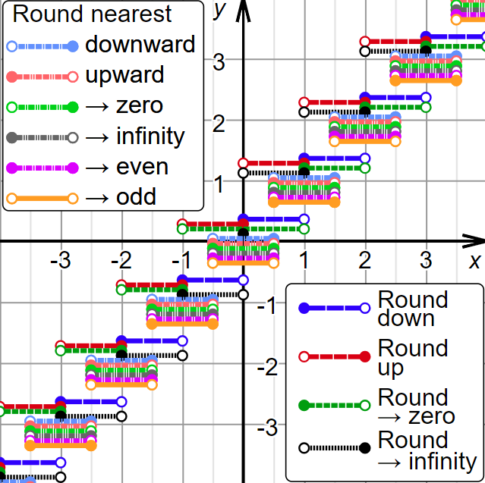
Alternating open and closed intervals

Slide 17
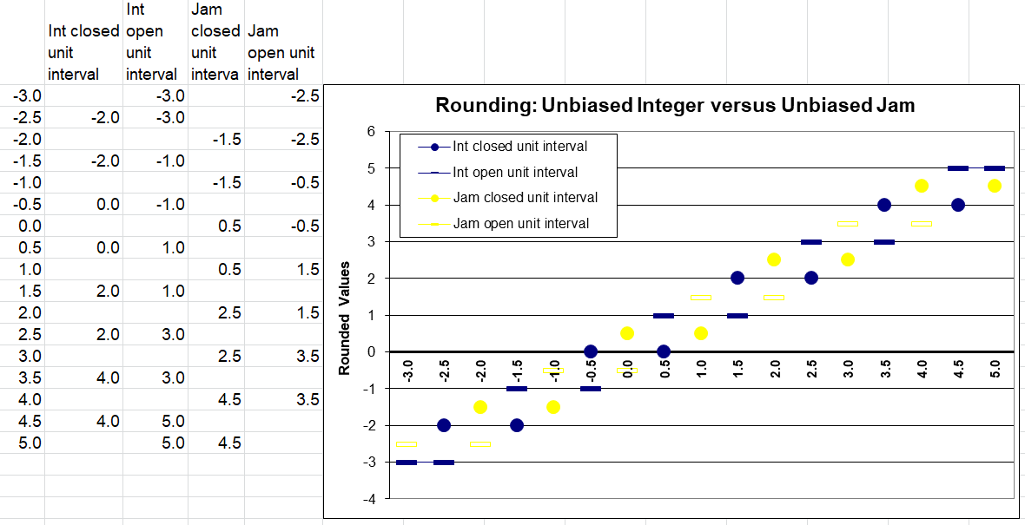
Open-Closed intervals diagram
2001 presentation to IEEE Austin Consultant Affinity Group
Yellow is “round-half-to-odd” per Brakefield, blue is IEEE 754
Needs a revision: yellow not a good color, negative yellows in error

Slide 18
Subsequent and current developments
Brakefield patent cited by ~80 other patents
IBM, Intel, Microsoft, Sun Microsystems, Oracle and others
(23) Sun Microsystems and Oracle patents by Guy Steel Jr.
No revenue, suggest planning on doing ten patents for every one that pays off
“Handbook of Floating-Point Arithmetic” Muller etal. 2010
An encyclopedia of floating-point
PDF available online, 2nd edition available, waiting for 3rd ed. with Posits
Book web page has computer arithmetic references:
https://perso.ens-lyon.fr/jean-michel.muller/Handbook.html

Slide 19
Subsequent and current developments
RISC-V may use additional exponent bit in floating-point registers
http://csl.snu.ac.kr/courses/4190.307/2020-1/riscv-spec-v2.2.pdf page 71
Short formats for AI/NN training: several candidates
https://en.wikipedia.org/wiki/Bfloat16_floating-point_format
MX Microscaling Data Format https://fpga.org/author/jan/
Posit format by Gustafson
https://posithub.org/docs/posit_standard-2.pdf
Achieves more mantissa bits for numbers close to +/-1
Has the most gradual taper:
https://inria.hal.science/hal-01959581v3/document page 7

Slide 20
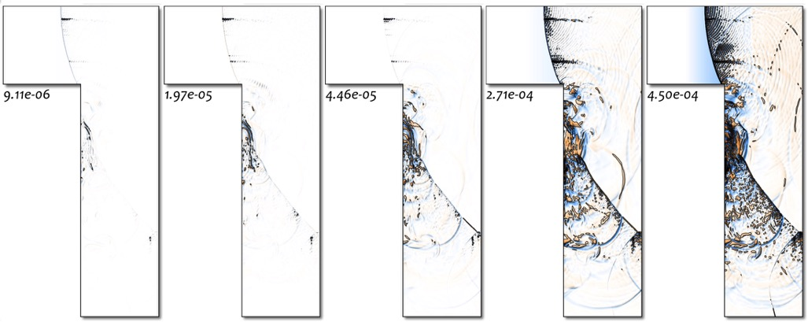
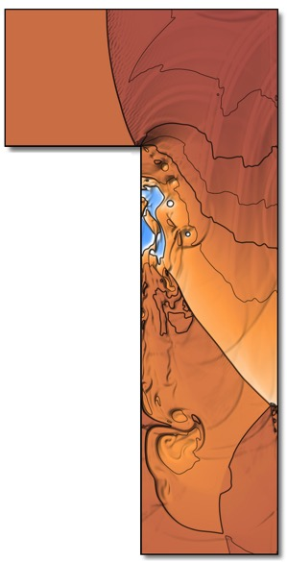
3rd Party Validation of Posits
From Lawrence Livermore National Laboratory, with permission. Simulation of a fluid shock wave in an L-shaped
region:
Errors for six different 32-bit formats (white = no error):
Elias Gamma
IEEE, but ¼ range
IEEE floats
Posits
Levenstein
Posits are 50x more accurate than floats, the best of any format tested.

Slide 21
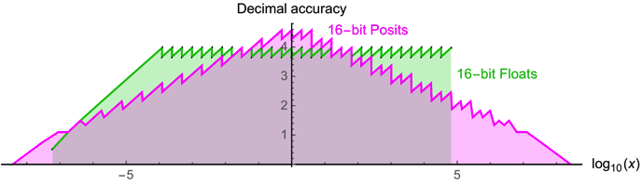
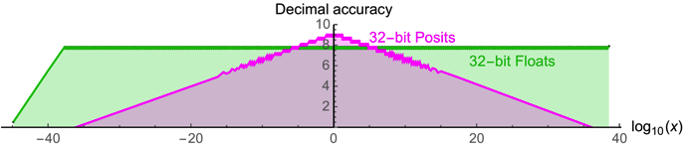
Taper plots: 16 & 32-bit data size Posit and IEEE-754

Slide 22
More taper plots
Gradual overflow taper
The tapers for gradual underflow and overflow can be widened by using additional exponents beyond all ones (overflow) and all zeros (underflow), see last slide.

Slide 23
Comparing Posit and IEEE-754 hardware costs
https://hal.science/hal-03195756v3/file/2021_Posit_IEEE754_Hardware_Cost.pdf
Has variant where registers contain decoded Posits
E.G. Registers have full exponent and mantissa fields.
Decode on register load, encode on store
Posit ALU larger due to larger mantissa vs IEEE 754
Encode and decode take time and gates

Slide 24
What can go wrong will go wrong
Handbook of Floating-Point Arithmetic 1st chapter
Intel Pentium divide bug
Text book in error story
Avionics upgrade stories
Available test suites
https://www.math.utah.edu/~beebe/software/ieee/
Unstable algorithms
Getting the LSB accurate ‘Table makers dilemma’
What Every Computer Scientist Should Know About Floating-Point Arithmetic Goldberg 1991
https://docs.oracle.com/cd/E19957-01/806-3568/ncg_goldberg.html

Slide 25
What can go wrong will go wrong
CASE STUDY OF THE SPACE SHUTTLE COCKPIT AVIONICS UPGRADE SOFTWARE: COTS products were beneficial to the development effort of the CAU project, however issues did exist. First, COTS products are not without error. The project encountered "bugs" in the compiler, VxWorks, …
Avionics upgrades
Textbook error
Ugh
IBID: Where the FP issue came in was when the GPC's IBM 4Pi FP needed to be converted to the FP of the auxiliary processor, which was different. The IBM FP was normalized hex and the aux processor's FP was IEEE FP of some flavor.
From Tom: The Space Shuttle AP101S General Purpose Computer had a subtle problem with the accuracy of the long floating point divide instruction, … The design flaw was traced to a graduate level computer science textbook used by the design team that underestimated the maximum size of the error term when using the Newton-Raphson method to implement a fast floating point divide algorithm.
From Tom: The app I supported was named MATLAN, for MATrix LANguage. It turned out that the results would change slightly depending on the region size, because the partitioning would affect the number of floating point multiplications used, and thus give different (but not wrong) results.

Slide 26
Final Comments
IEEE 754 was developed in the era of micro-programming
IEEE 754 was done by numerical analysts
Who were/are not savvy about commercial pressures on gate counts and gate delays
Cost sensitive embedded and real-time chips now have floating-point, typically flush denorms to zero
Floating-point terminology not 100% consistent
Fraction/mantissa, denorm/subnormal/underflow, rounding details
Advantage of round-half-to-odd not well understood: open & closed intervals diagram is clearer

Slide 27
Final Comments cont’d
Posit studies show the advantage of symmetrical tapers
https://hal.science/hal-04095151 future of 754
“Sylvie Boldo has made some major contributions to the field of floating-point representation”, see next web link
The 11/6/2023 correspondence with John Gustafson
https://groups.google.com/g/unum-computing/c/drUkke8CZLU
Introduction to Posits, with many diagrams
http://www.johngustafson.net/pdfs/BeatingFloatingPoint.pdf
https://pdfs.semanticscholar.org/3d87/065bb0a1e4bb4c6d922f3490d4c95389a957.pdf corresponding slides
11/7/2023
27

Slide 28
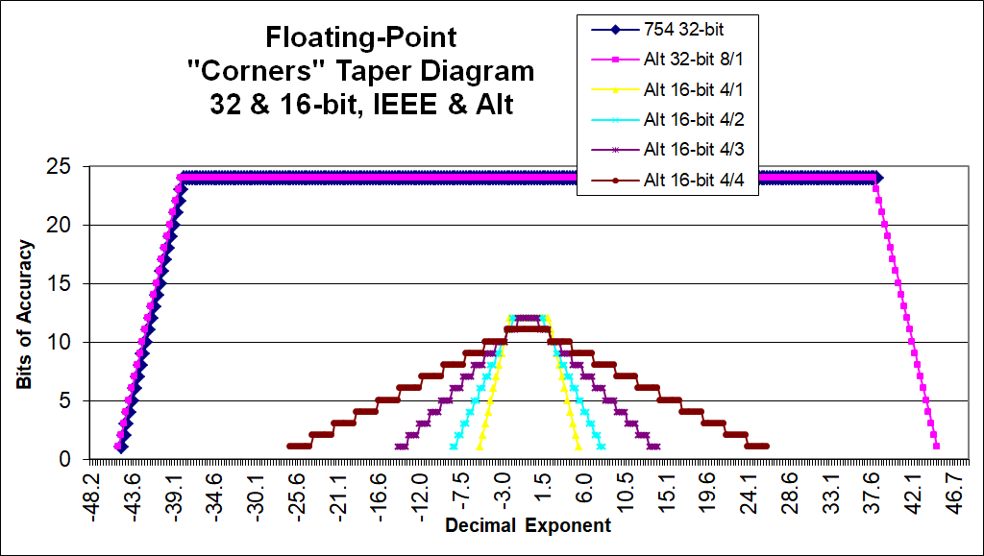
Adjustable Taper diagrams
Achieved by employing additional exponent values
2001 presentation to IEEE Austin Consultant’s Affinity Group
Yellow is steepest taper (12-bit mantissa), brown widest, (11-bit mantissa)

