Slide 1
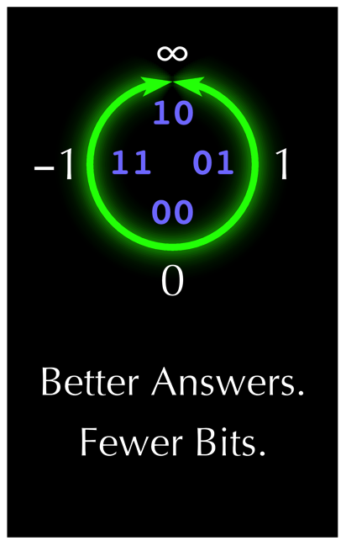
Introduction to PositTM Arithmetic also a work in progress
James C. Brakefield ©2019
TM John Gustafson
Figures and some slides curtesy of John Gustafson

Slide 2
Generic floating-point
https://en.wikipedia.org/wiki/Floating-point_arithmetic
Sign bit
Signed exponent
Usual radix is 2, radix ten (financial calculations) and radix 16 (IBM 360) exist
Fraction, usually has hidden leading one bit, e.g. normalized, but not a requirement
Value is: (1-2*s)*radix^{exponent} *fraction or
(2*s-1)*radix^{exponent} *(1+fraction) normalized with hidden one bit

Slide 3
The IEEE 754 floating point format
https://en.wikipedia.org/wiki/IEEE_754
Sign bit s
Fraction bits f
0 positive,
1 negative
Exponent bits e
Treat as an unsigned fixed point number f with the binary point at the left
5, 8 or 11 exponent bits for 16-bit (half), 32-bits (single) or 64-bits (double) format
Smallest exponent value used for zero and “denorms”
Largest exponent value used for two infinities and NaNs
Denorms do not have hidden leading one bit and are not normalized

Slide 4
IEEE-754 floating-point
hidden bit: An assumed 1 bit before the MSB of the fraction, except for denorms (AKA subnormal).
Standard word sizes: 16, 32 and 64-bits
Several rounding rules, default is round to “nearest even”
Gradual underflow/denorms expensive to implement in hardware
Suffers from double rounding problem
Weirdness: two zeros, two infinities, too many NaNs; stagnation; prejudice against von-Neumann rounding

Slide 5
Posit floating-point https://www.posithub.org/ calculator widget at https://www.posithub.org/widget/plookup
Single zero value
Round to nearest even
No NaNs (Not a Number), uses single NaR (Not a Real) instead, previously the same code for unsigned infinity
Has highest accuracy for numbers near +/- 1
More accuracy than IEEE-754
Accuracy decreases steadily as one moves away from +/- 1; symmetrical towards both zero and infinity
es usually adjusted to get needed dynamic range
Rigged so integer compare works for comparison

Slide 6
The Posit format
Total posit size is ps bits
Zero:
0
0
0
0
0
0
0
0
0
0
0
0
0
0
0
0
0
0
0
0
0
0
0
0
0
0
0
0
0
0
0
0
Not a Real (NaR):
1
0
0
0
0
0
0
0
0
0
0
0
0
0
0
0
0
0
0
0
0
0
0
0
0
0
0
0
0
0
0
0
Sign bit s. 0 for positive,
1 for negative.
Exponent es bits
Fraction size is fs bits
Fraction bits f
Fraction in positional notation. “Hidden bit” is always 1.
“Regime” bit string Signed unary integer k
Exponent bits e unsigned integer. Size is
es = 0, 1, 2,… for
ps = 8, 16, 32,…
1st regime bit: 1 or 0, continuing until different bit occurs

Slide 7
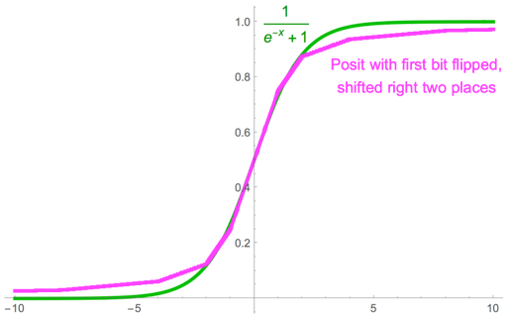
Advantages of the posit format
Monotone. Comparisons are the same as for integers!
Bitwise reproducibility across all systems
Tapered accuracy usually means more information-per-bit.
Only one exception value, NaR (no wasted bit patterns)
Only one rounding mode
Perfect reciprocals for all integer powers of 2
Sigmoid activation function for AI takes only 1 clock to evaluate.

Slide 8
Flexible size Posits
# of occurrences
For any application, examine the histogram of magnitudes.
Increasing ps raises the “tent” accuracy plot (and widens it).
Increasing es by one doubles tent width (and lowers accuracy).
Software and FPGAs need not follow Draft Posit Standard; you can customize to match the application requirements.
log(|x|)
0
accuracy
log(|x|)
log(minpos)
0
log(maxpos)
accuracy
log(|x|)
log(minpos)
0
log(maxpos)

Slide 9

Posit decoding
Easier to understand:
Check for 0 and NaR case first.
Else record s. If s = 1, find magnitude from 2’s complement.
Find k(regime length), e(es bits), and f (fraction bits).
Posit represents the number (–1)^{s}∙useed^{k}∙2e∙(1 + f/2^{fs})
Better for circuit design, but cryptic:
Check for 0 and NaR cases while finding s, k, e, f concurrently.
Posit represents $(1−3s+f)∙2^{\left.{\left({\left.−1\right)}^{s}(k∙2\right.}^{es}+e+s\right)}$
A longer regime field pushes e and f to the right
Shortening f and even e. Even to the point that there is no f or e.
“prefix k value to e value to form final exponent value”

Slide 10
Regime Notation: Signed Unary using bits
000001
00001
0001
001
01
10
110
1110
11110
111110
–5
–4
–3
–2
–1
0
1
2
3
4
A run of runlength identical r bits is terminated by the opposite bit.
Represents an integer k which we will need later, so please remember this part!
k = –runlength if r bit is 0, k = runlength – 1 if r bit is 1.
Numbers near 0 require very few bits.

Slide 11
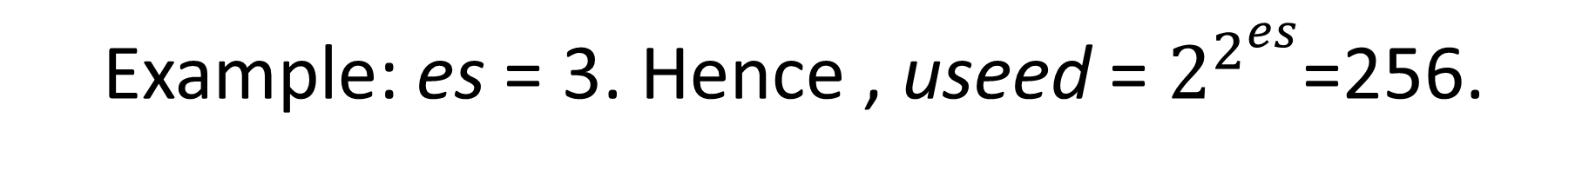
Example: es = 3. Hence , useed = $2^{2^{es}}$=256.
First, 2^{es}=8. The three exponent bits can represent 0 to 7 as an unsigned integer (the usual way).
Suppose we want to represent 2¹⁹. Find 19 mod 2^{es} = 3.
2¹⁹ = 2¹⁶∙2³
= (2⁸)² ∙2³
visually j is …10011 in binary
e = 3 = 011
So the j value 19 can be represented by seven bits: 1110011.
k = 1110 in regime format
Runlength = 3 bits; subtract 1 when run bit is a 1. k = 3 – 1 = 2.

Slide 12
Floating-point history
Floating-Point Formats http://www.quadibloc.com/comp/cp0201.htm good narrative, lots of details
Survey of Floating-Point Formats http://www.mrob.com/pub/math/floatformats.html up to date, comprehensive, well formatted
Variable length data formats, Brakefield, J.C.; Quin, M.J. 1977. Data Management Symposium; Huntsville, AL; Oct 1977 Proceedings p. 243-253

Slide 13
Floating-point history
Konrad Zuse was first to use hidden leading fraction bit http://zuse.zib.de/floatingPoint
PDP-11 floating-point set the stage for IEEE 754 http://gunkies.org/wiki/FP11_floating_point
First 754 chips were coprocessors: 8087, 68881 https://en.wikipedia.org/wiki/Floating-point_unit
Modern high performance floating-point is pipelined
IBM pioneered fused floating point multiply-add https://en.wikipedia.org/wiki/Multiply-accumulate_operation

Slide 14
Stakeholders
IEEE-754 https://en.wikipedia.org/wiki/IEEE_754
William Kahan https://en.wikipedia.org/wiki/William_Kahan
John Gustafson https://en.wikipedia.org/wiki/John_Gustafson_(scientist) https://en.wikipedia.org/wiki/Gustafson’s_law
Brakefield: ACM SigArch Optimal Floating-Point Format Oct. 1972; Variable length data formats Oct. 1977; correspondence with IEEE-854 committee 1985; US patent 5,892,697 June 1999.
Neural net & big data: doesn’t need high accuracy.
Many would like to save memory & memory bandwidth.

Slide 15
Gradual under & overflow: AKA Floating-point Taper
Not generally understood that tapered floating-point is better!
IEEE 754: gradual underflow
Assumes micro-coded implementation
Brakefield: gradual overflow at no additional circuit cost
Posit: Symmetrical and “extreme” taper
Other taper possibilities exist between none, 754 and extreme
No taper: for lowest cost & hard real-time
Many floating-point taper schemes in the literature
Need a thesis that “proves” the advantage of taper?

Slide 16
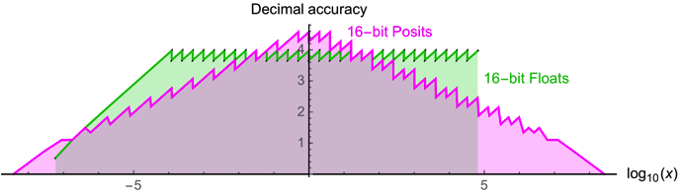
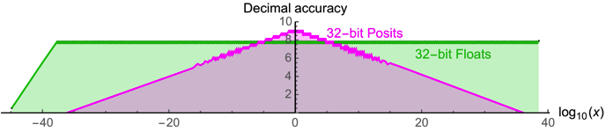
Taper Plots: 16 & 32-bit data size for Posit & IEEE-754

Slide 17
Empirical results: Posit superiority
Rethinking floating point for deep learning, Jeff Johnson, 2018. FPGA & ASIC implementations.
Posits: the good, the bad and the ugly, Florent de Dinechin etal 2019. Has taper diagrams and discussion of physical constants.
Cheetah: Mixed Low-Precision Hardware & Software Co-Design Framework for DNNs on the Edge, Hamed F. Langroudi etal 2019. Trade-off study.
Towards 16bit weather and climate models: Posits as an alternative to floats, Milan Klöwer etal 2019.
Universal Coding of the Reals: Alternatives to IEEE Floating Point, Peter Lindstrom etal 2018. Extensive comparison of various floating-point formats.

Slide 18
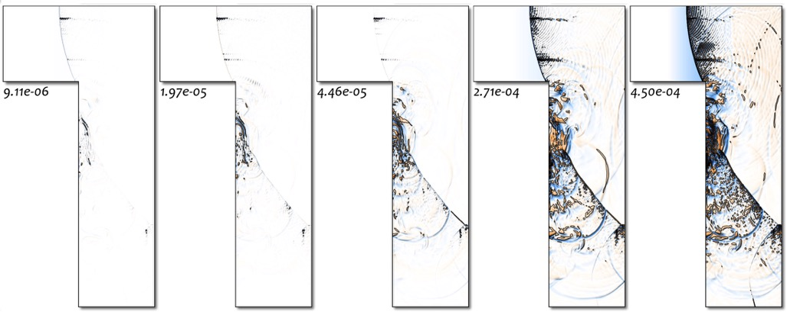
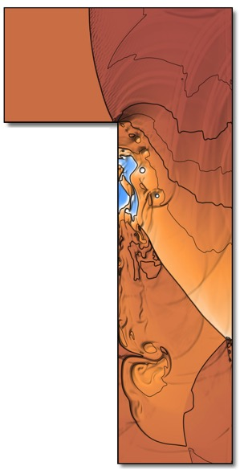
3rd Party Validation of Posits
From Lawrence Livermore National Laboratory, with permission. Simulation of a fluid shock wave in an L-shaped region:
Errors for six different 32-bit formats (white = no error):
Elias Gamma
IEEE, but ¼ range
IEEE floats
Posits
Levenstein
Posits are 50x more accurate than floats, the best of any format tested.

Slide 19
References
Supplemental Readings for IEEE 754 / 854: https://web.archive.org/web/20171230124220/http://grouper.ieee.org/groups/754/reading.html
Posit software & hardware implementations: https://posithub.org/docs/PDS/PositEffortsSurvey.html
Unums: https://en.wikipedia.org/wiki/Unum_(number_format)
Posit visualization: https://cse512-19s.github.io/FP-Well-Rounded/
Recent commentary: https://www.nextplatform.com/2019/07/08/new-approach-could-sink-floating-point-computation/
Usenet group: https://groups.google.com/forum/#!forum/unum-computing
Encyclopedic coverage of floating-point: Handbook of Floating-Point Arithmetic 2nd ed. Jean-Michel Muller, Nicolas Brunie, et al. Birkhäuser 2018;

Slide 20
References cont’d
Von Neumann rounding: https://en.wikipedia.org/wiki/Talk%3ARounding#Von_Neumann_rounding_and_sticky_rounding
Double Rounding Errors in Floating-Point Conversions, Rick Regan 2010. https://www.exploringbinary.com/double-rounding-errors-in-floating-point-conversions/
https://en.wikipedia.org/wiki/Rounding#Double_rounding
Gustafson video on Posits https://www.youtube.com/watch?v=JJgT-YphE1Y
Gustafson book: Gustafson, John L. (2015). The End of Error: Unum Computing. Boca Raton, Fla. CRC Pres.
Posit diagrams: http://www.johngustafson.net/pdfs/BeatingFloatingPoint.pdf
The great debate: Gustafson vs. Kahan: https://www.youtube.com/watch?v=KEAKYDyUua4

Slide 21
Brakefield’s floating-point preferences
Today’s slides at: https://github.com/jimbrake/alt_posit
Emphasis on hardware speed and number of pipeline stages
Numerical Analysts may not fully understand hardware issues
Gradual overflow for IEEE-754
Support for 12, 24 and 48-bit data sizes
Zero extension for extending short memory formats to register size
Von Neumann rounding at a cost of one fraction bit
Support both 754 exacts and Posit unums
Does not have double rounding problem

Slide 22
Brakefield’s floating-point preferences cont’d
Posit bit-reversed regime field on right hand side of fraction
Integer compare for floating-point not possible, use dedicated hardware
Fraction in fixed location & thus no shifter needed to normalize fraction
Does not change the set of Posit values, only their bit locations
Posit extract/insert in memory path
Unified design space: taper adjustment, unums, 754 and Posit
Via additional parameters for exponent formatting and unum bit

Slide 23
Posit arithmetic definitions
es exponent size: The maximum number of bits 0, 1, 2, 3, . . . that are available for expressing the exponent (complete signed exponent is e value and the prefixed regime value).
regime: A subfield of a posit consisting of some number of identical bits terminated by the opposite bit or the end of the number, that contributes to the specification of the power-of-two scaling of the fraction.
fraction: The component of a posit containing its significant binary digits after the binary point; 0 <= fraction < 1. Fraction plus hidden bit is a number >= 1 and < 2.

Slide 24
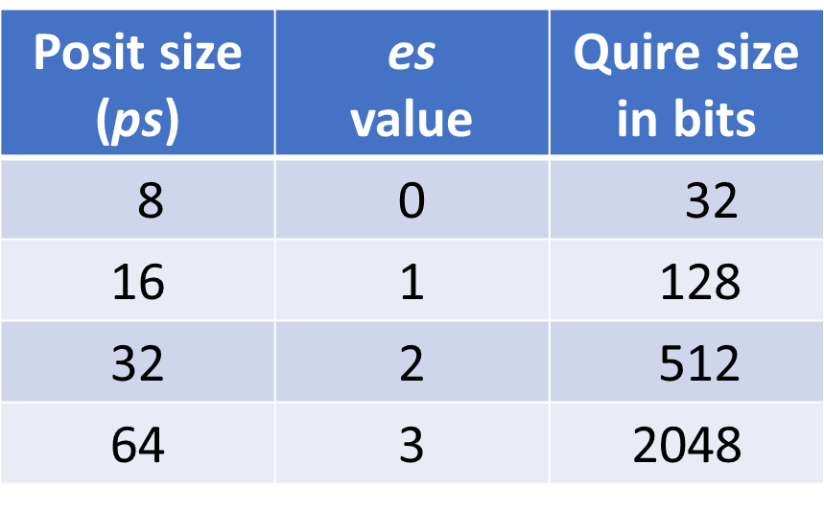
Posit floating-point definitions, cont’d
ps: Bit size of a posit format, e.g. the total number of bits (8, 16, 32, or 64).
NaR: Not a real. A value that has indeterminate magnitude, is indeterminate, is multi-valued, or requires an imaginary component to express, sqrt(-1) is represented as NaR.
Quire: A fixed-point format capable of storing sums of products of posits without rounding, up to some large number of such products. A fixed-point accumulator wide enough to hold the entire dynamic range of a Posit.

