Slide 1
Smart Car

Slide 2
Who we are
Contents
What we do
How we do
Why we do

Slide 3
01
Who we
are

Slide 4
Our team
陈吕劼
软工1205
李浩翔
软工1205
01
02
Why we talk about this
Give you some intuitional direction of this major
Hope you can take over this project after we graduate if you are interested in.

Slide 5
02
What we
do

Slide 6

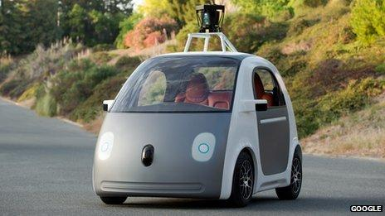
Related background
Self-driving Car
AlphaGo Deep Learning
谷歌研发的无人驾驶汽车（self-driving car/driverless car）目前只有一个启动和停止按钮（stop-go button），没有方向盘（steering wheel）和踏板（pedal）等汽车上的常见装置。这款汽车将激光和雷达传感器的数据相结合（combination of laser and radar sensors），同时收集监控摄像头的数据来实现无人驾驶。
Policy Network
Fast rollout
Value Network
Monte Carlo Tree Search

Slide 7
What we do
Avoid obstacles automatically
using image processing and machine learning
http://open.163.com/movie/2008/1/B/O/M6SGF6VB4_M6SGHJ9BO.html
Start at 3:20

Slide 8
Our Plan
硬件设计
躲避障碍
准备阶段
第一阶段
第二阶段
最后阶段
自动寻路
结合实际

Slide 9
03
How we
do

Slide 10
How we do – Procedure of AFT
02
04
01
Learn by Network
Process the Image
Decide how to move
Capture the Image
03

Slide 11
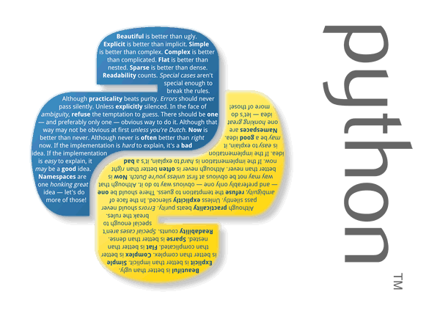

How we do – Image Capture & Process

Slide 12
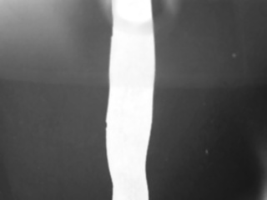
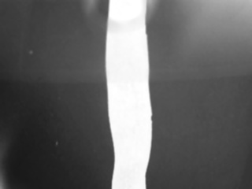
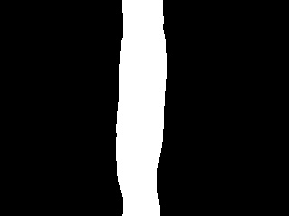
How we do – Process result
Raw image
Horizontal transitioned
Target image
Core technologies
Resizing
Linear transition
Gaussian Blur
Median Blur
Invert color

Slide 13
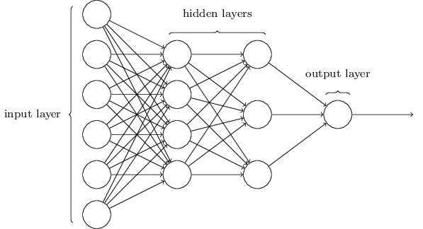
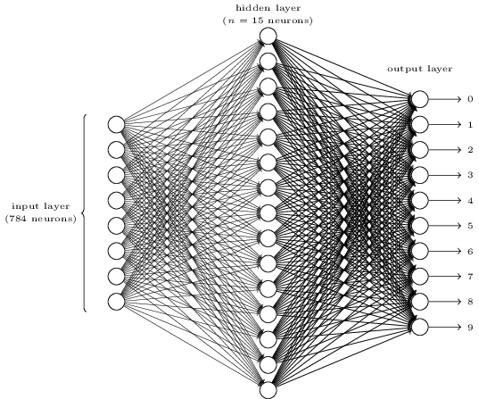
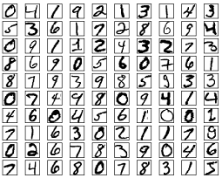
How we do – Neural Network

Slide 14
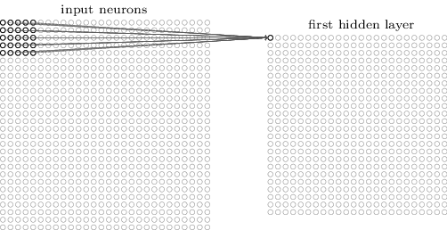
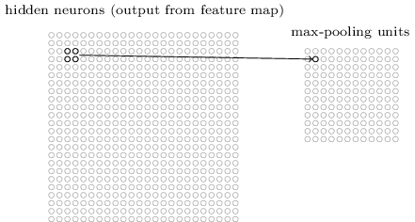
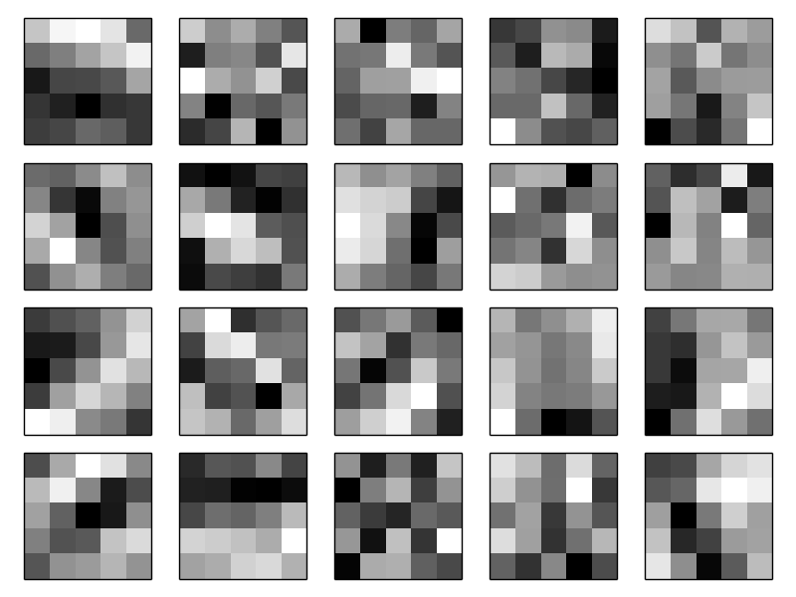
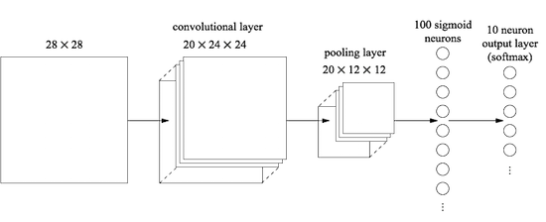
How we do – Convolutional Neural Network
Local receptive field
Max pooling
Convolutional Neural Network

Slide 15
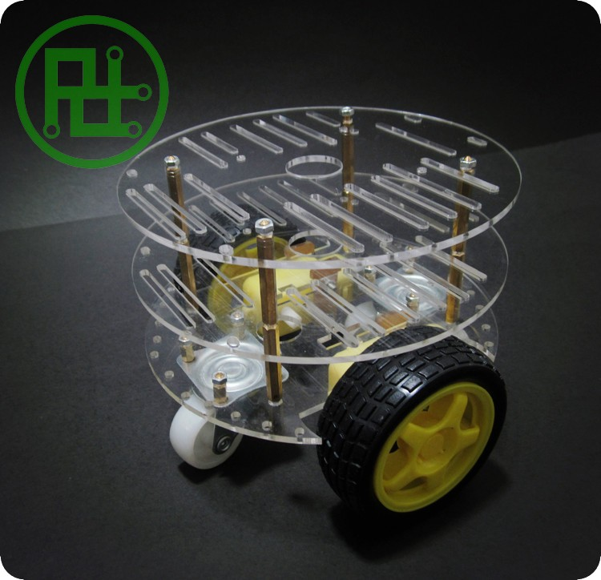
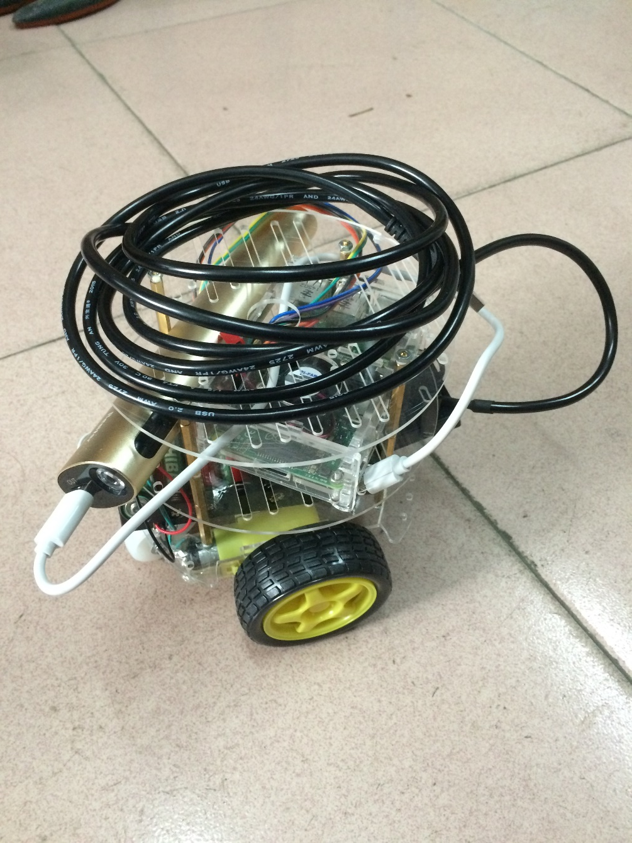
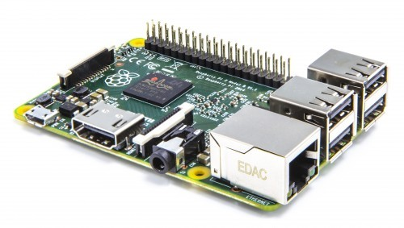
How we do – Movement
Raspberry PI 2 Model B

Slide 16
How we do – Procedure of obstacle avoidance
02
01
Calculate the position and distance
Build a 3D model with two webcam
03
Decide where to go

Slide 17
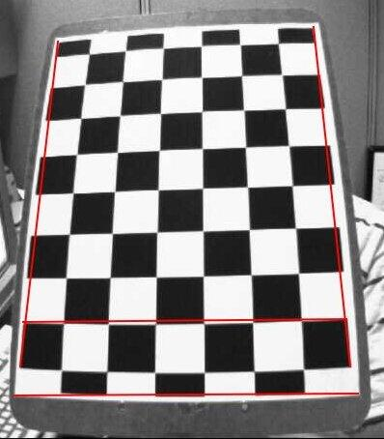
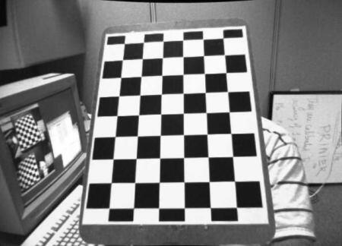
How we do – Calibration
After
Before

Slide 18
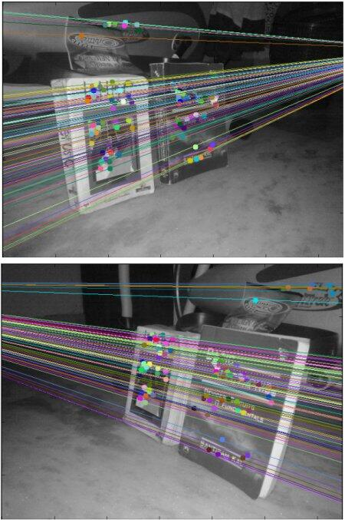
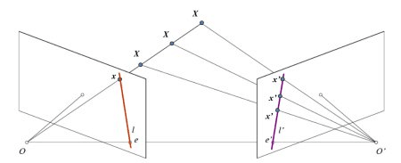
How we do – Point matching
对极几何
对极几何实例

Slide 19
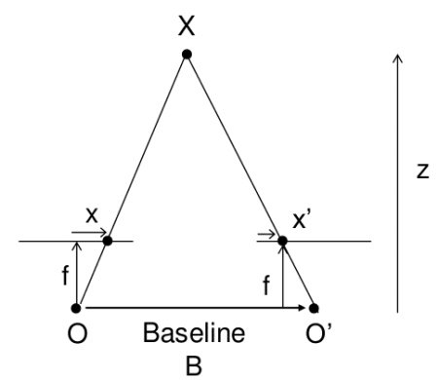
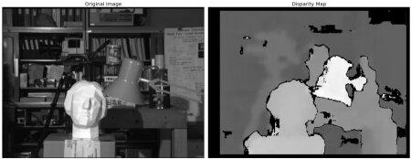
How we do – Calculate depth (distance)

Slide 20
04
Why we
do

Slide 21
Why we do
1
2
3
For learning
For creative
For fun
研究生的研究方向是人工智能，所以选择这样的一个项目来学习相关的知识
如今的智能汽车都主要是运用多传感器系统实现，所以希望能够使用这样有创新的技术做一次尝试
看了视频觉得非常神奇，决定自己也来尝试实现一下。

Slide 22
Recent Achievement

Slide 23
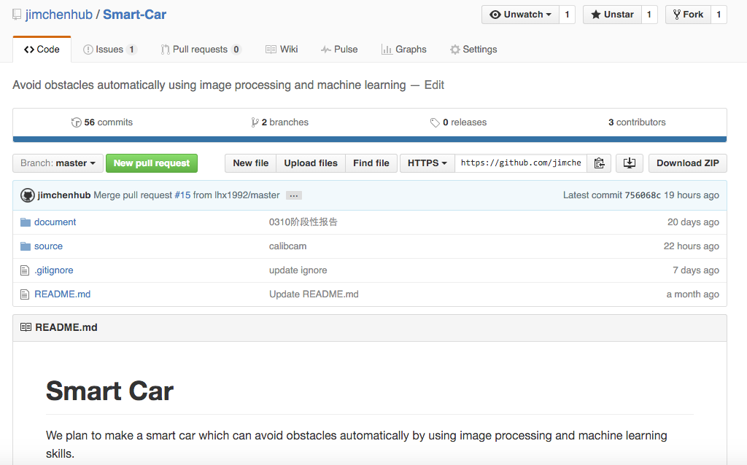
Coding
https://github.com/jimchenhub/Smart-Car
Hope for star and follow

Slide 24
Result
90%
Test accuracy of NN
95%
Test accuracy of CNN

Slide 25
WE ARE JUST ON THE WAY
THANK YOU

