Slide 1
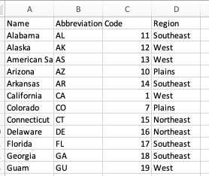
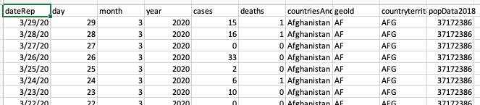
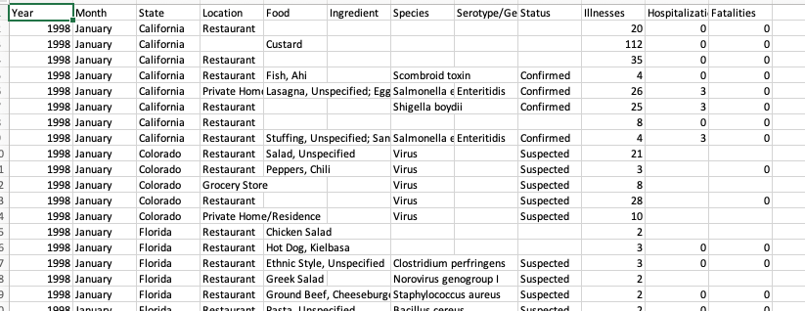
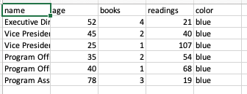
us-map-data.csv
COVID-19-geographic-distribution-worldwide.csv
outbreaks-dashboard csv
org_dashboard.csv
used in interactivity example

Slide 2
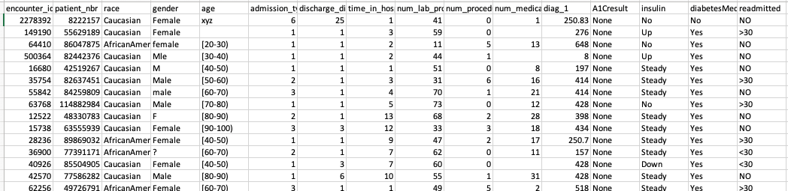
diabetes_for_plotly.csv

