Slide 1

A presentation by James Davies

Slide 2
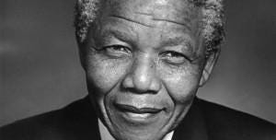
Nelson Mandela

Slide 3
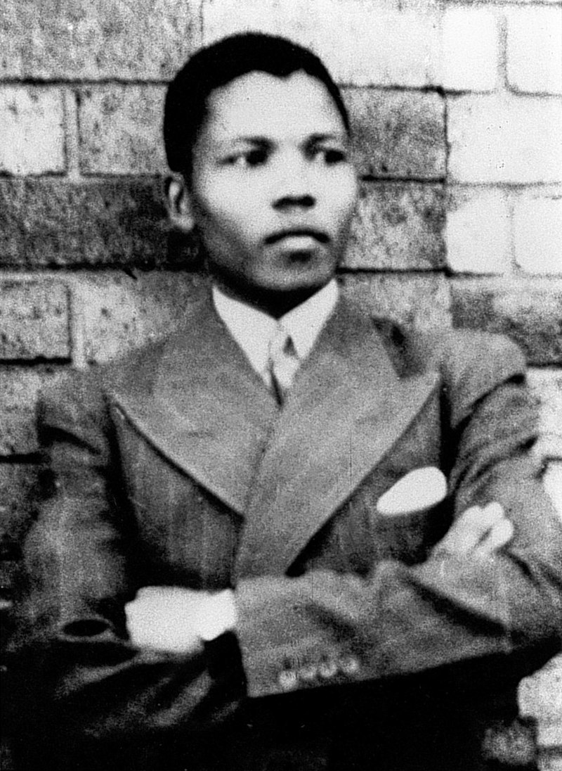
Born Rolihlahla Mandela
into the Thembu royal family
Began university study 1939
at the university of Forte Hare
1943 he began studying Law at
The University of Witwatersrand
Joined the ANC

Slide 4
July 1952 was arrested and stood trial
Found guilty of ‘statutory communism’
August 1962 captured and arrested
charged with ‘inciting workers to strike’
1964 Imprisoned on a life sentence

Slide 5
1989 P.W. Botha had a stroke
Replace by F.W. de Klerk

Slide 6
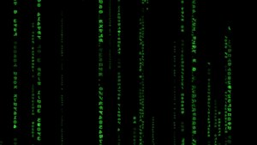
But wait…. This story isn’t over....

