Slide 1


Slide 2

Requirements
Design
Development
Testing
Deployment
Warranty
Support

Slide 3


Slide 4
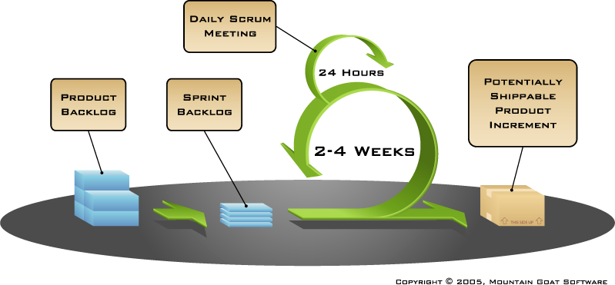

Slide 5

Environments

Slide 6
Development Environment
Test Environment
Operational Test Environment
Production Environment

Slide 7


