Slide 1



Initial Page
(Just a wireframe…will look different)
A Project Management and Invoicing App
Login

Slide 2
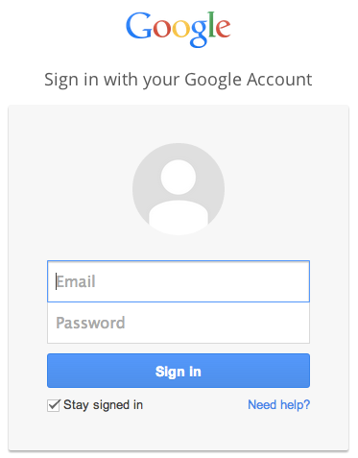
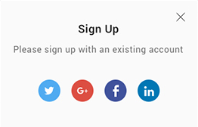
Independent Login Page
Pop-up will display when “Login” button clicked.

Slide 3







Main Page
(Optional)
Add New Project
View Project Deadlines
Projects
Chase Network App | Due Date: 5/25/2017
Design Walgreens Logo | Due Date: 5/25/2017
TeamViewer Login | Due Date: 5/25/2017
10.5
8.4
5.5
User is able to delete projects and mark them complete.

Slide 4
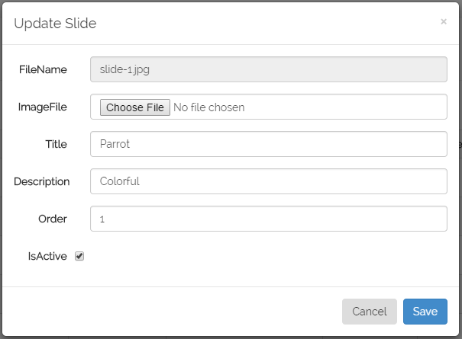

User can add a project. (Modal/Form)
Add New Project
New Project
Title
Description
Due Date
Timeframe
Hourly Rate
Million

Slide 5
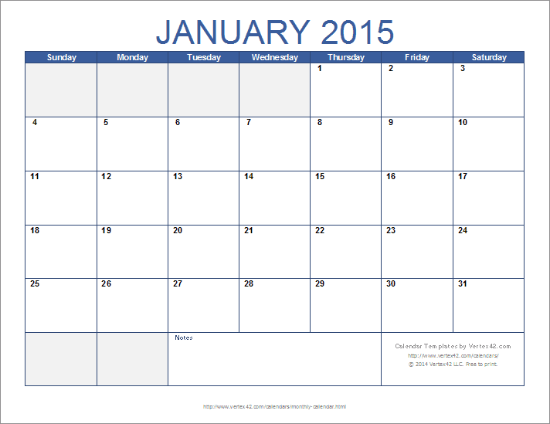
Shows deadlines for projects.
(Optional)
View Project Deadlines
Teamviewer
Due

Slide 6
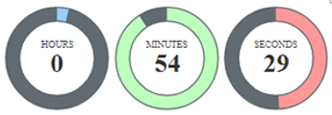

Icon
Displays project so user can work on it. I was thinking of sliding it open when icon is clicked. If clicked again, project details will slide closed.
User can add a task to the project.
x
SUBMIT
START
STOP
RESET
When user clicks the square-image a checkmark is displayed to show completion. (Hide/Show). If trash can icon is clicked, task is deleted

Slide 7

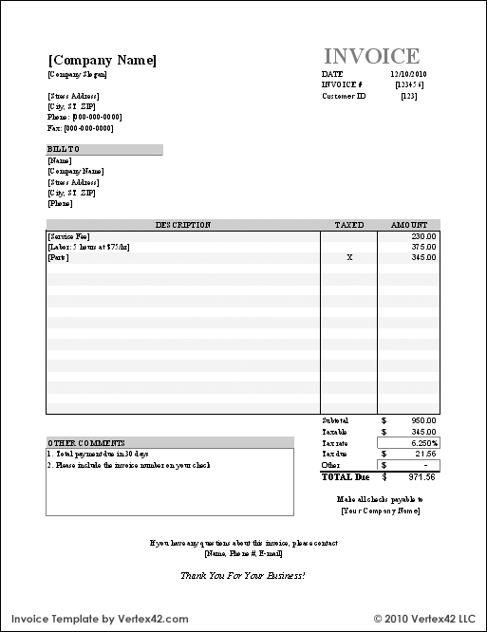


Email functionality through icon.
Invoice Page
(separate page)
Company Name
Address
Todays Date
User fills in company name and address and bill to info.
(form)
Billing Name and Address
Project Name
Project hours * hourly rate is displayed here.
Comments
Total Due

