Slide 1
Threading in Kodi

Slide 2

Theading
Originally there were separate implementation for all threading mechanisms by platform.
Refactor on a minimum of platform dependent implementations
DO NOT use boost.
The (java) “monitor” concept collapses all sychronization mechanisms to a single (actually 2) root.
3 Platform specific constructs
  Synchronization (monitor = reentrant lock/notify/wait)
  Thread
  ThreadLocal

Slide 3
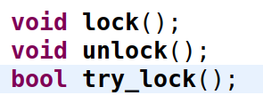
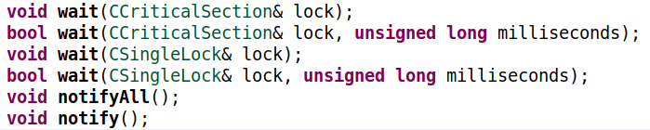
Theading - Synchronization
Two platform implementations
  POSIX
  Windows
Essentially, a monitor boils down to a reentrant mutex and condition variable (notify/wait).
At the time, the std::thread functionality wasn’t available on all supported platforms but we wanted to be ready for it.
Lockable “concept:”
Condition:

Slide 4

Theading - Lockables/Conditions
Base platform implementation of CRecursiveMutex
  Implements the Lockable concept for reentrant lockable
Base platform implementation of ConditionVariable
  Implements the notify/wait functionality
---------------------------------------------------------------------------------------------------------------------------
CountingLockable<L> template that adds counting and “exitable” behavior
TightConditionVariable<P> template
  Takes:
    ConditionVariable
    “predicate,” class P, defined as anything that overloads the operator!
  Binds a condition being monitored (the predicate) and the condition variable together
  Eliminate the “spurious returns.”

Slide 5

Theading - Lockables/Conditions
CCriticalSection concrete class implements most of Kodi’s mutexes.
CSharedSection concrete class that implements the “shared lockable concept”
  Shared lockable adds:
  aka Read/Write lock
  Built using previous components:
    CCriticalSection
    TightConditionVariable

Slide 6
Theading – Lockable Guards
UniqueLock<L> template:
  guards any lockable.
  Is a Lockable
  Add’s an owns flag.
SharedLock<SL> template:
  Guards any shared lockable.
  Locks for sharing (reading)
  Is a lockable, but not a shared lockable

Slide 7
Theading – Lockable Guard Extensions
CSingleLock:
  Adds a couple convenience methods for backward compatibility
CSingleExit:
  Takes a CCriticalSection.
  Guards an unlock
    Relocks on scope exit

Slide 8
Theading – Lockable Guard Extensions
CExclusiveLock:
  Adds a couple convenience methods for backward compatibility
  aka “write lock.”
CSharedLock:
  aka “read lock.”
  Adds a couple convenience methods for backward compatibility

Slide 9
Theading – Additional extentions
CEvent:
  Originally a Windows class
  Conceptually a condition variable with an optionally auto-resettable “signaled” condition
  Built on:
    Boolean signaled state - predicate
    TightConditionVariable<P>
    CCriticalSection
  Management of CEventGroup
CEventGroup:
  Watch multiple CEvents at the same time.
  Built on:
    TightConditionVariable<P>
    Exitence of a signaled event is the predicate
    CCriticalSection

Slide 10
Theading – ThreadLocal
ThreadLocal
  Originally platform specific
  2011, gathered into uniform template with platform specific implementations for POSIX and Windows
  2018, removed and replaced with C++11 standard thread_local

Slide 11
Theading – Thread class

Slide 12
Theading – Vestigal Code
CountingLockable:
  Appears to only be used to support CountingLockable::exit’s count parameter.
CThread is being used in an anti-pattern when inherited from.

