Slide 1
Codegeneration in Kodi

Slide 2

Codegeneration original intent
More flexible and straightforward means of managing the API.
Provide a means of merging different APIs into a single API accessed through different means. It would be nice to define the API independent of the means of access.
Tackle some longstanding stability issues resulting from the mixing of Python mechanisms with XBMC mechanisms. These are typically deadlocks.
Smaller source codebase to manage
Provide a basis to support other scripting language.

Slide 3
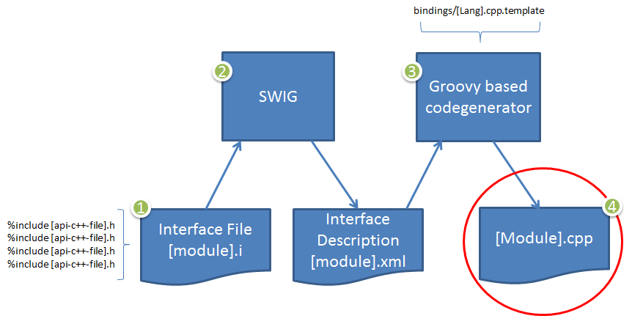
Codegeneration

Slide 4
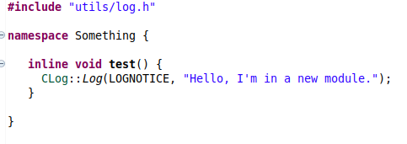
Codegeneration Example
Add a new module (example 1):
1) ModuleExample.h
2) AddonModuleExample.i
%module something
%{
#include "interfaces/legacy/ModuleExample.h"
%}
%include "interfaces/legacy/ModuleExample.h"
import something
if __name__ == '__main__':
something.test()
3) Add the module to AddonPythonInvoker.cpp
4) Update CmakeLists.txt wherever you put ModuleExample.h and in xbmc/interface/swig

Slide 5
Codegeneration Example
Generated XML
Transformed XML (need verbose output)
Resulting .cpp

Slide 6
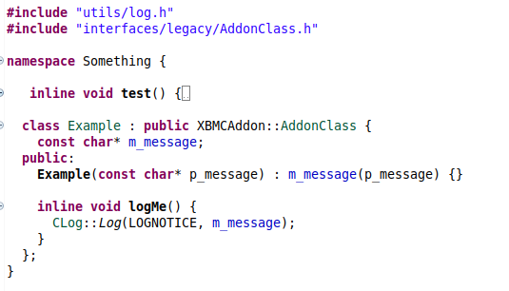
Codegeneration Example
Add a class (example 2):
You can just add a class and include it in the module definition (*.i file).
All public methods (by default) callable from python
  Block methods from python using
    #ifndef SWIG
Classes extends AddonClass (or AddonCallback)
  This is a python generation requirement not a general codegenerator requirement.
Generated XML
Transformed XML
Generated .cpp
import something
if __name__ == '__main__':
something.test()
e = something.Example("hello");
e.logMe()

Slide 7
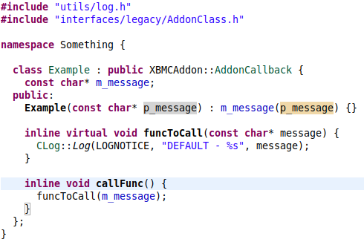
Codegeneration Example
Cross language polymorphism:
Enable Directors for module and by class (namespace workaround):
All public virtual methods can be overloaded
  You can hide the overriding ability from python using SWIGHIDDENVIRTUAL
module(directors="1") something
%{
#include "interfaces/legacy/ModuleExample.h"
using namespace Something;
%}
// Must be before the class is included
%feature("director") Example;
%include "interfaces/legacy/ModuleExample.h"
import something
import xbmc
class ExtendedExample(something.Example):
def __init__(self, message):
super(something.Example,self).__init__(message)
def funcToCall(self, message) :
xbmc.log("overridden - " + message, xbmc.LOGNOTICE)
if __name__ == '__main__':
e = something.Example("hello in constructor");
e.callFunc()
ee = ExtendedExample("hello in child constructor");
ee.callFunc()
Generated .cpp

Slide 8
Codegeneration Example
Cross language polymorphism in XBMC:
Code
Running
in
Python
Interp
Native
Thread
Python
Kodi
Core
Async
Call
Example: Player::OnPlaybackEnded()/Player::onPlaybackEnded()

Slide 9
Codegeneration Example
Writing Templates
  Examining bindings
  Groovy Simple Template Processing
  Example 4.1,4.2,4.3,4.4

Slide 10
Codegeneration Example
In - Typemaps
Out - Typemaps
Typemaps for converting types passed into the API.
Basically parameters.
Bindings include:
  param – The parameter name from the API
  type – The SWIG type spec for the API parameter
  ltype – The “locally assignable type”
  slarg – The scripting language variable name.
  api – The name of the variable holding the value passed to the API
  method – The method node
  seq – a Sequence for recursive calls
Typemaps for converting types passed out of the API.
Basically return values.
Bindings include:
  result – The name of the variable holding the value to return to the scripting language.
  type – The SWIG type spec for the API’s return type
  api – The name of the variable holding the value returned from the call to the API
  method – The method node
  seq – a Sequence for recursive calls

Slide 11
Codegeneration Example
Passing typemaps to Helper.setup
  Map of
    Type, ltype, regex pattern of type or ltype
    To typemap string or a File with the typemap
  Additionally a default to use when there’s no value found in the Map
  For out typemaps, the default only works for known API types. No, I don’t remember why.

