Slide 1
COVID-19 Positive Rates in Missouri, Kansas, and Selected States
Jim Felps

Slide 2
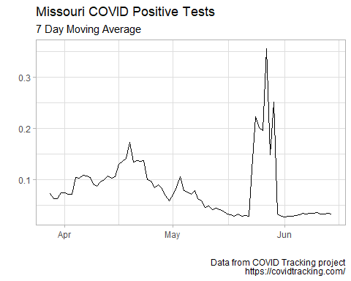
Missouri Positive Rate 7-day Moving Average

Slide 3
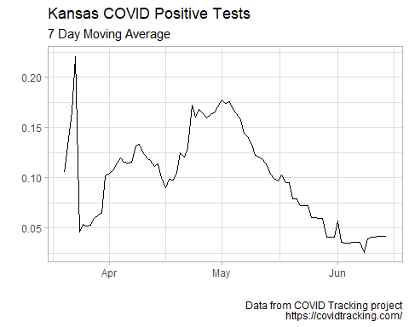
Kansas Positive Rate 7-day Moving Average

Slide 4
Select States with Problematic Trends (based on media coverage)

Slide 5
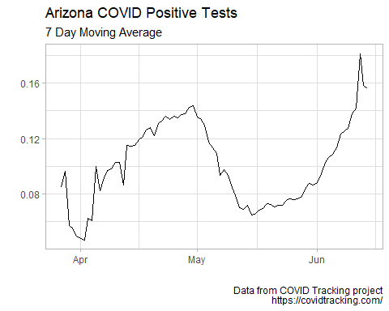
Arizona Positive Rate 7-day Moving Average

Slide 6
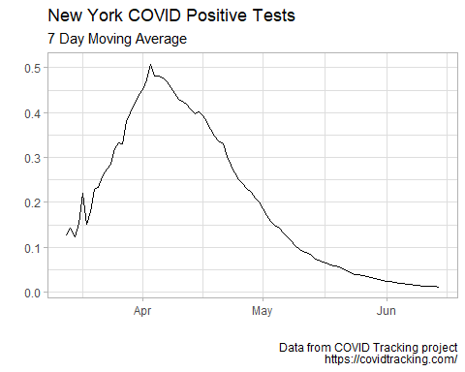
New York Positive Rate 7-day Moving Average

