Slide 1
COVID-19 Positive Rates in Missouri, Kansas, and Selected States
Jim Felps

Slide 2
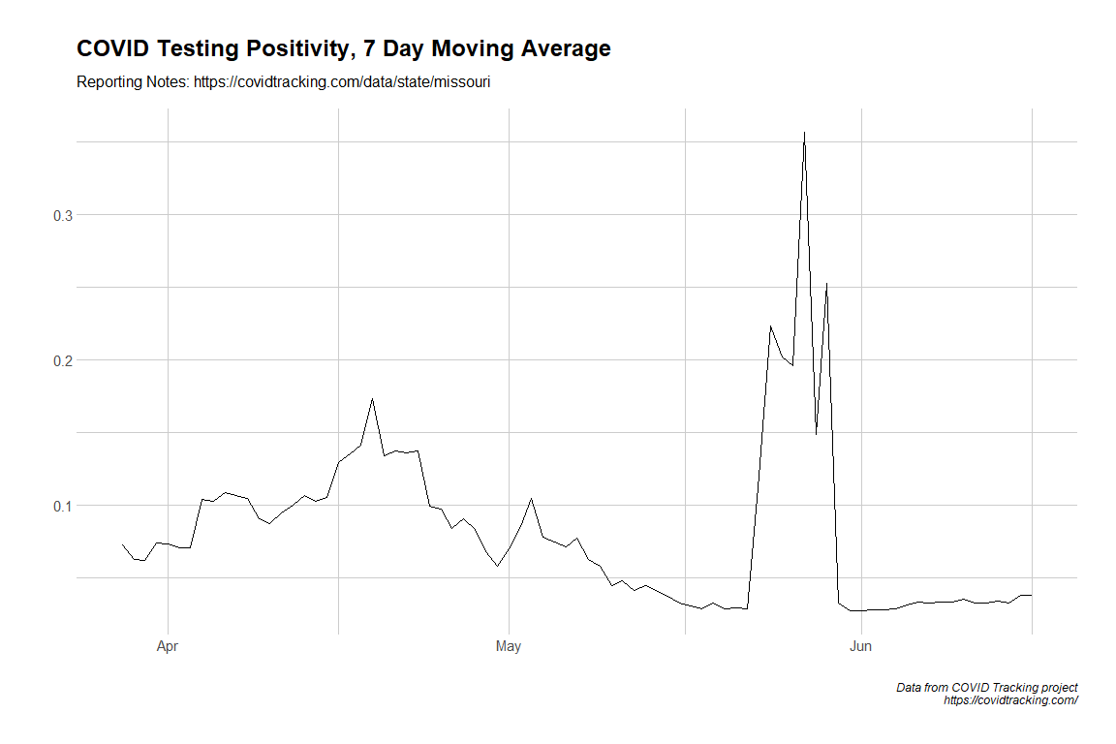
Missouri

Slide 3
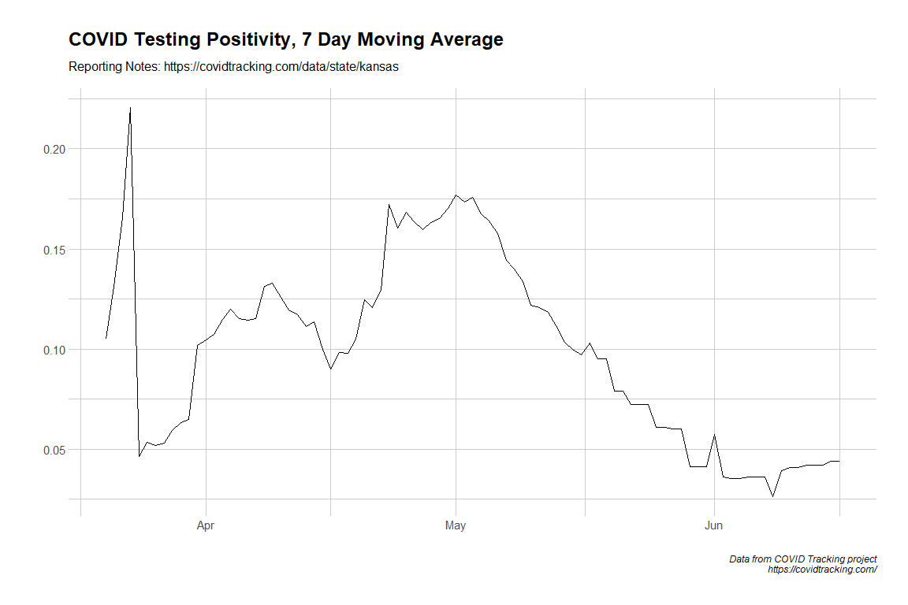
Kansas

Slide 4
County-level analysis - KC Metro

Slide 5
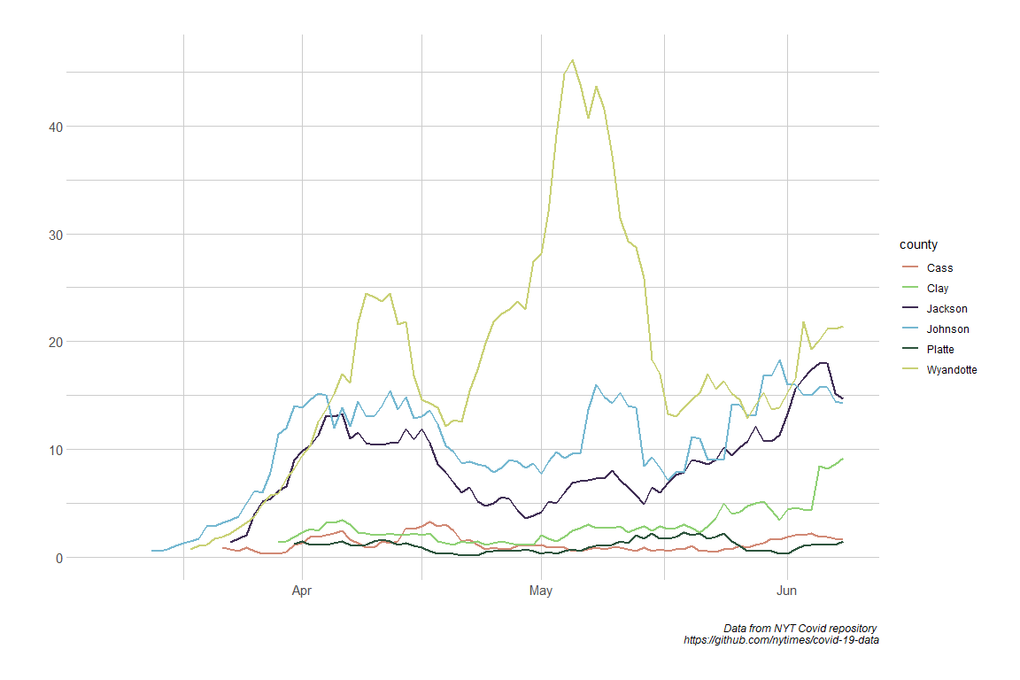
New Positive Cases by County

Slide 6
Select States with Problematic Trends (based on media coverage)

Slide 7
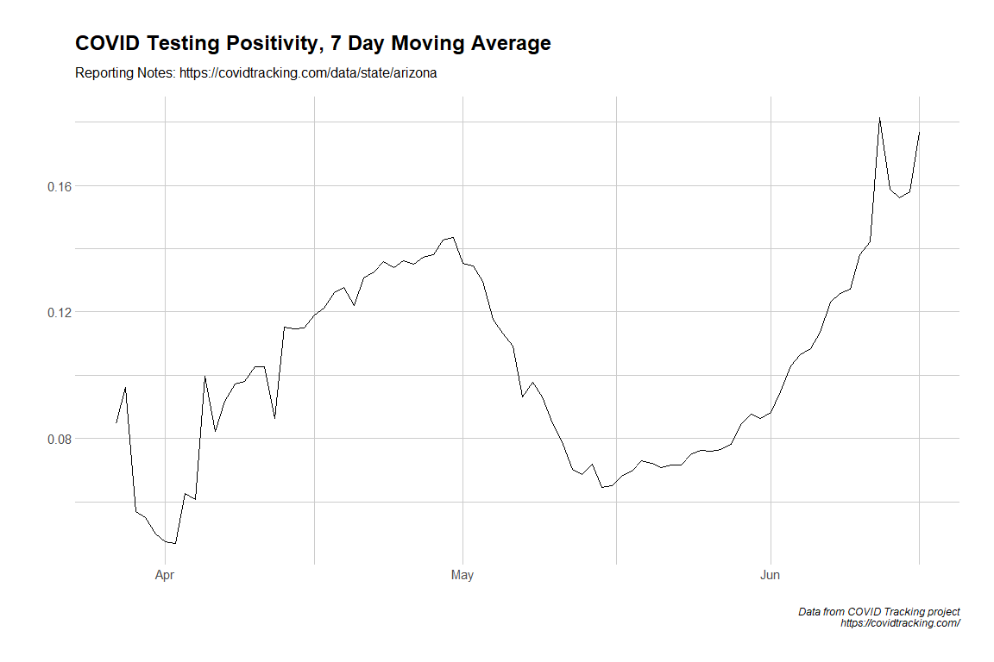
Arizona

Slide 8
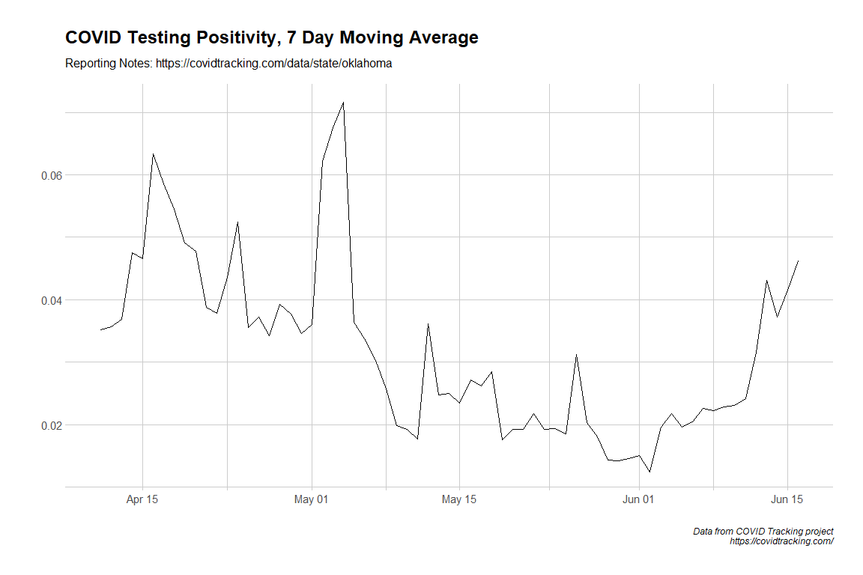
OK

Slide 9
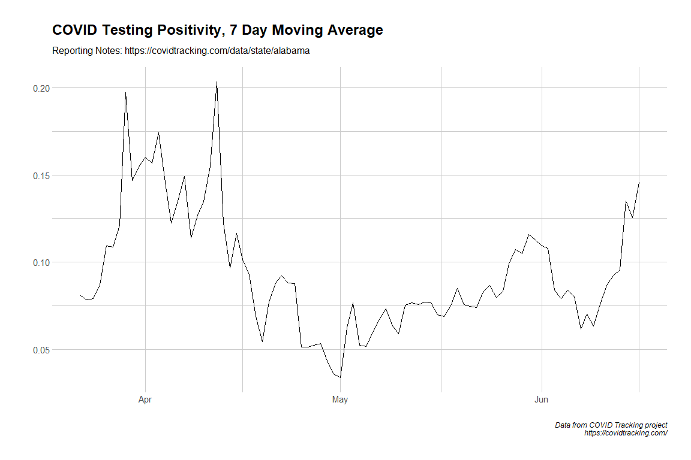
Alabama

Slide 10
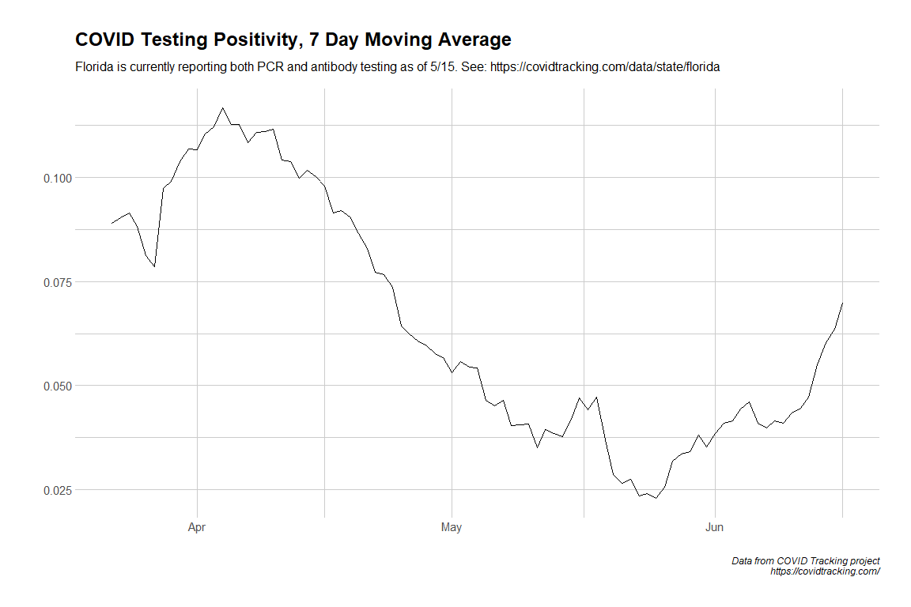
Florida

Slide 11
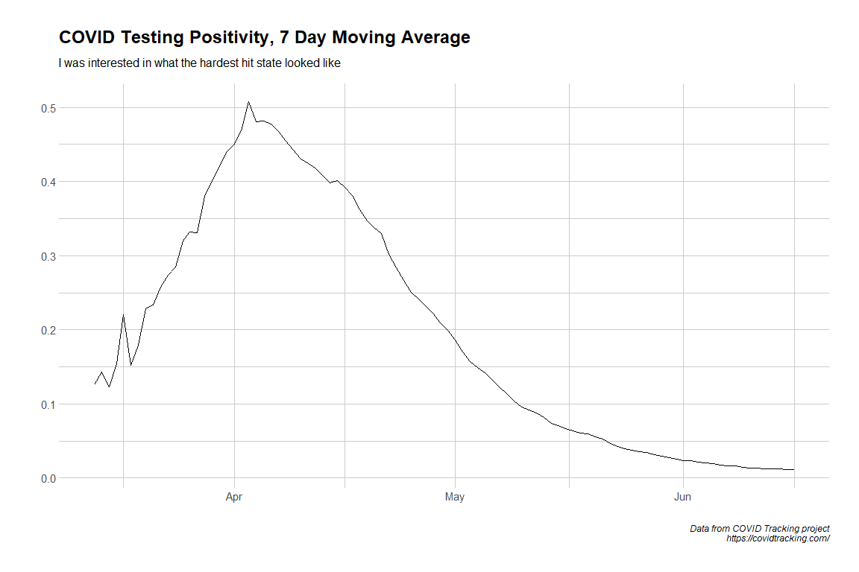
New York

