Slide 1
COVID-19 Positive Rates in Missouri, Kansas, and Selected States
Jim Felps

Slide 2
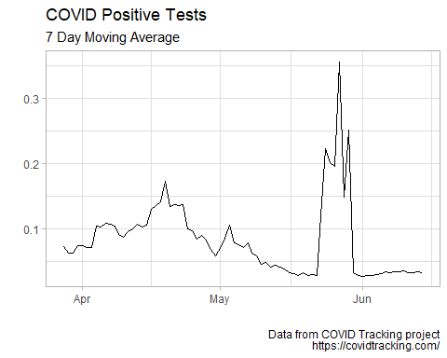
Missouri

Slide 3
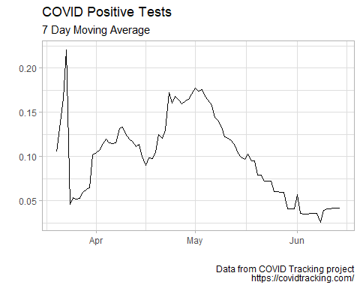
Kansas

Slide 4
Select States with Problematic Trends (based on media coverage)

Slide 5
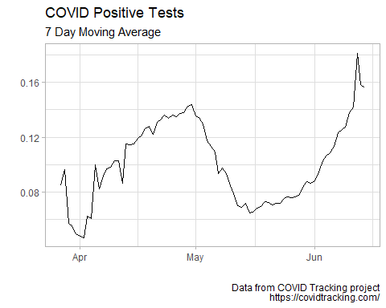
Arizona

Slide 6
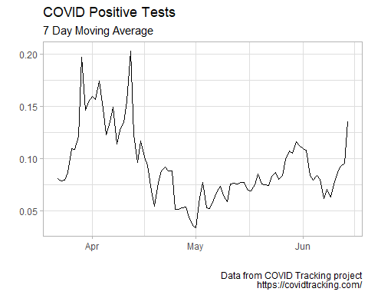
Alabama

Slide 7
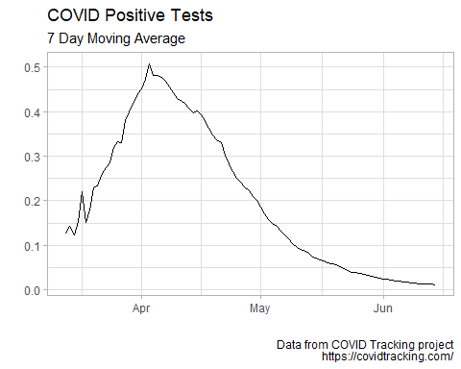
New York

