Slide 1

Department of Computer Science
Demonstrator Training
October 2023
Jim Finnis
Alan Macmillan

Slide 2

Web site
My Aber website has this information on it, and more (including a timesheet template)
https://users.aber.ac.uk/jcf12/teaching/demonstrating/landing/

Slide 3
Dignity and Respect
Equality and Diversity – equal respect for all:
https://www.aber.ac.uk/en/cs/equality-and-diversity/
Dignity and respect policy
Disabilities, learning differences and anxieties are not always visible
Be kind and patient
Help people towards understanding rather than show what you know
Respect personal space (!)
You are representing the University

Slide 4
All modules are different
I’ve tried to cover everything but will have missed things
If in doubt, talk to the module coordinator

Slide 5
Responsibilities
Best ability is availability – be on time
Be prepared for the class content
Be proactive – don’t wait to be asked
Be ready to interact with people
Focus for the length of the class
Don’t come if you are unwell – but let us know
Respect confidentiality
Declare conflicts of interest

Slide 6
Emergencies
You are not alone and responsible for everything – ask for help
We try to have more experienced demonstrators available, and the lecturer will always be available
Fire
Illness – look for first aiders
Disruptiveness – seek help from lecturing staff

Slide 7
Emergency contacts
It is very unlikely you’ll need these numbers, but:
In emergencies, call 2424 on an internal phone (01970 622424 on a mobile) for CompSci reception.
In extreme cases, call 2649 for Security at the porter’s lodge.

Slide 8
Practicalities
Register on Aberworks
Right to work checks
Apply for role
Check email regularly!
Payment by monthly timesheet:
Only slots for each month
Submit as soon as you can to ensure payment
Enter all the details of modules, times, employee number

Slide 9
Worksheet signoff system
https://signoff.dcs.aber.ac.uk
You should be able to log in and you should see your module.
Three options (for demonstrators!)
Signoff
Queueing (students can add themselves to a queue for signoff).
Instructions

Slide 10
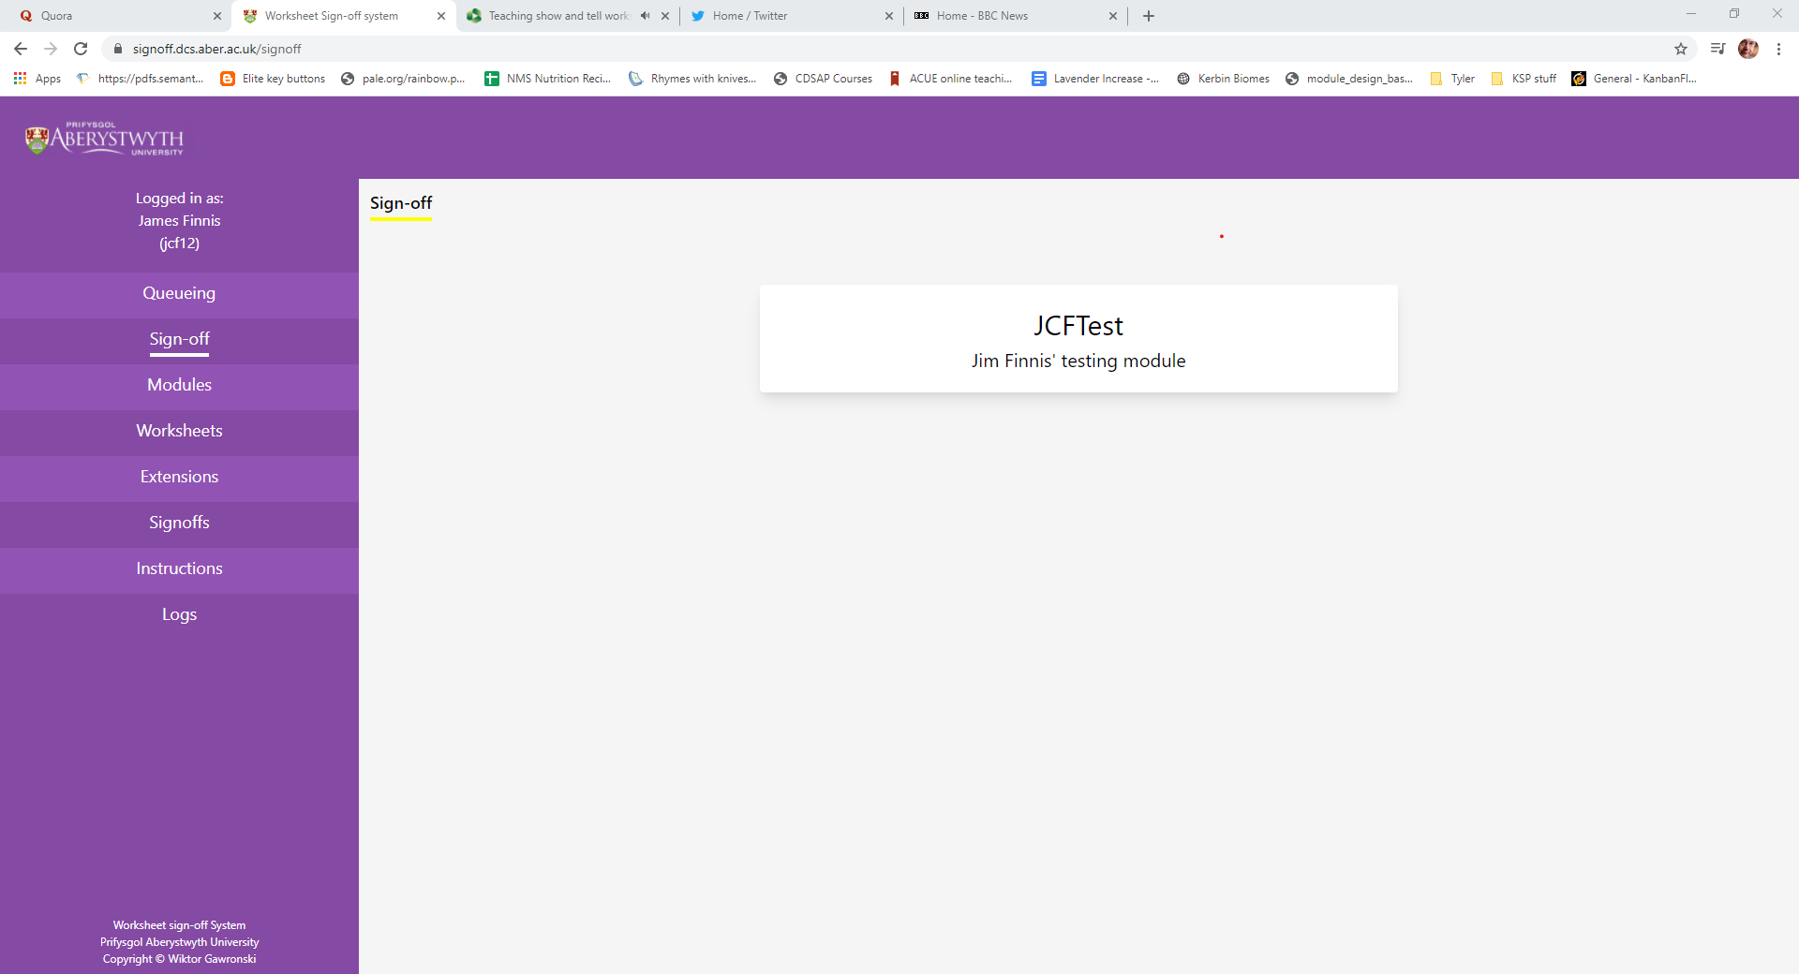
Worksheet signoff system

Slide 11
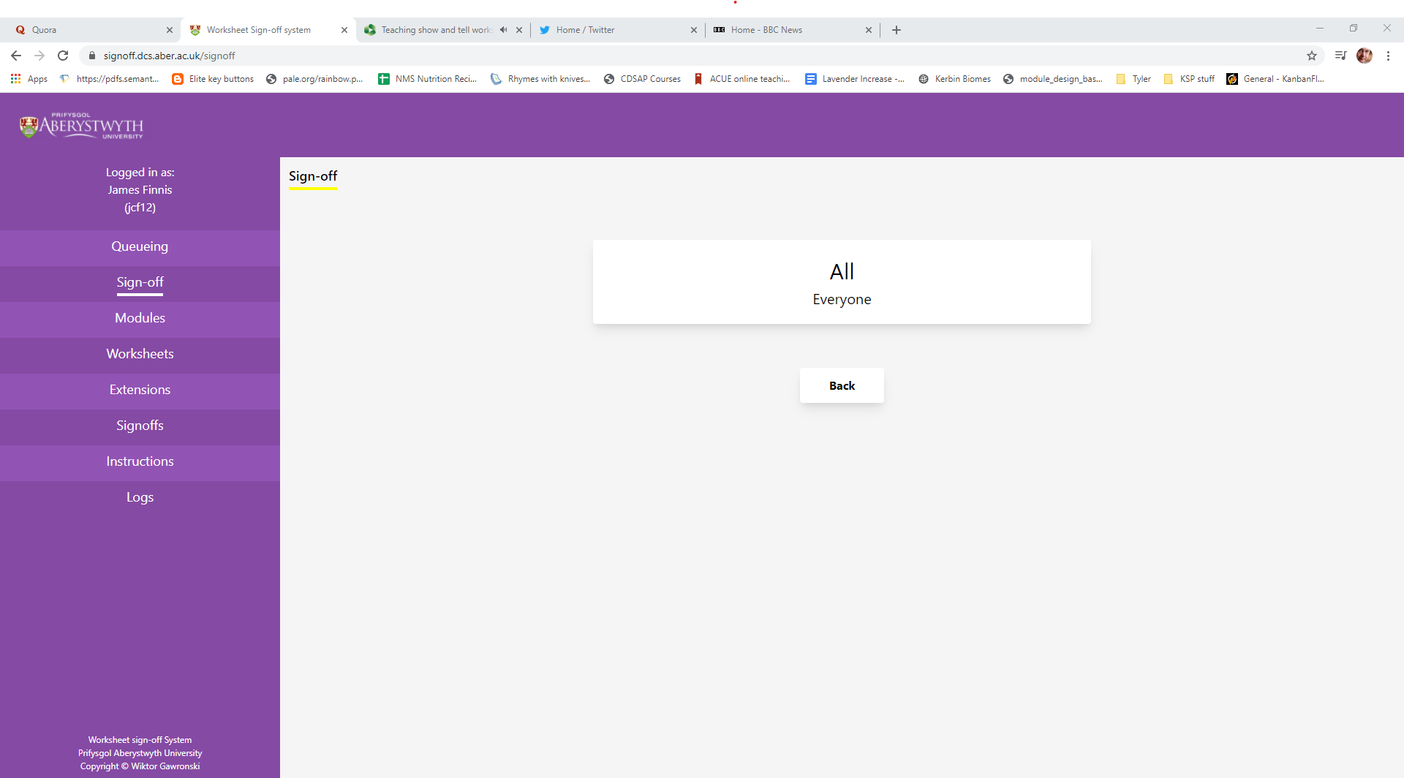
Worksheet signoff system

Slide 12
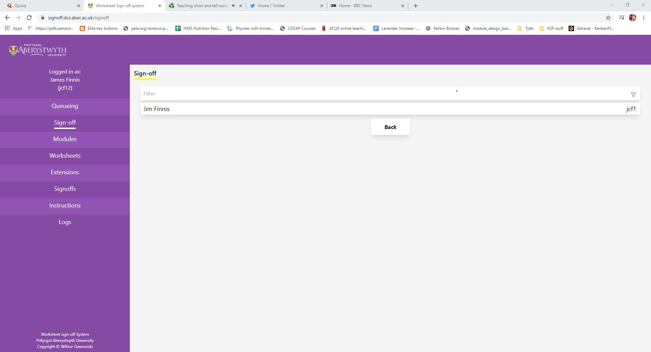
Worksheet signoff system

Slide 13
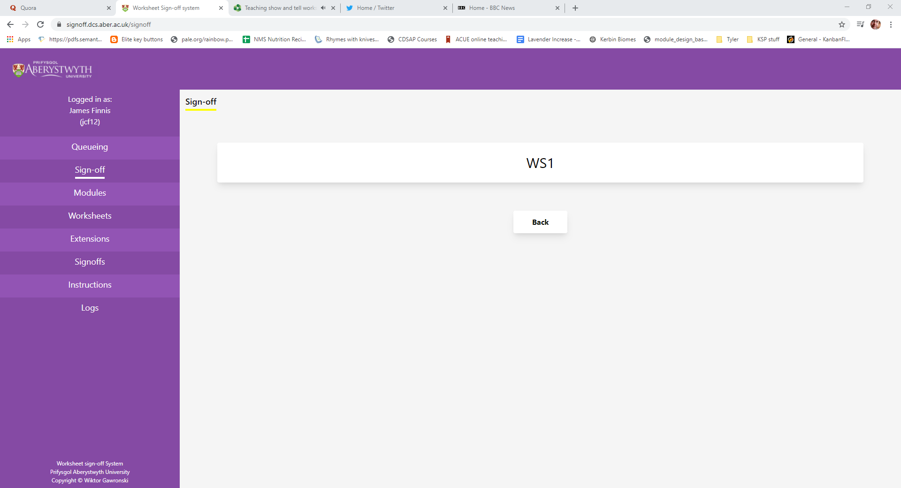
Worksheet signoff system

Slide 14
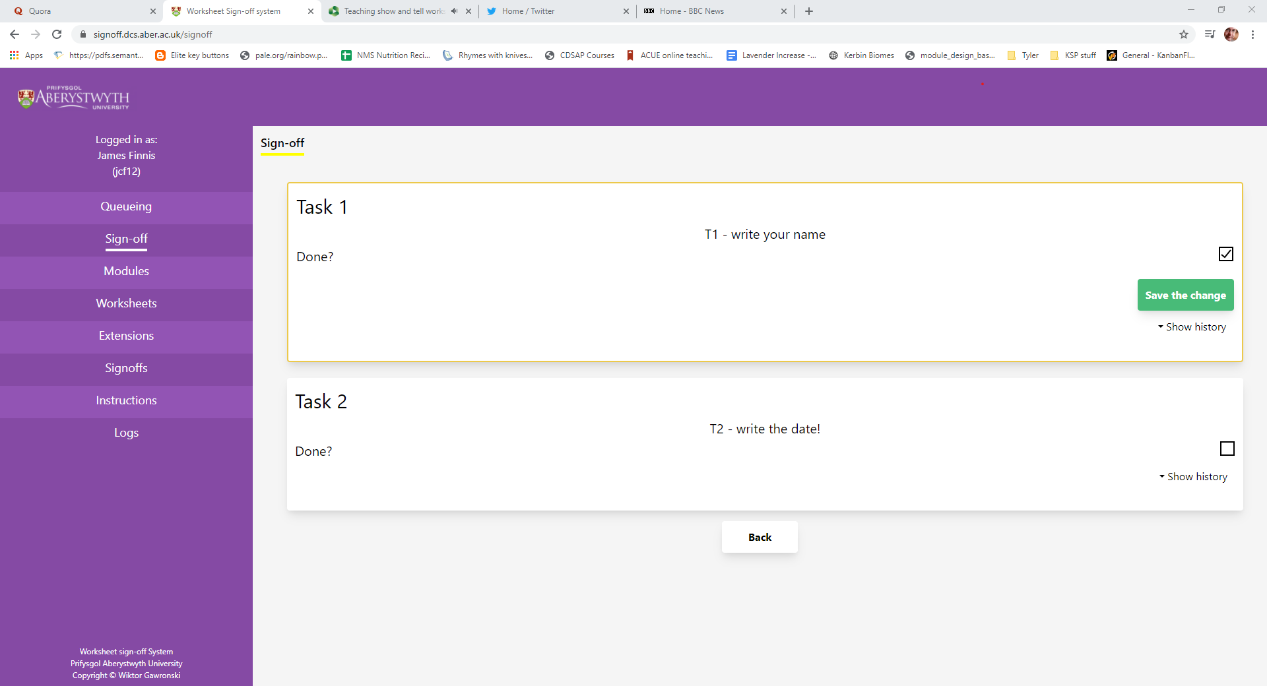
Worksheet signoff system

Slide 15
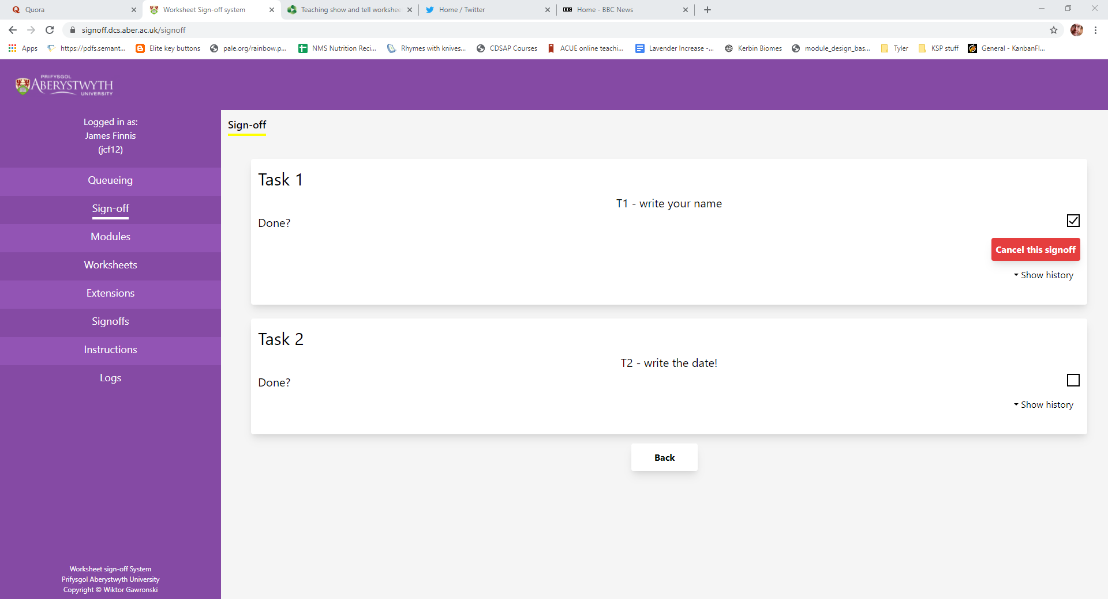
Worksheet signoff system

Slide 16
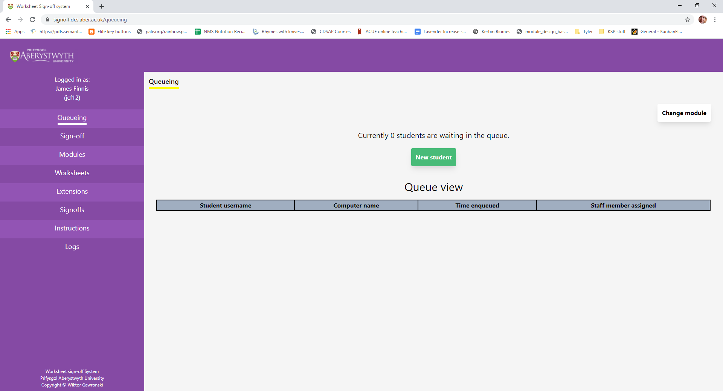
Queuing system
This will only show a queue when you have a session running. Click on “New Student” to start helping a student. Computer numbers are stuck onto the computers.

Slide 17
Name badges
You will get a name badge.
Wear your name badge.

Slide 18
Demonstrating
Read the worksheet in advance!
You don’t have to know everything, you can get help from the lecturer
Help students to work out the solution a step at a time
Ask them to describe the problem as precisely as they can
Don’t do the work for them – easy to do that incrementally
Needs to be their work, their way
Be aware of plagiarism
Try to be available to all students
Be relaxed

Slide 19
Kent (adj.)
Politely determined not to help despite a violent urge to the contrary. Kent expressions are seen on the faces of people who are good at something watching someone else who can't do it at all.
- The Meaning of Liff (Douglas Adams & John Lloyd)

Slide 20
Demonstrating
If you think a student can’t do it, and you show it, they will believe you. Don’t even think it.
It is very easy to lose patience and become dismissive. This makes students “disengage.”
This can sometimes be a real challenge.

Slide 21
End of session
Try to make sure student work is reasonable before sign-off
You need to know what the requirements are
Feedback any issues to module coordinator

Slide 22
Please turn up.
If you don’t come to a session you’re supposed to attend, it puts an unfair load on the other demonstrators and the lecturer.
Students might not get seen. They might start to fall behind.
If you can’t come, tell us in good time.

Slide 23
Finally
Thank you.
We are really delighted that you all want to demonstrate and help other students. You can have a wonderful effect on what people will learn and how they will feel about computing and their prospects for the future. You are role models and have really helpful expertise to share.

Slide 24
Any questions?
?

