Slide 1

Department of Computer Science
Demonstrator Training
October 2025
Jim Finnis

Slide 2

Web site
My Aber website has this information on it, and more (including a timesheet template)
https://users.aber.ac.uk/jcf12/teaching/demonstrating/landing/

Slide 3
Introduction
Thanks. Really.
Covered today:
Equality, Dignity and Inclusion
Health, Safety and Employment
How to Demonstrate

Slide 4
Dignity and Respect
Equality and Diversity – equal respect for all:
https://www.aber.ac.uk/en/cs/equality-and-diversity/
Dignity and respect policy
Disabilities, learning differences and anxieties are not always visible
Be kind and patient
Help people towards understanding rather than show what you know
Respect personal space (!)
You are representing the University

Slide 5
Indignity and Disrespect!
(pause the recording, Jim)
What’s the worst thing a demonstrator has ever done for you?

Slide 6
Dignity and Respect
And what’s the best?
(remember to start the recording again, Jim)

Slide 7
Discrimination
Gender balance in STEM is skewed
Compsci in particular:
Not many women
Quite a few trans folk
Do not discriminate
Everyone is just a student. Treat them all with exactly the same kindness and professionalism.
Notes:
Look around you. You will see there aren’t many women here. This is a problem, and it’s been getting worse. If you want to help, do not discriminate – treat the women around you exactly as you would treat everyone else. You will also see some trans folk. Aberystwyth has been seen as a safe space for trans people for a long while. Again, do not discriminate. These are all just students, and you should treat all students with exactly the same kindness and professionalism.

Slide 8
Discrimination
Do not treat people differently on the basis of
Gender
Gender identity
Sexual orientation
Race or nationality
Age
Anything else
Differently means worse or better!
Notes:
Look around you. You will see there aren’t many women here. This is a problem, and it’s been getting worse. If you want to help, do not discriminate – treat the women around you exactly as you would treat everyone else. You will also see some trans folk. Aberystwyth has been seen as a safe space for trans people for a long while. Again, do not discriminate. These are all just students, and you should treat all students with exactly the same kindness and professionalism.

Slide 9
DO NOT
Hang around near particular students, it can make them uncomfortable
Send students DMs / emails
Give some students more time than others
Ask students out during the session (!)
Notes:
Look around you. You will see there aren’t many women here. This is a problem, and it’s been getting worse. If you want to help, do not discriminate – treat the women around you exactly as you would treat everyone else. You will also see some trans folk. Aberystwyth has been seen as a safe space for trans people for a long while. Again, do not discriminate. These are all just students, and you should treat all students with exactly the same kindness and professionalism.

Slide 10
We hold you to a high standard of behaviour.
You are employees of the university, just as we are.
We are trusting you do this professionally.
Notes:
Look around you. You will see there aren’t many women here. This is a problem, and it’s been getting worse. If you want to help, do not discriminate – treat the women around you exactly as you would treat everyone else. You will also see some trans folk. Aberystwyth has been seen as a safe space for trans people for a long while. Again, do not discriminate. These are all just students, and you should treat all students with exactly the same kindness and professionalism.

Slide 11
Name badges
You will get a name badge.
Wear your name badge.
You will be able to get them from compsci reception
(you can guess why this has become necessary. Sorry.
I don’t like it either.)

Slide 12
Health, Safety and Employment

Slide 13
Emergencies
You are not alone and responsible for everything – ask for help
We try to have more experienced demonstrators available, and the lecturer will always be available
Fire
Illness – look for first aiders
Disruptiveness – seek help from lecturing staff

Slide 14
Emergency contacts
It is very unlikely you’ll need these numbers, but:
In emergencies, call 2424 on an internal phone (01970 622424 on a mobile) for CompSci reception.
In extreme cases, call 2649 for Security at the porter’s lodge.

Slide 15
Practicalities
Register on Aberworks
Right to work checks
Apply for role
Check email regularly
May need to change sessions
May need substitutes due to illness etc.
Payment by monthly timesheet…

Slide 16
Payment
Monthly timesheet template from website
https://users.aber.ac.uk/jcf12/teaching/demonstrating/landing/
Complete timesheet once you’ve finished the teaching for a particular month
Put only sessions for that month on the sheet!
Get the timesheet signed by module coordinator, and email it as an attachment to Academic Operations (for the attention of Glenwen Morgans)
You will be paid at the end of the next month

Slide 17
Payment
Get timesheets in promptly – don’t save them up (this can cause Tax/NI problems)
At Christmas get it in before you leave
Deadlines are on the website (or will be soon)

Slide 18
Admin contacts
Payment/timesheet issues:
Academic Operations acadops@aber.ac.uk
Mark “FAO: Glenwen Morgans” (it’s a shared address)
Scheduling and employment:
Carys Pike cyl@aber.ac.uk
Other issues:
Jim Finnis (me): jcf12@aber.ac.uk
We also have a Discord. I’ll send out invites by email.

Slide 19
How to Demonstrate

Slide 20
All modules are different
I’ve tried to cover everything but will have missed things
If in doubt, talk to the module coordinator

Slide 21
Responsibilities
Best ability is availability – be on time
Be prepared for the class content
Be proactive – don’t wait to be asked
Be ready to interact with people
Focus for the length of the class
Don’t come if you are unwell – but let us know
Respect confidentiality
Declare conflicts of interest

Slide 22
A summary
Read the worksheet in advance!
You don’t have to know everything, you can get help from the lecturer
Help students to work out the solution a step at a time
Ask them to describe the problem as precisely as they can
Don’t do the work for them – easy to do that incrementally
Needs to be their work, their way
Be aware of plagiarism
Try to be available to all students
Be relaxed

Slide 23
Preparation
Read the worksheet in advance
Revise the language and system
Revise how to use the debugger (if there is one)
Try to refamiliarize yourself with common error messages in the compiler/IDE
Be relaxed, calm and approachable
Above all
Don’t be worried that you might not know the answer to the students’ questions…

Slide 24
Not knowing
It’s OK not know the answer to a student’s question
It’s often better!
“I don’t know, but let’s find out together.”
Help them find out the answer themselves
Or let them help you figure it out so they can see your thought process
Don’t just let them watch passively
Remember – you are expected to get help from the lecturer when stuck!

Slide 25
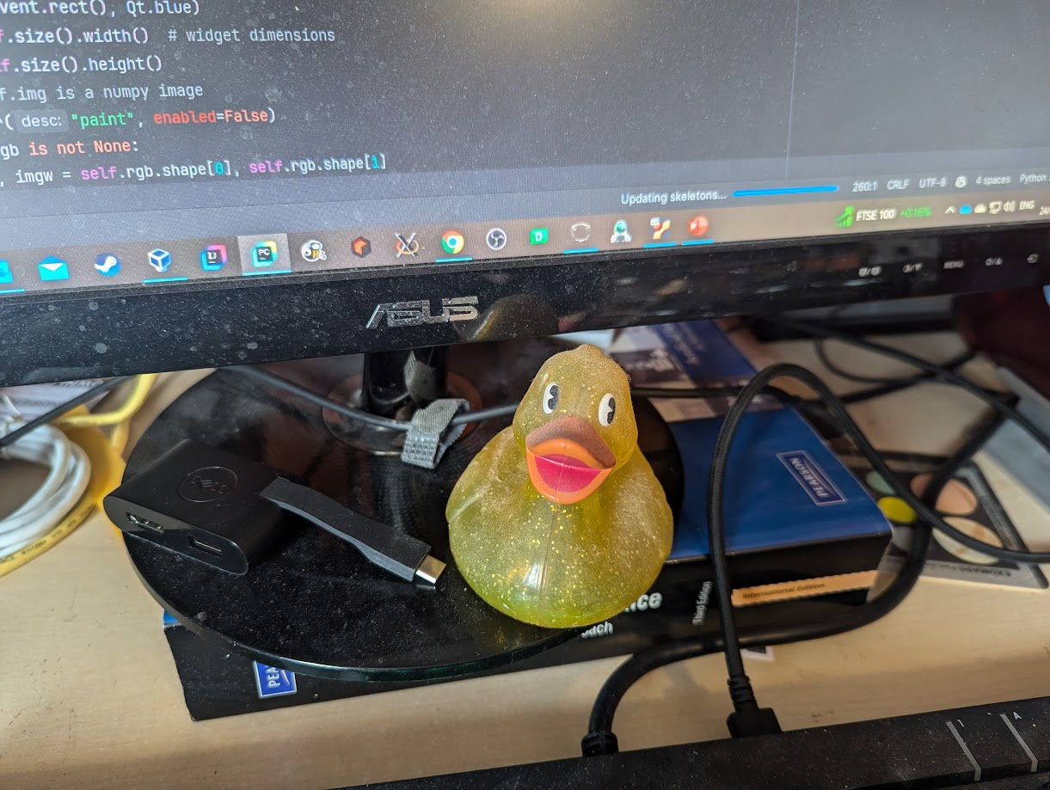
Rubber duck debugging For when the question is “why doesn’t it work?”

Slide 26
Rubber duck debugging
Be their rubber duck
Make the student explain their code to you line by line
Explaining something in detail helps you see problems
“Many programmers have had the experience of explaining a problem to someone else, possibly even to someone who knows nothing about programming, and then hitting upon the solution in the process of explaining the problem. In describing what the code is supposed to do and observing what it actually does, any incongruity between these two becomes apparent.”
[https://en.wikipedia.org/wiki/Rubber_duck_debugging]

Slide 27
Oh no
If their whole concept is flawed get them to tell you their thinking
Do not just delete their code or be dismissive of it
Never, ever say their code is rubbish…

Slide 28
Don’t lose patience
If you think a student can’t do it, and you show it, they will believe you. Don’t even think it.
It is very easy to lose patience and become dismissive. This makes students “disengage.”
This can sometimes be a real challenge.

Slide 29
Unacceptable Academic Practice
All assessed work must be the student’s own (unless stated otherwise)
It’s a fine line between getting help from a fellow student and copying their code.
It’s a fine line between getting hints from websites or AI and copying code.
Even if unassessed work is being copied
the copier won’t learn anything
and will become reliant on copying work

Slide 30
Unacceptable Academic Practice
It’s OK for students to ask a fellow student a question
It’s not OK for students to work together (because usually one student is actually doing the work)
Keep an eye on students who appear to be working too closely together.
Particularly watch for this when assignments are being worked on

Slide 31
“AI”
(in the form of Generative AI / Large Language Models)
If you see a student using an LLM make sure
They are aware that LLMs aren’t a database of facts, they’re a statistical model of the most likely way to complete a prompt given a big, blurry snapshot of the internet and loads of books.
The internet is full of lies. The LLM doesn’t know the difference.
The blurry nature of the snapshot means it’s very far from perfect.
They should be able to understand and explain what the LLM is telling them.
Otherwise, they aren’t learning.
Blackboard course on generative AI and using it ethically:
https://blackboard.aber.ac.uk/ultra/organizations/_54998_1/outline

Slide 32

Kent (adj.)
Politely determined not to help despite a violent urge to the contrary. Kent expressions are seen on the faces of people who are good at something watching someone else who can't do it at all.
- The Meaning of Liff (Douglas Adams & John Lloyd)

Slide 33
Good for you too!
This is a great opportunity for you to learn
Technical stuff
How to explain things

Slide 34
End of session
Try to make sure student work is reasonable before sign-off
You need to know what the requirements are
Feedback any issues to module coordinator

Slide 35
Please turn up.
If you don’t come to a session you’re supposed to attend, it puts an unfair load on the other demonstrators and the lecturer.
Students might not get seen. They might start to fall behind.
If you can’t come, tell us in good time.

Slide 36
Finally
Thank you.
We are really delighted that you all want to demonstrate and help other students. You can have a wonderful effect on what people will learn and how they will feel about computing and their prospects for the future. You are role models and have really helpful expertise to share.

Slide 37
Any questions?
?

