Slide 1
Robot Operating System (ROS),
(and a brief intro to Python and Terminal)
James Borzillieri

Slide 2

Overview
What is ROS? What is TCP/IP? What is Python? Key ROS Terms Sample Python

Slide 3

What is ROS?
Overview
ROS stands for Robot Operating System
It is also known as “middleware”
ROS is open source
Open source is cool
ROS is compatible with a number of programming languages (C++, Python, ...)

Slide 4

ROS- Middleware
Robotics middleware is used to manage the complexity of robot hardware and apps.
Simplifies design
Hides the complexity of low-level communications
Allows for reusablity

Slide 5
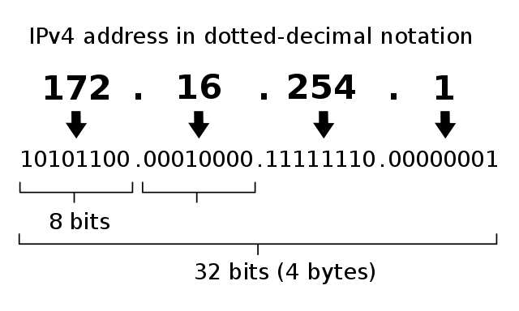
What is TCP/IP?
Transfer Control Protocol / Internet Protocol (Internet Protocol Suite)
Every computer in a network needs an address
Think about how houses need addresses to send and receive mail
Standard IPv4 was implemented on the ARPANET in 1983
Industry and government is slowly transitioning to IPv6
We are using IPv4!

Slide 6

Key Terms
Node
A Node is the smallest unit of processor running on ROS.
Robots are made of multiple nodes
Nodes are controlled by a single “master node”
Programmers and nodes use “APIs” to interact with ROS and hardware components
API stands for “Application Programming Interface”
  These are libraries for interacting with other software. This allows us to communicate with ROS processes

Slide 7
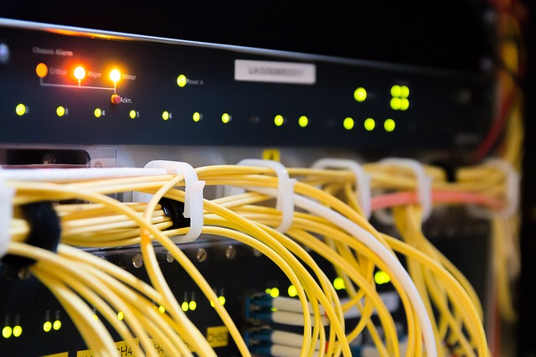
Key Terms
Master Node
Acts as a name server for all nodes
  AKA a network service that allows lesser nodes to communicate
The command “roscore” starts the Master node
Running the master node allows subsidiary nodes to check in with master, and communicate with one another

Slide 8
Key Terms
Node (continued)
Nodes can:
Publish
Subscribe
Service client and server processes
Exchange “topics” and “services”
Nodes use:
Use XMLRPC when communicating with the Master node
Use TCP/IP to communicate with one another

Slide 9

Key Terms
Publish/Subscribe
Nodes must register their topics with the master node first
Once registered, nodes can produce and consume data between one another
Publisher nodes send messages to subscriber nodes
Subscriber nodes must also register with master before receiving data from publishers

Slide 10
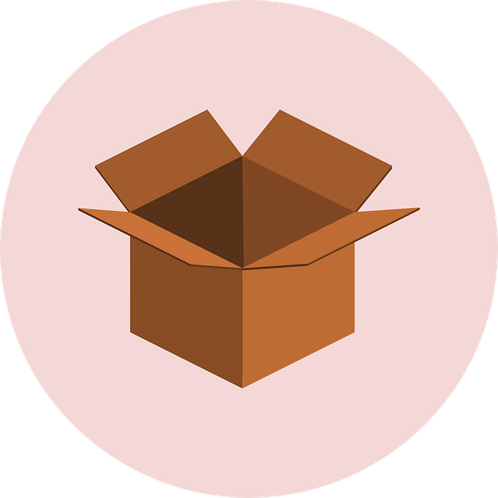
Key Terms
Package
Packages are basic units in ROS
Projects are developed on a package basis
Packages contain:
  Configuration files to launch other packages
  Config files to launch other Nodes
  Files necessary fro running the package

Slide 11
Key Terms
Message
Nodes send and receive data via “messages” (int, boolean, float, etc.)
TCP/IP is used for message delivery between nodes
UDPROS is used as well (not covered in this course)
“Topics” are used for unidirectional messaging between nodes
“Services” are used for multi-directional communication between nodes

Slide 12
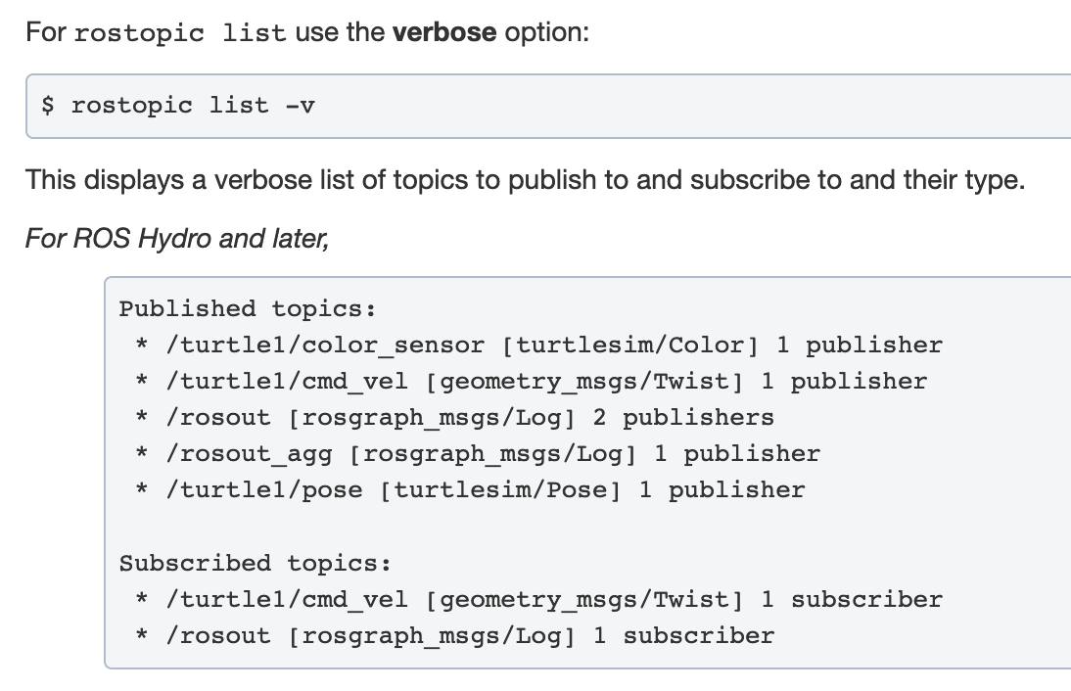
Key Terms
Topic
Think about the “topic” of a conversation
Publishing nodes register their topic with the master node
Subscriber nodes receive the topic s registered with the master node

Slide 13
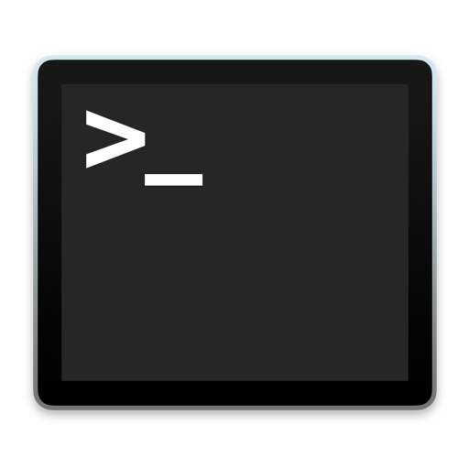
What is the Terminal?
What is it?
The terminal is an interface in which you can type and execute text based commands.
Why use it?
It can be much faster to complete some tasks using a Terminal than with graphical applications and menus. Another benefit is allowing access to many more commands and scripts.

Slide 14
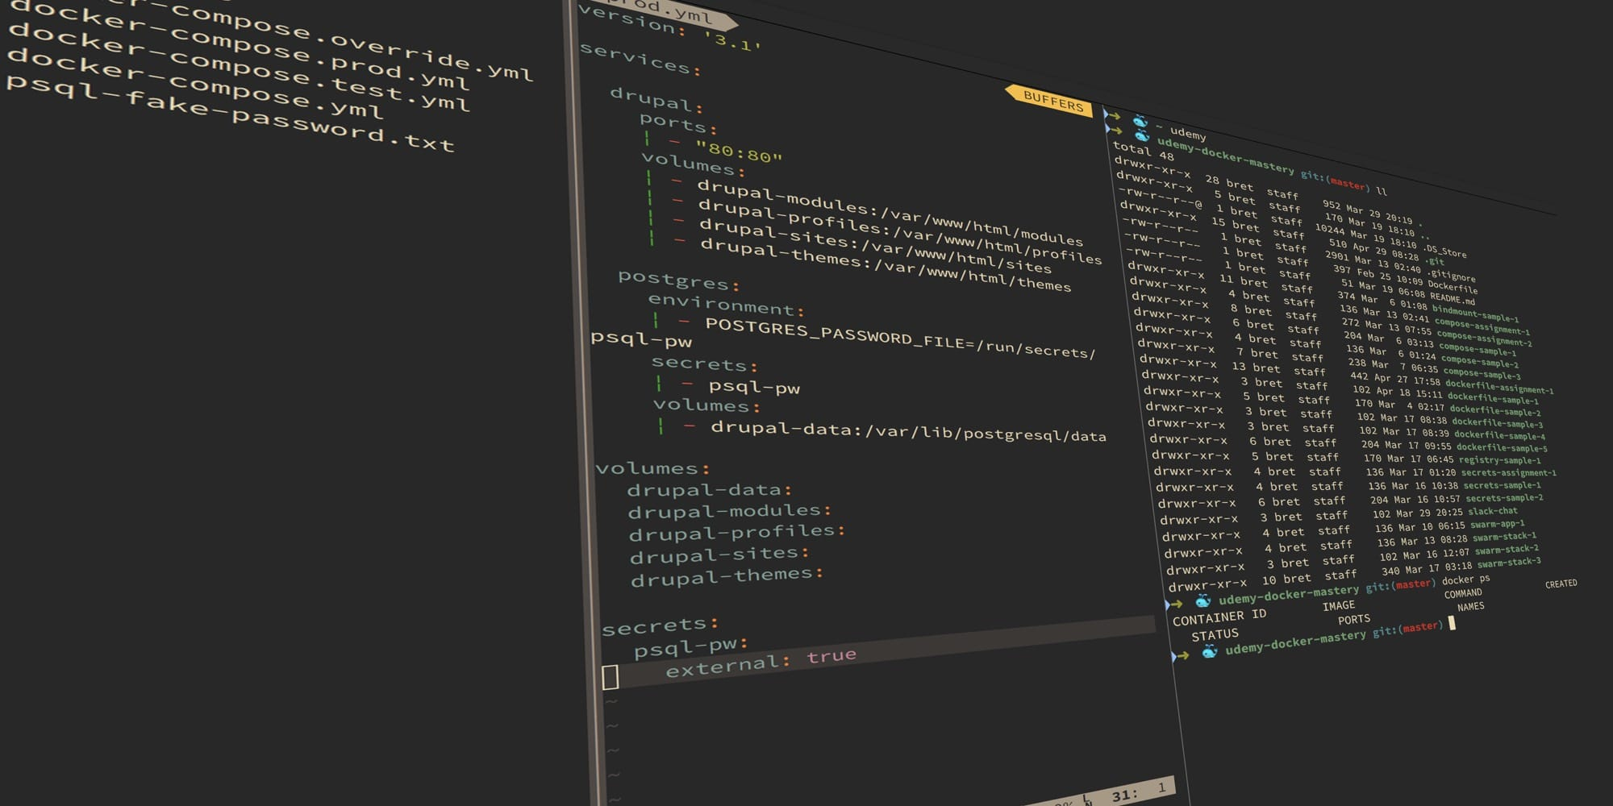
Terminal commands
Print working directory
  pwd
Change directory
  cd file_name
  cd ..
List (directory elements)
  ls
Make directory
  mkdir directory_name
Create file
  touch file_name
Open Nano text editor
  nano file_name

Slide 15

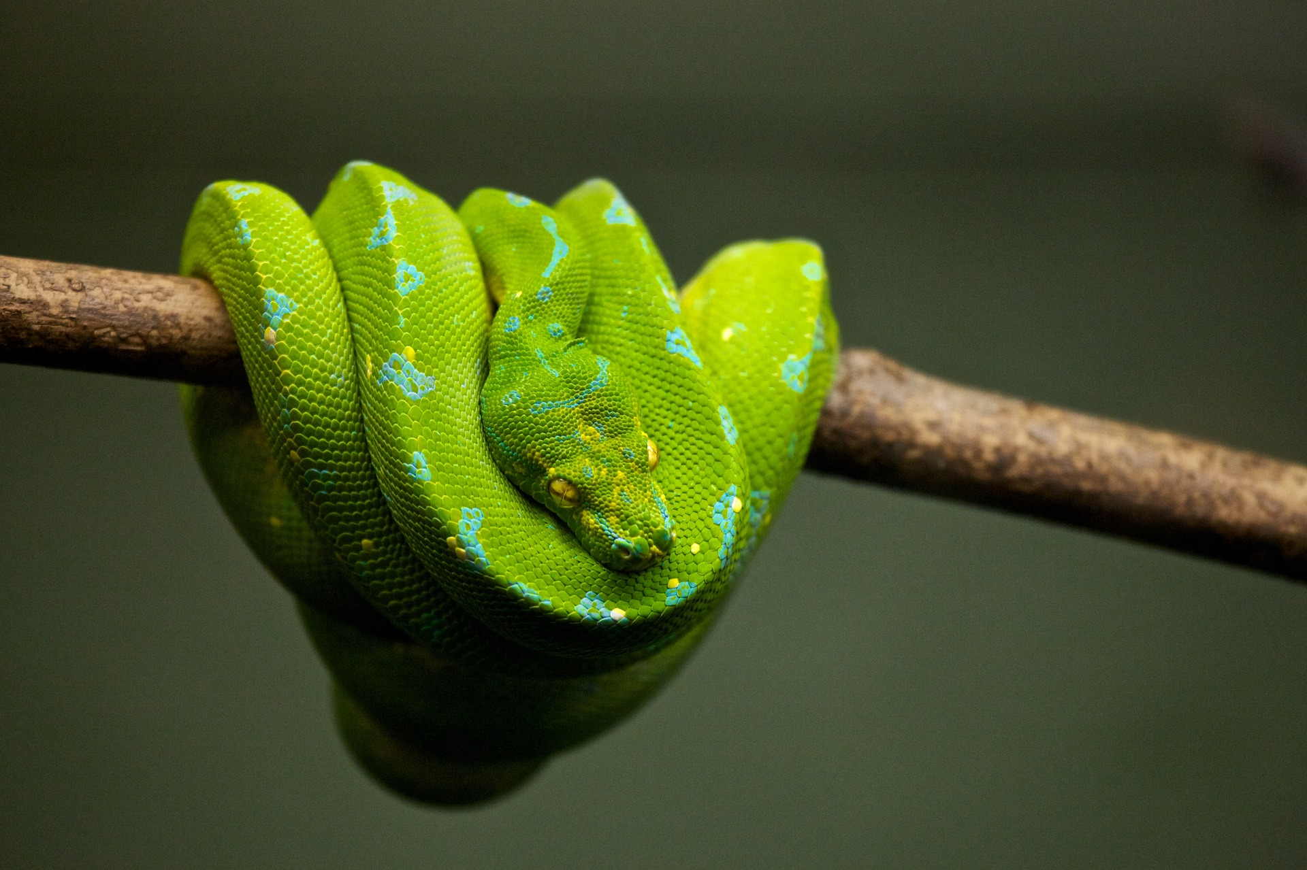
What is Python?
Python is an interpreted, high-level programming language
High level = abstract
Object-Oriented
Very popular

Slide 16

Python
Anatomy of a Program
A program is a set of instructions set to accomplish a certain task or computation
Though there are many languages, all programs share a set of common features:
  Input
  Output
  Conditional execution
  Math
  Repetition
  Notes!

Slide 17
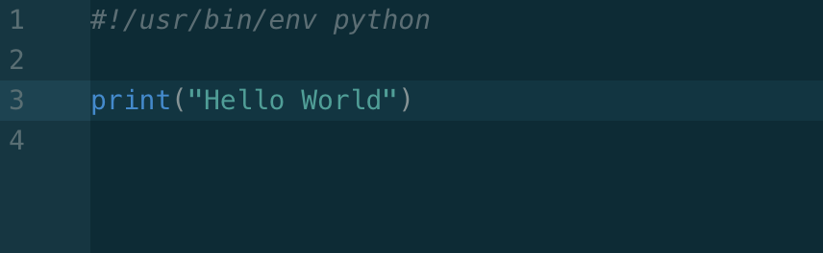
Python
Hello World
The “Hello World” is a standard among programmers trying out a new language or environment.
This is how we ensure that our compiler works correctly, and our tools are in working order.
Then we can start cooking.

Slide 18
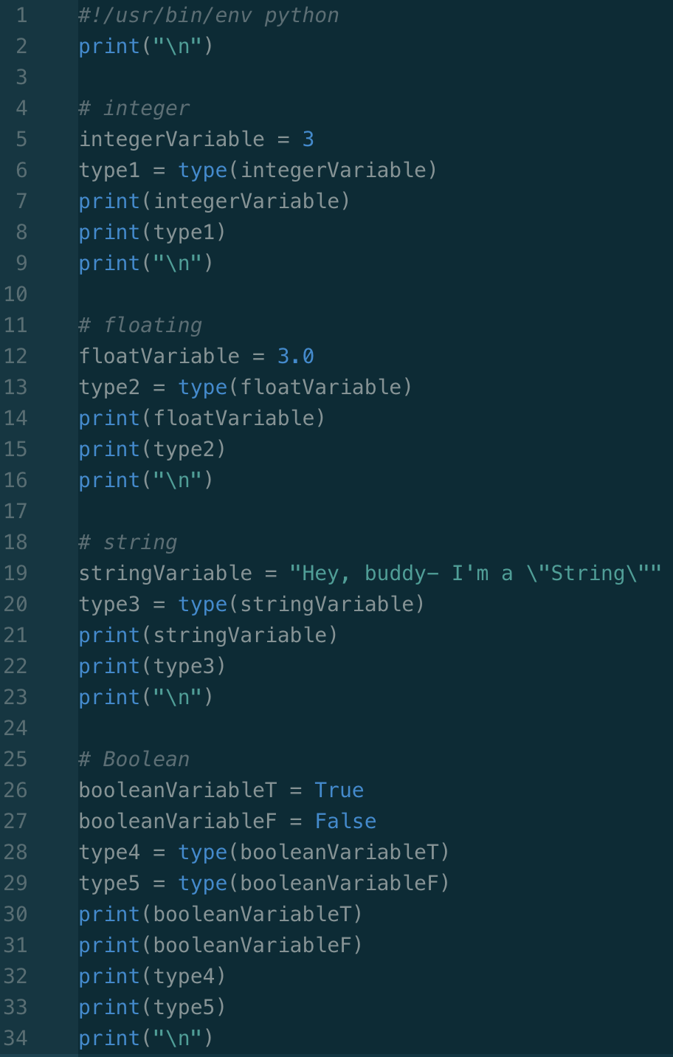
Python
Data Types & Values
Every programming language uses types
Some languages require you to be more explicit than others
In Python, this is not the case
  All we have to do is name the variable
  Python does the interpreting for us

Slide 19
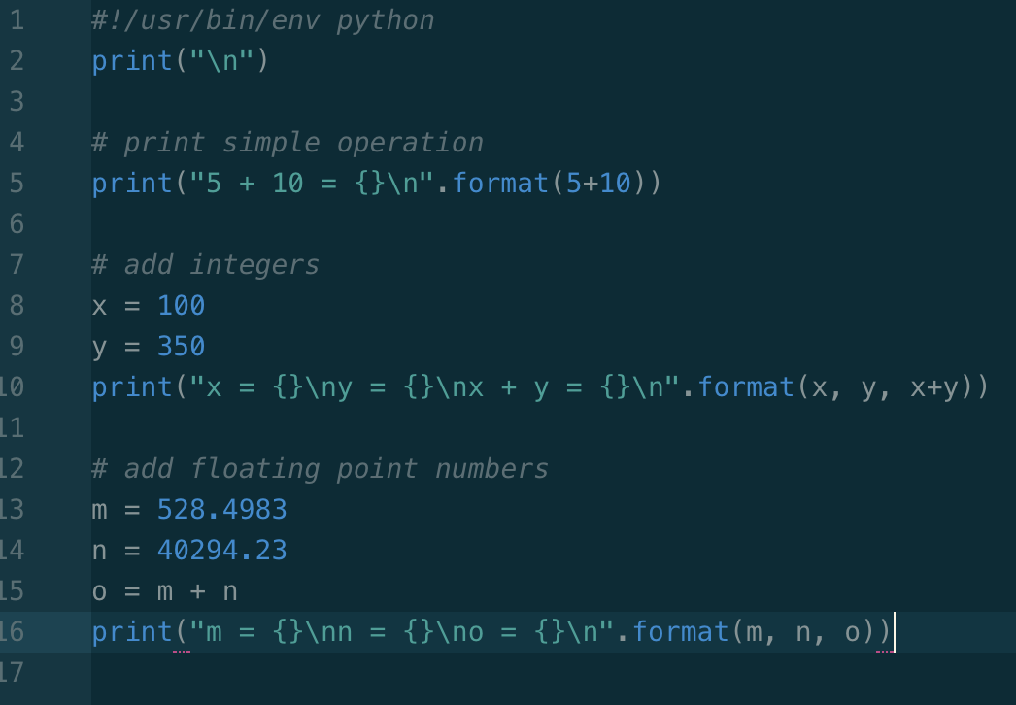
Python
Arithmetic Operators
Add, subtract, multiply, divide (+, -, *, /)
Computers do most of the hard work for us
Keep in mind the order of operations!
We can perform computations and store them as variables

Slide 20
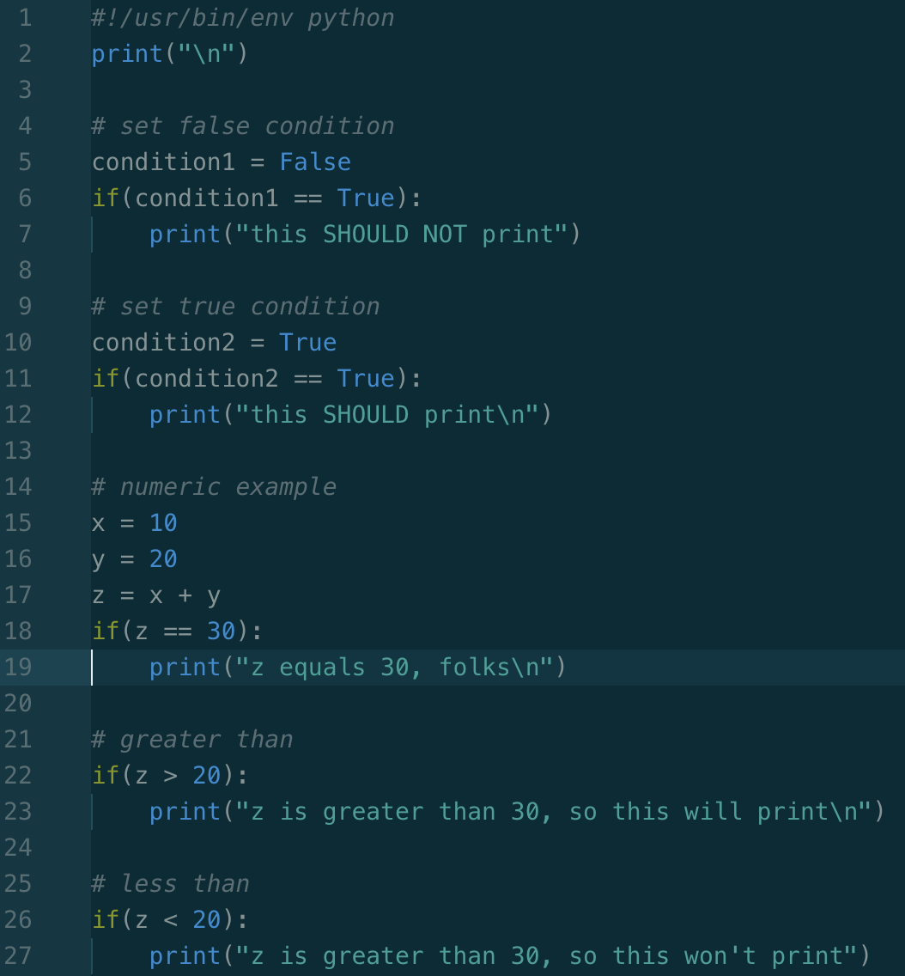
Python
Conditionals
Computers are “conditional” machines
Conditions can be numeric, logical, Boolean
Computers perform operations if the setting (condition) permits it
  eg. If the machine detects smoke, sound the alarm

Slide 21
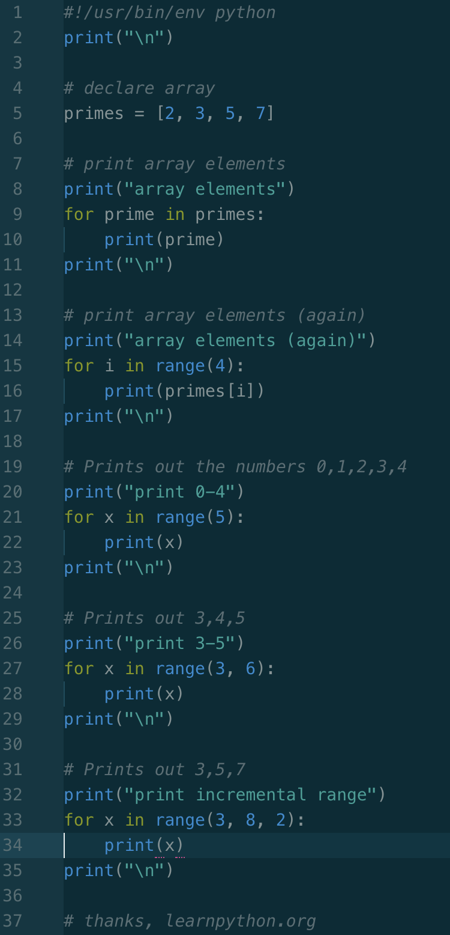
Python
Loops
Loops are used to execute a series of repetitive tasks
Computers wouldn’t be very useful without loops
Loops can be used to :
  Increment/count
  Iterate through a collection/array

Slide 22
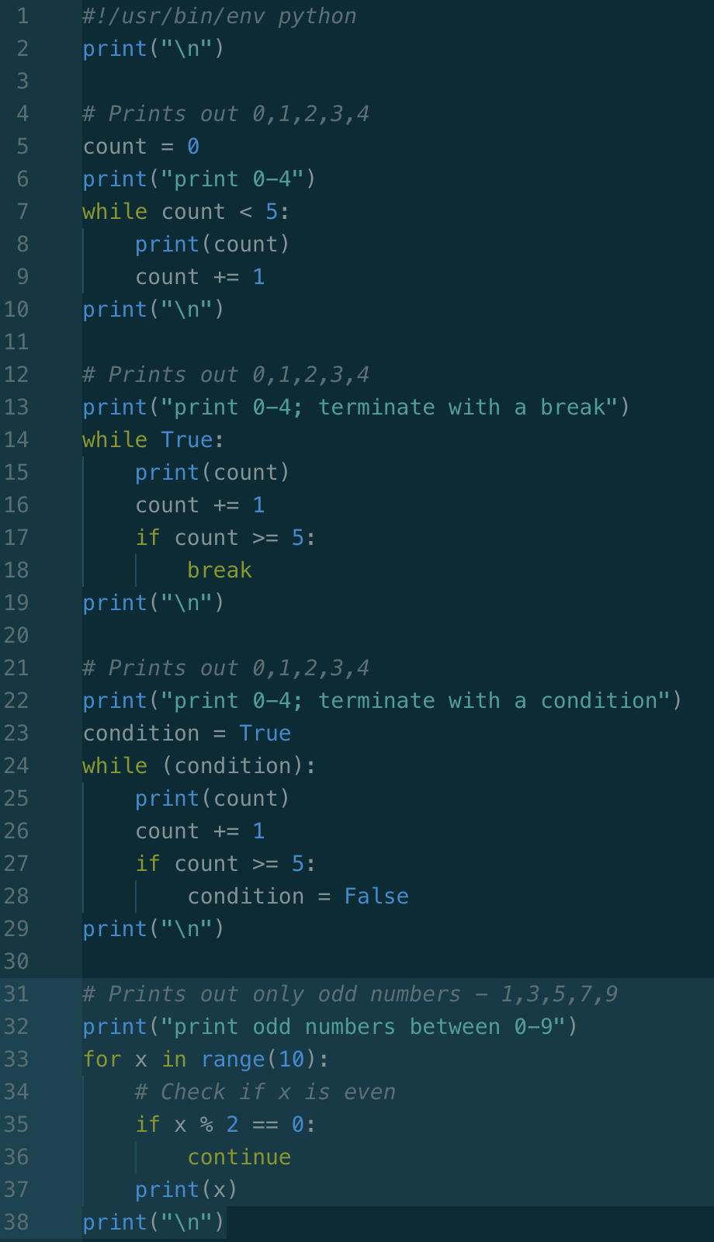
Python
More Loops
We can use conditional statements to terminate loops, or to perform operations within loops
“While” loops are useful to achieve this

Slide 23
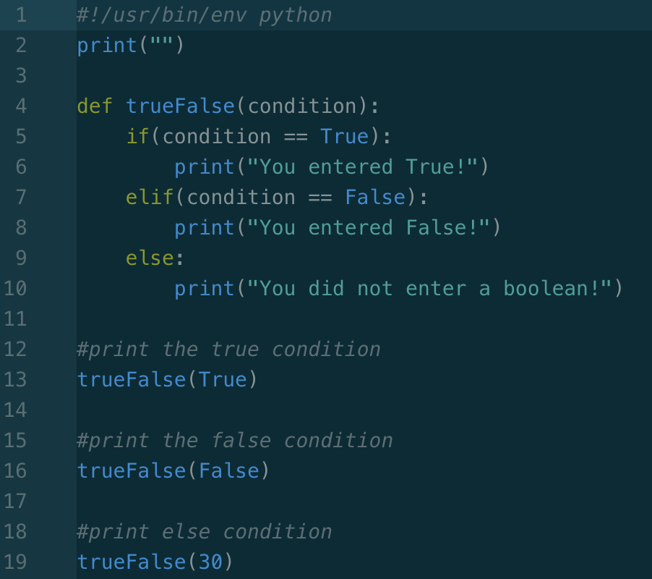
Python
Functions & Parameters
Functions allow us to compose more complex operations
This allows us to re-use code rather than duplicate what we already have
This is what computers are all about!
Next, let’s put it all together (queue drumroll)

Slide 24
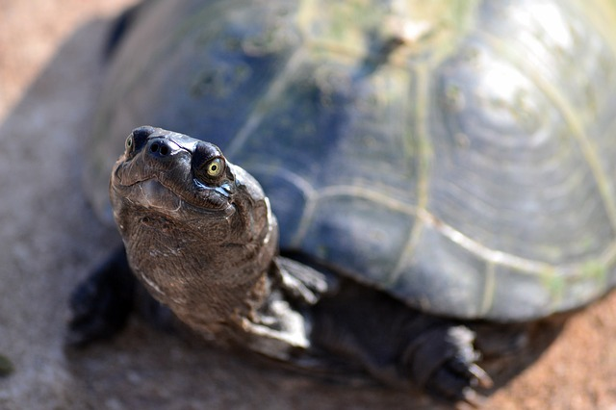
Python
The Turtle Module
The turtle mod allows us to draw simple graphics with a virtual rover.
This is similar to the TurtleBot 3 devices the hardware group is building
We will name our turtle “Bob”
Let’s code some TurtleBobs

Slide 25
ROS
Working in a Catkin Workspace
“Catkin packages can be built as a standalone project, but catkin also provides the concept of workspaces, where you can build multiple, interdependent packages together all at once.”
Translation: this is a project folder that can contain smaller projects as well.
(source must be performed every time you open a new terminal, unless command is added to ~/catkin_py_/devel/setup.bash)
$ mkdir catkin_py
$ cd catkin_py
$ mkdir src
$ catkin make
$ cd devel
$ source setup.bash

Slide 26
ROS
Create a ROS Package
To run code in ROS, we must create a “package”
Packages contain nodes
This compartmentalizes our code into reusable blocks
Applications may contain many packages
A package may be meant to control a cooling fan; that fan may be reused for many types of hardware
Packages must be named, and dependencies must be listed
Then we must rebuild the project with the catkin_make command
$ cd src
$ catkin_create_pkg ssi_prac rospy std_msgs
$ cd ssi_prac
$ cd ../..
$ catkin_make

Slide 27
ROS
Running Our First Node
$ cd catkin_py/src/ssi_prac
$ ls
$ mkdir scripts
$ cd scripts
$ touch my_first_node.py
$ chmod +x my_first_node.py
$ nano my_first_node.py
$ python my_first_node.py
-OR-
$ cd catkin_py/src/ssi_prac/scripts
$ rosrun ssi_prac my_first_node.py
$ cd catkin_py
$ roscore
$ cd catkin_py
$ rosnode list
/my_first_python_node
/rosout

Slide 28
ROS
Creating a Publisher Node
$ cd catkin_py/src/ssi_prac/scripts
$ touch robot_publisher.py
$ chmod +x robot_publisher.py
$ nano robot_publisher.py
$ rosrun ssi_prac robot_publisher.py
$ cd catkin_py
$ roscore
$ rostopic list
/robot_news
/rosout
/rosout_agg
$ rostopic echo /robot_news

Slide 29
ROS
Creating a Subscriber Node
$ cd catkin_py/src/ssi_prac/scripts
$ touch robo_subscriber.py
$ chmod +x robo_subscriber.py
$ nano robo_subscriber.py
$ python robo_subscriber.py
$ cd catkin_py
$ roscore
$ rosrun ssi_prac robo_publisher.py

Slide 30
Thanks for the free pics ;)
Pixabay.com
Wikipedia.com

Slide 31
References
Elkady, Ayssam (29 January 2012). "Robotics Middleware: A Comprehensive Literature Survey and Attribute-Based Bibliography". Journal of Robotics. 2012.
Downey, Allen (2016) “Think Python: How to Think Like a Computer Scientist”. O’Reilly Books
Renard, Edouard (2019ish) “ROS for Beginners”. www.udemy.com.
Askubuntu.com

