Slide 1

Support Weald Schooling
Public Meetings: November 13, 2024

Slide 2
Welcome – why we are here
To get you to help KCC and DfE to restore a non-selective
secondary school in Cranbrook.
We will tell you WHY our children deserve better:
The personal experience
The education experience
The numbers game
Our Vision of what should be in place
Our response to the Tunbridge Wells Local Plan

Slide 3
The Effect on our Children
Journeys to and from school of over 10 miles
Very early departure times
Unpleasant and lengthy travelling experience
Very difficult to attend after school activities
Friendship groups fractured due to distances
Impact on mental health
Clear safeguarding concerns
High level of School refusers/Home-schooling
Impact on educational outcomes: disadvantaged by rural setting & distance travelled

Slide 4
The Effect on our Community
Impact of children having to leave communities
Reliance on parents / family / friends
Absence of a local school sharing community assets
Are our communities being valued by our children?
- Do we care about their experience?
- How does this bode for the future?

Slide 5
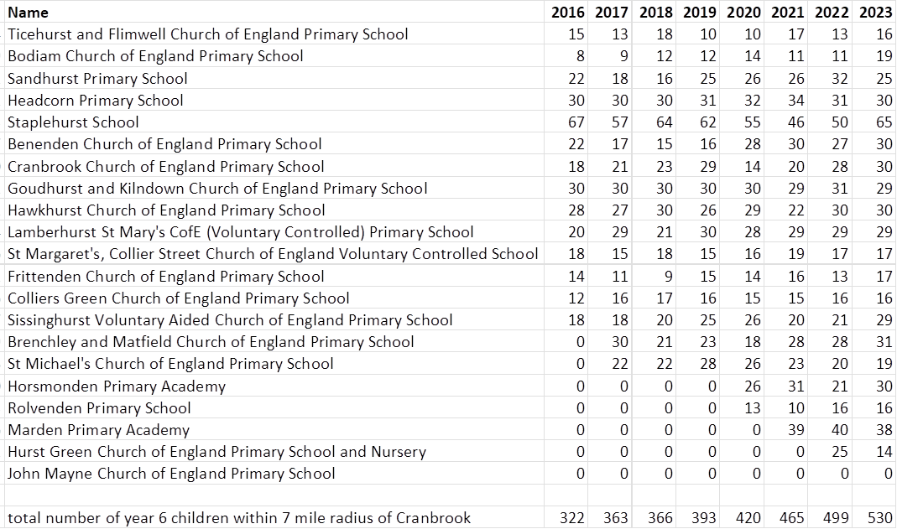
Year 6 children leaving school within 7 miles of Cranbrook

Slide 6
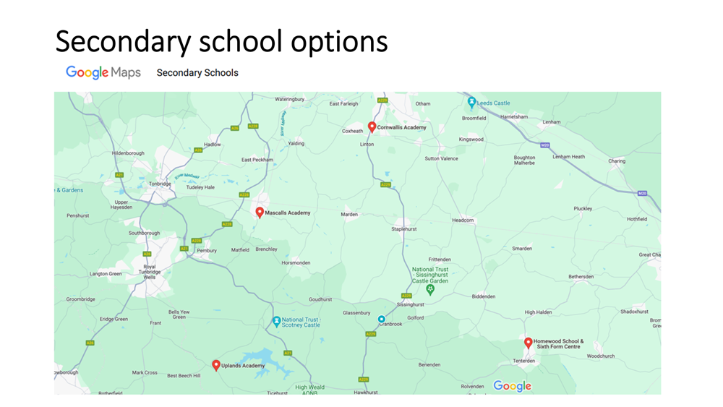

Slide 7
It’s acknowledged this is wrong MY CHILD IS NOT A NUMBER
Department for Education recognises The Weald as a ‘cold spot’ with regard to provision of a non-selective secondary school
In essence, this means children are travelling too far to and from school: there should be one more locally…but there isn’t
To view it…

Slide 8
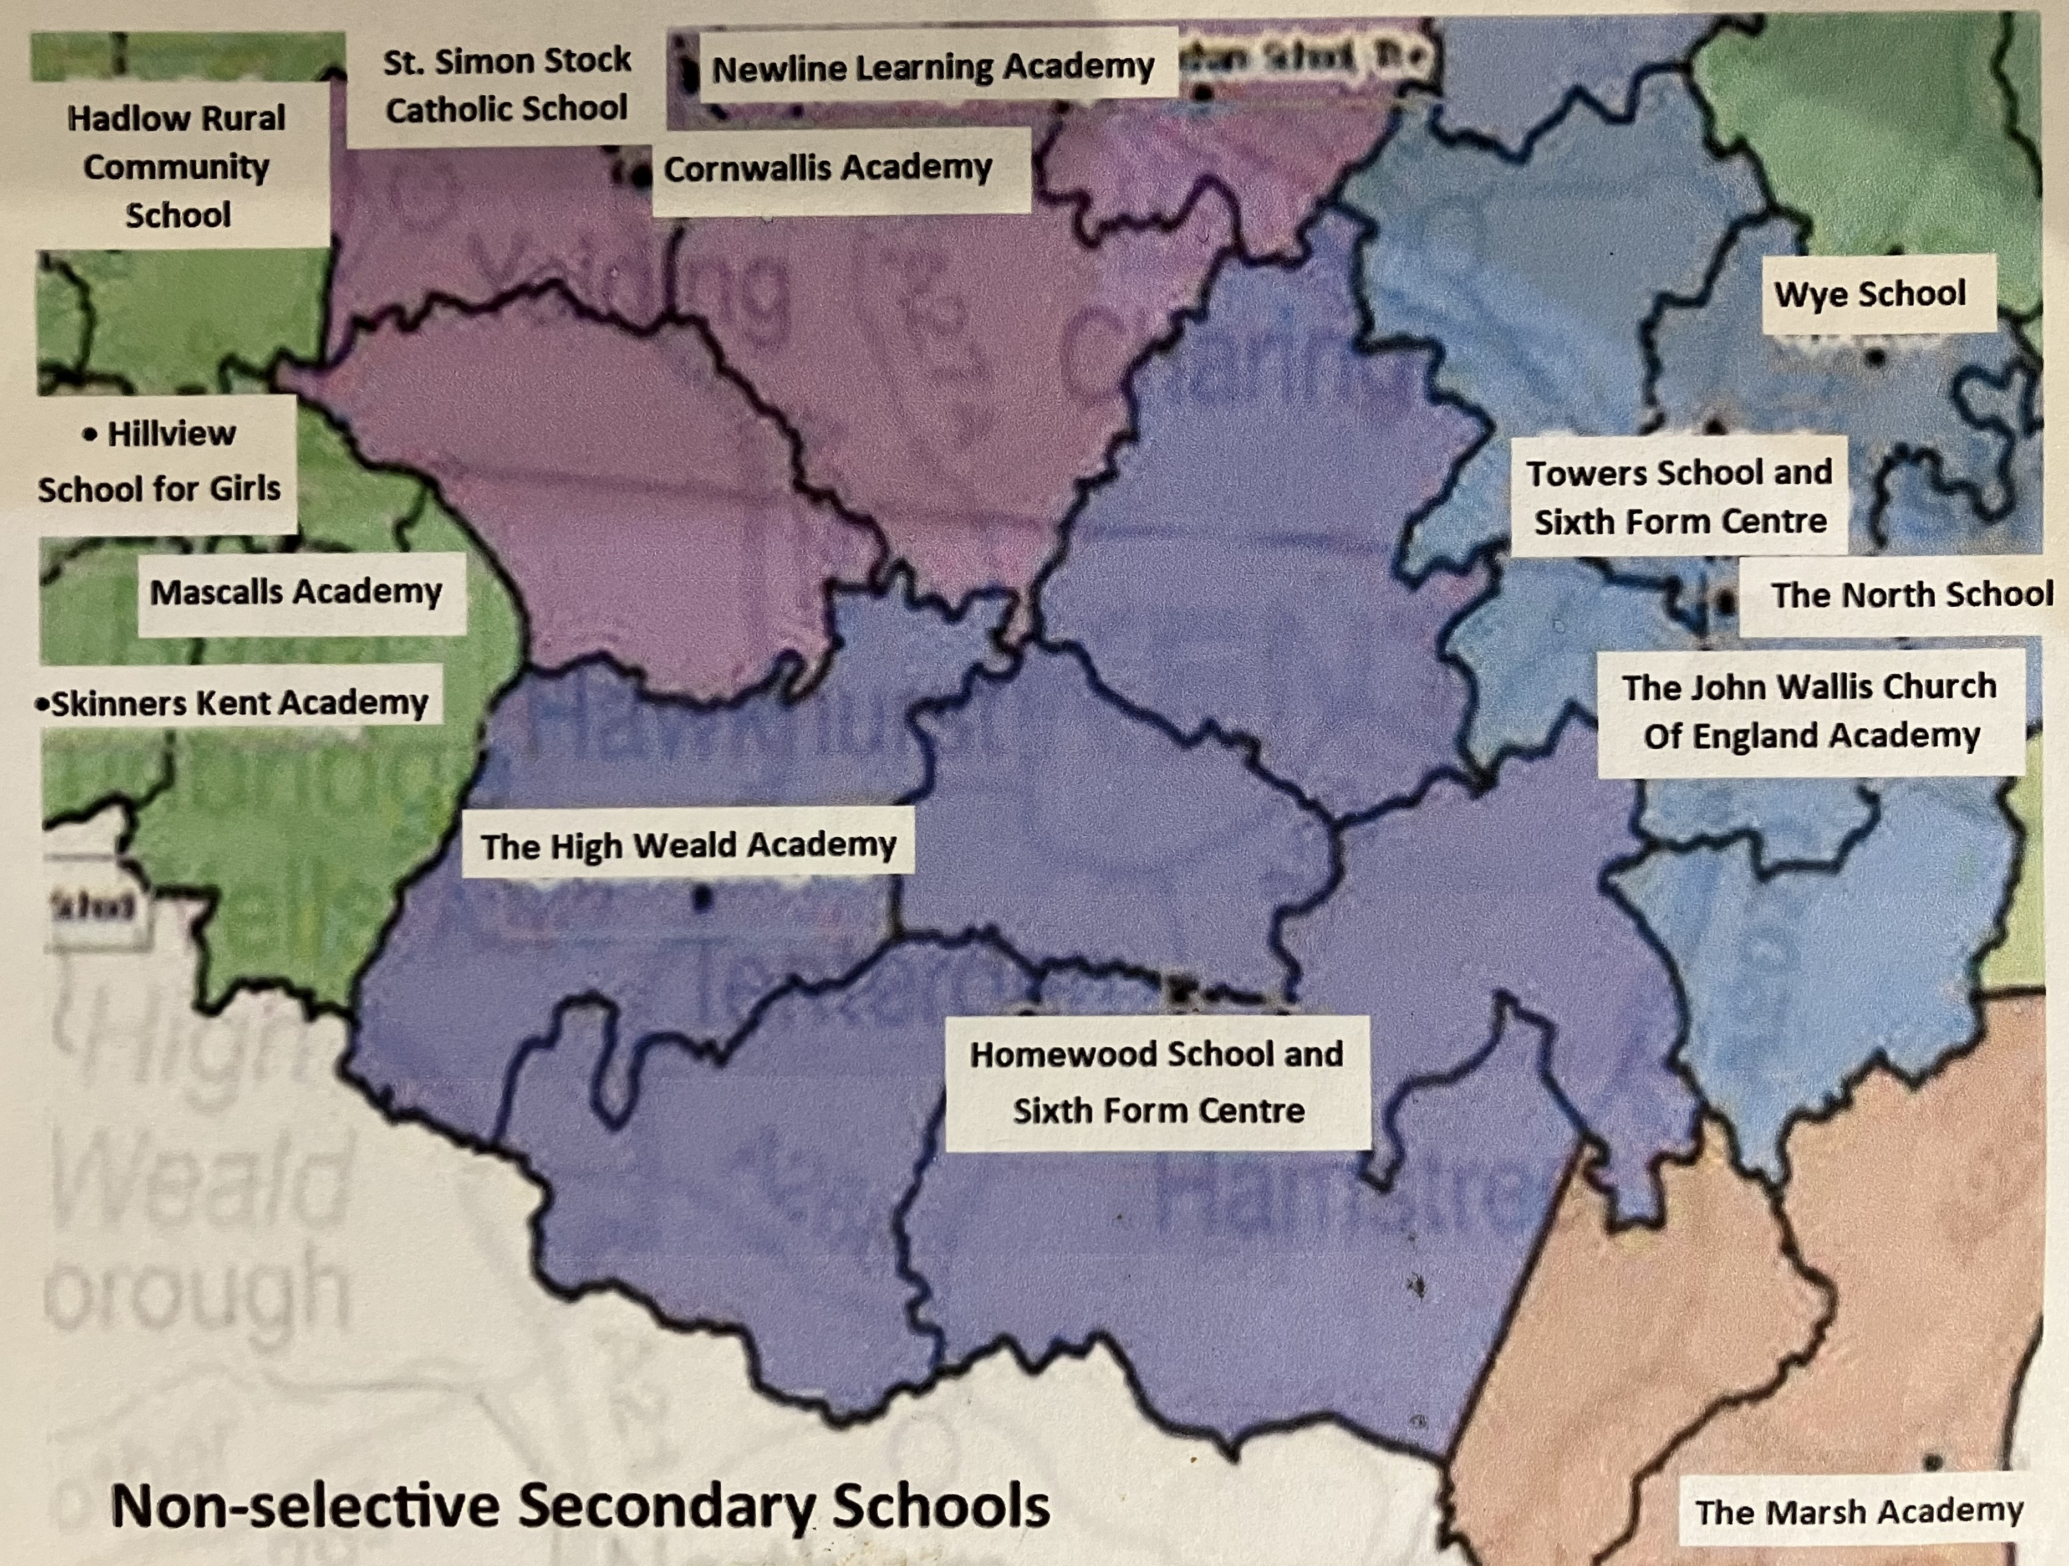
Lack of secondary schools in the Weald
Notes:
Illustrate with comments about growth and further expansion
Quote Hill Housing re inability to sell due to no local school

Slide 9
Growth in Housing
Houses paying council tax
 | 2020 | 2021 | 2022 | 2023 | 2024 |  | Increase | Currently being built | in planning
Cranbrook and Sissinghurst | 2646 | *2617 | 2676 | 2713 | 2775 |  | 129 | 303 | 392
Staplehurst | 2479 | 2631 | 2859 | 2990 | 3086 |  | 607 |  | 142
Biddenden | 1136 | *1100 | 1208 | 1310 | 1305 |  | 254 | 38 | 50
Hawkhurst |  |  | 2033 | 2100 | 2134 |  | 100 | 100 | 107
 |  |  |  |  |  | Total | 1090 | 441 | 691
 |  | * reflects fall in households able to pay council tax.
Notes:
Illustrate with comments about growth and further expansion
Quote Hill Housing re inability to sell due to no local school

Slide 10
Limited Alternative Secondary Schooling
Grammar Schools
Cranbrook is highly selective
Trying to help locality by increasing from 3 Form Entry to 4 Form Entry
Still not an option for most children/parents
Independent Schools
January 2025 - 20% VAT on school fees
Cost becoming prohibitive: Mergers/closures
Inevitability of more children in mainstream, state education

Slide 11
Our Vision - 1
A non-selective secondary school
Where?
LAT confirm space on the Angley School/High Weald Academy site
Some existing buildings
Road access
Parking
Size?
4/5 Form Entry
Reflects our smaller primary school cohorts
Notes:
Where (existing access and land, central position)
Size (link to our numbers and v small primary schools – mental health/v bad experience with huge schools)
Needs a quick mention of history of old school: v good, spiralled, V poor management (unchecked) by previous Trust, LAT handed a v difficult task. DfE decision to close and turn to SEND provision was pragmatic given KCC needs. ‘Outstanding’ rating

Slide 12
Our Vision - 2
A truly ‘comprehensive’, inclusive school offering different pathways to lead to qualifications and the best routes to the workplace
- traditional academic
- skills-based
- Special Educational Needs & Disabilities (SEND) provision
A school that can be used by our collective community

Slide 13
Our Vision - 3
Government Pledges:
Will deliver modern curriculum so young people are ready for work and life
Will take a community-wide approach, improving inclusivity and expertise in mainstream schools
Will create higher-quality training and employment paths by empowering local communities to develop the skills people need
Recognises poor mental health is another barrier to learning – will seek to address this

Slide 14
Tunbridge Wells BC Local Plan
TWBC Local Plan (Education) is a proposal to meet the numerical demands over the coming years
We have submitted a challenge to aspects of the Local Plan
Speaking at the Hearing on 14.11.2024
Local Plan only proposes solution to increased numbers of children as being expansion of Mascalls, Paddock Wood
(That isn’t the issue – large housing development in Paddock Wood may demand an increase. But…)

Slide 15
Local Plan
Our experience needs to be considered
The Inspector’s comments on previous Local Plan draft:
consideration should be given to elsewhere: the possibility of having an alternative site in addition to the expansion of Mascalls, Paddock Wood (highlighted in The Appendix)
concern about the distance many children are having to travel at present

Slide 16
Local Plan – Our Stance
The Local Plan does not take into account The Weald
No consideration of housing developments East of Paddock Wood
No consideration of alternative school site this side of Paddock Wood.
No data for the number of Weald children travelling to Mascalls.
No KCC data for number of home-schooled children
No data for potential increase in pupils due to VAT on independent schools’ fees
Effectively, we seem not to exist or it is believed we are perfectly well served as things stand

Slide 17
Local Plan – Our Proposal
Restoring a non-selective school in Cranbrook (5FE) would:
Stop children travelling unacceptable distances
Allow children to access after school activities
Allow friendships to develop and children to socialise
Allow our communities to recover and strengthen
Allow further opportunities to strengthen learning and skills
Free up space in the already full 4 secondary schools they are having to attend (Cornwallis, Homewood, Mascalls, Uplands)
Reduce KCC school travel & SEND budgets

Slide 18
Collaboration is KEY
Yes, we oppose the Local Plan, as it stands. Rural areas are being stripped of infrastructure and community
We MUST protect the land use at Cranbrook for education
We do recognise limitations and financial constraints
And we must work together to find a common-sense solution which is better for everyone – and get this in front of the Department for Education
Notes:
(mention home-schooling/refusers/misery/disadvantages for rural children and for those who travel increasing distances – cite surveys)

Slide 19
Working Together
Members of Parliament
Borough Councillors
Kent County Councillors
KCC Education
Leigh Academies Trust
Media
You
…to persuade the DfE we need the return of a school.

Slide 20
Support Weald Schooling
Thank you for joining us

