Slide 1
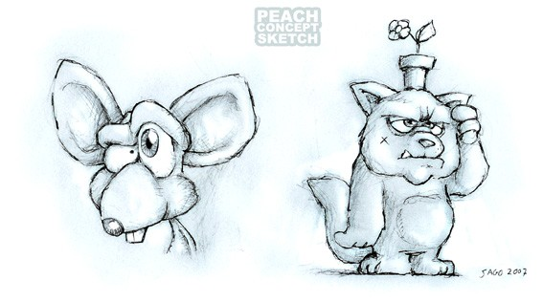
The Fine Art of Sharing
The Creative Commons Art of Big Buck Bunny
Sacha Goedegebure (Netherlands)
Untitled, 2007.
This pencil sketch shows the head of a bucktoothed big-eared rat and a dimwitted cat with a flowerpot on his head. The cat is thinking intently. There is a mysterious X on his cheek.
Notes:
<div id="x-imprint.org.microformats.vevent-2013-01-10T21:30:18">
<div class="vevent" title="Event">
<h2 class="summary">The Fine Art of Sharing</h2>
<span class="description">© James Holgate</span>
<span class="dtstart" title="2013-01-10T21:30:18">2013</span>
</div>
<hr />
</div>
<div style="text-align: center;"><b>Artwork © 2008, <a href="http://www.blender.org/" target="_blank">Blender Foundation</a> / <a href="http://www.bigbuckbunny.org/" target="_blank">www.bigbuckbunny.org</a></b></div>
<div style="text-align: center;"><a href="http://creativecommons.org/licenses/by/3.0/" target="_blank">Creative Commons Attribution 3.0 license</a>
</div>
<div style="text-align: center;">Text © 2012 James Holgate</div>
<div style="text-align: center;"><a href="http://creativecommons.org/licenses/by/2.5/ca/" target="_blank">Creative Commons Attribution 2.5 (Canada) license</a></div>

Slide 2
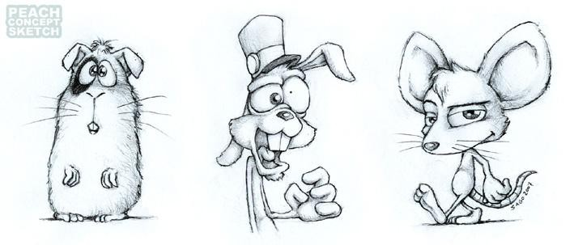
Sacha Goedegebure (Netherlands)
Rodent Concept Art, 2007
This pencil sketch shows three villainous rodents. The rodent on the left is standing timidly as if he is awaiting a terrible fate. The middle rodent is talking. He is wearing a hat. His head is very asymmetrical. One eye pupil is huge and the other is tiny. One ear goes up, and the other goes down. The third rodent walks confidently and eyes the viewer suspiciously. He’s clearly the ringleader.
Notes:
Blender is an open source toolkit for rendering and animating drawings. The Blender team produced several movies to test animation tools and work flow.
But when you put a lot of creative people together, magic happens.
This is a story about a big bullied rabbit and three mean rodents. The early sketches communicate a lot about the personalities of the characters. Before animation begins, the drawings are simplified. Filmmakers need to decide what is essential for the story.

Slide 3
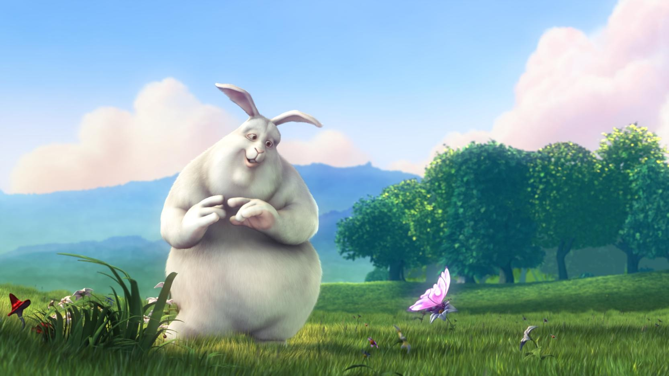
Blender Team (Netherlands)
Bunny and Butterfly, 2008
It’s early morning on a beautiful spring day in a field. Big Buck Bunny looks wistfully at a butterfly sipping nectar from a dew-laden flower.
Notes:
This is a still frame from the finished movie. Notice how the animators have introduced texture, light, shadow, and atmospheric effects in the final animation. The colours are warm and soft, suggesting an idyllic country paradise. The peaceful tone will soon be shattered...

