Slide 1
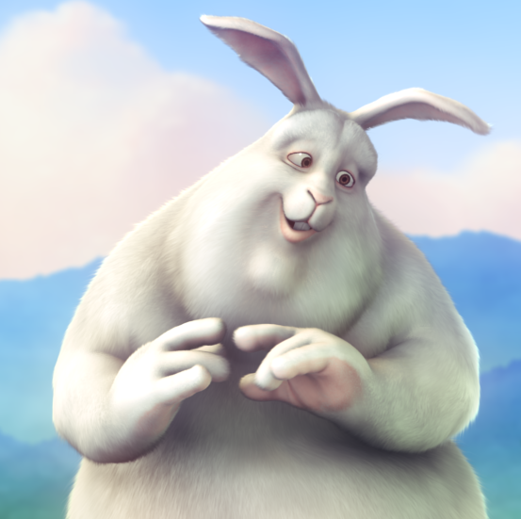
Cover
THE TALE OF
BIG BUCK BUNNY
BASED ON A SCREENPLAY BY
BLENDER PEACH PROJECT
Notes:
<div style="text-align: center;"><b>Artwork © 2008, <a href="http://www.blender.org/" target="_blank">Blender Foundation</a> / <a href="http://www.bigbuckbunny.org/" target="_blank">www.bigbuckbunny.org</a></b></div>
<div style="text-align: center;">Text © 2012 James Holgate</div>
<div style="text-align: center;"><a href="http://creativecommons.org/licenses/by/2.5/ca/" target="_blank">Creative Commons Attribution 2.5 (Canada) license</a></div>

Slide 2
In a hole in the ground...
It’s early morning on a beautiful spring day in a field. Big Buck Bunny looks wistfully at a butterfly sipping nectar from a dew-laden flower.
Notes:
In a hole in the ground there lived a rabbit. Not a dainty, timid rabbit with a wiggly nose that would just as soon turn and hide as to bid you hello, but a big rabbit, a gregarious rabbit, a rabbit to be contended with.
Now, Buck was big, but he was a gentle soul. He loved nature and he loved his life in the green acres. Sometimes bullies confuse gentleness with weakness. But don’t be confused. Big Buck was very strong.

