Slide 1
MART AI
IBM PBL PROJECT
Presented By:
Student Name_ : JAHNAWI MANI
College Name & Department : CSE-IoT

Slide 2
OUTLINE
Problem Statement
Technology used
Wow factor
End users
Result
Conclusion
Future scope
IBM Certifications

Slide 3
Problem Statement
Title: The Challenges of Modern Shopping
Online shopping can be overwhelming with vast product selections.
Finding the right product quickly and efficiently is often difficult.
Personalized recommendations are often lacking or inaccurate.
Customers need instant support and guidance throughout the shopping journey.

Slide 4
Technology used
WATSONX AI SERVICE
IBM CLOUD TECHNOLOGY

Slide 5
IBM cloud services used
1. IBM Watson Assistant: This is a core service for building conversational AI experiences. You can use Watson Assistant to:
Design conversational flows: Create the dialog and logic for your chatbot's interactions.
Train the NLP model: Teach your chatbot to understand user intents and entities.
Integrate with other channels: Deploy your chatbot on your website, mobile app, or messaging platforms.
2. IBM Watson Discovery: If your chatbot needs to search and retrieve information from a large product catalog or knowledge base, Watson Discovery can help. It can:
Ingest and index data: Load your product information into a searchable index.
Use natural language queries: Allow users to search using everyday language.
Extract relevant information: Identify key details like product features, prices, and reviews.
3. IBM Cloud Object Storage: You might need to store images, videos, or other product-related media. Cloud Object Storage provides:
Scalable storage: Store and manage large amounts of data.
Cost-effective solutions: Choose from various storage classes based on your needs.
Secure access: Protect your data with access controls and encryption.
4. IBM Visual Recognition: If you're implementing visual search (as mentioned in your "Wow Factor" slide), Visual Recognition can be very useful. It allows you to:
Analyse images: Identify objects, scenes, and concepts within images.
Train custom models: Tailor image recognition to your specific product categories.
5. IBM Machine Learning: For advanced personalization and recommendation features, you can leverage IBM Machine Learning services to:
Build and train models: Create custom machine learning models for tasks like product recommendations or predicting user preferences.
Deploy and manage models: Easily deploy and scale your models in the cloud.

Slide 6
Wow factors
What Makes MART AI Stand Out?
Effortless Style Discovery with Visual Search: Imagine snapping a photo of an outfit you love and instantly finding similar items in your chatbot! Our AI-powered visual search lets you discover fashion inspiration from anywhere and effortlessly find the clothes you desire. No more struggling to describe what you're looking for - just show it!
Your Personal Shopping Assistant, Always One Step Ahead: [Chatbot Name] learns your unique style preferences as you browse and interact. It proactively suggests items you might love, even before you know you want them! Discover new brands, explore curated collections, and find the perfect pieces tailored to your taste, all without lifting a finger.
Shop the World, Compare Prices, Find the Best Deals: Say goodbye to endless browsing across different websites! [Chatbot Name] seamlessly integrates with multiple retailers, allowing you to compare prices, find exclusive deals, and shop from various stores all within one convenient chat. Save time and money with our smart shopping companion.
Key takeaways:
Visual Search: Emphasize the ease and convenience of finding products through images.
Proactive Personalization: Highlight the chatbot's ability to learn and anticipate user needs.
Seamless Integration and Price Comparison: Showcase the benefit of shopping across multiple retailers within the chatbot.
Remember to
Adapt the language to your chatbot's personality and target audience.

Slide 7
End users
Title: Designed for Every Shopper
Busy professionals seeking quick and efficient shopping.
Tech-savvy individuals looking for personalized experiences.
Customers who value convenience and instant support.
[Specify your target audience, e.g., "Fashion enthusiasts, Home decor shoppers."]

Slide 8
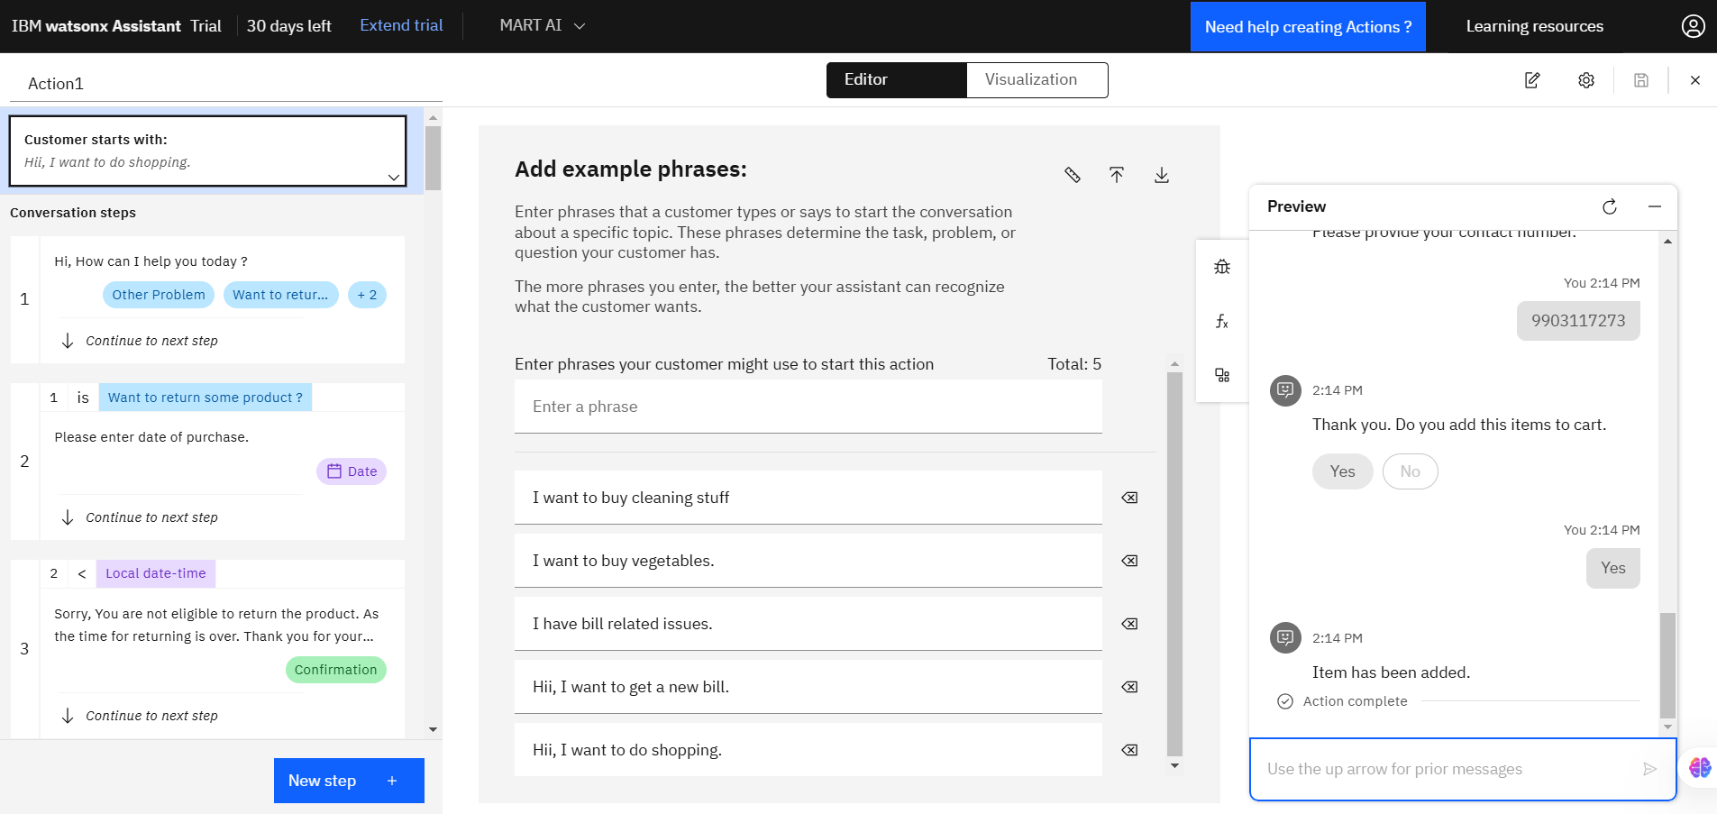
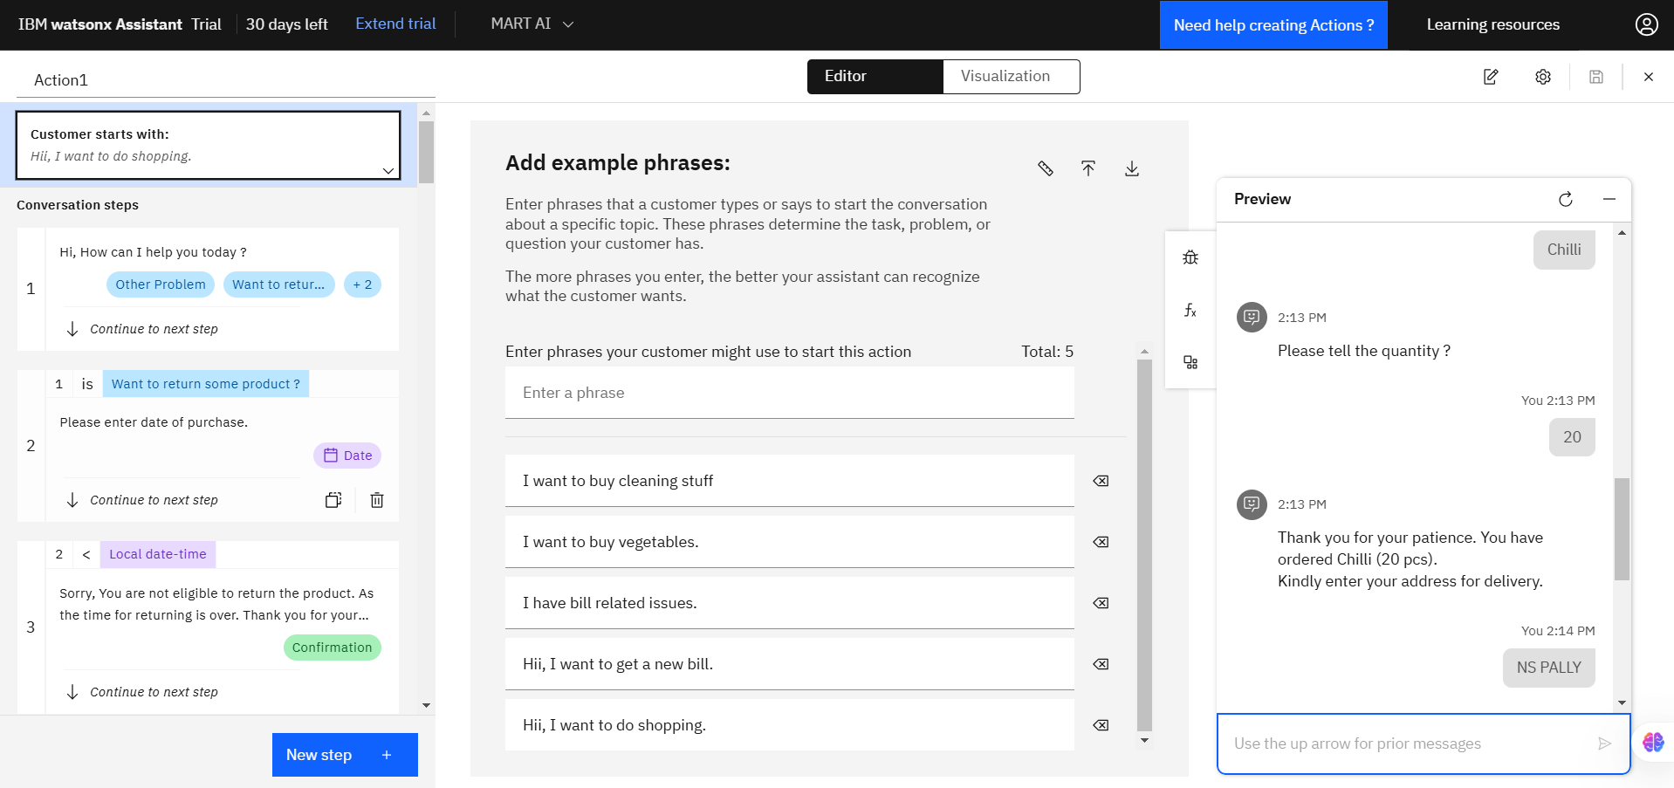
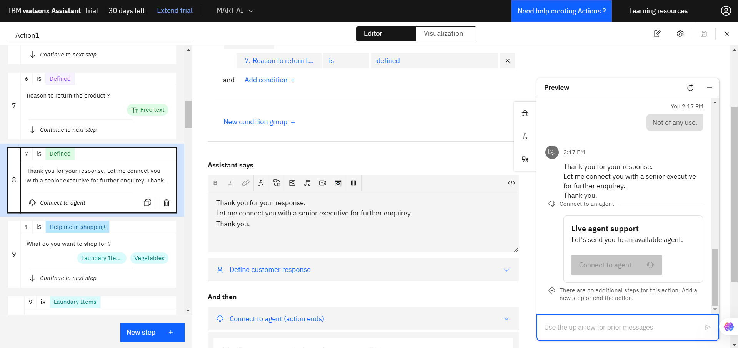
Results

Slide 9
Conclusion
Title: The Future of Shopping is Here
MART AI offers a personalized and efficient shopping experience.
It leverages AI to solve common shopping challenges.
It empowers users to make informed purchasing decisions.

Slide 10
GitHub Link
GitHub Link :- https://github.com/jimi1111/mart_ai

Slide 11
Future scope
Title: Looking Ahead
Stepping into the Future with Augmented Reality: We're not stopping at visual search! We envision a future where [Chatbot Name] integrates with augmented reality (AR) technology, allowing you to virtually try on clothes, visualize furniture in your home, or even "test drive" makeup products before you buy. Get ready for a truly immersive and personalized shopping experience.
Expanding Horizons: More Products, More Platforms: [Chatbot Name] is just getting started! We plan to expand our product offerings to include a wider range of categories, from electronics and home goods to groceries and travel. We'll also be integrating with new platforms and channels, making it even easier to access [Chatbot Name] wherever you prefer to shop.
The Power of Personalization, Amplified: We're committed to continuously improving the personalization capabilities of [Chatbot Name]. By leveraging advanced machine learning techniques, we'll be able to provide even more accurate and relevant recommendations, anticipate your needs with greater precision, and ultimately make your shopping journey more enjoyable and efficient.
Collaborating for a Better Future: We believe in the power of collaboration. We're actively seeking partnerships with retailers, brands, and technology providers to enhance [Chatbot Name]'s capabilities and create a truly connected and seamless shopping ecosystem. Together, we can shape the future of online shopping.
Key takeaways:
AR Integration: Highlight the potential for a more immersive shopping experience.
Expansion: Emphasize the chatbot's growth potential and commitment to wider accessibility.
Advanced Personalization: Reinforce the focus on continuous improvement and user-centricity.
Collaboration: Showcase the openness to partnerships and building a strong ecosystem.
Remember to:
Use visuals to illustrate future possibilities (e.g., mock ups of AR features).
Keep the tone optimistic and forward-looking.
Align the future scope with your overall vision for the chatbot.

Slide 12
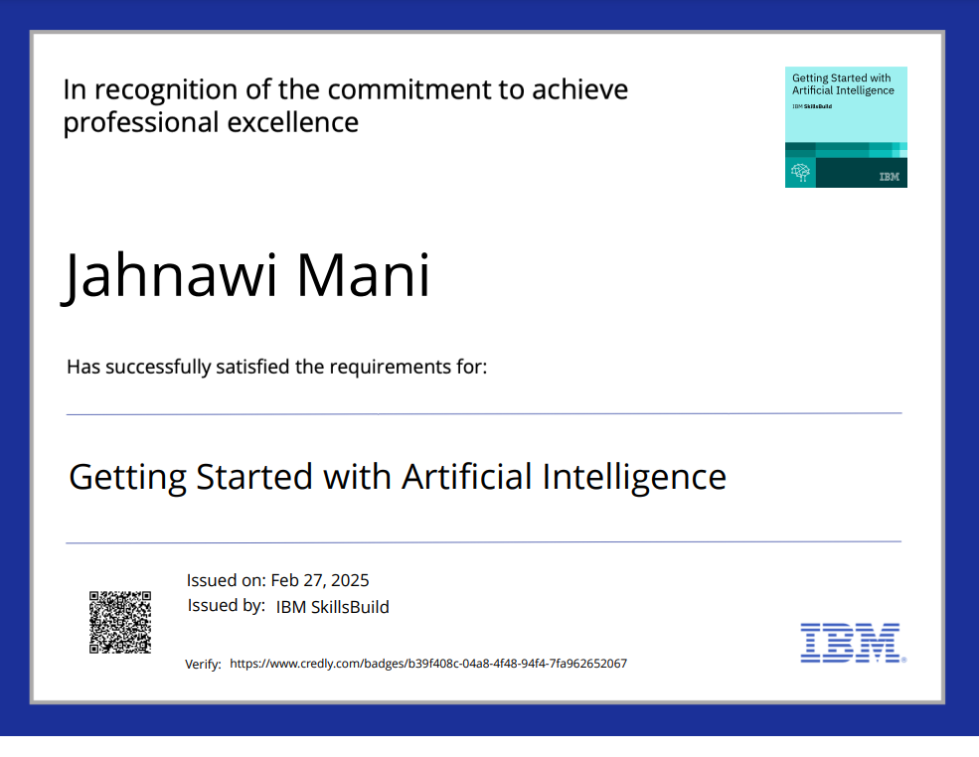
IBM Certifications

Slide 13
THANK YOU

