Slide 1
MAIN FINDINGS
Selectivity Options for
Age-Structured Stock Assessments
A comparative framework using RTMB
James Ianelli · NOAA / NMFS Alaska Fisheries Science Center
Logistic · Double Logistic · Penalized Spline · 2D AR1 Time-Varying

Slide 2
MOTIVATION
Why selectivity choice matters
4
The most influential — yet least observable — component
selectivity families compared
Selectivity governs how fishing mortality and survey catchability vary with age.
Its assumed shape directly affects:
Spawning biomass and recruitment estimates
Fishing mortality and reference points
Management advice and quota recommendations
Misspecification propagates into biased advice (Punt 2013; Thompson 1994).
1
unified RTMB framework
∞
trade-offs between
flexibility and estimability
Selectivity Options for Age-Structured Stock Assessments · J. Ianelli
2 / 10

Slide 3
FRAMEWORK
Four selectivity families on one gradient
1
Logistic
2
Double Logistic
3
Penalized Spline
4
2D AR1 Time-Varying
Two parameters, monotone ascending. Strong structural prior — robust but rigid.
Three parameters, dome-shaped. Captures avoidance at older ages; confounds with M.
Flexible B-spline with smoothness penalty. Semi-parametric middle ground.
Separable autoregressive surface over year × age. Smooth temporal evolution.
Low complexity
Low–Medium
Medium–High
High complexity
◄ Structural assumptions strong
Latent-process flexibility high ►
Selectivity Options for Age-Structured Stock Assessments · J. Ianelli
3 / 10

Slide 4
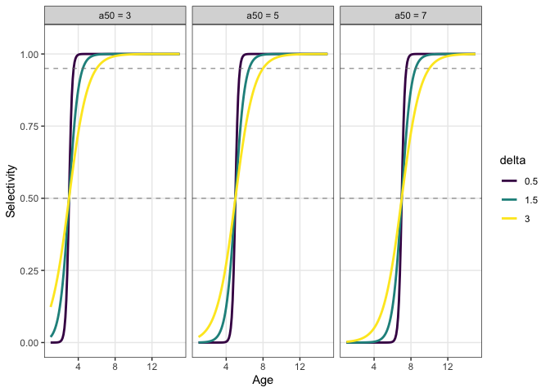
FAMILY 1
Standard logistic: parsimonious baseline
Parameters
a₅₀ — age at 50% selectivity
δ — slope width (50% → 95%)
Strengths
Stable when composition data are limited
Interpretable, easy to communicate
Defensible default baseline
Limitation
Strict monotonicity induces structural bias when older fish are less vulnerable; variation gets pushed into other parameters.
Selectivity Options for Age-Structured Stock Assessments · J. Ianelli
4 / 10

Slide 5
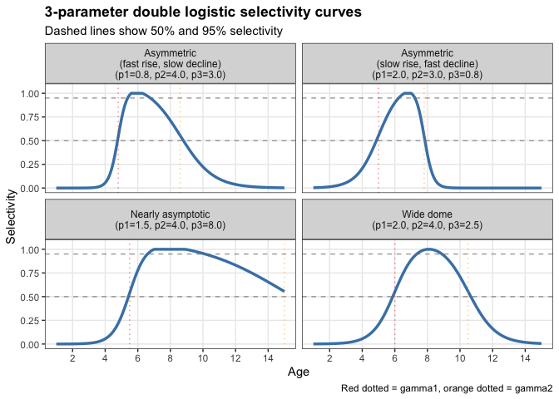
FAMILY 2
Double logistic: dome-shape with three parameters
Three parameters
p₁ ascending slope
p₂ horizontal shift
p₃ descending slope
Why use it
Captures gear avoidance, ontogenetic habitat shifts, or differential availability while staying low-dimensional.
⚠ Confounding risk
Dome shape can be confounded with natural mortality and cohort effects when older ages are weakly informed by composition data (Thompson 1994).
Selectivity Options for Age-Structured Stock Assessments · J. Ianelli
5 / 10

Slide 6
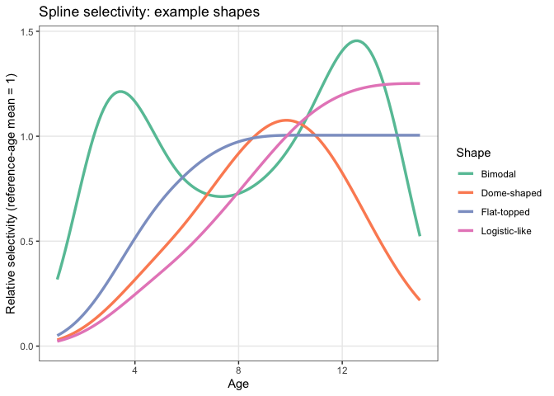
FAMILY 3
Penalized spline: flexible with explicit smoothness
Construction
Cubic B-spline basis on age, mean-normalized over a reference age range to keep the objective smooth.
Smoothness control
λ × Σ (Δ²β)² penalty on second differences trades fit against roughness.
Captures arbitrary shapes
Logistic-like
Dome-shaped
Bimodal
Flat-topped
Selectivity Options for Age-Structured Stock Assessments · J. Ianelli
6 / 10

Slide 7
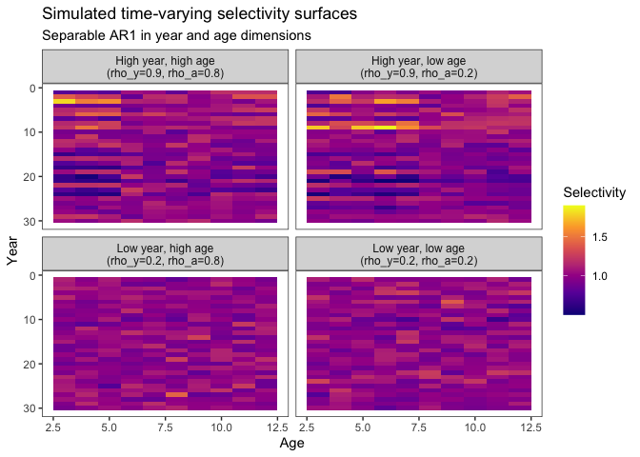
FAMILY 4
2D AR1: time-varying selectivity surface
Three hyperparameters
ρy year-to-year correlation
ρa age-to-age correlation
σ innovation scale
Separable Kronecker structure
Q = Qy ⊗ Qa evaluated by RTMB's dseparable + dautoreg — O(B·A) rather than O((B·A)³).
Why it's attractive
Coherent year × age evolution
Few hyperparameters per fishery
Layers on top of block structure
Selectivity Options for Age-Structured Stock Assessments · J. Ianelli
7 / 10

Slide 8
KEY INSIGHT
Selectivity is a latent process,
not a deterministic curve
Choosing a functional form is equivalent to choosing a prior precision structure on an unobserved year × age surface.
1
Match complexity to data
2
Regularization is essential
3
Use multiple diagnostics
Effective selectivity flexibility should track information content in composition data.
Penalties, priors, and precision structures are not optional — they prevent confounding and overfitting.
AIC, DIC, cross-validation, and posterior-predictive checks under explicit prior structure.
Selectivity Options for Age-Structured Stock Assessments · J. Ianelli
8 / 10

Slide 9
RECOMMENDATION
A defensible selectivity workflow
1
Start parsimonious
Logistic or double logistic baseline. Diagnose composition residuals and retrospective patterns.
2
Add flexibility only as needed
Move to splines or 2D AR1 when diagnostics show systematic lack of fit and the data support richer structure.
3
Compare with multiple tools
Information criteria, posterior-predictive checks, and sensitivity of management quantities — not a single AIC.
4
Report the regularization
Inferred selectivity dynamics are conditional on prior and penalty assumptions. State them explicitly.
Selectivity Options for Age-Structured Stock Assessments · J. Ianelli
9 / 10

Slide 10
THE BOTTOM LINE
No curve family is universally best
The right question is whether the assumed latent structure is commensurate
with the available information and management objectives.
Trade-off in one sentence
What to take away
Low-dimensional forms are robust under sparse data but risk structural bias.
Flexible latent surfaces reduce bias risk but require explicit regularization to prevent confounding.
Treat selectivity as a latent process, not a deterministic curve
Match flexibility to data information content
Make priors and penalties part of the reported result
Compare candidates with multiple diagnostics, not one statistic
Selectivity Options for Age-Structured Stock Assessments · J. Ianelli
10 / 10

