Slide 1
Prototype Cities Update

Slide 2
Population Synthesis Pipeline
Since we are doing population synthesis for a virtual city, it’s desirable that the synthetic population will characterize people from cities in the same cluster
Step 1: We will collect microdata samples from several archetype cities in one cluster
Step 2: do structure learning and parameter learning based on those samples
Step 3:simulate synthetic population from the Bayesian networks we learned, there will be a pool of individuals and another pool of households
Step 4: use the Algorithm 1 from sample-free papers

Slide 3
Sample-Free Population Synthesis
Related Paper:
F. Gargiulo, S. Ternes, S. Huet, and G. Deffuant. An iterative approach for generating statistically realistic populations of households. PLoS ONE, 5, 2010.
P. Barthelemy, J.and Toint. Synthetic population gen- eration without a sample. Transportation Science, 47:266–279, 2013.
Step 1: generate individuals
Step 2: generate households
Step 3: match individuals with households

Slide 4
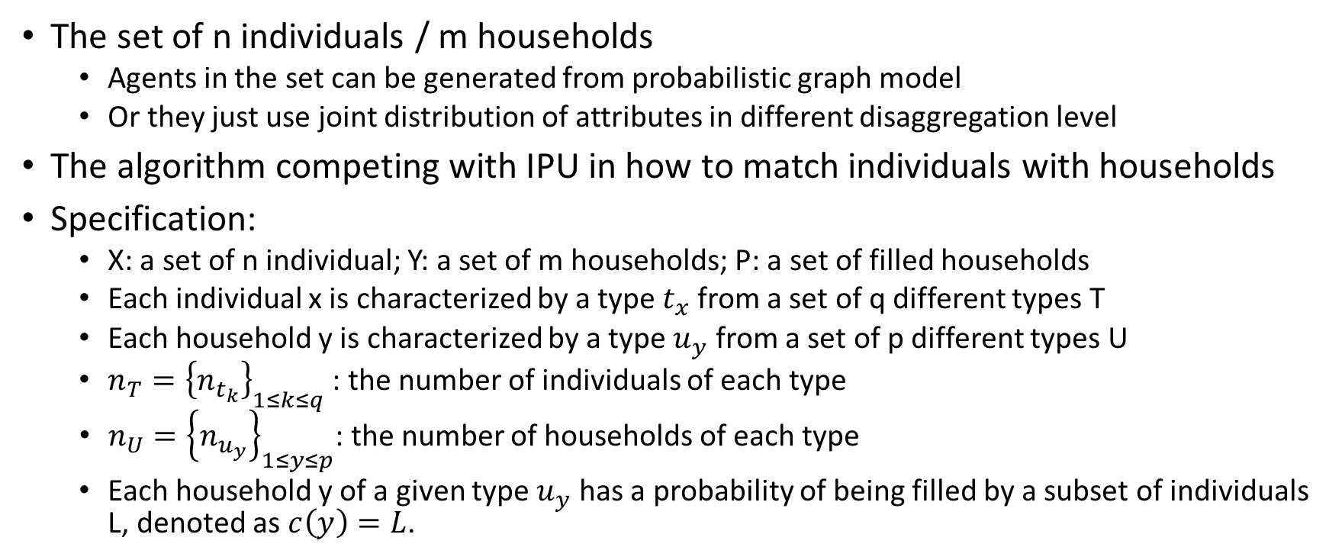
Sample-Free Population Synthesis
The set of n individuals / m households
Agents in the set can be generated from probabilistic graph model
Or they just use joint distribution of attributes in different disaggregation level
The algorithm competing with IPU in how to match individuals with households
Specification:
X: a set of n individual; Y: a set of m households; P: a set of filled households
Each individual x is characterized by a type $t_{x}$ from a set of q different types T
Each household y is characterized by a type $u_{y}$ from a set of p different types U
$n_{T}={\left\{n_{t_{k}}\right\}}_{1≤k≤q}$ : the number of individuals of each type
$n_{U}={\left\{n_{u_{y}}\right\}}_{1≤y≤p}$: the number of households of each type
Each household y of a given type $u_{y}$ has a probability of being filled by a subset of individuals L, denoted as $c\left(y\right)=L$.

Slide 5
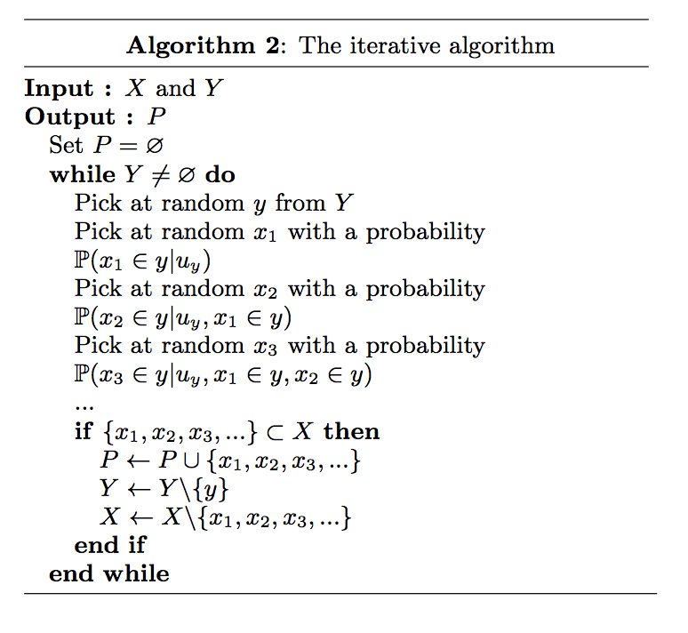
Sample-Free Population Synthesis
Conditional and marginal distributions we need:

Slide 6
Data
We are doing experiments on Beijing
Microdata:
Chinese Household Income Program (CHIP) 2013
For China: 19,887 individuals and 6,674 households
IPUM data, China 2000
For Beijing: 131,576 individuals and 49,135 households
For China: 11,804,344 individuals and 3,600,005 households ()
Problem
One source is outdated but with large sample size
The other is new but with less data

Slide 7
Bayesian Network
Based on CHIP2013 data, build a toy
According to Sun2015Bayesian, BN method outperform MCMC, IPF when sample size is smaller than 40%
Attributes
Combinations: 5*6*2*7*5*2*6*6 = 151200
Individuals in SimMobility have more attributes and more categories
Level | Variable | Description | Categories
household | Hh_size | number of people in household (5) | 1.one, 2. two, 3.three, 4.four, 5. >=5
Individual | rel | relationship with the head of the hh (6) | 1.self, 2.spouse, 3.child, 4.grandchild, 5.parent, 6. others
 | sex | gender (2) | 1. male, 2.female
 | age | age group (7) | 1.[0,9], 2.[10,19], 3.[20,29], 4.[30,39], 5.[40,49], 6.[50,59], 7.>=60
 | emp_status | employment status (5) | 1.working 2.student 3.retired 4.unemployed 5.others
 | marriage | married or not (2) | 1.not married, 2.married
 | edu | education level (6) | 1.Never schooled, 2.Elementary school, 3.Middle school, 4.Junior school, 5. University or higher, 6. Other
 | inc | income range (6) | 1. [0,5000), 2.[5000,10000), 3.[10000, 15000), 4.[15000, 20000), 5.[20000, 30000), 6.>=30000

Slide 8
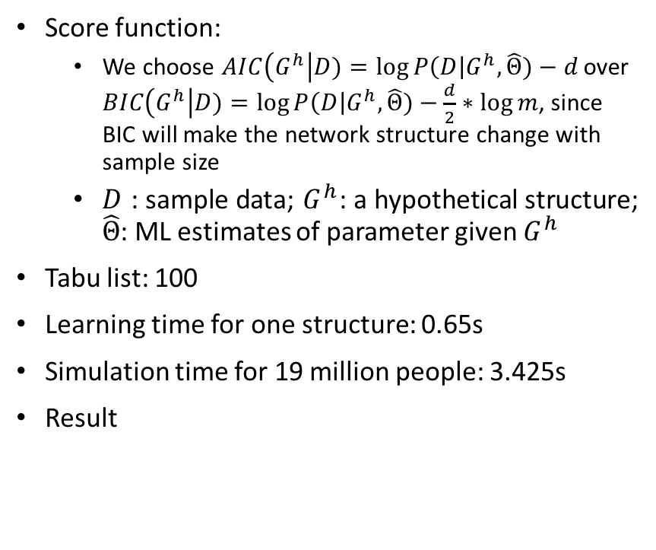
Bayesian Network
 |  | 1. Not married |  | 2. married
 |  | 1. male | 2. female | 1. male | 2. female
Relationship with the head of household | 1.Self | 0.03783 | 0.08639 | 0.65337 | 0.28705
 | 2. spous | 0.00284 | 0.00606 | 0.27843 | 0.64034
 | 3. Child | 0.86034 | 0.76356 | 0.05426 | 0.05768
 | 4. Grandchild | 0.07472 | 0.06244 | 0.00089 | 0.00118
 | 5. Parent | 0.01765 | 0.07366 | 0.01275 | 0.01331
 | 6. Others | 0.00662 | 0.00788 | 0.00030 | 0.00044
Score function:
We choose $AIC\left(G^{h}\right|D)=\log{P\left(D\right|G^{h},\hat{Θ})}−d$ over $BIC\left(G^{h}\right|D)=\log{P\left(D\right|G^{h},\hat{Θ})}−\frac{d}{2}∗\log{m}$, since BIC will make the network structure change with sample size
$D$: sample data; $G^{h}$: a hypothetical structure; $\hat{Θ}$: ML estimates of parameter given $G^{h}$
Tabu list: 100
Learning time for one structure: 0.65s
Simulation time for 19 million people: 3.425s
Result
1.male | 2.female
0.4964 | 0.5036
1.married | 2.Not married
0.3239 | 0.6761

Slide 9
Bayesian Network
P(hh_size|marriage, sex, rel)
P(age|marriage, sex, rel)
P(Rel |marriage, sex)

Slide 10
To do
Modification of Bayesian Network
Independence test
Add domain knowledge in the form of constraints to network structure
Eg. an edge with certain direction must exists in the network
Start with 20-30 different initial network structures and run tabu search in parallel
Implement the algorithm matching individuals with households
Incorporate land use in zonal system development

