Slide 1
MITei Internal Meeting
07/27/2017

Slide 2
Personnel Update

Slide 3
Team
Eytan: Simmobility, scenario discovery
Jimi: typologies, scenario discovery, prototype city (network)
Jin: prototype city modeling (population synthesis) [leaving Setp 1]
Sean: dashboard update, thesis [leaving mid-August]
Yafei: typologies, and then prototype city
TRB draft being worked on by Yafei/Jimi/Jin – to be ready for review by tomorrow.

Slide 4
Agenda
Prototype city update/proposal framework
Simmobility update
Rebalancing
Scenario discovery

Slide 5
Prototype Cities Update

Slide 6
Framework
Road Network
Transfer from OSM format to SimMobility Input
Handling turning points
Put public transport network into SimMobility using data from GTFS
Population
Data
Population Synthesis algorithm
Synthesize population in city level
Clustering population
Spatial allocation
Demand
Trip generation
Trip distribution
Mode choice
Route assignment

Slide 7
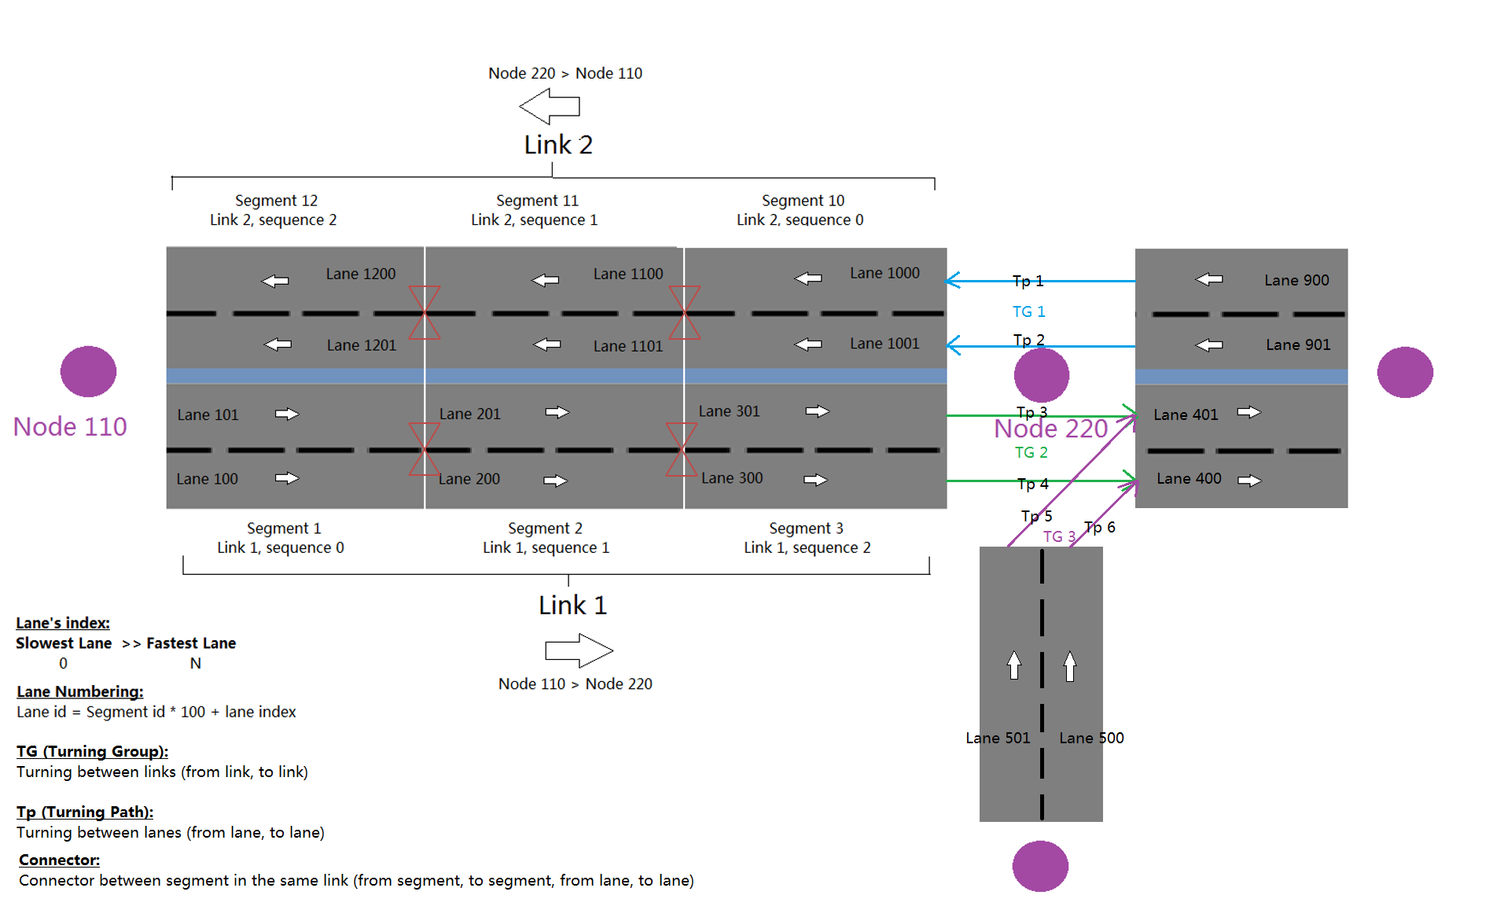
SimMobility Network

Slide 8
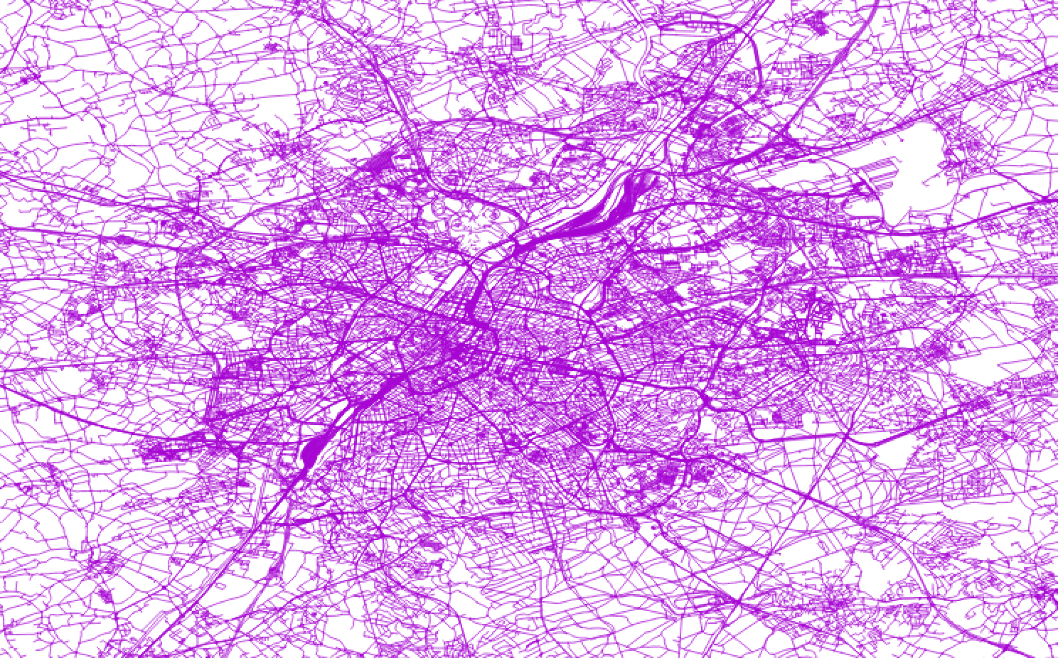
Network transformation
Input: OSM network
Manage and organize attributes of nodes and links
Use “ShortenPolyline102” toolbox in ArcGIS to shorten the links
Generate turnings from SUMO
Road network in Brussels

Slide 9
Population Synthesis
PUMS Housing Unit Record
SerialNo. | Household Type | Person | Incom | Others
2599 | Family: married | 2 | 80,500 | ...
2797 | Family: married | 3 | 10,000 | ...
13525 | Nonfamily: female living alone | 1 | 59,800 | ...
4325 | Nonfamily: male living alone | 1 | 45,000 | ...
4562 | Family: female householder | 2 | 15,000 | ...
PUMS Person Record
Data
Survey data
PUMS in all US cities
IPUMS-International
Aggregate census data (Age, Sex, Income, Education)
US cities
Beijing
SerialNo. | Sex | Edu | Age | Inc | Other attributes
2366 | Female | High School | 32 | 54,200 | ...
5237 | Female | Bachelor | 27 | 96,000 | ...
12343 | Male | Primary School | 10 | 0 | ...
3426 | Female | Junior | 15 | 0 | ...
6826 | Male | High School | 25 | 47,800 | ...
 | Female | male | Total
District 1 | 31816 | 42167 | 73983
District 2 | 19190 | 25959 | 45149
District 3 | 12626 | 16208 | 28834
District 4 | 43795 | 56794 | 100589
District 5 | 23615 | 31088 | 54703
District 6 | 20180 | 25706 | 45886
Total | 151222 | 197922 | 349144
Table 1
 | Under 20 | 20-35 | 35-55 | Over 55 | Total
Male | ? | ? | ? | ? | 444,730
Female | ? | ? | ? | ? | 523,064
Total | 99,125 | 132,216 | 453,141 | 283,312 | 967,794

Slide 10
Population Synthesis (IPF)
Input
Disaggregate sample data
Census data for each zone
Iterative Proportional Fitting (IPF)
Step 1: Iteratively fitting the multi-way table expanded by demographics in census, Such that:
Marginal distribution of demographics are satisfied
Correlation structure in sample is preserved
Step 2: sampling population according to the probabilities we get from last step

Slide 11
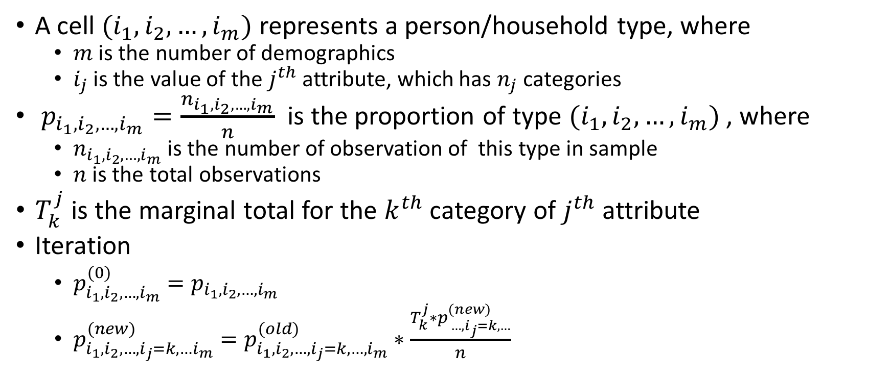
Population Synthesis (IPF) Cont.
A cell $(i_{1},i_{2},…,i_{m})$ represents a person/household type, where
$m$ is the number of demographics
$i_{j}$ is the value of the $j^{th}$ attribute, which has $n_{j}$ categories
$p_{i_{1},i_{2},…,i_{m}}=\frac{n_{i_{1},i_{2},…,i_{m}}}{n}$ is the proportion of type $(i_{1},i_{2},…,i_{m})$ , where
$n_{i_{1},i_{2},…,i_{m}}$ is the number of observation of this type in sample
$n$ is the total observations
$T_{k}^{j}$ is the marginal total for the $k^{th}$ category of $j^{th}$ attribute
Iteration
$p_{i_{1},i_{2},…,i_{m}}^{(0)}=p_{i_{1},i_{2},…,i_{m}}$
$p_{i_{1},i_{2},…,i_{j}=k,…i_{m}}^{(new)}=p_{i_{1},i_{2},…,i_{j}=k,…,i_{m}}^{(old)}∗\frac{T_{k}^{j}∗p_{ …,i_{j}=k,…}^{(new)}}{n}$
 | i1 = 1 | i1 = 2 | i1 = 3 | i1 = 4 | Total
i2 = 1 |  |  |  |  | 1290
i2 = 2 |  |  |  |  | 2181
i2 = 3 |  |  |  |  | 1126
Total | 694 | 2032 | 769 | 1102 | 4597
An illustration of table of 2 attributes

Slide 12
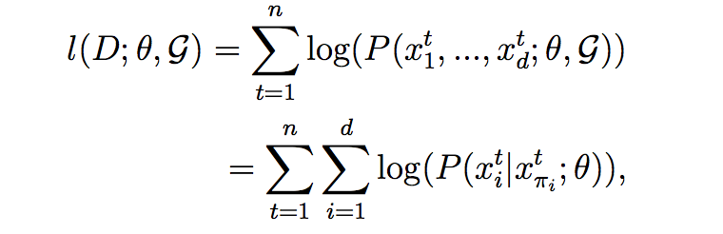
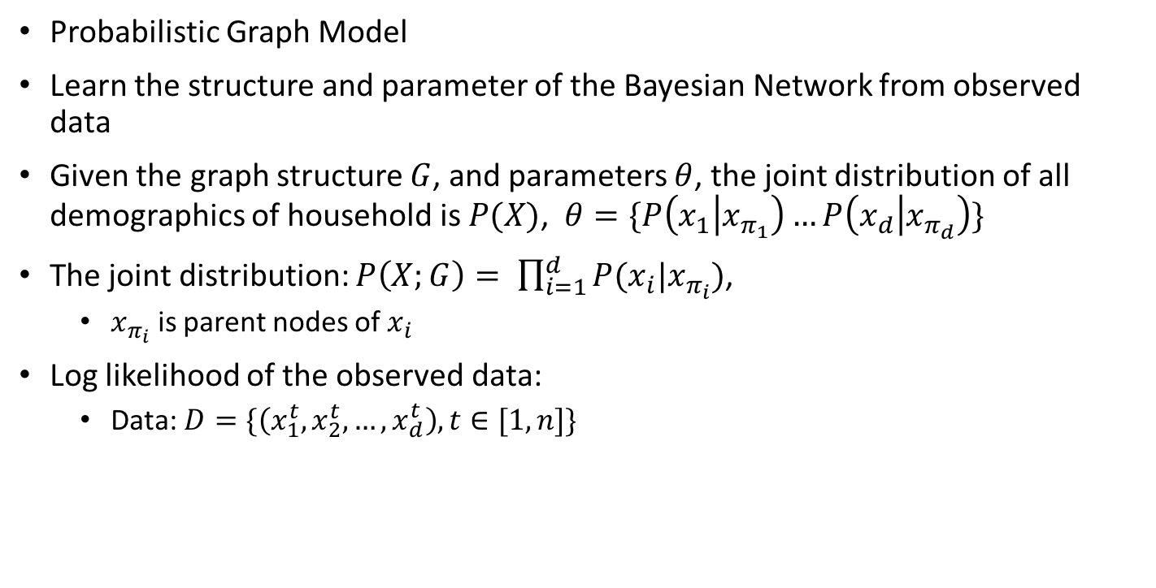
Population Synthesis (Bayesian Network)
Probabilistic Graph Model
Learn the structure and parameter of the Bayesian Network from observed data
Given the graph structure $G$, and parameters $θ$, the joint distribution of all demographics of household is $P(X)$, $θ=\{P\left(x_{1} | x_{π_{1}}\right)…P\left(x_{d} | x_{π_{d}}\right)\}$
The joint distribution: $P\left(X;G\right)= \prod_{i=1}^{d}{P(x_{i}|x_{π_{i}})}$,
$x_{π_{i}}$ is parent nodes of $x_{i}$
Log likelihood of the observed data:
Data: $D=\{\left(x_{1}^{t},x_{2}^{t},…,x_{d}^{t}\right), t∈[1,n]\}$
Sex
Age
Edu
Emp
Inc
Car

Slide 13
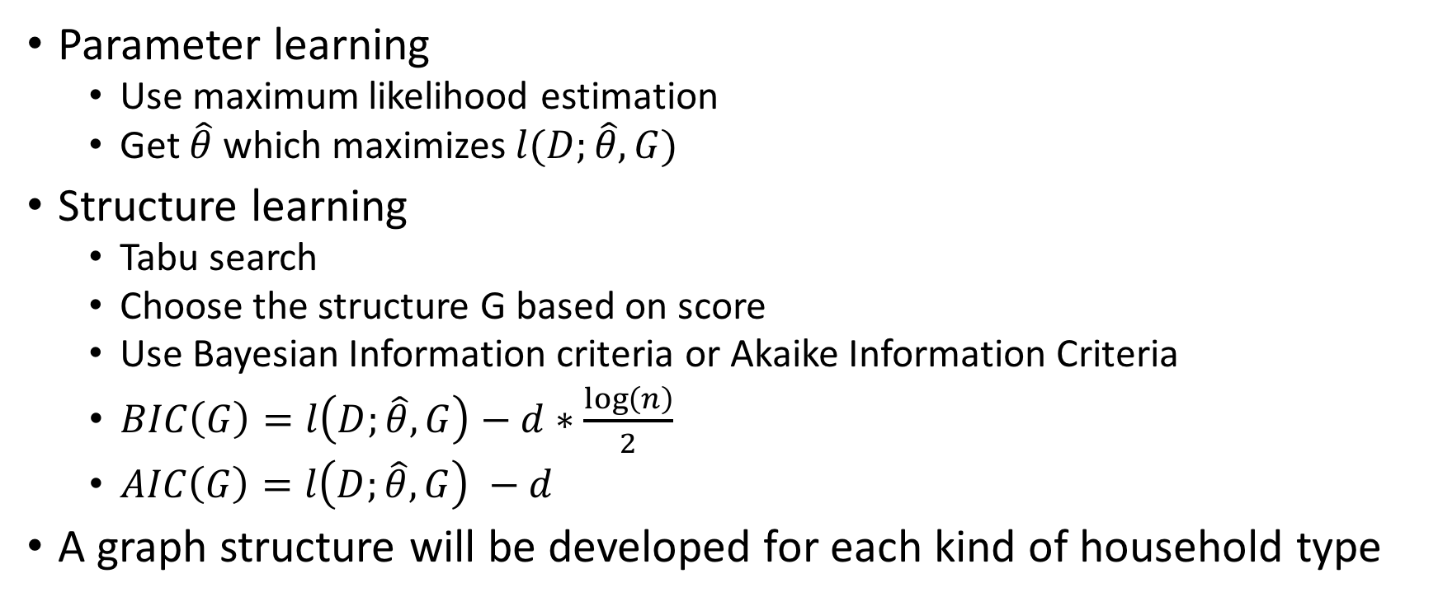
Population Synthesis (Bayesian Network)
Parameter learning
Use maximum likelihood estimation
Get $\hat{θ}$ which maximizes $l(D;\hat{θ},G)$
Structure learning
Tabu search
Choose the structure G based on score
Use Bayesian Information criteria or Akaike Information Criteria
$BIC\left(G\right)=l\left(D;\hat{θ},G\right)−d∗\frac{\log\left(n\right)}{2}$
$AIC\left(G\right)=l\left(D;\hat{θ},G\right) −d$
A graph structure will be developed for each kind of household type
Sex
Age
Edu
Emp
Inc
Car

Slide 14
Clustering Population
The whole population for a city will be sampled from Bayesian Network
There is link between household and individuals within synthetic population
The hypothesis: similar households will live in the same area in the city
Cluster household based on their attributes
We assume all households in the same cluster will be in the same geographical zone
Still need an algorithm to assign physical location to zones

Slide 15
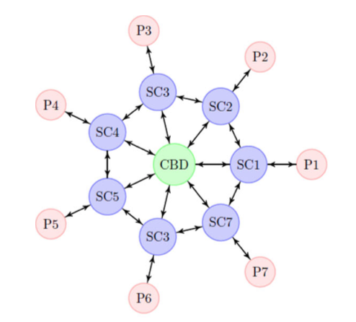
Mapping population to zones – proposal 1
We can generate zones from clusters using Voronoi tessellation
Add constraints like using highways, roads or rivers as boundaries of zones
The zonal system in prototype city will borrow a structure like [Fielbaum2016]
SC: sub-center
P: periphery
Zones of city from Feilbaum2016

Slide 16
Sample-Free Population Synthesis
Related Paper:
F. Gargiulo, S. Ternes, S. Huet, and G. Deffuant. An iterative approach for generating statistically realistic populations of households. PLoS ONE, 5, 2010.
P. Barthelemy, J.and Toint. Synthetic population gen- eration without a sample. Transportation Science, 47:266–279, 2013.
Step 1: generate individuals
Step 2: generate households
Step 3: match individuals with households

Slide 17
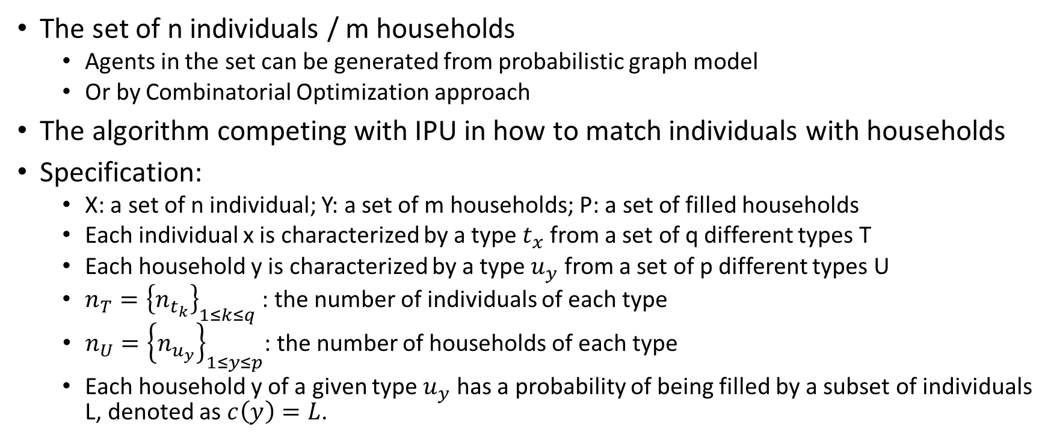
Sample-Free Population Synthesis
The set of n individuals / m households
Agents in the set can be generated from probabilistic graph model
Or by Combinatorial Optimization approach
The algorithm competing with IPU in how to match individuals with households
Specification:
X: a set of n individual; Y: a set of m households; P: a set of filled households
Each individual x is characterized by a type $t_{x}$ from a set of q different types T
Each household y is characterized by a type $u_{y}$ from a set of p different types U
$n_{T}={\left\{n_{t_{k}}\right\}}_{1≤k≤q}$ : the number of individuals of each type
$n_{U}={\left\{n_{u_{y}}\right\}}_{1≤y≤p}$: the number of households of each type
Each household y of a given type $u_{y}$ has a probability of being filled by a subset of individuals L, denoted as $c\left(y\right)=L$.

Slide 18
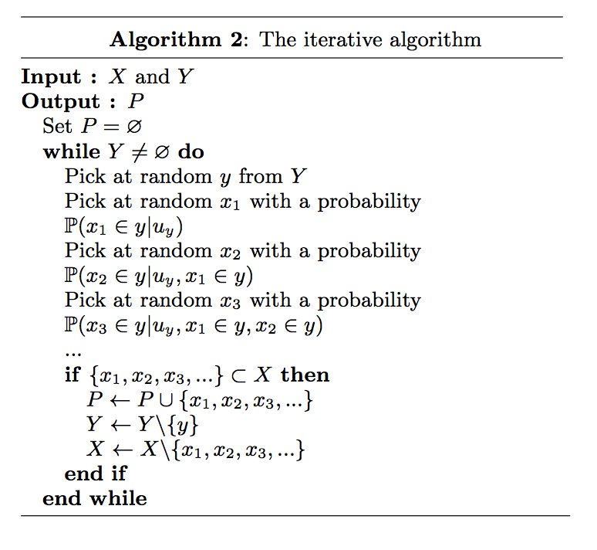
Sample-Free Population Synthesis
Conditional and marginal distributions we need:

