Slide 1
Min Zan a1673755 Yuzhu Wang a1690773
Clinical Pathway Creator
Group 4

Slide 2
Background & Motivation
Daily work needs assistant guide
Care pathways standardize patient’s care by documenting the hospital’s best practice for each medical condition.
Why care pathway?
Save doctors and patients time.
Immediate decision making
Prevent and reduce errors
Documents
Clinicians
Clinical pathway

Slide 3

Problem
Searching returns a large list of results, some of which may not be pathways
The static PDF or document files with no interactivity
Care pathways keep change
Source: https://www.tipsandtricks-hq.com/stress-management-tips-for-online-shop-admins-2820

Slide 4

Goal
Create a care pathway creator
User friendly & easy to understand and use (elder users & less computer experiences)
Can be used in different devices and different size

Slide 5
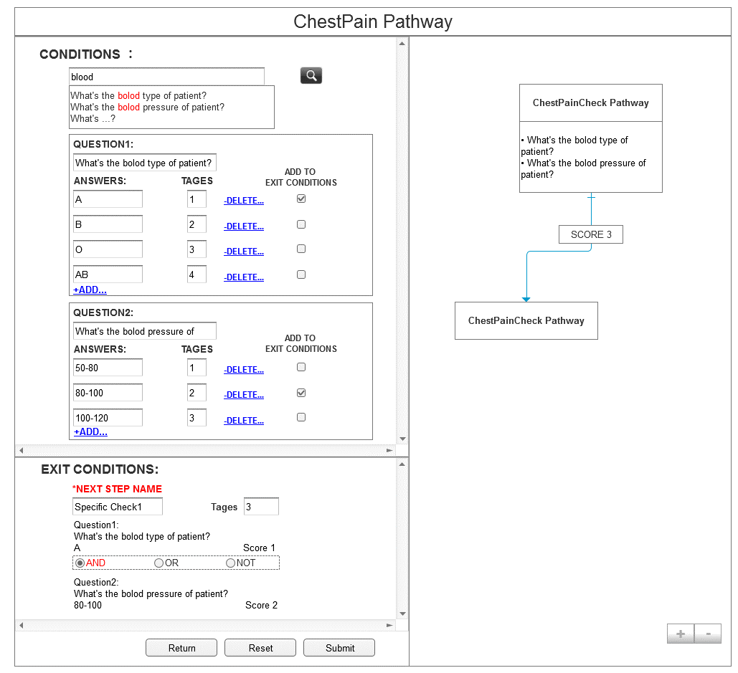
Solution
NPL assistant input
Faster, easier, more accurate input
for elder users
Left Part ( Form logic )
Conditions and Exit conditions
Optimized process to create pathway
Easy and Clear
Right Part ( Graph logic )
PML-like data
Optimized pattern to display pathway
NPL
Logic
Logic
Left
Right

Slide 6
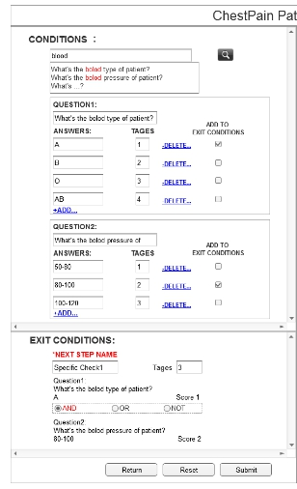
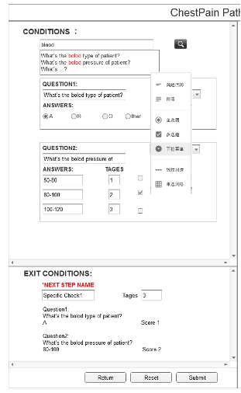
Solution-Form logic
Risk management process(RMP).
Exit conditions depends on scores.
Conditions and Exit conditions
are separated.
Improve version of RMP
Not very suitable for pathway.
Form-logic based process.
Conditions-first.
Fast, Flexible, but may cause logic chaos
Logic-first.
Logic clear, standardized, but slow
Condition-first
Logic-first
1. Illustrate all conditions
1. Build form as real
2. Use selector choose conditons
2. Fulfill the form
3. Generate 1 exit conditons
3. Define the logic

Slide 7


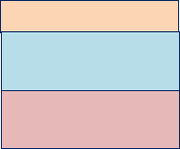












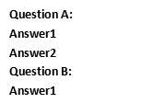

Solution-Graph logic
Library choose
GoJS:
The best one.
JsPlumb:
Good at drawing,
but we only need displaying.
D3JS
highest rating
but suitable for chart rather than work-flow.
Group-based element
A group generally contains 3 parts
Horizontal layout
Element

Slide 8
Plan
 | Min Zan Graph Logic part | Yuzhu Wang Form Logic part
Week 7 | Interface & User requirement freeze. Finish graphic logic part requirements specification. | Interface & User requirement freeze Finish form logic part requirements specification.
Week 8 | Finish software design of graphic logic, including architecture design, components design and class design. | Finish software design of form logic part, including architecture design, components design and class design.
Week 9 | Start with “basic” map structure, try to implement “nice” map structure. | Start with “basic” appearance, try to implement “nice” appearance.
Week 10 | Complete proposal Implementing. | Complete proposal implementing.
Week 11 | Combine the proposal with form logic part. | Combine the proposal with graphic logic part.
Week 12 | Demonstrate pathway editor proposal. | Demonstrate pathway editor proposal.

Slide 9
Thank you Question time

