Slide 1
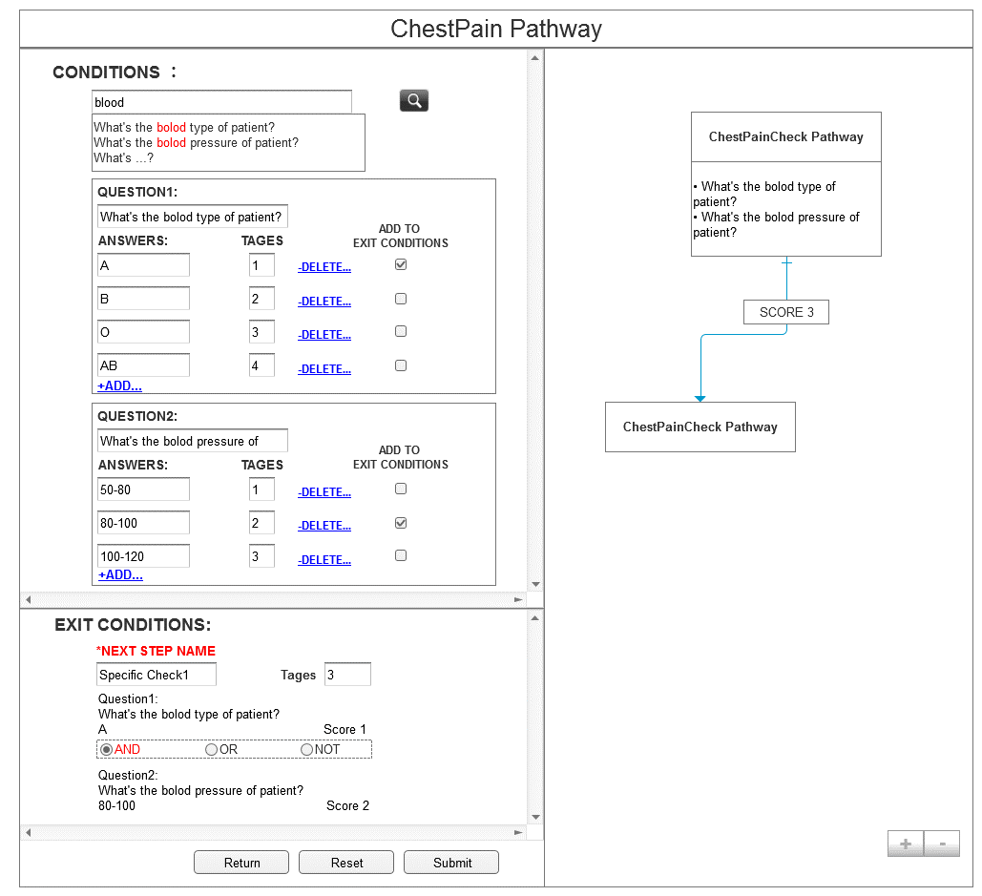
Solution
Left Part ( Form Logic )
Conditions-first.
Logic-first.
Form Logic is the solution?
We can not prove it
Transfer Form Logic into PML
PML could solve all resource flow logic
Use PEOS to check PML
Right Part (Graphic Logic)
Resource flow chart
NPL
Logic
Logic
Left
Right

Slide 2





Framework and libraries choose
AngularJS
Framework
Suitable for form-based
application
GoJS:
Suitable for work-flow chart
JSON
NodeJS
PEOS
MySQL
AngularJS
JSON
GoJS
PEOS
MySQL
NodeJS
PEOS

Slide 3
The architecture of
Pathway Creator
Front-end
AngularJS
GoJS
1.Form part generates JS object
2.Transfer JS object into PML
language file
3.Using PEOS to check PML
4.Pass the correct JS object
to graph part
5.Using GoJS to generate pathway
6. Saving or load graph as
Jon File
7.Saving or load Json into
database
1
5
4
JavaScript Object
JavaScript Object
6
2
3
Transfer
Save
Load
Back-end
PEOS
PML
Json
Shell
Save
7
Load
MySQL

Slide 4
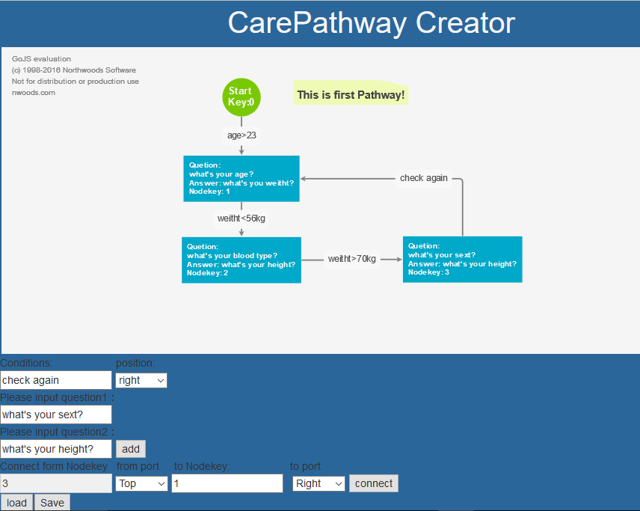
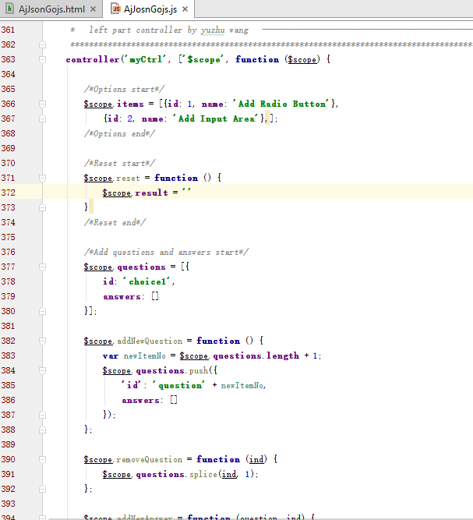
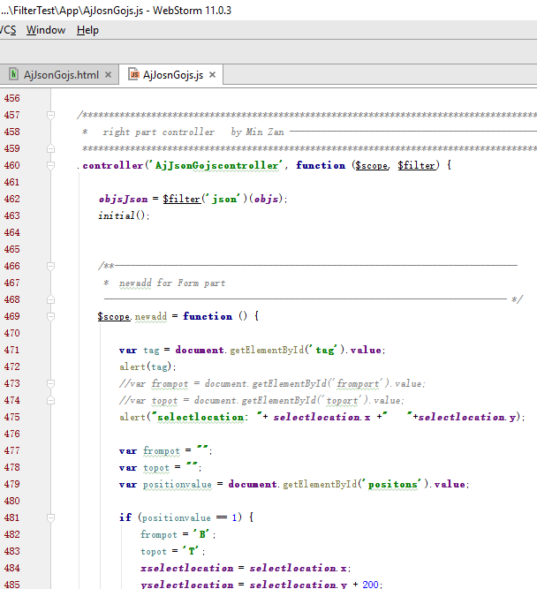
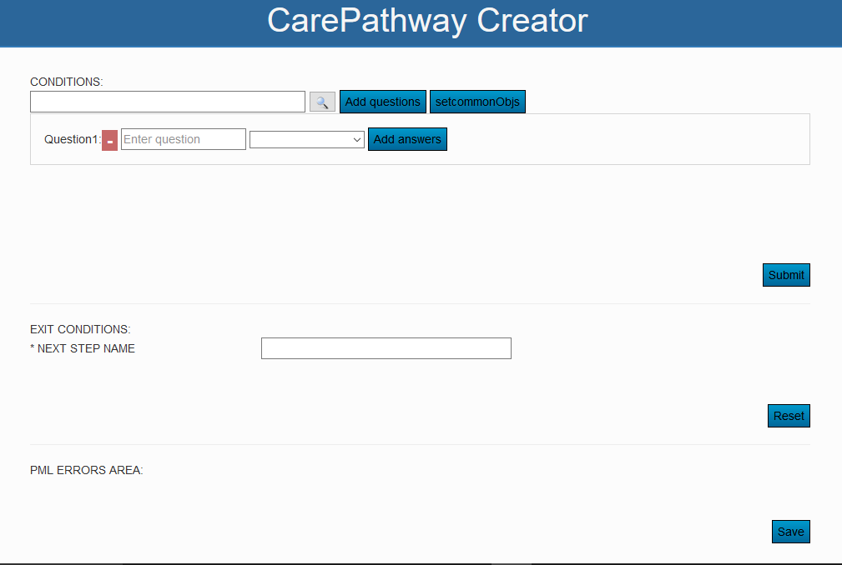
Implement of interface
The problem of GoJS
Event-drive
Integrate AngularJS and GoJS
Integrate 2 pages

Slide 5
