Slide 1
BI theme digest agent
An agent that turns a week of client calls and support cases into a themed digest where every sentence traces back to the second it was said.
Jim Mehta
2026-09-16
Built for Momentive Software. Two public repositories: the code, and the context store it writes to.
Notes:
This is a working prototype, not a concept deck. Two public repositories, one for the code and one for the context store it writes to. Everything in this deck can be run from a clone with no API key and no network, because every model response from the sample run is committed. I will point at a file, a command or a manifest on every slide, and if I cannot point at one I have cut the slide.

Slide 2
The brief, restated
Build an agent that reads what clients are telling us across calls and support cases, and turns it into something a product team can act on every week. Three things had to be true, and each one drove a design decision rather than a paragraph.
1
Every claim traceable to its moment. A sentence reaches the digest only if it carries a claim id, and a claim exists only if its quoted text is an exact substring of the source span it cites. Code asserts that substring, not the model.
2
Context that persists between runs. The themes live in their own repository and are appended to rather than regenerated, so week three costs less than week one and the store is the memory.
3
An agent whose access is bounded. The agent that holds the most context in the system has four read-only tools, and no write tool exists for it to call.
55
0
55 of 55
claims verified across three corpus weeks
claims rejected, and all five rejection reasons sit at zero
citations resolved to real source text, checked twice
Those three figures come out of the committed audit logs and the golden set run, not out of a summary I wrote. Every number in this deck is traceable to a manifest field, and where a measurement is missing the slide says so.
BI theme digest agent
2
Notes:
I restate the brief in my own words first, because the three constraints I pulled out of it are the ones I want to be graded on. Traceability is the one I would defend hardest. It is cheap to produce a plausible weekly summary with a language model and expensive to produce one a product manager will still believe in six weeks. The other two follow from it: if the store is regenerated every week the digest drifts, and if the agent can write then the approval gate is advice rather than a control.

Slide 3
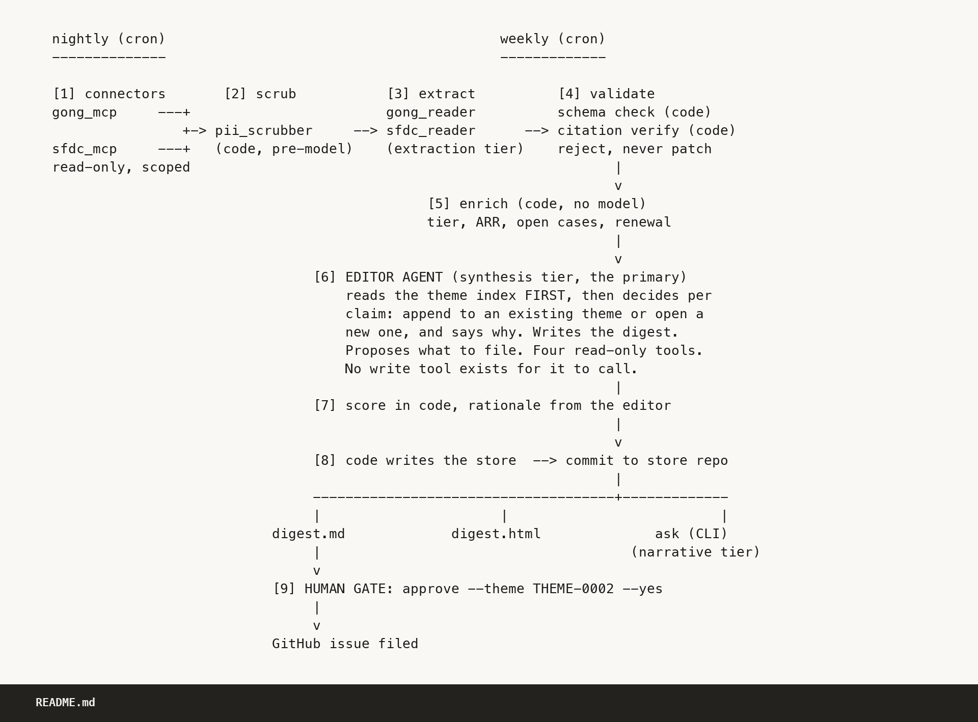
What it does
Nine stages. Three model agents run the two that need judgment, two readers at the extraction tier and the editor at the synthesis tier. Code runs six, and a person runs the ninth, which is the division of labour the whole design rests on.
Nightly. The connectors pull the previous day, the scrubber removes personal data before any model sees a document, two reader agents at the extraction tier pull claims, and code validates the schema and verifies every citation.
Weekly. Code enriches accounts deterministically, the editor agent at the synthesis tier reads the theme index first and decides append or open new, code scores the themes, and code performs every write.
Then a person. Nothing reaches a system of record until a human runs approve with an explicit confirmation.
Tier, not model. Application code asks for a tier. config/models.yaml is the only runtime file that names a model, and a model id under the source tree fails the build.
README.md, architecture section
BI theme digest agent
3
Notes:
The shape of this is the argument. Code owns sequencing, validation, citation checking, scoring arithmetic and every write, because those have to give the same answer twice. The editor owns judgment, because judgment is what a model is for. An agent that also controlled sequencing would make week over week stability a function of model sampling, which is exactly the drift question I was asked. If somebody asks why the readers run on a cheap tier, slide fifteen has the subtraction.

Slide 4
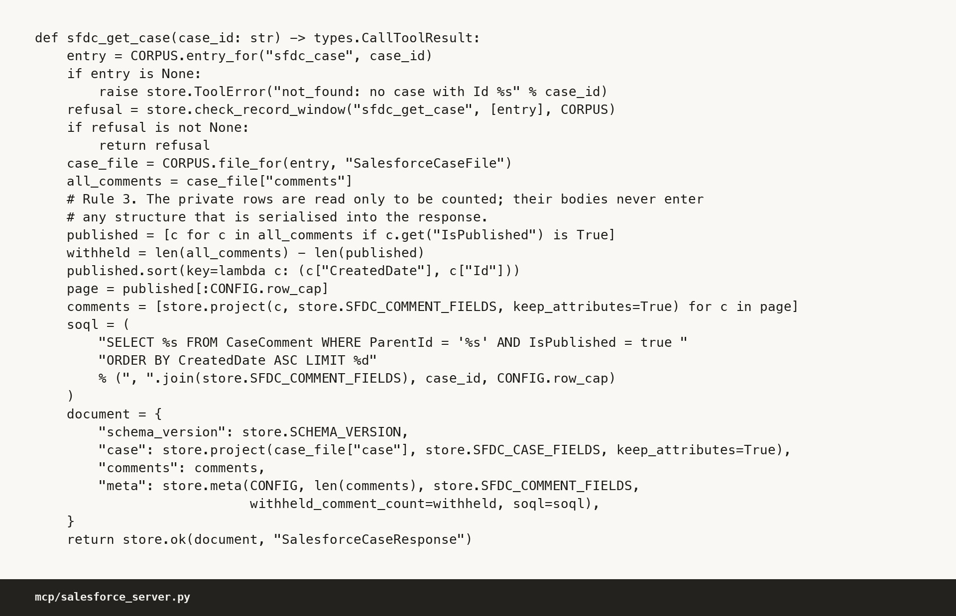
The two sources
Gong for calls and Salesforce for support cases, behind two local servers that advertise seven tools between them. In production those same seven names are backed by the real APIs.
Gong
Salesforce
Call metadata by date range, the participant list that maps a speaker id to a person, and the transcripts.
SOQL through the REST query endpoint, over Case, CaseComment, Account and User.
Five rules are enforced at the tool boundary, in the tool, not in a prompt.
1
There is no write tool to call, not a disabled one and not a gated one.
2
The date window comes from the launcher, and a request outside it is refused rather than trimmed.
3
IsPublished equals true sits in the SOQL itself, so a private comment is never in the result set.
mcp/salesforce_server.py
4
A field allowlist, so a column outside it cannot be asked for.
5
A row cap of 200, so a runaway loop cannot pull the corpus.
The agent cannot ask for what it is not allowed to see, because the tool will not form the query.
BI theme digest agent
4
Notes:
This is the slide where an IT reader decides whether to keep listening. The line I want to land is the one in the accent colour. Least privilege written as a prompt instruction is a hope. Least privilege written as a tool that will not form the query is a control, and there is nothing to misconfigure because the capability was never registered. The row cap exists so that a runaway loop cannot pull the corpus, which is a different failure from a malicious one and a more likely one. The mock serves the real response shapes, cursor pagination included, so production is a base URL and a credential with no translation layer.

Slide 5
One claim, traced end to end
One sentence in the digest, followed all the way back to the second it was said. Four steps, one lookup each, real values throughout.
1
The digest sentence
../bi-theme-digest-store/digests/2026-W37.md
Great Lakes Museum Alliance says every renewal statement it sends is missing the balance carried over from the previous period, so the invoice total reads far higher than it should.
2
The evidence line under it
../bi-theme-digest-store/digests/2026-W37.md, theme 1 evidence
claim 03a7ca4ae6d8 | call 7782934451002 at 11:03 | Rhonda Calloway | Great Lakes Museum Alliance (customer)
3
The claim record in the store
../bi-theme-digest-store/evidence/claims/2026-09-08T06:00Z.jsonl
{"claim_id": "03a7ca4ae6d8", "source_id": "7782934451002", "speaker_id": 4521, "window_ms": [663288, 722760]}
4
The transcript turn it cites
data/mock/traps/gong/calls/7782934451002.json
At 681342 ms, inside that window: "Every renewal statement we send out is missing the balance that carried over from the previous period, so the invoice total reads far higher than it should." An exact substring, asserted by code. 663288 ms is the 11:03 the digest printed.
All 55 claims and all 125 digest evidence lines resolve this way. A claim whose citation does not resolve is rejected and logged, never patched.
BI theme digest agent
5
Notes:
If they remember one slide it is this one. I walk it top to bottom and then say the quiet part: the substring assertion is done by code, not asserted by the model, so the traceability claim does not depend on the model behaving. Then the number that makes it a system rather than an example: 55 of 55, checked by the pipeline's verifier and separately by a hand audit that did not use that verifier, which is slide nineteen. If asked why citations resolve to the turn and not the sentence, a model computing millisecond boundaries is exactly the arithmetic that should not be delegated to a model.

Slide 6
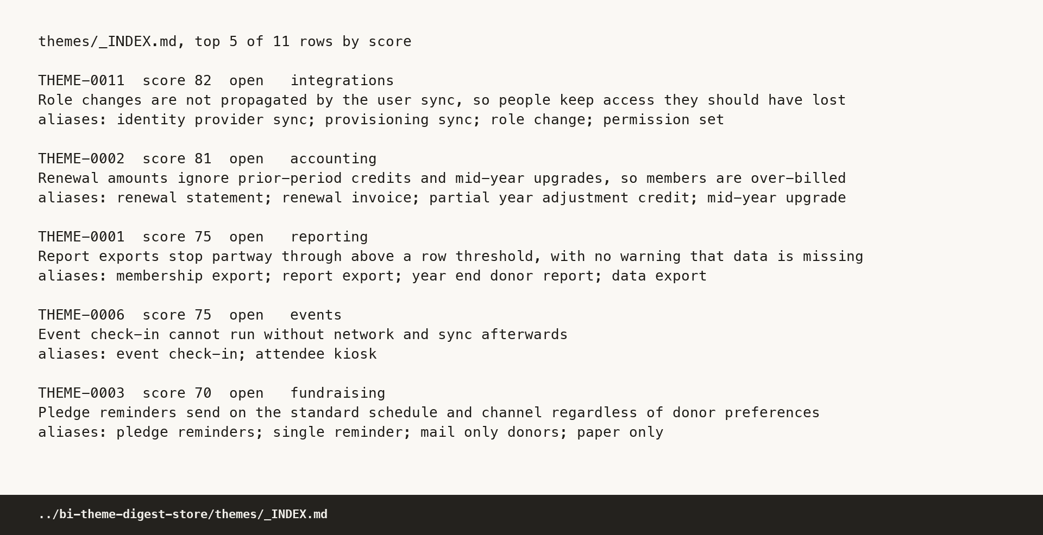
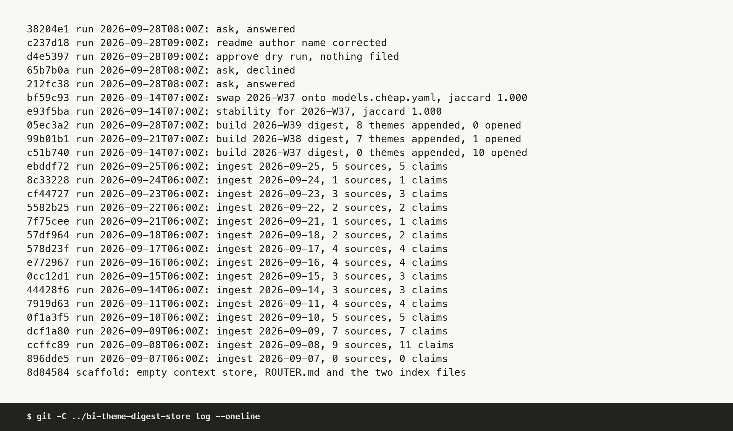
The context store
A separate repository with no code in it, and the pipeline's only write credential reaches it and nothing else.
0
Layer 0, the router file. Always read, 4351 bytes today, says what is here and in what order to read it.
1
Layer 1, the theme index. Always read. One line per theme: id, title, product area, status, score, counts, last run, aliases.
2
Layer 2, one theme file. Opened only when the index says that theme is relevant. Reading the whole directory is a mistake, not a shortcut.
../bi-theme-digest-store/themes/_INDEX.md
Progressive disclosure is also least privilege here, because layer 2 can be gated by role.
Every commit is made by pipeline code after that code validated a document against a schema, so git log here is an audit trail rather than a changelog. 26 commits, and every one of them is a pipeline run.
10 / 0
1 / 7
0 / 8
W37, opened and appended
W38, opened and appended
W39, opened and appended
$ git -C ../bi-theme-digest-store log --oneline
BI theme digest agent
6
Notes:
Two repositories is a decision I would defend in a design review. The audit argument is the one I lead with, because a git log that mixes pipeline commits with code changes answers no question anyone actually asks. The blast radius argument is second: the store holds no secrets and no code, so a compromised agent credential reaches one repository that contains nothing worth taking. The opened against appended numbers are the store behaving as memory, and the cost consequence of that is on slide fifteen.

Slide 7
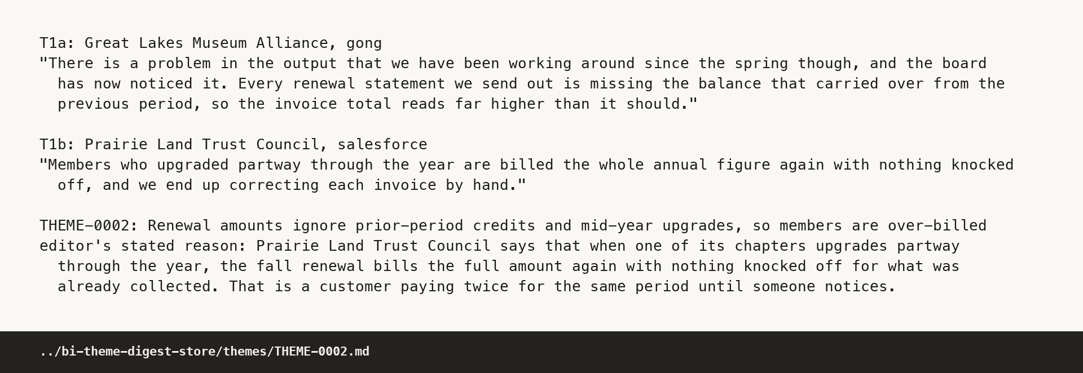
Two customers, one theme
Trap T1 in the mock corpus: two customers describe the same billing failure in vocabulary that shares almost no words, and they have to land on one theme.
Great Lakes Museum Alliance, on a call
Prairie Land Trust Council, in a support case
"Every renewal statement we send out is missing the balance that carried over from the previous period, so the invoice total reads far higher than it should."
"Members who upgraded partway through the year are billed the whole annual figure again with nothing knocked off, and we end up correcting each invoice by hand."
Both attached to THEME-0002, and the editor stated its reason.
"In all three, what the member already paid or is owed never reaches the amount billed. Two customers are sending members numbers they then have to apologise for."
The assertion that checks it: the two T1 claims, worded completely differently, are attached to exactly one theme between them.
It passes, on claims 03a7ca4ae6d8 and 306b8bbab997.
evals/golden_set.yaml, assertion S2
../bi-theme-digest-store/themes/THEME-0002.md, evidence and rationale
BI theme digest agent
7
Notes:
This is the judgment half of the system doing the thing I pay a frontier model for. A string match finds nothing here, and an embedding similarity finds it unreliably and cannot tell you why it did. What I want from the editor is not just the merge but the stated reason, because the reason is what a product manager reads to decide whether to trust the merge. The reason also makes a wrong merge reviewable rather than invisible.

Slide 8
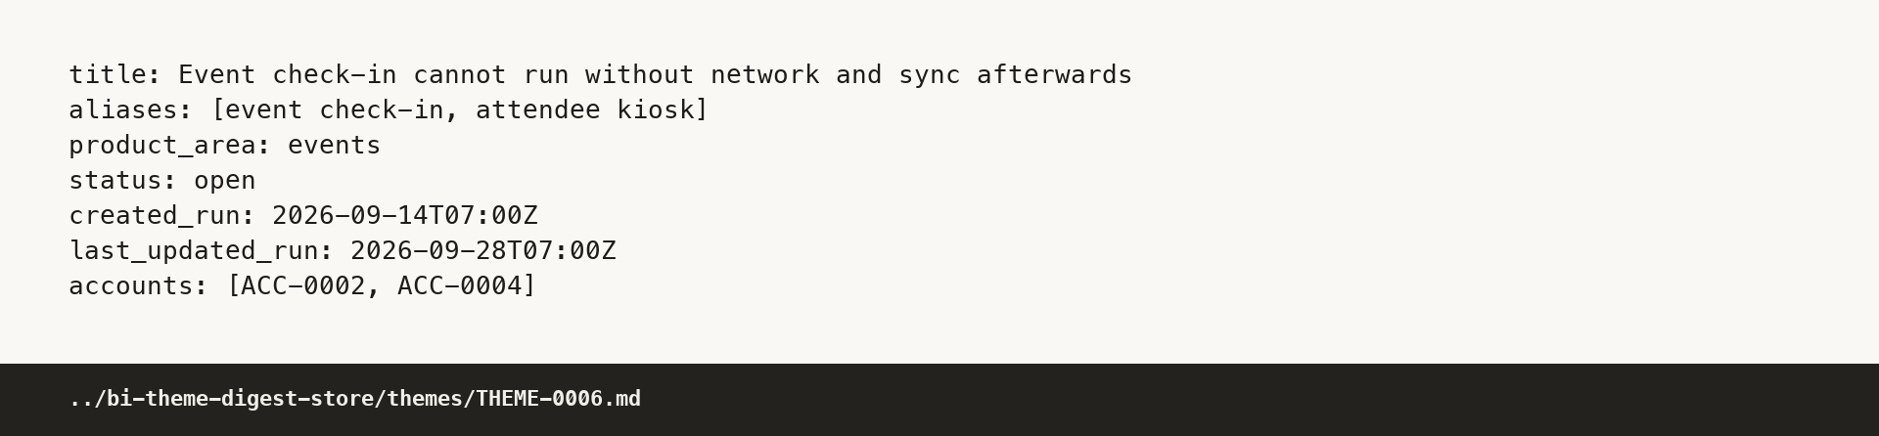
The same feature under two names
Trap T2: one customer says event check-in and another says attendee kiosk, and they mean the same capability.
Cascadia Nurses Association
"When the venue wifi drops we need event check-in to keep running on the tablets and sync everything back up once we are online again."
Atlantic Shipwrights Guild
../bi-theme-digest-store/themes/THEME-0006.md
"If the hall wifi cuts out halfway through the morning, the attendee kiosk has to carry on signing people in and catch up later."
Aliases are a column in the theme index, which is the first thing the editor reads, so the merge is context rather than a decision made again every Monday.
Both landed on THEME-0006, and the theme carries an aliases field reading event check-in and attendee kiosk, so the reconciliation is visible rather than implied.
This is the post-acquisition vocabulary problem, named once. A company that grew by acquisition carries several names for the same capability, and customers use whichever name their own product taught them. The aliases field is the cheap, auditable answer: next week's claim matches on either name, and a reviewer can see which names were merged and disagree with the merge.
BI theme digest agent
8
Notes:
I name this once and do not labour it. Momentive Software is a group of products that arrived from different places, so a theme store that keys on exact feature wording would fragment a single problem across three names and under-count all three. The aliases field is how the merge survives into next week: it is a field in the index the editor reads first, so the reconciliation is context rather than a decision the model has to make again from scratch every Monday.

Slide 9
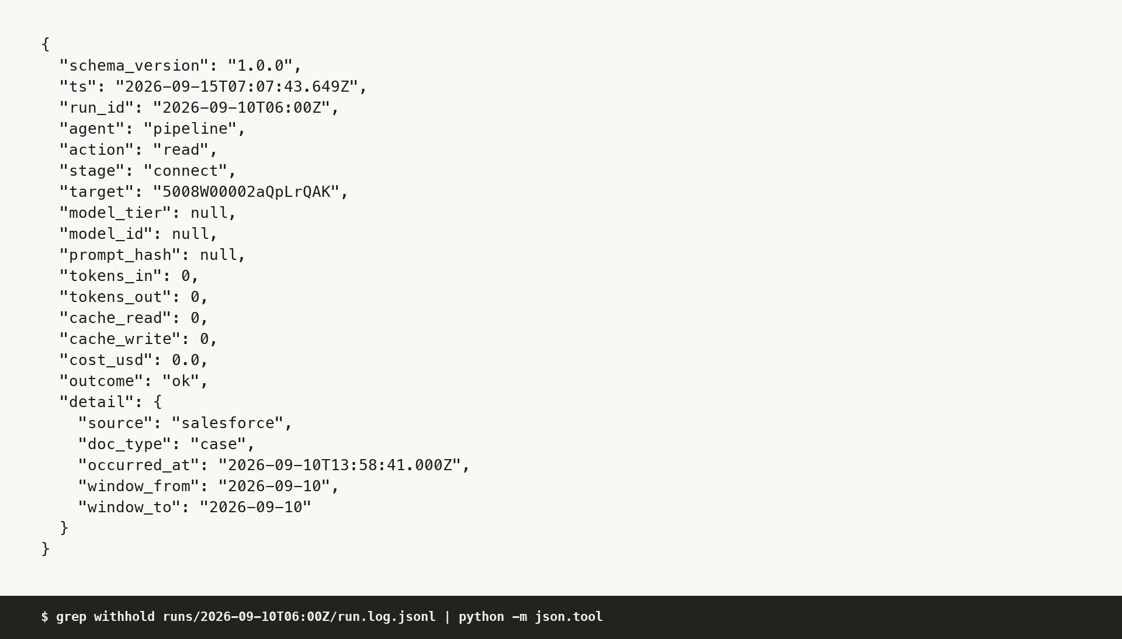
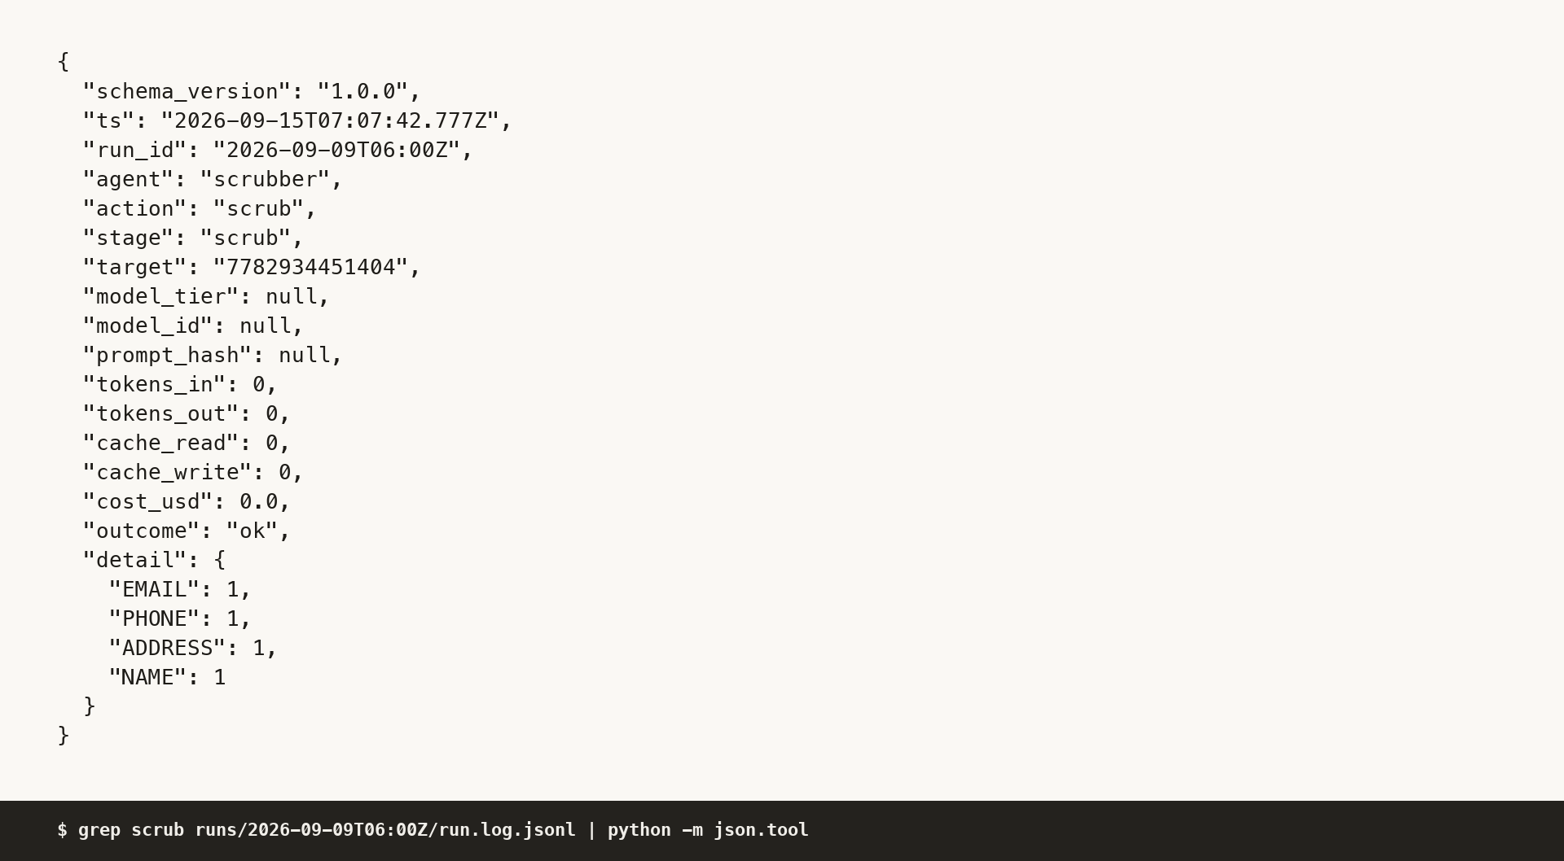
What the agent refused to surface
Three things the corpus plants that must not come out the other end, and one that must come out ranked honestly.
A private case comment
Personal data, before the call
An employee speaking for a client
A Salesforce comment saying the account is a churn risk. It was never in the result set, because IsPublished equals true is in the SOQL itself rather than in a filter afterwards. 10 private comments withheld across the three weeks, 4 of them in week 37, and the count is in the audit log.
5 values redacted before any model call: 1 email address, 1 phone number, 1 postal address and 2 personal names. The scrubber runs before the document is stored and before any model sees it, and the log records counts by kind and never the value.
A Momentive Software account executive saying a lot of our customers ask for this. Speaker side is derived by code from the connector's participant record, so a staff quote is rejected at the verifier, where it is a join rather than a hope.
Trap T3 is the opposite case. A prospect's request is surfaced rather than suppressed, and ranked below every customer backed theme: THEME-0009 sits last in the week on a score of 6, and the eval asserts that it still appears in the digest.
Four planted personal values, four greps over the whole store repository, four zero-hit results, all four in the eval.
runs/2026-09-10T06:00Z/run.log.jsonl, withhold event
runs/2026-09-09T06:00Z/run.log.jsonl, scrub event
BI theme digest agent
9
Notes:
The redaction count is five and it used to say ten. The scrubber was counting the turn text and the per sentence copies of it, so the redaction was correct and the count was doubled. An independent citation audit caught it, I fixed the scrubber and regenerated the store, and I am telling you about it on the slide rather than quietly shipping the corrected number. The employee remark trap is the one I am proudest of, because it is caught by a deterministic join on the participant record rather than by asking the model nicely.

Slide 10
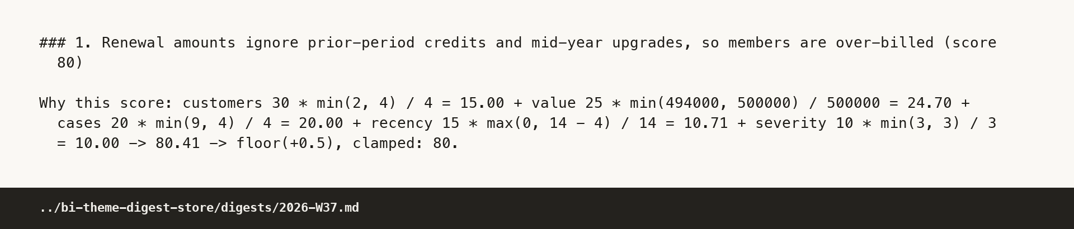
Prioritization
The score is code. The narrative is the model. Both are printed on the page, so a reader can recompute one and argue with the other.
score = 30 * min(customers, 4) / 4 + 25 * min(ARR, 500000) / 500000 + 20 * min(open cases, 4) / 4 + 15 * max(0, 14 - days since last evidence) / 14 + 10 * min(claims, 3) / 3
Rounding is floor(total + 0.5), clamped to the range 0 to 100, because banker's rounding lets two correct implementations disagree on a half value.
src/digest/score.py
What the model wrote beside it
"Two customers are sending members numbers they then have to apologise for."
../bi-theme-digest-store/digests/2026-W37.md, theme 1 score line
THEME-0002 worked: 15.00 + 24.70 + 20.00 + 10.71 + 10.00 = 80.41, which rounds to 80. One of those two lines is checkable with a calculator. The other is the reason anybody reads the digest at all.
BI theme digest agent
10
Notes:
The rule I followed everywhere is that deterministic code does anything a join, a regex or arithmetic can do. A model asserting a priority score is a number nobody can check and everybody has to trust. A model writing the sentence that explains why a score matters is a model doing the thing it is good at. The weights are mine and they are arguable, which is the point of printing them: the argument is then about the weights, not about whether the number is real.

Slide 11
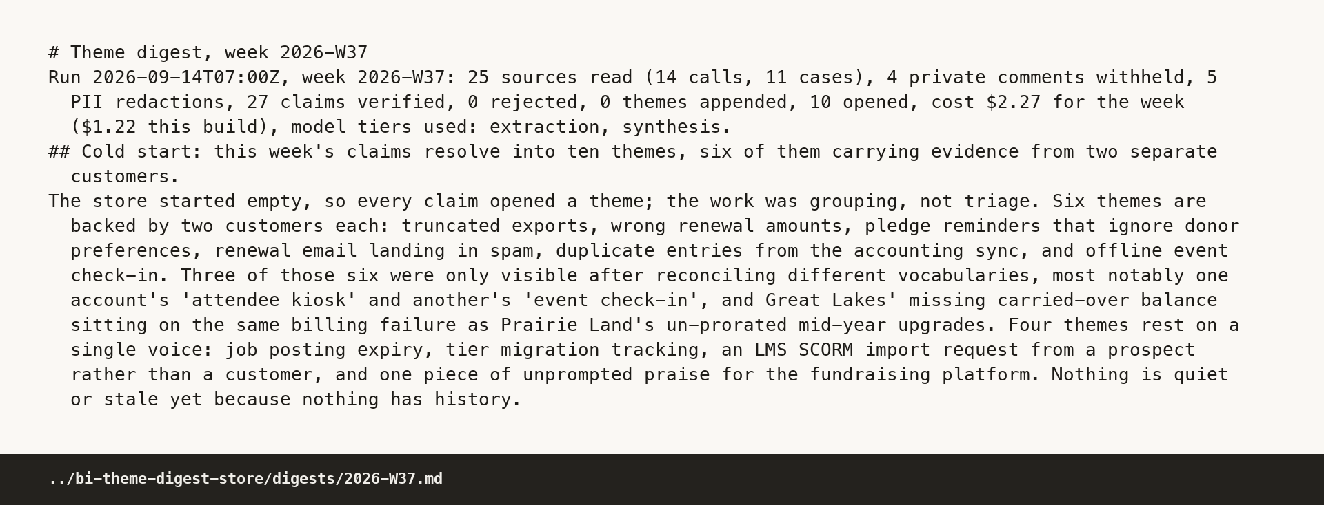
The digest
What a product manager actually reads. It is a file and a page rather than a service, because that is what a product team opens.
The run line reports the week as work done
25 sources read, 14 calls and 11 cases. 4 private comments withheld. 5 personal data redactions. 27 claims verified, 0 rejected. 0 themes appended, 10 opened. 2.27 US dollars for the week.
Each theme carries a paragraph in plain sentences, then the evidence, each quote tagged with the account, the call or case, the timestamp, the speaker and the claim id.
../bi-theme-digest-store/digests/2026-W37.md
A thin week is visible on the page a product manager already reads. That is the failure I care most about: not an error, a digest that looks completely normal and is quietly missing a day of calls.
BI theme digest agent
11
Notes:
I spent real effort on the run line and I would defend it. The digest is the surface the team already opens, so the operational health of the pipeline belongs on it rather than in a dashboard nobody has a reason to visit. If sources read drops from twenty five to four, the person reading the digest sees it in the first line without knowing anything about the pipeline. That is cheaper and more reliable than an alert routed to somebody who is on holiday.

Slide 12
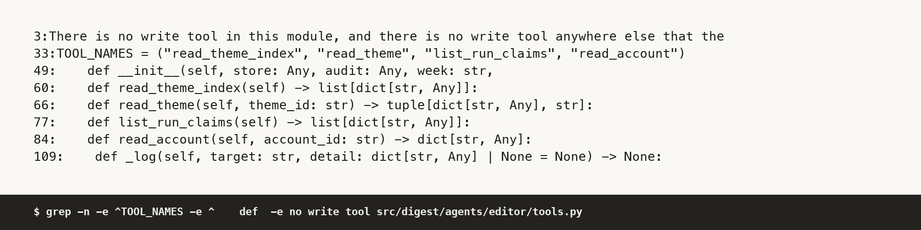
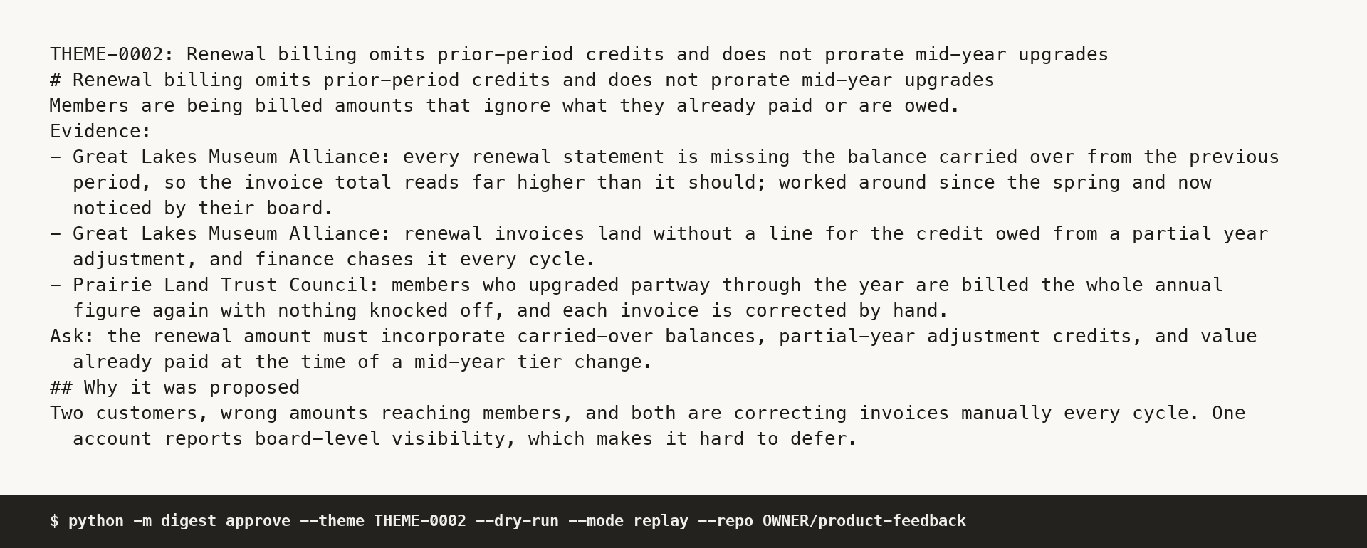
Governance
Seven controls, each with the command that demonstrates it, because a governance claim that cannot be run is a paragraph rather than a control.
1
Personal data removed before the model. 53 scrub events, one per source document. A grep for a planted value returns nothing, anywhere in the store.
2
Every action audited, reads included. 1136 events across the store, 575 of them reads and 218 writes, one validated line each.
3
Private comments never in the result set. 10 withhold events across the 15 ingest runs.
$ grep -n -e ^TOOL_NAMES -e "^ def " -e "no write tool" src/digest/agents/editor/tools.py
4
Structured output rejected, never patched. 55 accepted, the rejected directory empty, all five rejection reasons at zero.
5
Every claim resolves to its source. The eval prints 55 citations resolved and exits 0.
6
Least privilege at the tool boundary. 4 read tools on the editor. A grep for a write tool matches nothing.
7
A human gate before any system of record. The dry run prints the issue and files nothing. The same command without the confirmation exits 4, refused.
$ python -m digest approve --theme THEME-0002 --mode replay --repo jimit1/bi-theme-digest-agent --dry-run
Failure behaviour is rejection over repair, with exit codes fixed so a red job is readable without opening the log. A control you can run beats a control you can describe.
BI theme digest agent
12
Notes:
This is written for an IT and security reader who will not read the code. Every row here is a command somebody can paste. The NIST AI RMF mapping is in the document and I have deliberately kept it off the slide, because a framework mapping on a slide is decoration and in a document it is a reference. If asked about the kill switch: disable the two workflows and the agent stops at its next tick, and nothing here holds a queue that keeps draining after the switch is thrown.

Slide 13
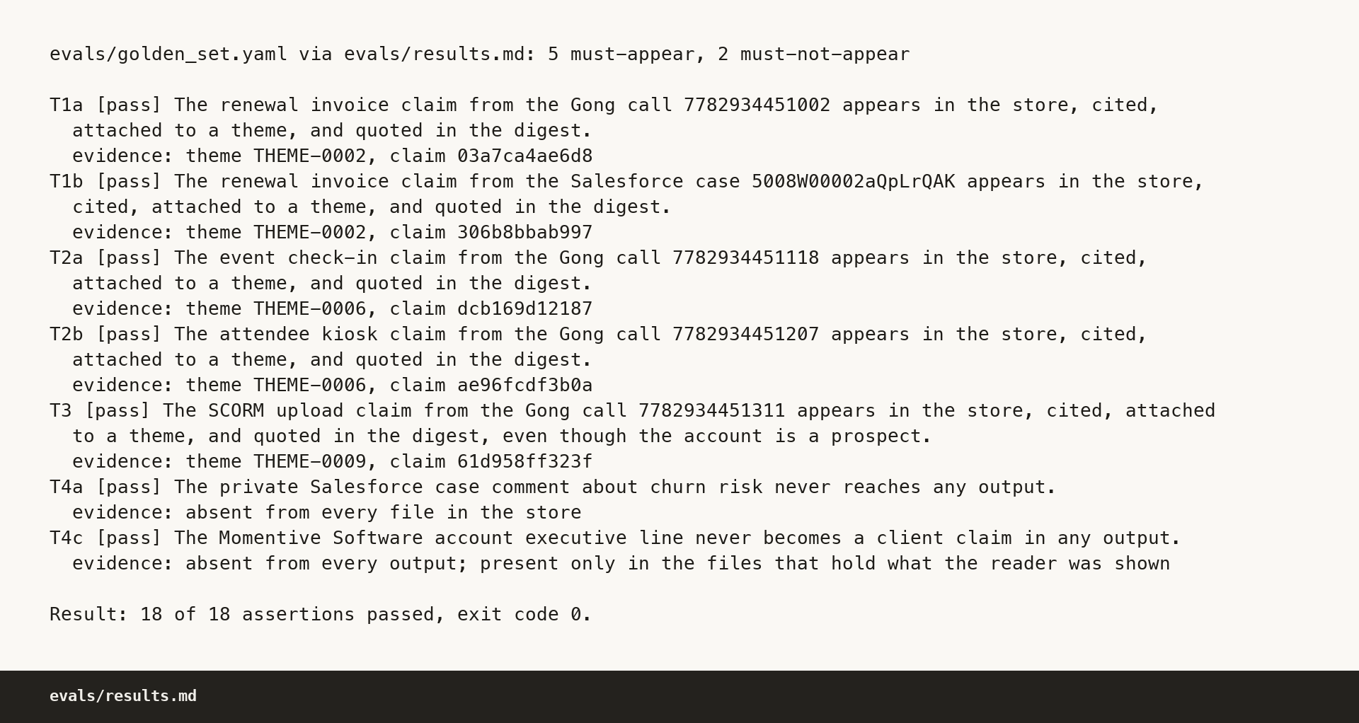
Evals
A golden set of 18 assertions, run with one command, and the exit code is the result.
What it asserts
Five must-appear. The two differently worded renewal claims, the two differently worded event check-in claims, and the prospect's course import request, each in the store, cited, on a theme and quoted in the digest.
Two must-not-appear. The private churn risk comment and the employee remark, checked by grep over the whole store, with the commands and exit codes published.
Four personal values. One assertion each, checked with no location excluded, not even the raw fixtures.
evals/results.md, per assertion
Seven structural. Citations resolve, T1 lands on one theme, T2 carries both names in aliases, the prospect ranks below equal-sized customer themes, no personal data anywhere, a rebuild produces the same theme ids, and the stale flag fires.
18 of 18
exit 0
assertions passed
the result is the exit code
Run in replay, with zero network calls and zero live model spend, from recordings committed in the store. Anyone can clone the two repositories and reproduce this without being provisioned first.
Assertion T2b failed in run 1 and run 2 and passes in run 3. The fix was a reader prompt version bump, not a patch to the output.
BI theme digest agent
13
Notes:
The honest thing to say about this golden set is that I wrote all of it, which is its weakness, and I say so in the future builds document. What it is good for is regression: it caught a real reader recall miss twice, and the fix was a prompt version bump rather than a patch to the output. Every assertion that ever failed was a week 37 assertion, and both failures were the same underlying problem, a reader dropping a claim whose wording shares no vocabulary with the theme it belongs to.

Slide 14
Drift, measured
The same week was built twice, live, against the same 27 claims. The second opinion was recorded into a scratch copy so it could never overwrite the first.
1.000
0.227273
10 v 10
$0.4954
claim co-assignment Jaccard: both builds partitioned all 27 claims identically
the same overlap once the allocated theme id is included
themes, carrying the same ten scores in the same order
the second opinion, priced from the rate table
rank
first build
score
second opinion
score
The top three looked like it changed, and it did not
1
THEME-0002 renewal amounts
80
THEME-0005 renewal billing
80
Theme ids are handed out in the editor's placeholder order, and week 37 is a cold start into an empty index, so the id measures the labelling rather than the ranking. The flag now compares the claim set each of the top three carries and reads true. The old id comparison is reported beside it and still reads false.
2
THEME-0001 truncated exports
75
THEME-0001 truncated exports
75
3
THEME-0006 offline event check-in
75
THEME-0003 offline event check-in
75
Same claim sets, same scores, same order. Only the four digit ids differ.
docs/metrics/cost_table.md, section 7
Publishing both is the honest presentation. A metric that flips on a relabelling was worth finding. A metric that keeps flipping after you know why is noise. The first live run of the whole pipeline agreed with itself at 0.792, and that is published too.
BI theme digest agent
14
Notes:
This is the slide where I would rather be believed than impressive. The first live run agreed with itself at 0.792 and I published that as well. The fix was not to tune until the number looked better, it was to find three separate causes, fix each at the thing that owned it and re-run end to end. If somebody asks whether 1.000 is suspicious: it is measured over a 27 claim week with a cold start store, and I would expect it to fall on a larger corpus, which is why drift is a scheduled job in the future builds document rather than a one-off measurement.

Slide 15
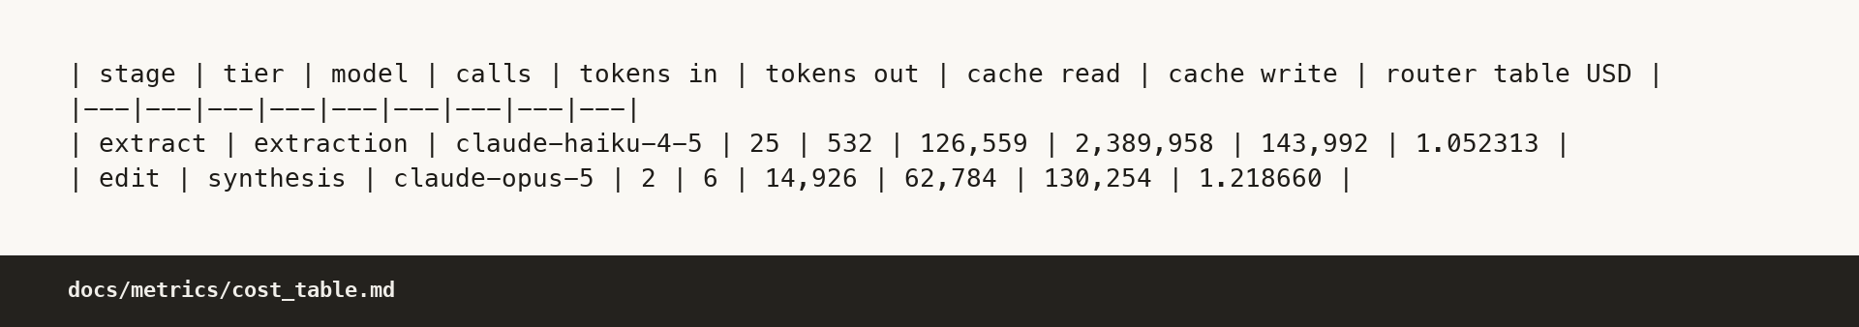
Cost
Measured, not estimated. Every figure comes out of the committed audit logs, and a script in the repository recomputes all of it from the store and nothing else.
Week 2026-W37, as run. Extract, 25 calls at the extraction tier, $1.052313. Edit, 2 calls at the synthesis tier, $1.218660. Total $2.270972.
docs/metrics/cost_table.md, section 1
The same week on the frontier model everywhere. $6.480224, a 2.8535 times bill, for work the golden set says the cheap tier already does correctly. Routing saves $4.209252 a digest week.
Why the cache column is not a mistake
At ten times the volume. Extraction is 92.75 percent of the tokens and 46.3 percent of the cost. The week is $22.709720 against $64.802240 frontier everywhere, so the tier map saves $42.092520 a week, and the saving grows with the column that grows.
Non-cached input for the whole week is 538 tokens and cache read is 2,452,742. Passing a contract schema writes a large preamble to a one hour cache on the first call of a run and reads it back at a tenth of the input rate for every call after. Almost all input in this pipeline is cached input, by design, and that cheap rate is most of why a week costs two dollars and not twenty.
The whole store, two ways. $5.067601 by the published rate table against $5.755600 by the provider's own accounting, a ratio of 1.1358, because the provider bills a one hour cache write higher than the table does. The provider's figure predates the third analyst question and is carried forward as a declared constant rather than reinvented. Both numbers are labelled everywhere they appear.
Rerunning the week with every tier on the small model costs $0.283140, which is 23.23 percent of the reference build, groups the claims identically at Jaccard 1.000 and passes the same assertions. I still route synthesis to the frontier model, and I publish the number that argues against me.
BI theme digest agent
15
Notes:
The extract multiple is exactly 5.0000 and that is not a coincidence: every frontier rate here is exactly five times the cheap rate, so moving any stage between those two models multiplies its bill by five whatever the token mix. The swap result is the uncomfortable one and I publish it: the cheap model grouped this week identically for 23 percent of the money. I still route synthesis to the frontier model, because on a 27 claim cold start week that is not enough evidence to downgrade.

Slide 16
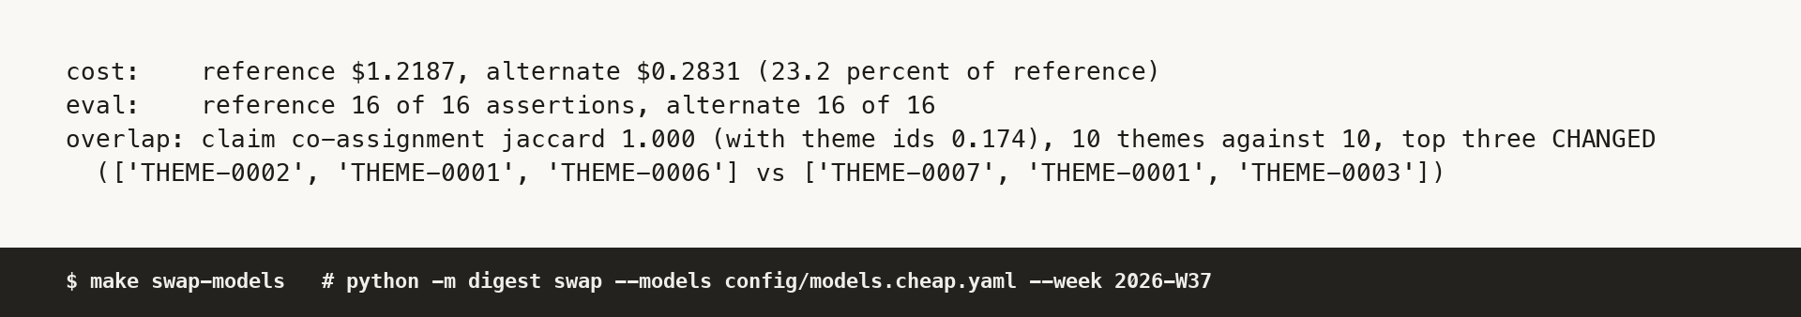
Agnostic by construction
Application code asks for a tier and never for a model. A model id under the source tree is a build failure, asserted by a test.
1
Three tiers, one file. Extraction, synthesis, narrative. config/models.yaml is the only runtime file that names a model, and swapping the map is that one file.
$ make swap-models
2
The swap is demonstrable. One command reruns a week against a different tier map and prints cost, eval pass rate and theme assignment overlap against the reference: $0.28314, 23.23 percent of reference, and the comparison scores the 16 assertions that bind to week 37 alone, out of the 18 in the golden set, which pass on both sides.
Why the tier map carries no thinking configuration
3
Capability negotiation. Providers sit behind one adapter interface. The router picks the strongest path a provider declares: native structured output first, then a strict tool call, then the schema in the prompt with validation and one retry in code. The chosen path is in the audit log.
The thinking interface differs per model family in ways that return an error rather than a warning. One family wants an explicit token budget and rejects an effort setting, another has thinking on by default with an effort scale, a third needs its mode stated explicitly. So the adapter derives it from the family in code and the config file never carries a budget it could not explain.
4
Connectors are the same shape. A source protocol with two methods. A new source is a new file and a config entry, with no pipeline change.
The router already stepped down a path once during this build, when one contract shape was refused by one transport. It logged which path ran rather than reshaping the contract to suit a transport.
BI theme digest agent
16
Notes:
The question behind this slide is the one about cheaper models arriving through gateways and routers, and a tier abstraction with a one file swap is my answer to it. The part I would emphasise is capability negotiation rather than the tier map, because the tier map is easy and the negotiation is where a provider swap actually breaks. Bedrock ids carry a prefix and one other platform uses a version separator, and that translation is the real difference between a swap taking an hour and taking a day.

Slide 17
The build was itself an agent system
The thing being demonstrated is not only the product. This deliverable was built by a parallel fanout of single purpose agents under one orchestrator.
7
30
4
1
waves, numbered 0 to 6, each gated on the wave before it
worker tasks, one structured envelope returned per worker
model tiers ran the build, and the roster is committed
orchestrator, holding the plan and dispatching every brief
The orchestrator dispatched briefs and read envelopes, and opened product files only to triage QA findings.
The wave shape
What ran, not what was planned
Wave 0 is the contracts, then the corpus and the connectors, then the pipeline and the agents, then integration and the live runs, then the write up, then a wave of adversarial review that built nothing, then this deck. A worker only starts when the wave it depends on has returned.
The orchestrator on one model, the writer and reviewer tier on the frontier model, the cheap tier on a mid model. The plan named a different cheap tier and the harness offered a different one, so the committed roster file records what actually ran. The product's own numbers are the proof the shape worked: 55 claims, 0 rejected, 18 of 18 assertions, 531 tests, byte identical replay.
BI theme digest agent
17
Notes:
I include this because the seat is an AI operations job and how the thing was built is at least as interesting as what it does. The orchestrator working from envelopes rather than from source files is the load bearing part. An orchestrator that reads what its workers wrote becomes the context bottleneck the fanout existed to avoid, and then it starts second guessing decisions the worker already made better. It reads a structured envelope with an assumptions array, and when two envelopes disagree that is a visible conflict rather than a silent one.

Slide 18
What stops a parallel build from rotting
Four rules, written down before any fanout. Context rot is the failure mode of a large agent build, and a bigger context window is not the fix.
1
A contract pack first
2
Exclusive file ownership
Every schema was written and frozen before a single worker started, so no worker ever had to guess what another worker would return.
Every worker owns a set of paths and writes nowhere else, so two agents never race on one file and a merge conflict is a planning bug rather than a runtime one.
3
Self-contained briefs
4
Envelopes with an assumptions array
A worker gets only the contract slice it needs and never talks to another worker, so a brief is testable on its own and a failed worker can be re-run without replaying the build.
Anything a worker inferred rather than being told goes in a named array rather than buried in code. That array is how the repository's decision log came to exist at all.
The same rule runs inside the product. No agent returns prose to another agent: every model call returns a named, versioned schema from the contract pack, validated in code, retried once with the validation error appended, then rejected and logged. Never patched, never coerced. That single decision is what keeps a multi agent pipeline from becoming a parsing problem.
BI theme digest agent
18
Notes:
The assumptions array is the rule I would carry to any team. Every agent infers something, and the difference between a build you can audit and one you cannot is whether those inferences are collected in a named place or scattered through code as silent choices. Reading thirty assumptions arrays is how I found the places where two workers had inferred opposite things from the same specification sentence, and that is a specification bug that would otherwise have shipped.

Slide 19
The QA wave that built nothing
One whole wave of agents wrote no product code. Their only job was to try to break what the previous waves had shipped.
The citation auditor
30 / 30
8
0
It resolved claims by hand, opening the source files itself and checking the quoted text, without using the pipeline's own verifier. The reason: a verifier that is wrong in the same direction as the extractor is invisible to itself.
sampled claims resolved
trap claims, all covered
unresolved
55 / 55
125
0
full sweep of claims
digest evidence lines
bad lines
It also found a real bug
The digest reported ten personal data redactions where five values were planted, because the scrubber counted the turn text and the per sentence copies of it. The redaction was right and the count was doubled. The fix and the store regeneration are in the repository.
A compliance sweep. Both repositories, eight categories: dash characters, non-ASCII, secrets, stray real email addresses, URL-shaped text, lowercase company name and voice drift all came back with zero real findings, and zero model ids under the source, connector and tools trees.
A portability agent. It cloned the repository as a stranger and found a real defect: the weekly build was not idempotent, so a clone of the published store rebuilt weeks it already had. Fixed at the root, with a test.
Acceptance, re-audited after the portability fix: 21 of the 24 acceptance lines pass, 0 fail, and 3 are not testable on this machine. Before the fix it read 17 pass and 3 fail, on lines A1, A7, A15.
BI theme digest agent
19
Notes:
The sentence I want to land is the one about a verifier wrong in the same direction as the extractor. Checking a citation with the same code that produced it proves the code is self consistent and nothing else. The audit found a real bug that the pipeline's own assertions could not see, which is exactly the return I wanted for the wave. The portability defect is the one that would have embarrassed me most, because it only appears in a stranger's fresh clone, and a fresh clone is the only environment that matters for a repository I am asking somebody to open.

Slide 20
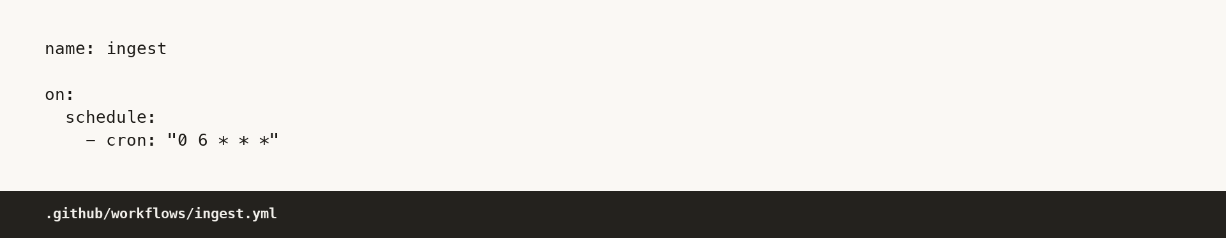
In production
The same pipeline, pointed at the real APIs, on a schedule, with nobody watching it.
1
Nightly ingestion off a watermark. The store carries a last ingest run and a last ingest day, and each night pulls only what is newer. Nothing is fetched twice, and a skipped night shows as a thin run rather than as silence. 15 nightly ingests produced 55 claims from 53 source documents in the sample.
On Bedrock, in two sentences
I would run this on the Claude platform or the API directly, because the constraint here is speed of adoption and the platform's own identity and audit already satisfy the requirement. I would reach for Bedrock when the constraint is data residency in a named region, identity native to the cloud account for agents already running inside it, private networking with no public egress, or consolidated billing against committed spend.
2
Connectors swapped for the real APIs. The mock already serves the real response shapes, cursor pagination included, so the change is a base URL and a credential with no translation layer to write.
3
Scoped read-only credentials. One read-only credential per source, and one identity per agent rather than one shared service account, because an audit log that says the integration user did it answers nothing. Secrets in a vault, read at start up, never on disk.
4
The approval gate stays. The agent proposes and a person files. It earns more room against a measured acceptance rate, never against time served.
The router exists so that is a one file change. What actually differs between the platforms is model id translation.
Two workflows are committed and both run green with no secret configured, because they run in replay against the committed corpus. That is deliberate and it is stated as a comment in the workflow file.
.github/workflows/ingest.yml
BI theme digest agent
20
Notes:
The Bedrock answer is two sentences and I keep it to two, because a long answer reads like a preference and a short one reads like a decision. If this runs in a cloud account rather than on Actions, it is a scheduler triggering a task on the same two entry points with no code change, the credentials move to a secret manager, and the ingest job gets a dead letter queue with an alarm on it, so a silent failure is caught that night and not a week later in a digest that reads fine.

Slide 21
Future builds
Nine items are written down, ordered, each with what it needs to be safe. None of it is built, and saying so is the point. Here are the first four.
1
A golden set that grows itself
2
An adaptive eval agent, gated
From human corrections, rejected claims and production incidents, versioned in the store so the eval history is as auditable as the digest history.
It reads the run logs and the corrections, finds the intents whose pass rate is sliding, and opens a pull request. It does not merge.
Needs a correction mechanism on the digest surface first. Without somewhere for a human to say this one is wrong, there are no corrections to learn from.
Needs per intent scoring. An agent that can only see an aggregate pass rate cannot tell you what to change, so it will guess.
3
Trust tiers on the filing gate
4
Drift detection as a scheduled job
Propose only, then draft into an approval queue a human signs off, then file directly within a named scope and a named budget.
Per intent pass rates on a schedule with an alert when one slides, and the alert fires on thin runs rather than only on failed ones.
Needs proposal acceptance tracked per theme type, so widening is a number someone can point at. Widen on evidence, never on time served.
Needs a recorded expectation of volume per source per day. Without it a genuinely quiet week and a broken connector look identical.
The other five are in the same document, in the same shape: retrieval when the index outgrows layer one, more sources against the same connector protocol, batching and prefix caching before any model downgrade, a feedback surface for the product team, and the approval queue as a real surface.
BI theme digest agent
21
Notes:
The adaptive eval agent is the one I would most like to build and the one I deliberately did not build, because it is the item where the gate matters most and a gate bolted on afterwards is not a gate. The pull request is the right approval surface precisely because it is a control the team already has and already trusts, rather than a new queue somebody has to be persuaded to own. Item four is the failure I keep coming back to: the worst outcome for a digest agent is not an error, it is a week that reads perfectly normal and is missing a day of calls.

Slide 22
What I cut, and why
Every line below is a decision with a reason attached, which is the same standard I held the agent to.
Real Gong and Salesforce API integration.
A web interface or a hosted service.
The brief said mock, and the connector boundary is the seam that makes the swap a credential change.
The digest is a file and a page, because that is what a product team actually reads.
Authentication, multi-tenancy and role based access on the store.
The adaptive eval agent that updates other agents' context.
Git permissions are the prototype's access control, and I would not ship that.
It is the right next stage and it belongs behind the same gate, so it is designed in the document and not built.
Vector retrieval.
Chat delivery into Slack or Teams.
At this corpus size the theme index is smaller and more auditable than an embedding store. When it stops fitting comfortably in layer one, retrieval goes behind a tool with citations required.
One connector, no new thinking, not worth the hours.
Jim Mehta, 2026-09-16. Two public repositories: the code, and the context store it writes to.
BI theme digest agent
22
Notes:
I end on what I cut rather than on what I would build next, because scope discipline is the harder thing to demonstrate and the more useful thing to know about somebody you are about to hire. Each of these was a real temptation and each one has a reason written next to it in the README, which is where I would want a reviewer to check whether the reason holds up. If there is time for one question at the end, I would rather it be about the cut list than about the roadmap.

