Slide 1
Orientation
what you have and how to run it
The BI theme digest agent, built for Momentive Software. This deck is for me, not for the review. It is the same forty five minute tour as docs/ORIENTATION.md, in slide form.
Jim Mehta
Notes:
Open a terminal at the root of the code repository, with the store beside it.
cd ~/momentive-bi-digest/bi-theme-digest-agent
ls ../bi-theme-digest-store

Slide 2
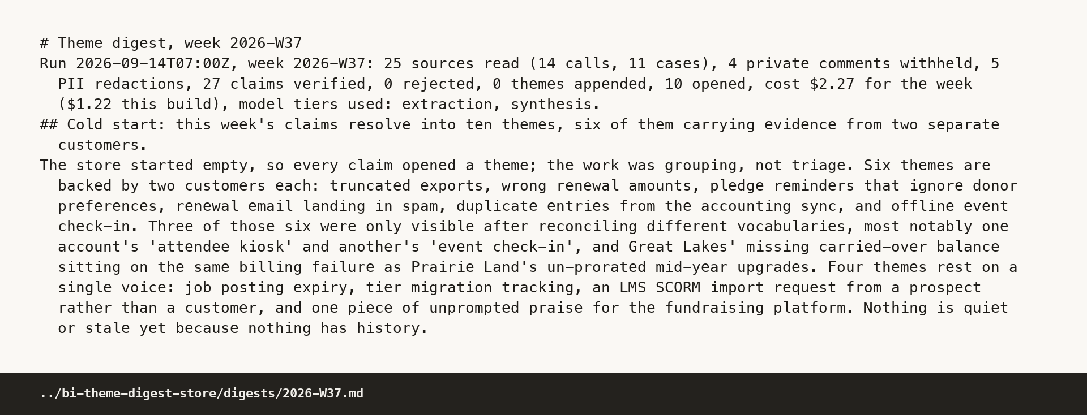
TEN MINUTES TO SEE IT RUN
Three commands, twenty seconds, no network
make setup
make demo
open ../bi-theme-digest-store-demo/digests/2026-W37.html
The demo clones the store's first commit into a scratch store, restores the recorded model responses, replays fifteen nightly ingests and three weekly builds, then runs the golden set. My last run finished in 19.5 seconds and printed 18 of 18 assertions passed and 19 commits.
In the HTML page, click an evidence line to expand it to the source moment, and click Why this score to expand the five weighted terms with the arithmetic shown.
The run line at the top of the markdown digest is the week in one sentence.
Notes:
Type:
make setup
make demo
open ../bi-theme-digest-store-demo/digests/2026-W37.html
Then open ../bi-theme-digest-store-demo/digests/2026-W37.md and read the run line, the cold start paragraph, and theme 1.

Slide 3
THE MAP
What lives in each top level folder
src/digest is the package. Everything that runs is in there.
contracts is the schema pack, and it is the law. Every boundary validates against a file in it.
mcp holds the two mock servers, Gong and Salesforce, which enforce read only access at the boundary.
config holds models.yaml and models.cheap.yaml, the only runtime files that name a model.
data/mock holds the generated corpus, the four hand written traps, the accounts and the PII name list.
tests holds 531 tests, one file per area, plus the fixtures.
evals holds the golden set and its recorded results.
docs holds decisions, governance, cost, production context, future builds, the verification guide and this orientation.
deck holds the review deck, its outline and seventeen rendered panels.
tools holds the corpus generator, .claude holds the same roles as subagents, .github holds the two crons.
Notes:
Type:
ls
ls src/digest
Say: two repositories, code here and the context store next door. The store has no code in it at all.

Slide 4
THE MAP
Every file under src/digest, in five groups
Top level
pipeline.py runs a day, a week and the demo. router.py is the model seam. store.py is the only module that writes to the store. audit.py logs one event per action. contracts.py, errors.py, verify.py, enrich.py, score.py, eval.py, swap.py, gate.py and the CLI in __main__.py.
connectors
base.py is the protocol, gong.py and salesforce.py are the two implementations, mcp_client.py is a synchronous client over an asynchronous SDK.
agents
readers/reader.py plus two extraction prompts. editor/editor.py, tools.py and two prompts. analyst/analyst.py, retrieval.py and one prompt.
providers
agent_sdk_seat.py is the working default, anthropic_direct.py is implemented and unit tested, bedrock, vertex, foundry and openai_compatible are honest stubs with real model id translation. _families.py holds the per family thinking rules.
pii and render
pii/scrubber.py runs four regex passes before any model call. render holds markdown.py, html.py, citations.py and scoring.py.
Notes:
Type:
find src -name '*.py' | sort
Say: about nine thousand lines, and the only three files that talk to a model are reader.py, editor.py and analyst.py.

Slide 5
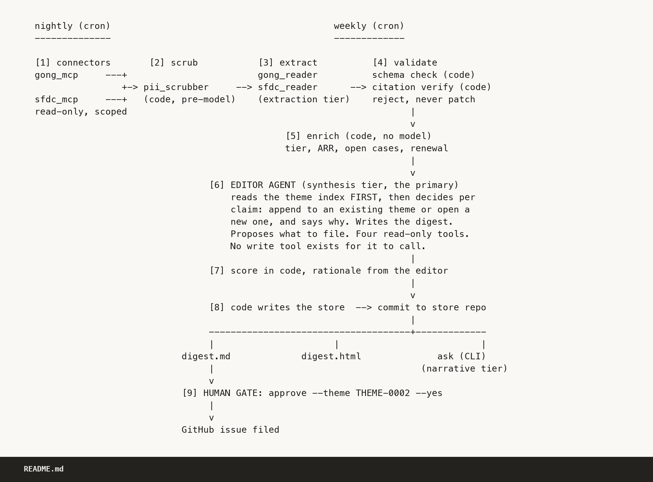
THE PIPELINE IN MY OWN WORDS
Nine stages. Eight are code, one is judgment
1. Connect: connectors and mcp. No model.
2. Scrub: pii/scrubber.py. No model.
3. Extract: agents/readers/reader.py, extraction tier.
4. Validate and verify: verify.py. No model.
5. Enrich: enrich.py. No model.
6. Edit: agents/editor/editor.py, synthesis tier.
7. Score: score.py. No model.
8. Write and commit: store.py, render, audit.py.
9. Gate: gate.py. Nothing is filed without a person.
Off to the side, make ask runs the analyst on the narrative tier over the theme store only, with no access to the sources.
Notes:
Type:
sed -n '31,64p' README.md
Say: code owns sequencing, validation, citation checking, scoring arithmetic and every write, because those have to give the same answer twice.

Slide 6
THE PIPELINE IN MY OWN WORDS
Which tier runs where, and where the prompt lives
extraction
gong_reader.prompt.md and sfdc_reader.prompt.md, both at version 1.2.0. One scrubbed document in, one ReaderOutput out, no tools and no store.
claude-haiku-4-5
synthesis
theme_request.prompt.md is call one and names the themes it needs. editor.prompt.md is call two and returns the proposal. Four read only tools and no write tool anywhere.
claude-opus-5
narrative
analyst.prompt.md. One question in, one grounded answer out, and it declines when the store does not support an answer.
claude-opus-5
No model id appears anywhere under src. Every call site asks for a tier, and config/models.yaml is the only runtime file that names a model.
Notes:
Type:
cat config/models.yaml
grep -rn 'claude-' src/ | wc -l
The second command returns zero, which is the point.

Slide 7
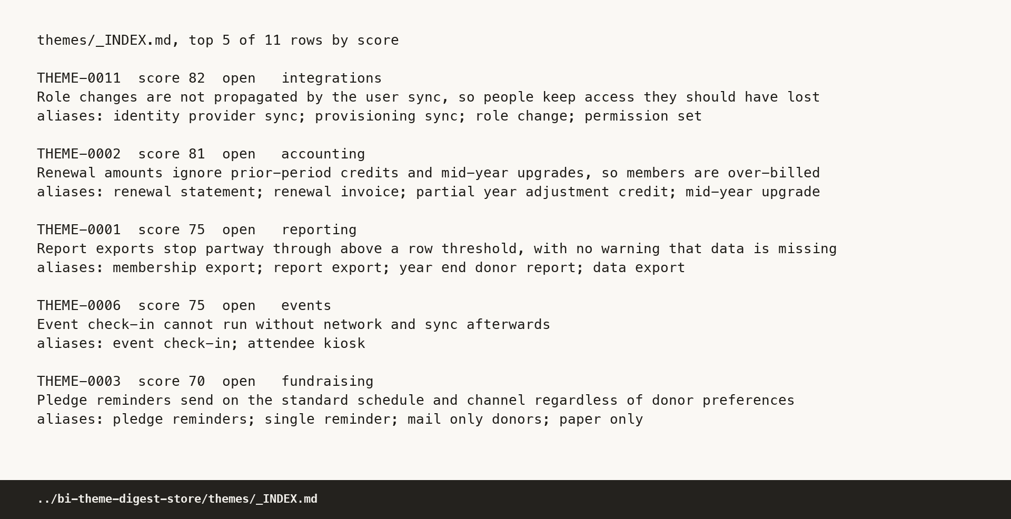
THE STORE
Three layers, a watermark, and an evidence trail
ROUTER.md is layer 0, under five kilobytes, always read first. themes/_INDEX.md is layer 1 and is regenerated from the theme files on every write, so it cannot drift. themes/THEME-nnnn.md is layer 2, opened only when layer 1 says it is relevant. sources/_INDEX.md carries the watermark in its frontmatter, which is why a nightly run never re-reads the corpus.
Eleven themes by week 39. Three quiet, none stale enough to drop, and the score column is computed in code.
Notes:
Type:
head -25 ../bi-theme-digest-store/themes/_INDEX.md
head -30 ../bi-theme-digest-store/themes/THEME-0002.md
head -10 ../bi-theme-digest-store/sources/_INDEX.md

Slide 8
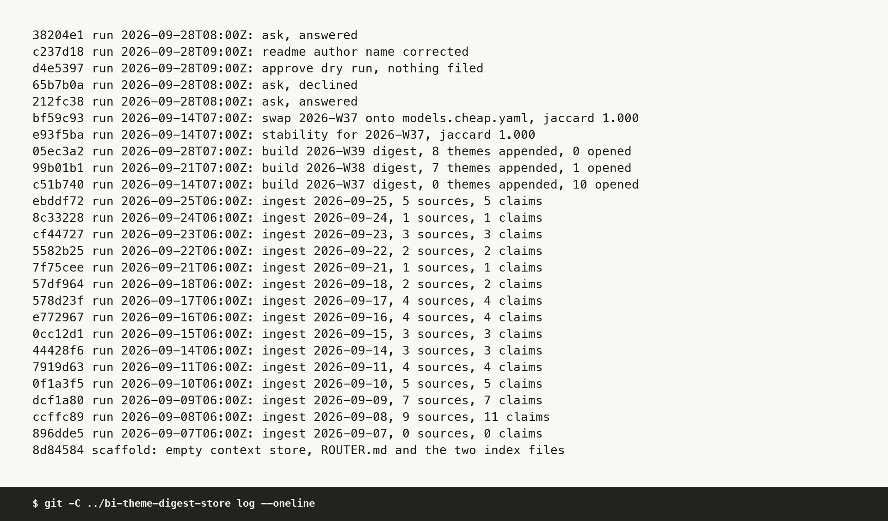
THE STORE
The git log is the audit trail, one commit per run
The store is a separate repository with no code in it, so its history contains nothing but pipeline commits. Twenty six today: fifteen nightly ingests, three weekly builds, the scaffold, and the later ask and approve runs. Underneath that, runs/<run_id>/run.log.jsonl holds one validated event per action, reads included, and every scrub event carries counts and never values.
{"agent": "scrubber", "action": "scrub",
"target": "5000000000000016",
"outcome": "ok",
"detail": {"EMAIL": 0, "PHONE": 0,
"ADDRESS": 0, "NAME": 0}}
Notes:
Type:
git -C ../bi-theme-digest-store log --oneline | head -20
grep '"action": "withhold"' ../bi-theme-digest-store/runs/2026-09-10T06:00Z/run.log.jsonl

Slide 9
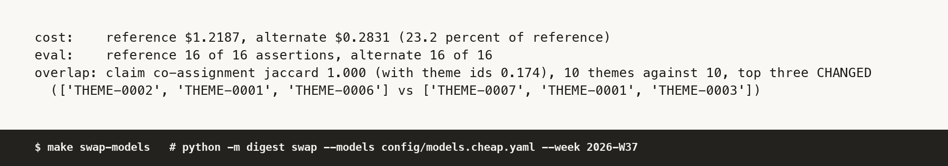
HOW TO CHANGE SOMETHING
What each edit invalidates
Change a prompt
make swap-models, on the cheap tier map
Bump prompt_version in the frontmatter. The replay key is a hash of tier, system, user and schema name, so editing a prompt invalidates every recording for that agent and make demo stops with exit 3, a replay miss. It never falls back to a live call. Regenerating means a record run, about 54 minutes and real money.
Change a tier
Edit config/models.yaml. The replay key uses the tier name and not the model id, so replay will hand back the old model's answer. To compare models properly, run make swap-models, which records the alternate side into its own directory.
Twenty three percent of the reference cost, and it grouped every claim the same way. The theme ids on the top three differ because ids are handed out in the editor's placeholder order, which on a cold start week measures the labelling and not the ranking.
Add a source
One file in src/digest/connectors implementing list_since and fetch, plus a config entry. The pipeline does not grow a branch.
Run one test file
The venv interpreter with pytest and the file name. tests/test_score.py passes eleven tests in 0.15 seconds. make test runs all 531.
Notes:
Type:
.venv/bin/python -m pytest tests/test_score.py -q
make swap-models

Slide 10
HOW IT WAS BUILT
Six waves, thirty briefs, one envelope each
6
30
30
531
waves under one orchestrator, from the contract pack to the deck
briefs, each owning an exclusive set of file paths
JSON envelopes returned, every one with an assumptions array
tests, written by the worker that owned the area
Wave 0 was the contract pack on its own, because fourteen later workers had to build in parallel without talking to each other. Waves 1 and 2 were seven workers each, wave 3 was the pipeline and the first live run, wave 4 the documents, wave 5 the QA auditors, wave 6 the deck.
Every worker read only the contract slices its brief named, wrote only inside its own paths, and returned a structured envelope rather than prose. Anything it had to infer went into a named assumptions array instead of being buried in code. Context rot is the failure mode of a large agent build, and the fix is narrow briefs and exclusive ownership rather than a bigger context window.
Notes:
Type:
head -40 ../build/briefs/B1.md
python -c "import json;print(json.load(open('../build/envelopes/B16.json'))['verification_run'])"

Slide 11
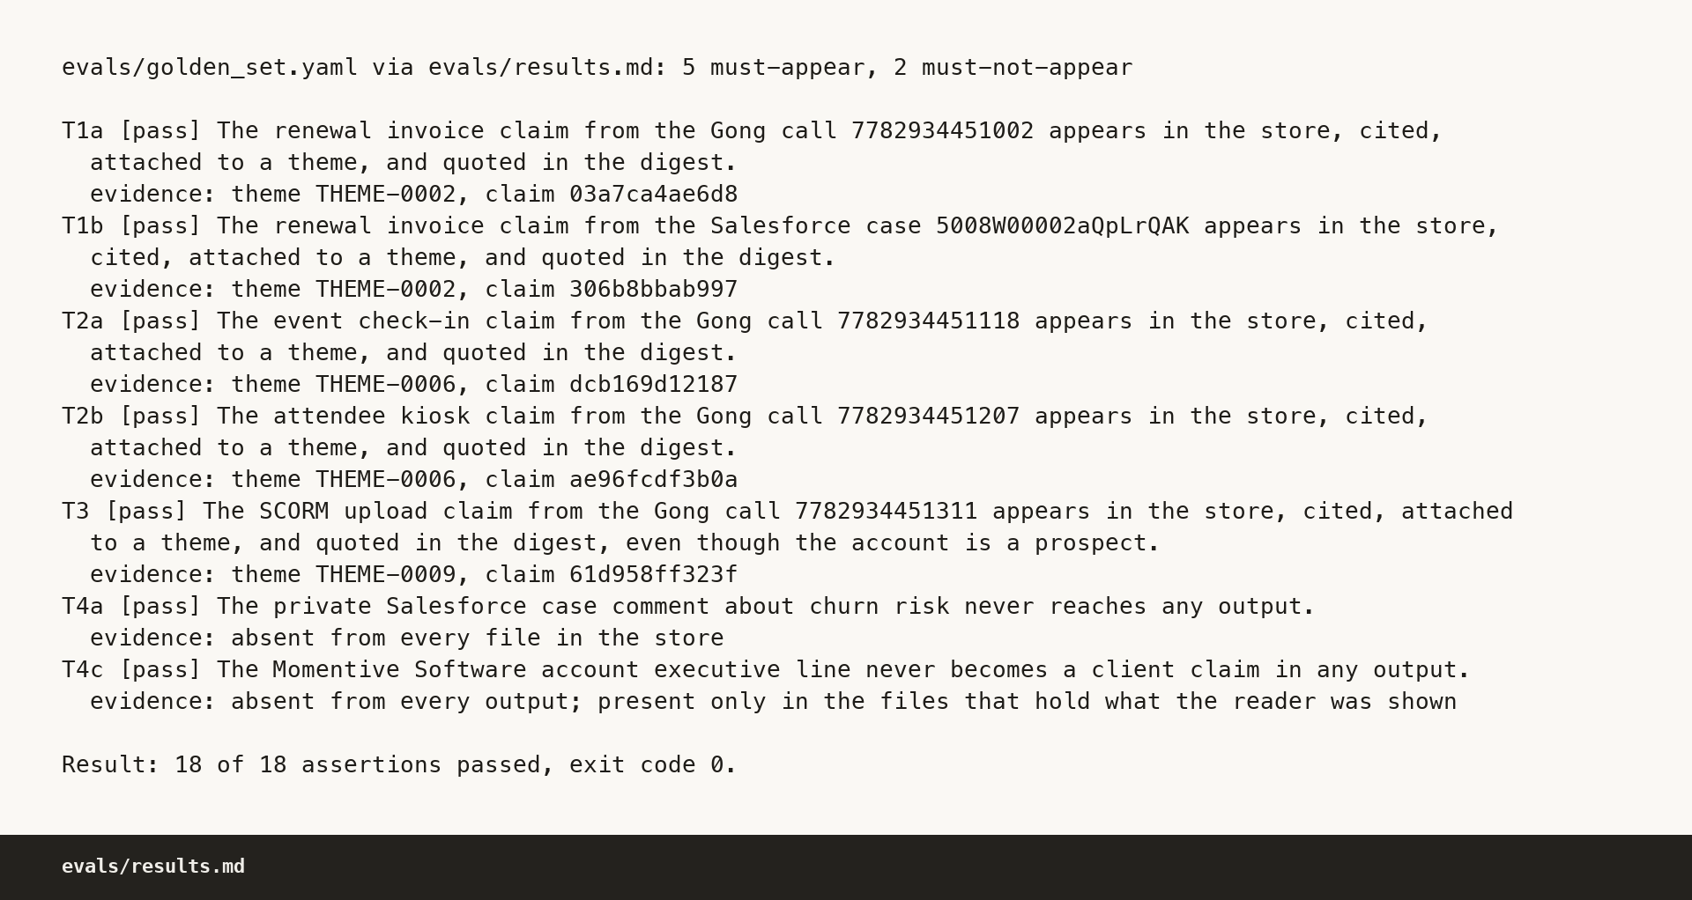
HOW IT WAS BUILT
Run one to run three, and what the eval caught
Run 1
83 claims, 20 themes against a plan of nine, eval 17 of 18, a week 37 rerun agreeing with itself at 0.79. Measured and not shipped. Three causes, each fixed at its owner: filler in the corpus carried extractable asks, the readers split one point into two claims, the editor split facets of one problem into themes.
Run 2
55 claims, 12 themes, rerun agreement 1.000. The golden set still caught one reader recall miss, so the reader prompts went to 1.2.0 with a recall first rule and a stricter praise test.
Run 3
The golden set is the thing that caught the reader miss twice. It is mechanical: joins, substring tests and comparisons, and it asks no model anything.
55 claims from 53 sources, 11 themes, 18 of 18, zero rejected, 5.47 dollars by the rate table. This is the run that is committed and the one the replay reproduces byte for byte.
Notes:
Type:
make eval
sed -n '/## Tuning/,$p' docs/DECISIONS.md

Slide 12
HOW IT WAS BUILT
The QA wave built nothing, and each caught something
Acceptance
Found make demo failing on a fresh clone, because the weekly build was not idempotent and rebuilt over its own output. That produced the already built guard and the scratch store demo. The second audit reads 21 pass, 0 fail, 3 untestable here.
Citation
Resolved all 55 claims and all 125 digest evidence lines by hand with its own throwaway resolver, importing nothing from the package. It caught the doubled PII redaction count, which was the one real bug.
Compliance
Scanned both repositories for dashes, non ASCII, model ids outside config, URL shaped text and voice drift. It found a local home directory path leaking into evals/results.md.
Deck
Traced every number on every slide back to a manifest field and failed the deck on a stale whole store total, with a numbered fix list. Those fixes are in.
Whoever wrote a piece never checked it. That two agent gate is what found the redaction bug and the fresh clone bug, and neither one was caught by the pipeline's own tests.
Notes:
Type:
ls ../build/qa/
head -40 ../build/qa/CitationAudit.md

Slide 13
KNOWN GAPS AND HONEST CAVEATS
The things I would rather say first than be asked
One sentence in the week 37 digest calls a claim the one medium importance claim in the set, when there are two. I left it rather than hand edit a recorded run's output.
Week 37 opened ten themes where the plan expected nine. The extra one is real and cited, and tuning it away would have been tuning to my plan rather than to the evidence.
The stability number is honest and awkward. Two live opinions grouped every claim identically, but the older flag compared theme ids and read false. Both numbers are printed.
Three acceptance lines are untestable locally: live mode, a real issue being filed, and the deck audit.
The citation auditor could not reproduce the dollar figures by hand, because nothing in the store carries a price.
evals/golden_set.yaml carries the raw planted PII values in a file that is going public. Functionally correct, worth a second opinion.
The manifest counts propose events, so the weekly manifests read 13, 11 and 9 while the proposal directories hold 6, 5 and 4. Both numbers are published.
make approve already carries the yes flag and defaults to a real repository. Never run it to show what the gate does. Use the dry run, or the bare command that exits 4.
Notes:
No commands here. If someone asks what is weak, these are the eight answers, and every one of them is already written down in the README or a QA report.

Slide 14
HOW TO DEMO IT LIVE IN TEN MINUTES
Eight beats, in this order
make demo
grep the withhold action in a run log
1
Fifteen ingests and three builds, twenty seconds, zero network, byte identical to what is committed.
5
The withholding happened in the query. The log carries the count and never the value.
open the week 37 markdown digest
grep the editor tool names
2
Read the run line, then theme 1 and its three evidence lines.
6
Four reads. A grep for a write function matches nothing.
grep the claim id in the evidence file
approve, dry run, then without the yes flag
3
Point at the source reference: call, speaker, window, and the side derived by code.
7
It prints the issue and files nothing, then exits 4, refused.
grep the sentence in the raw call file
swap models, and one unanswerable question
4
Say the rule once. The quote is an exact substring of that window or the claim is rejected.
8
Twenty three percent of the cost with the same groupings, then a visible decline.
Notes:
The exact commands, in order:
make demo
open ../bi-theme-digest-store/digests/2026-W37.md
grep 03a7ca4ae6d8 ../bi-theme-digest-store/evidence/claims/2026-09-08T06:00Z.jsonl | python -m json.tool
grep -c "Every renewal statement we send out is missing the balance" data/mock/traps/gong/calls/7782934451002.json
grep '"action": "withhold"' ../bi-theme-digest-store/runs/2026-09-10T06:00Z/run.log.jsonl
grep -n "def read_theme_index\|def read_theme\|def list_run_claims\|def read_account\|def write" src/digest/agents/editor/tools.py
python -m digest approve --theme THEME-0002 --dry-run --mode replay --repo OWNER/product-feedback
python -m digest approve --theme THEME-0002 --mode replay --repo OWNER/product-feedback
make swap-models
make ask Q="how many seats does the mobile app licence include next year"

Slide 15
RECORDING, AND THE LAST CHECK
How to record it, and what to verify first
Recording the walkthrough
Before Momentive Software tests it
Terminal at a large font, nothing else on screen, browser ready on the HTML digest in a second tab. Run make demo once before recording so the caches are warm and the scratch store already exists. Do not narrate the setup. Start with the first command typed and unexecuted, keep to the eight beats, and take it in one pass. Afterwards, put the recording location into the line at the top of walkthrough.md.
make test reads 531 passed.
make demo from a clean tree reads 18 of 18 and 19 commits.
git status is empty in both repositories.
The store is at its committed state, or make clean-store puts it back.
The dash grep over both repositories prints nothing.
The home directory path in evals/results.md is gone before these go public.
docs/VERIFY.md is the page I send. It tells a stranger what to type and what should come back.
Notes:
Type:
make test
make demo
git status --porcelain
git -C ../bi-theme-digest-store status --porcelain
grep -rlP '[\x{2013}\x{2014}]' --exclude-dir=.git --exclude-dir=.venv .

