Slide 1
Feature / Bug Requests
A prioritized digest for the product team
Jim Mehta · September 2026

Slide 2
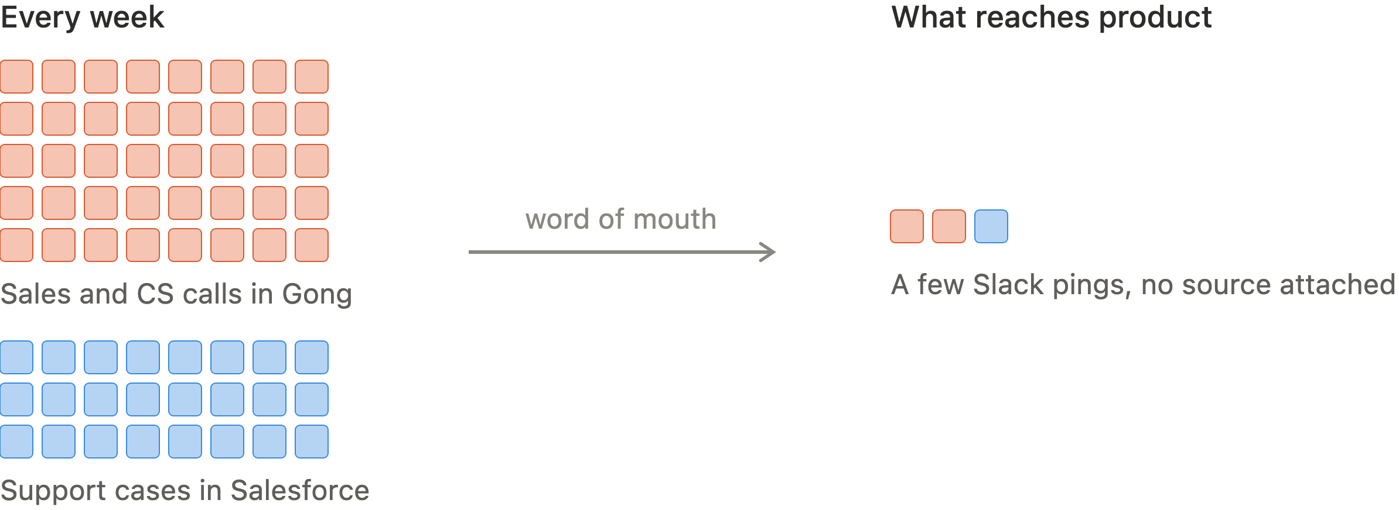
2
Product hears a fraction of what customers and prospects ask for
Notes:
Situation and complication. Dozens of calls and cases a week hold what the market wants. What reaches product today is word of mouth with no source attached.

Slide 3
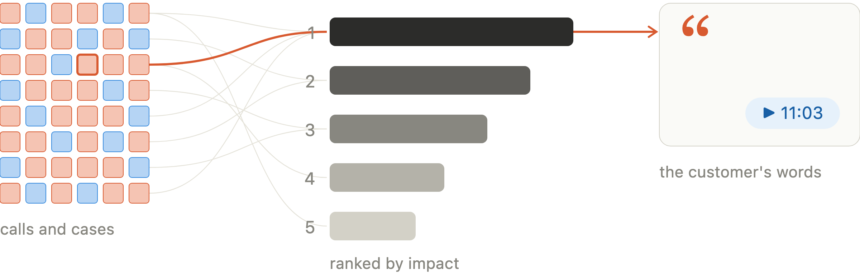
3
Every request lands in one ranked list, with the customer's own words attached
Notes:
The answer. Calls and cases collapse into a ranked list. Any line opens to the customer quote and the exact moment it was said.

Slide 4
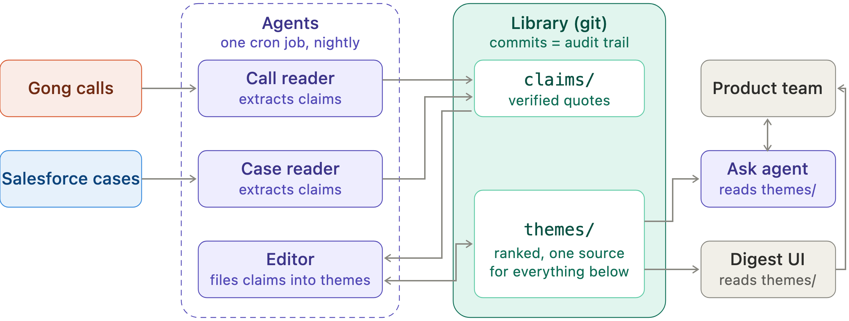
4
The whole system: two sources, three agents, one git library, one product team
Notes:
System. One nightly job: readers write verified claims, the editor files claims into themes. themes/ is the single source; the digest UI and the ask agent both read it. Commits are the audit trail.

Slide 5
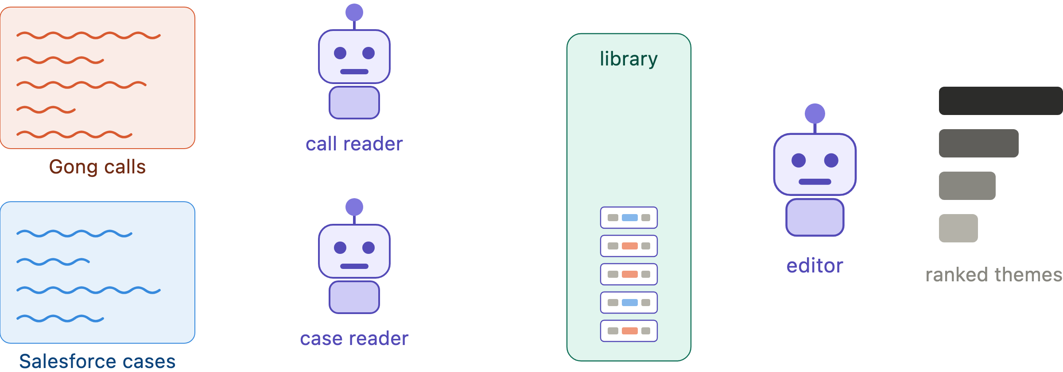
5
Reader agents turn conversations into records; the editor agent sorts records into themes
Notes:
Agents. Two cheap reader agents, one per source, return structured records. The frontier editor agent reads existing themes first, then files each new claim: append or open, with one line of why. All nightly.

Slide 6
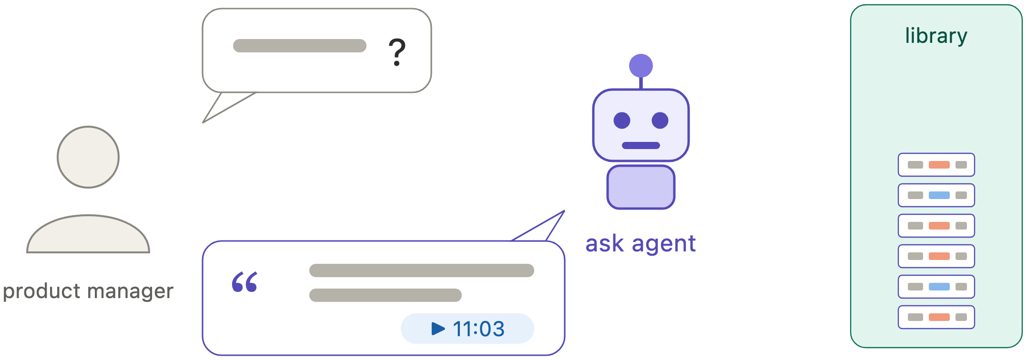
6
Ask why a theme matters; the answer comes from the library, with the customer's words
Notes:
Ask. The ask agent answers only from the library. It never queries Gong or Salesforce live.

Slide 7
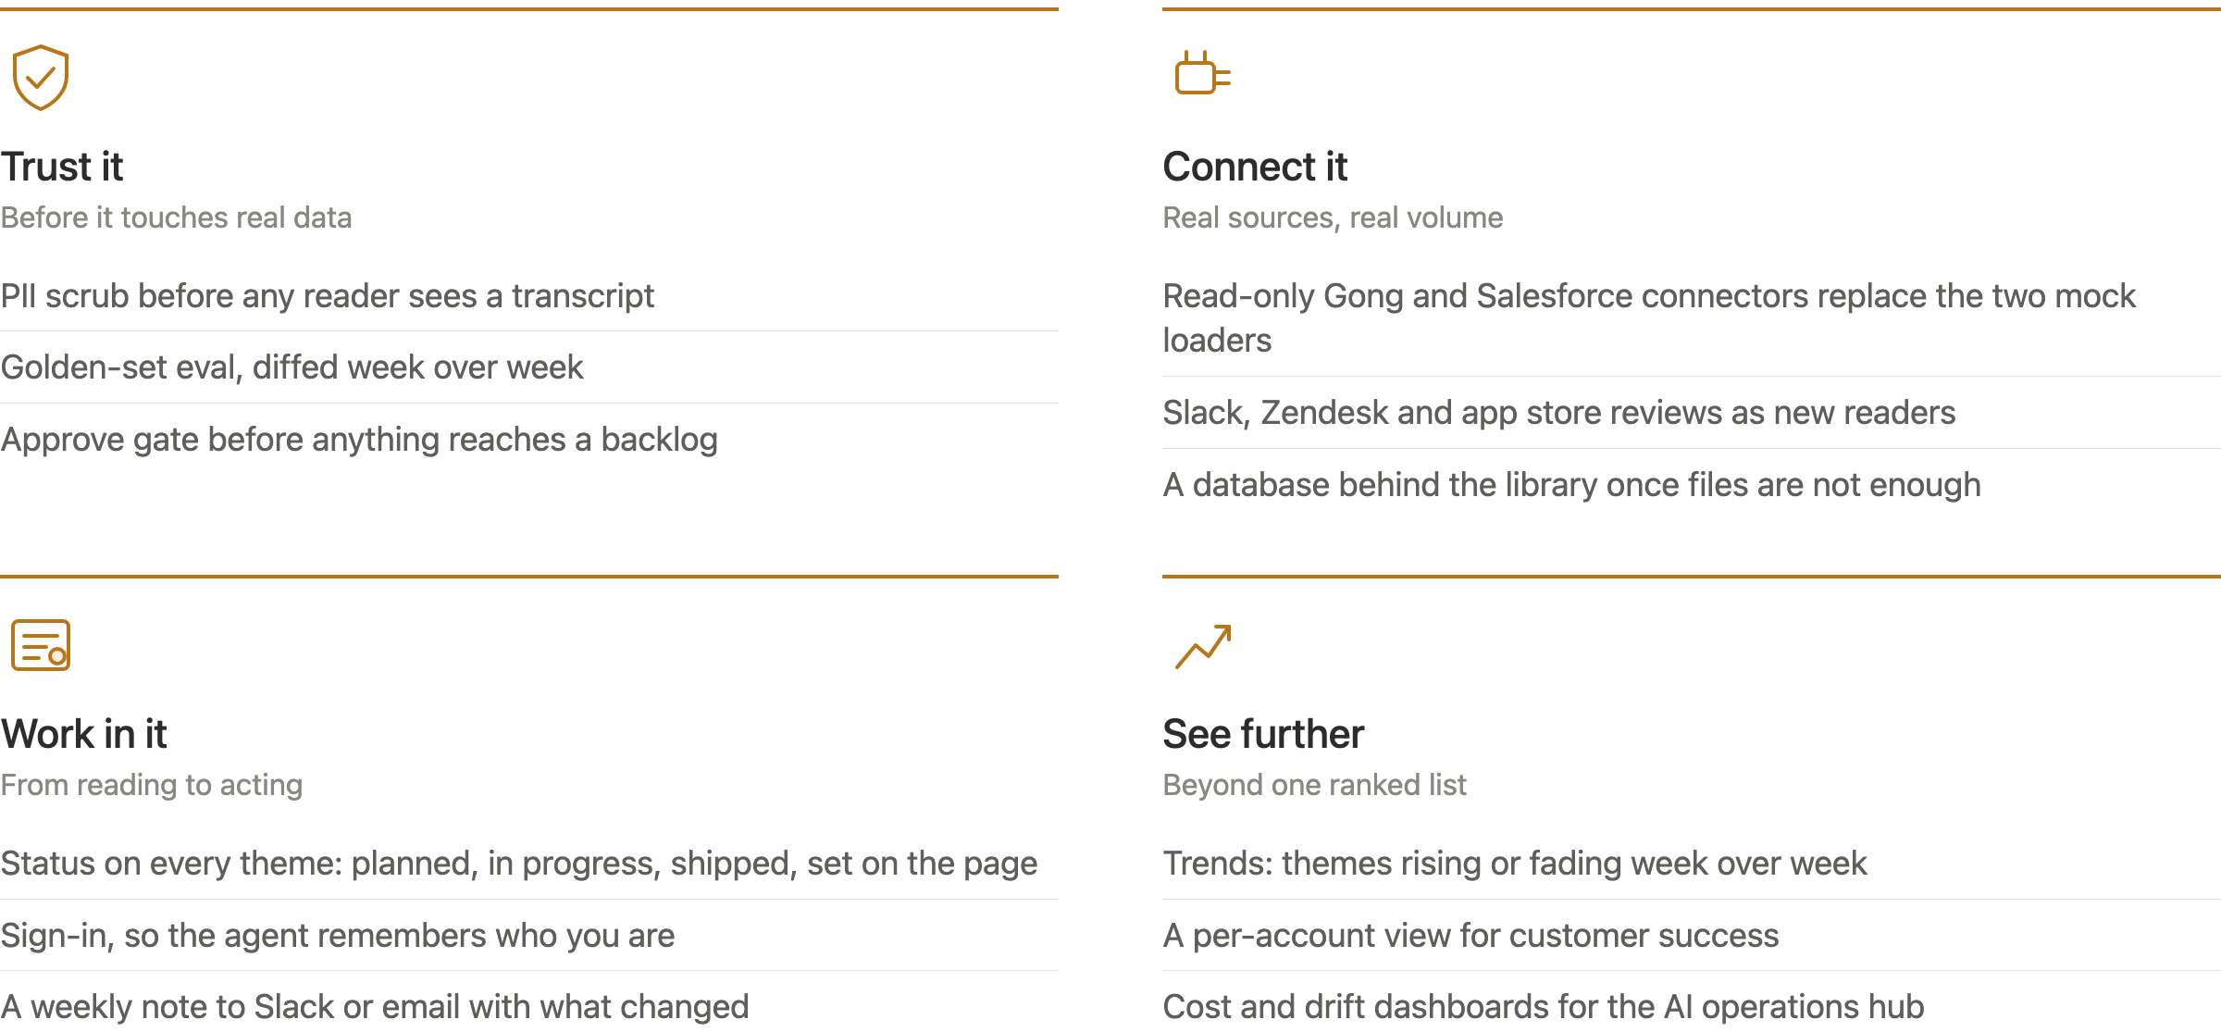
7
Built to the brief; the next steps are designed, not built
Notes:
Scope. Built only what the brief asked for. PII scrub, live connectors, evals and an approve gate are drawn on the system; a database, sign-in with memory, status per theme, weekly notes, more sources, per-account and trend views are listed for later. None of it is built.

Slide 8
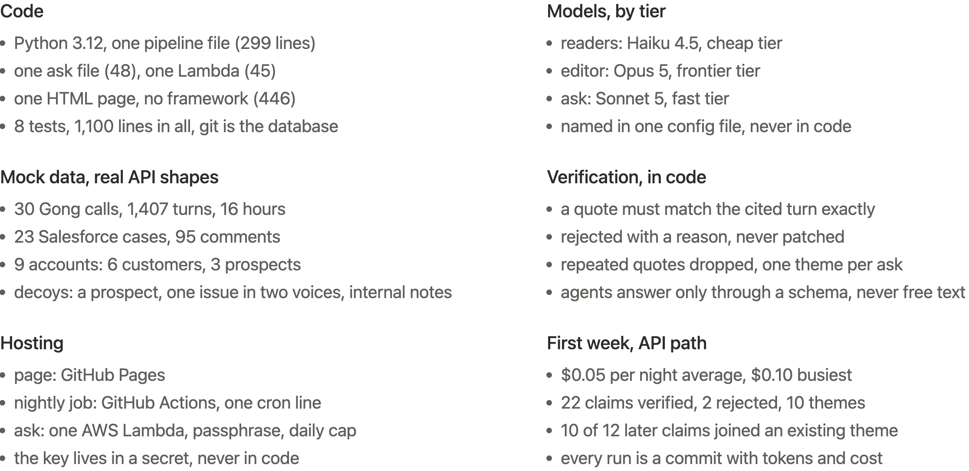
8
Appendix: the decisions behind it
Notes:
Appendix. The stack, the model tiers, the size of the mock data, the checks in code including that every agent answers only through a schema, the hosting, and the first week of real numbers. Every one of these was a choice; the point is that nothing here is accidental.

