Slide 1
Analysing Perceptron's model for and gate
Minimum threshold at which there is no error.
Bias and weight printed for each training cycle.
What is a effect of change in learning rate?
Take a 3 input and train for 6 input set and predict for rest 2.

Slide 2
1. Minimum threshold at which there is no error.
Threshold value | Correct Prediction
1 | No
2 | No
3 | No
4 | No
5 | Yes
100 | Yes
Conclusion :- The minimum Threshold at which there is no error is 5.

Slide 3
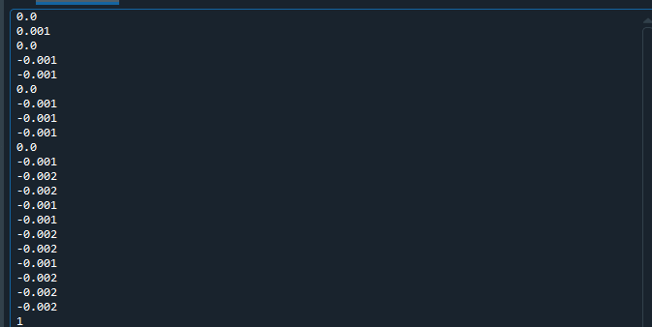
2. Bias obtain in each iteration

Slide 4
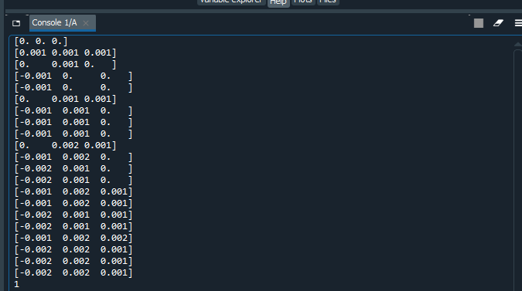
Weights obtained in each iteration

Slide 5
3. What is a effect of change in learning rate?
There are multiple ways to select a good starting point for the learning rate. A native approach is to try a few different values and see which one gives you the best loss without sacrificing speed of training. We might start with a large value like 0.5, then try exponentially lower values: 0.01, 0.001, etc.
Learning rate | Elapsed time during the whole program in seconds
0.5 | 0.015625
0.01 | 0.0
0.001 | 0.0

Slide 6
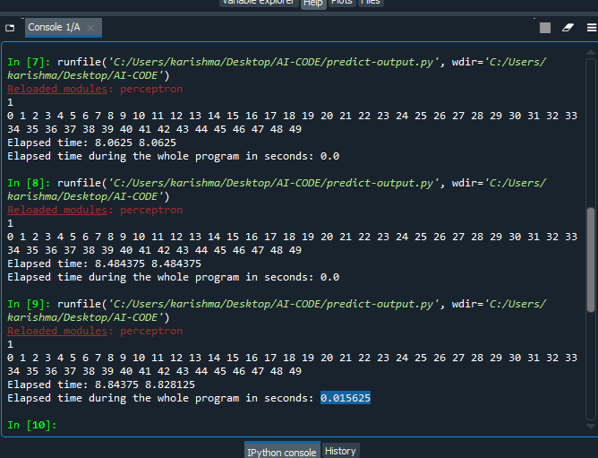
Conclusion:-
The learning rate controls how quickly the model is adapted to the problem.
If the learning rate is low, then training is more reliable and more efficient.
If the learning rate is high, then training model may be slower comparatively.

Slide 7
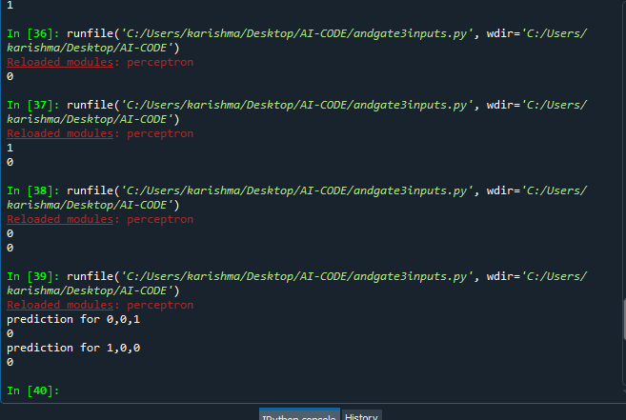
4. Take 3 input and train for 6 input set and predict for rest 2.

Slide 8
CODE :-
import numpy as np
from perceptron import Perceptron
training_inputs = []
training_inputs.append(np.array([0,0,0]))
training_inputs.append(np.array([1,0,1]))
training_inputs.append(np.array([0,1,0]))
training_inputs.append(np.array([0,1,1]))
training_inputs.append(np.array([1,1,0]))
training_inputs.append(np.array([1,1,1]))
#predict for rest 2
#training_inputs.append(np.array([0,0,1))
#training_inputs.append(np.array([1,0,0]))
labels = np.array([0,0,0,0,0,1])
perceptron = Perceptron(3)
perceptron.train(training_inputs,labels)
inputs = np.array([0,0,1])
print(perceptron.predict(inputs))
inputs = np.array([1,0,0])
print(perceptron.predict(inputs))

