Slide 1
I.V. FLUID CONTROLLING SYSTEM
By
Saurabh Kumar Mishra (21MCA048)
Jimit Patel (21MCA085)
Under Guidance of Internal Guide
Dr. Jaimin Undavia
Mr. Ravi Patel

Slide 2
Project Profile
Project Name: I.V. Fluid Controlling System
Type of Application: IOT Application
Project Description: Our system is an IOT application which allow controlling the “I.V. Fluid” in Hospital. Hospital worrier manage the application.
Team Size: 2
Front End: HTML, CSS, Bootstrap
Back End: PHP, MySQL Database
Tools used: HX711 Amplifier, LCD Display, Load cell, I2C Model, Node MCU, MAX30102, DS18B20.

Slide 3
Introduction To Tools
HX711 Amplifier:
The HX711 is a precision 24-bit analog-to-digital converter (ADC) that is designed for weighing scales and industrial control applications to interface directly with a bridge sensor.
It is specially made for amplifying signals from cells and reporting them to another microcontroller.
HX711 module is a Load Cell Amplifier breakout board for the HX711 IC that allows you to easily read load cells to measure weight.
The HX711 uses a two wire interface (Clock and Data) for communication.
HX711 has added advantages such as high integration, fast response, immunity, and other features improving the total performance and reliability.
LCD Display:
A liquid-crystal display (LCD) is a flat-panel display or other electronically modulated optical device that uses the light-modulating properties of liquid crystals combined with polarizers.
LCD display responsible for displaying the result of counting drop of I.V. bags.

Slide 4
Introduction To Tools
Load Cell:
S-type Load Cell to continuously measure the bag weight to monitor the amount of fluid in the I.V. bag.
It also uses RFID tag to identify patients. Additionally, the data from the system is uploaded to a healthcare cloud (unspecified) for further review and analysis.
The system checks if the level of fluid inside the I.V. bag is normal or abnormal.
It uses a 6502 microcontroller and an Adriano, a Load Cell of 600 g maximum capacity, RFID tag, ID-20-RFID reader and a Wi-Fi module for transmitting data.
I2C Module:
I2C_LCD is an easy-to-use display module, It can make display easier.
We developed the Arduino library for I2C_LCD, user just need a few lines of the code can achieve complex graphics and text display features.
Supports standard I2C mode (100Kbit/s) and fast I2C mode (400Kbit/s).
Arduino library supported, use a line of code to complete the display.

Slide 5
Introduction To Tools
Node MCU:
Node MCU is an open source platform based on ESP8266 which can connect objects and let data transfer using the Wi-Fi protocol.
In addition, by providing some of the most important features of microcontrollers such as GPIO, PWM, ADC, and etc.
MAX30102 spo2:
The MAX30102 is a very versatile sensor and it can also measure body temperature other than heart rate and blood oxygen level.
This is a sensor designed by Analog Devices and features two LEDs (one Infrared and one Red), a photodetector, optics, and low-noise signal processing unit to detect pulse oximetry (SpO2) and heart rate (HR) signals.
The MAX30102 Digital Pulse Oximeter and Heart Rate Sensor, and this module have 7 pins VCC, SCL, SDA, INT, IRD, RD, and GND.

Slide 6
System Study
Existing System:
In Existing system is totally manual Nurse or Doctor has to check your I.V. and measure health data regularly to be sure patients getting the correct amount of fluid in I.V. bag and patients condition is normal.
Inefficient monitoring of IV drip, leads to complications such as under infusion, blood back flow, over infusion, air embolism etc.
Poor nurse -> patients Ratio globally.(india approx 1.7 nurses->1000 population.)
System are available but at very high price(100k minimum) and only available in ICU’s and not IOT system.
Proposed System:
In our system admin can register doctor and nurse so we can keep data in our database.
Doctor and Nurse can monitor fluid and health data through our application.
Doctor and Authorized staff can check I.V. fluid status from our application, when I.V. fluid is need to closed then display message for available nurse.
Admin view report which is generated by Doctor and also view feedback which is given by user.
Admin can manage application.

Slide 7
System Study
Scope of Proposed System:
Admin as well as Doctor/Nurse will also able to use this system affectively .It would be used on internet.
Doctor manage their I.V. fluid status and if the fluid is closed nurse get notification from our application based on I.V. fluid status update
Our system is only used for Hospitals.
Aim and Objective of the System:
It is a system design especially for Doctor (admin/nurse).
I.V. fluid controlling system provides complete functionality to automatically manage the I.V. for service from our desktop device.

Slide 8
System Study
Advantage of Proposed System:
Not too expensive compare to market products.
Less human effort & monitoring required.
IOT based monitoring so, patient’s data available on cloud server.
Work with low power so, energy efficient.
Make thinks easier for medical staff.

Slide 9
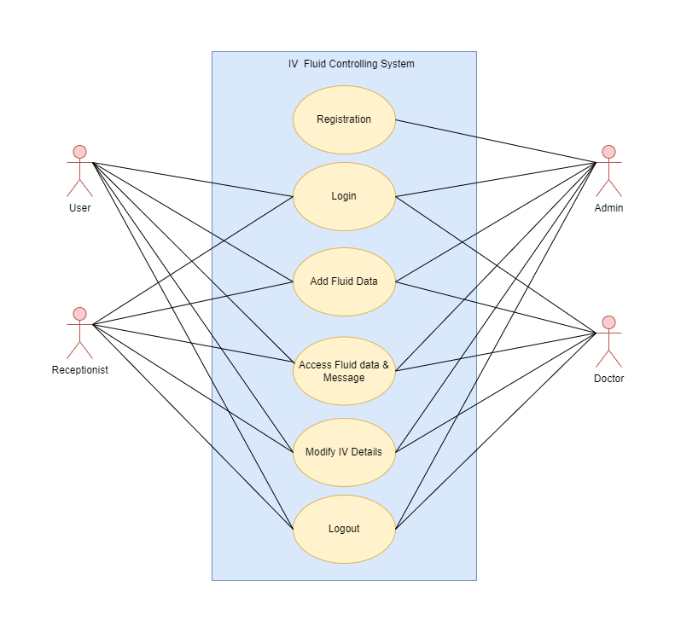
System Analysis
Requirements Specification:
Use case diagram:

Slide 10
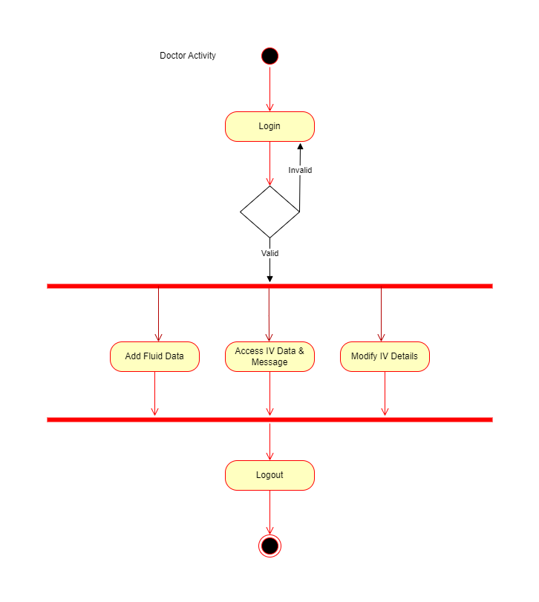
System Analysis
Doctor activity diagram:

Slide 11

System Analysis
User activity diagram:

Slide 12
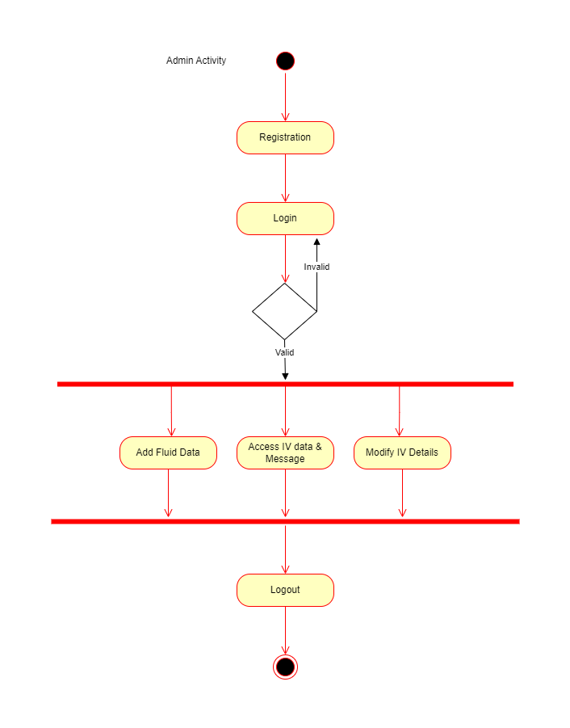
System Analysis
Admin activity diagram:

Slide 13
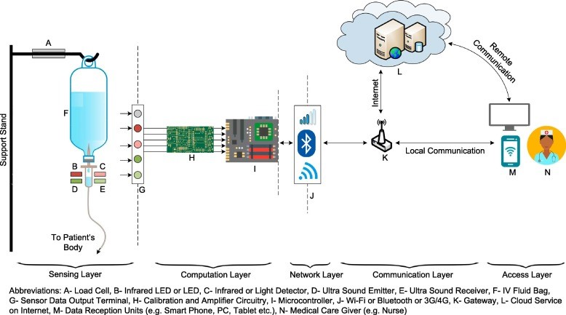
System Design

Slide 14
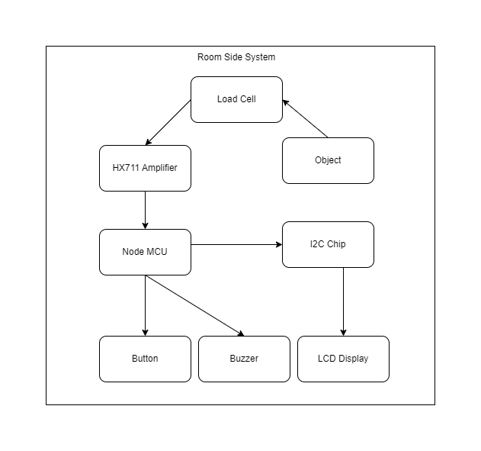
System Design
Room side system:

Slide 15
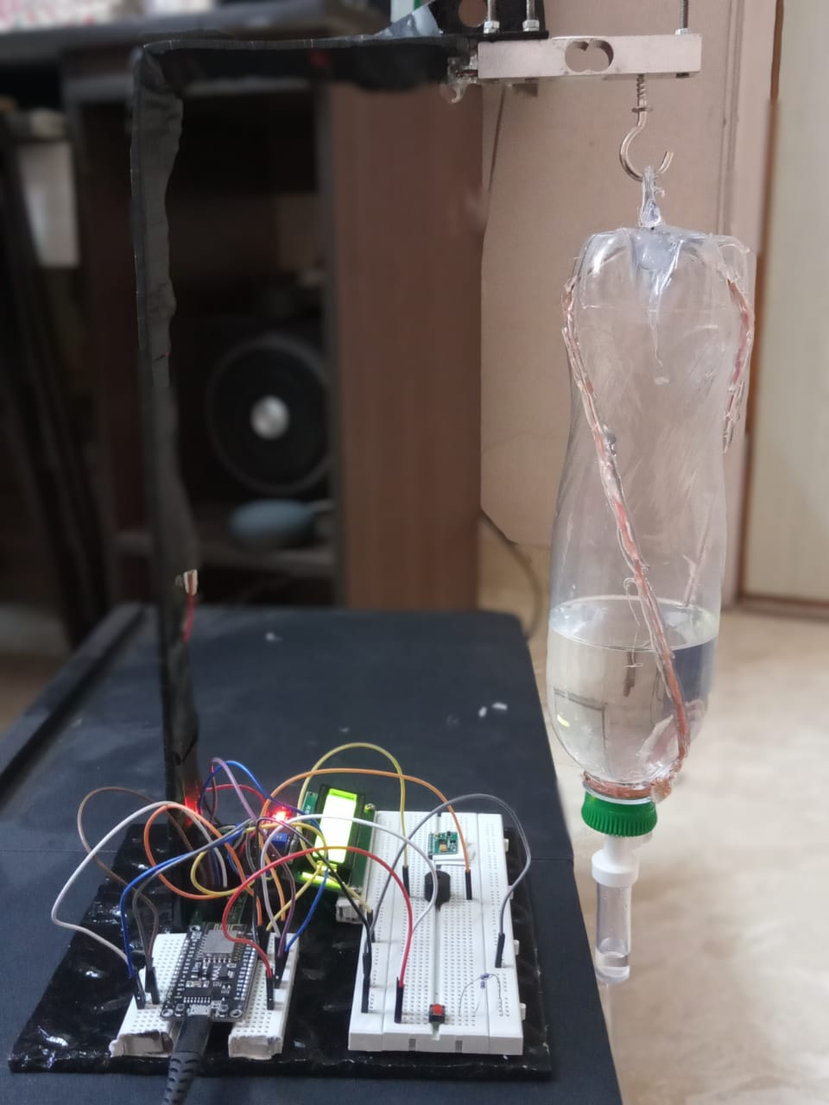
System Design
System screenshots:

Slide 16
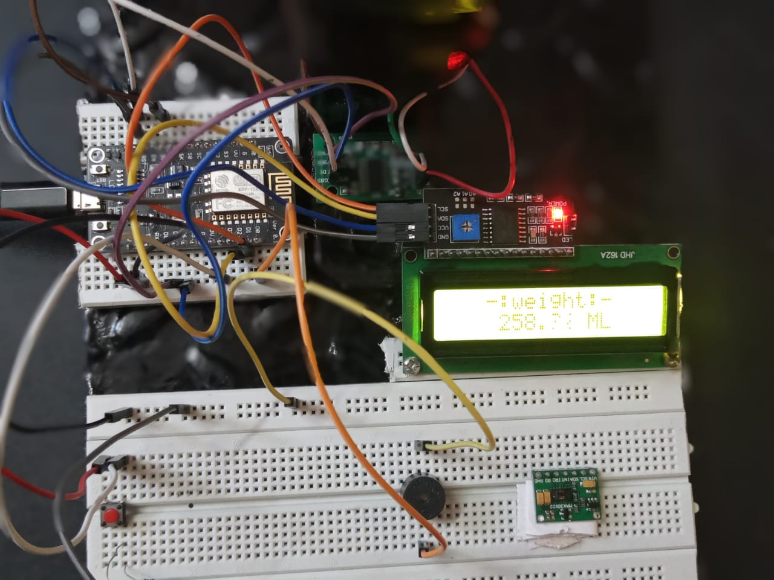
System Design
System screenshots:

Slide 17
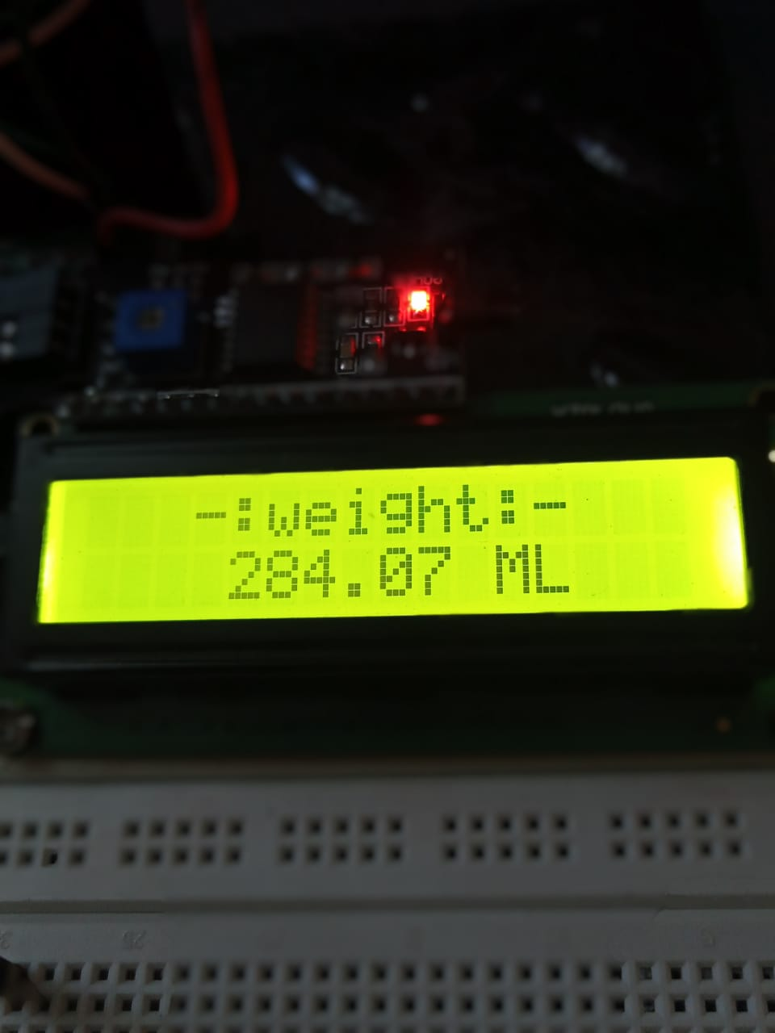
System Design
System screenshots:

Slide 18
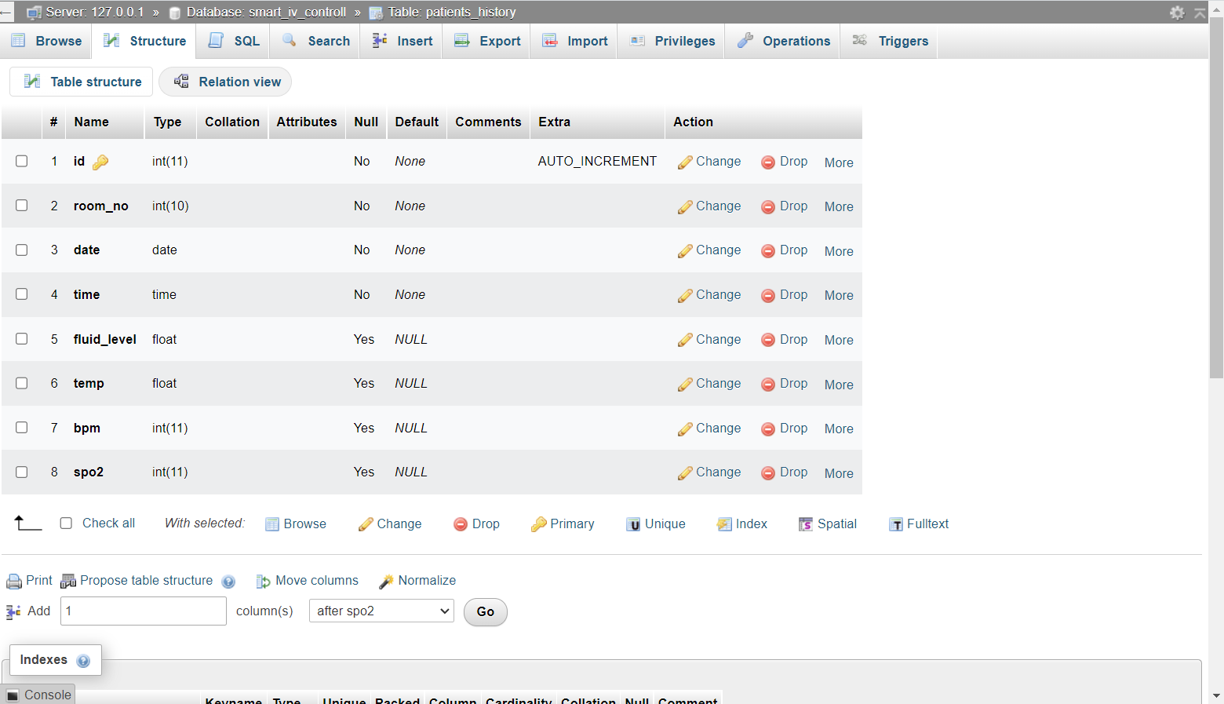
System Design
Database table structure:

Slide 19
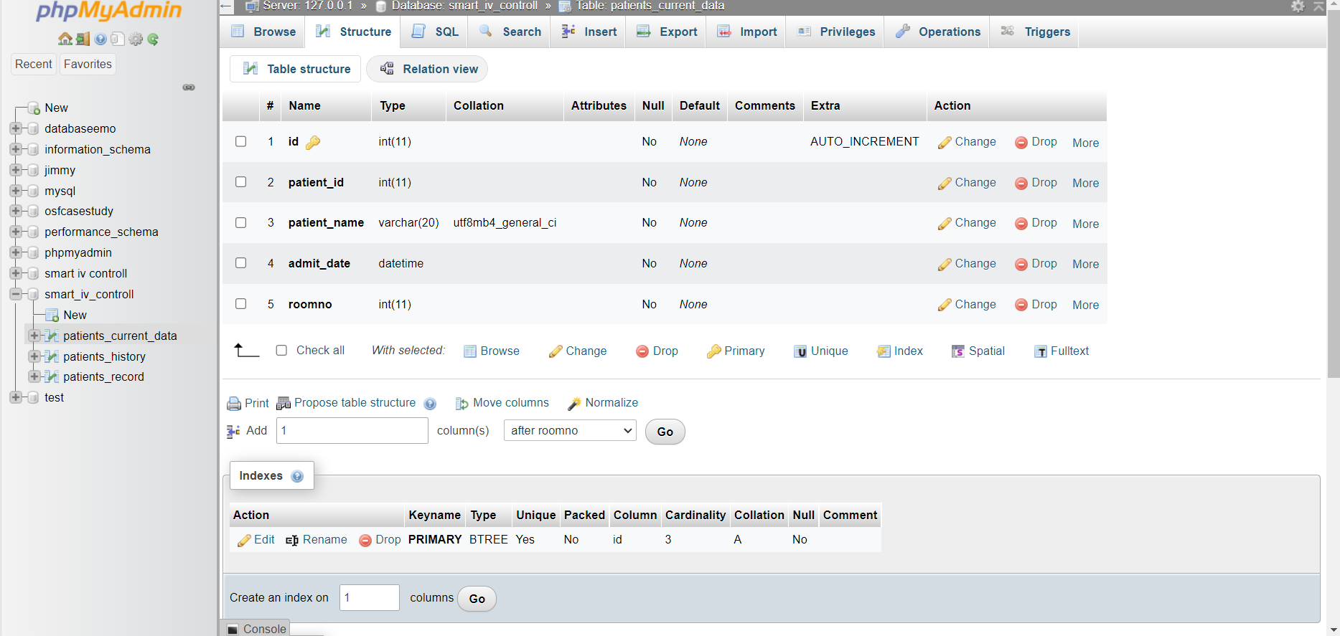
System Design
Database table structure:

Slide 20
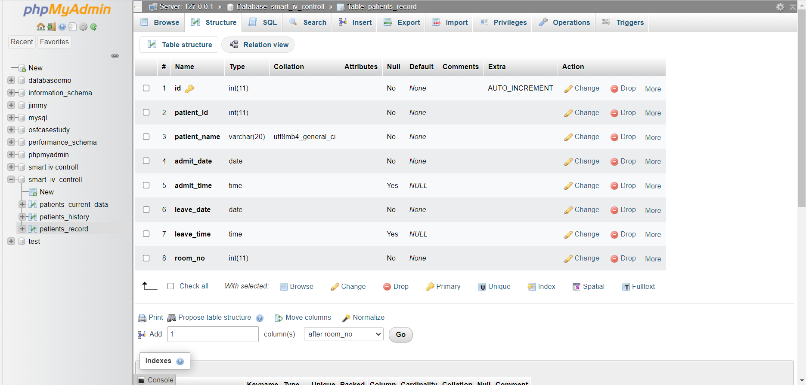
System Design
Database table structure:

Slide 21
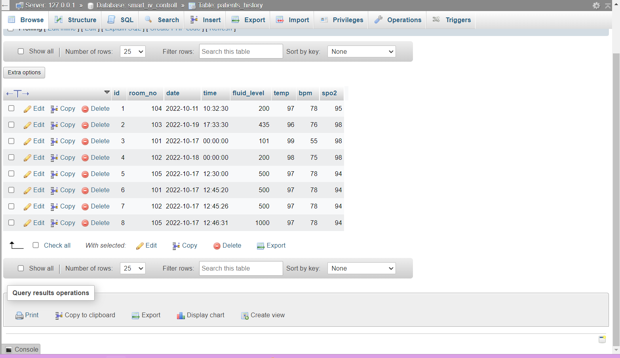
System Design
Patient record database table:

Slide 22
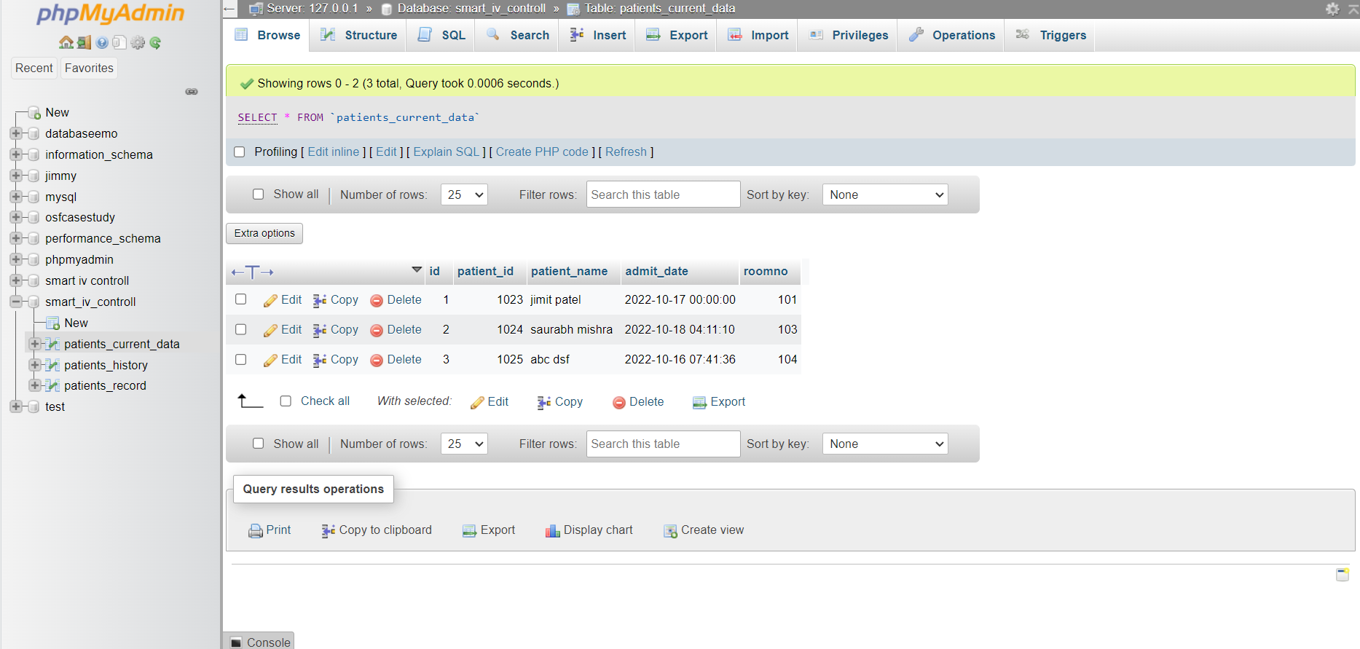
System Design
Patient record database table:

Slide 23
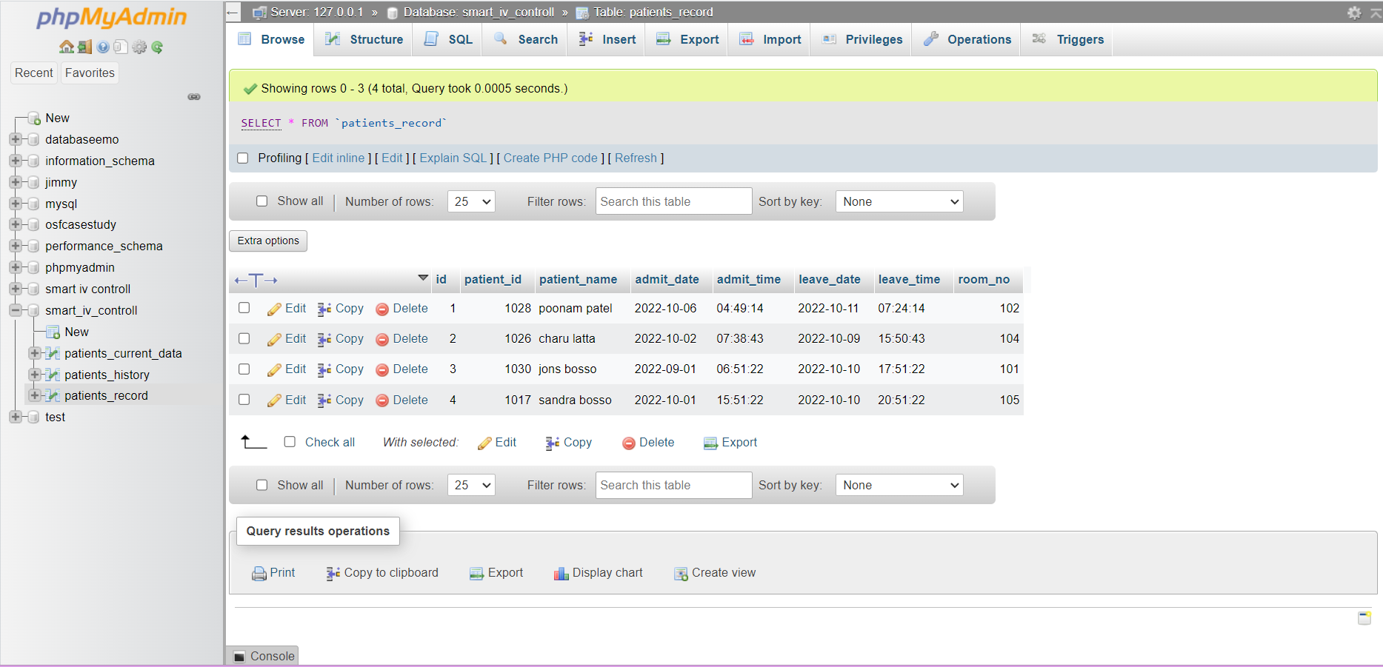
System Design
Patient record database table:

Slide 24
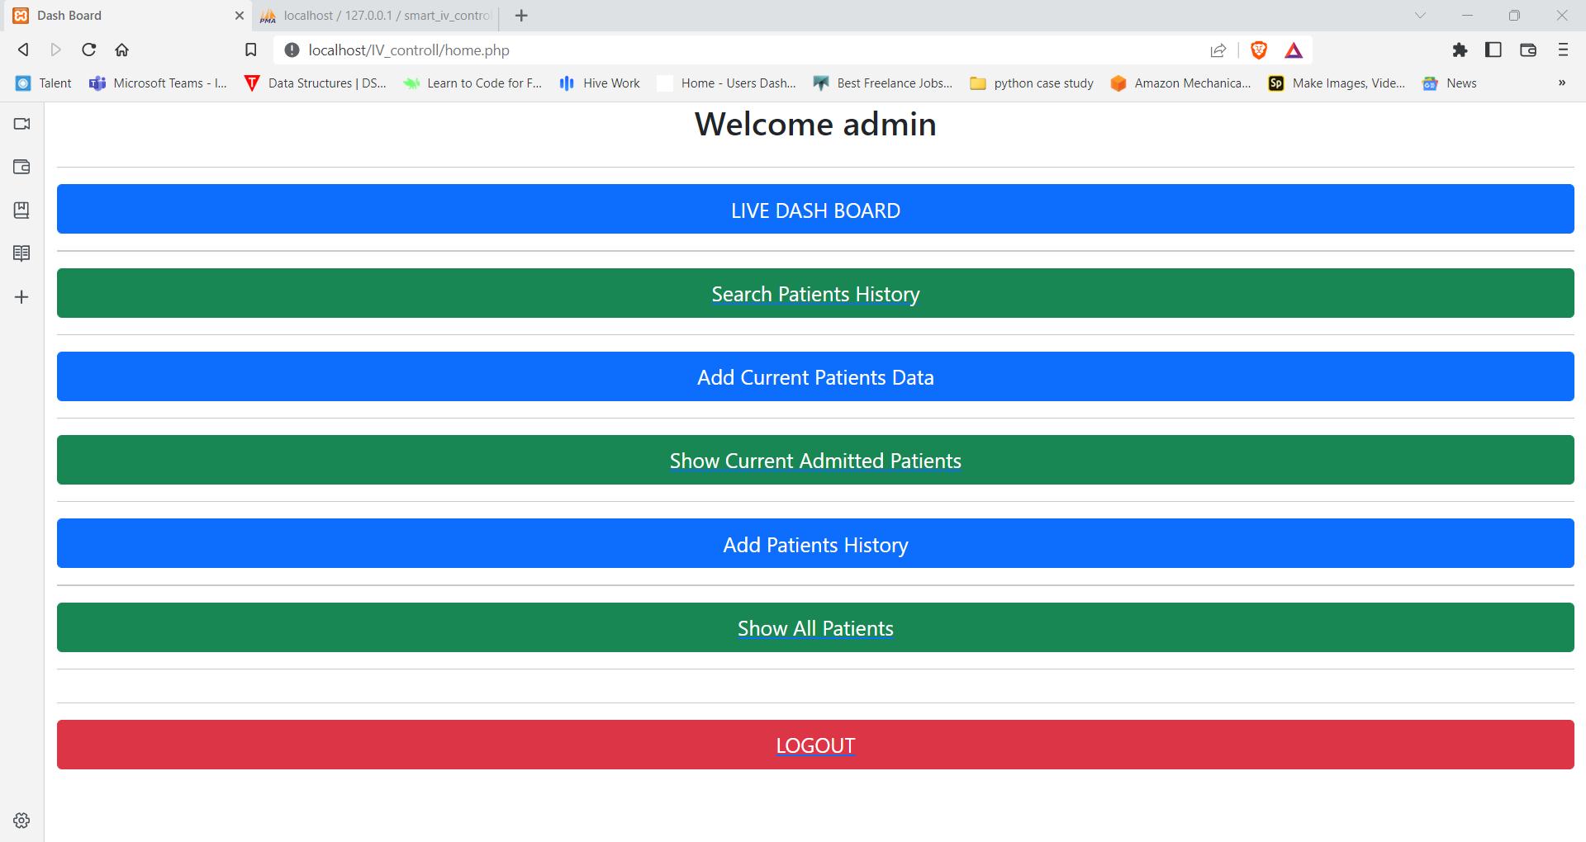
System Design

Slide 25
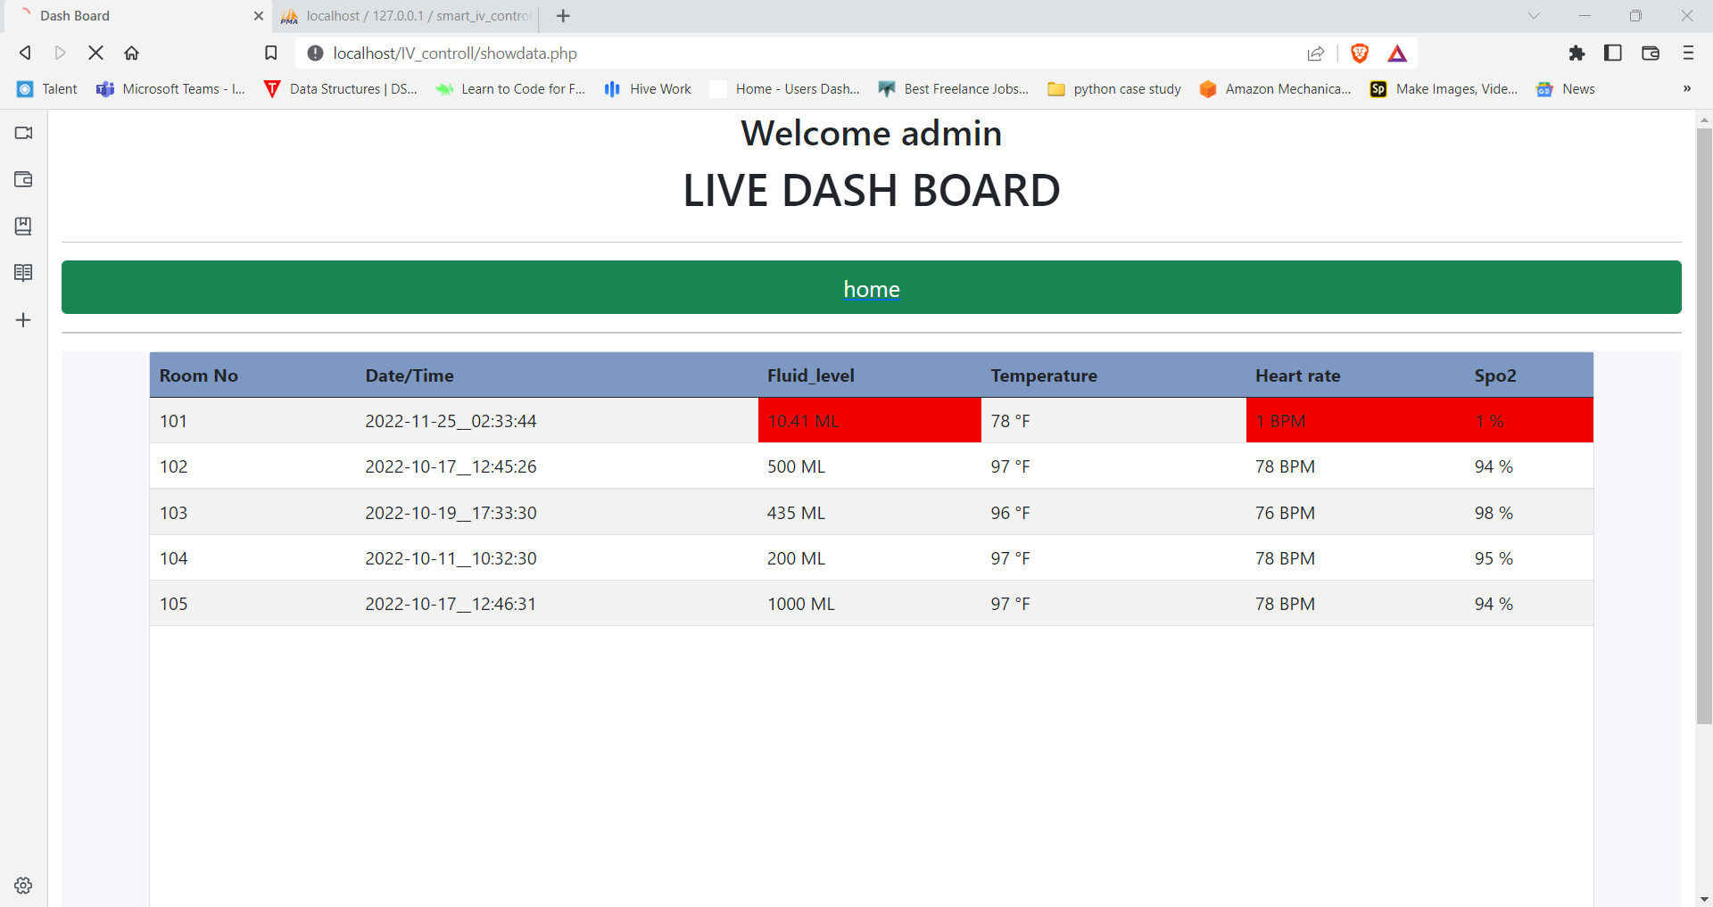
System Design

Slide 26
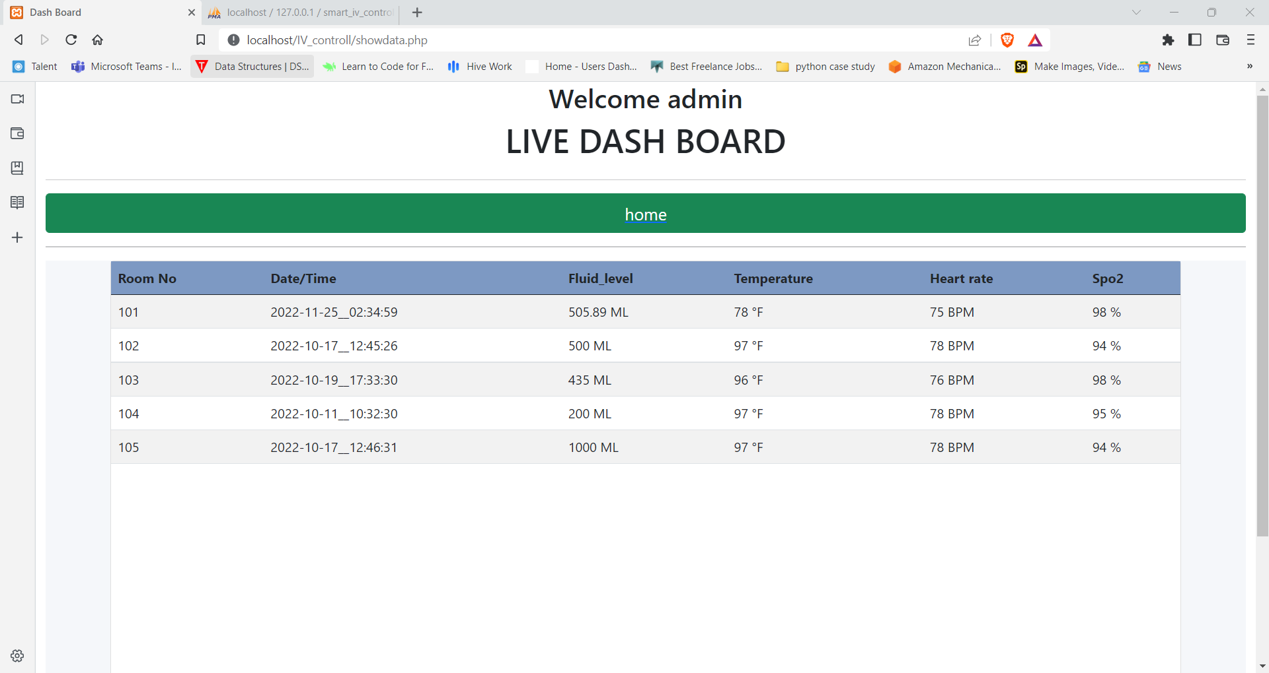
System Design

Slide 27
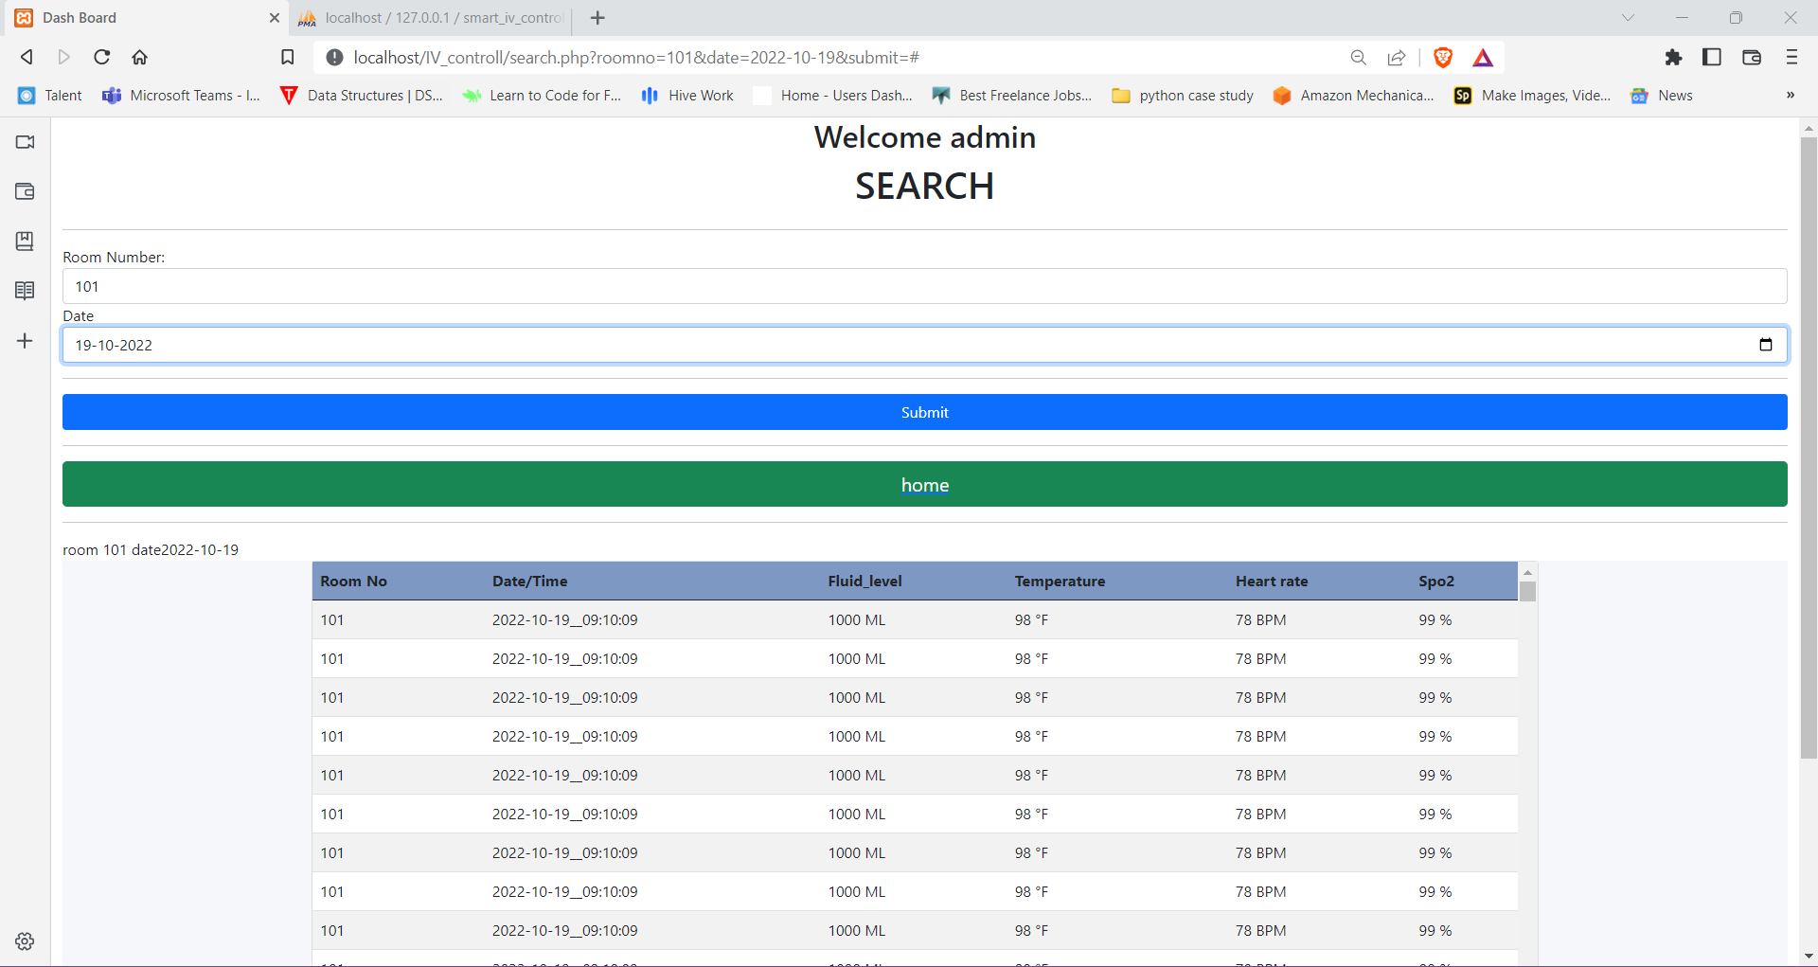
System Design

Slide 28
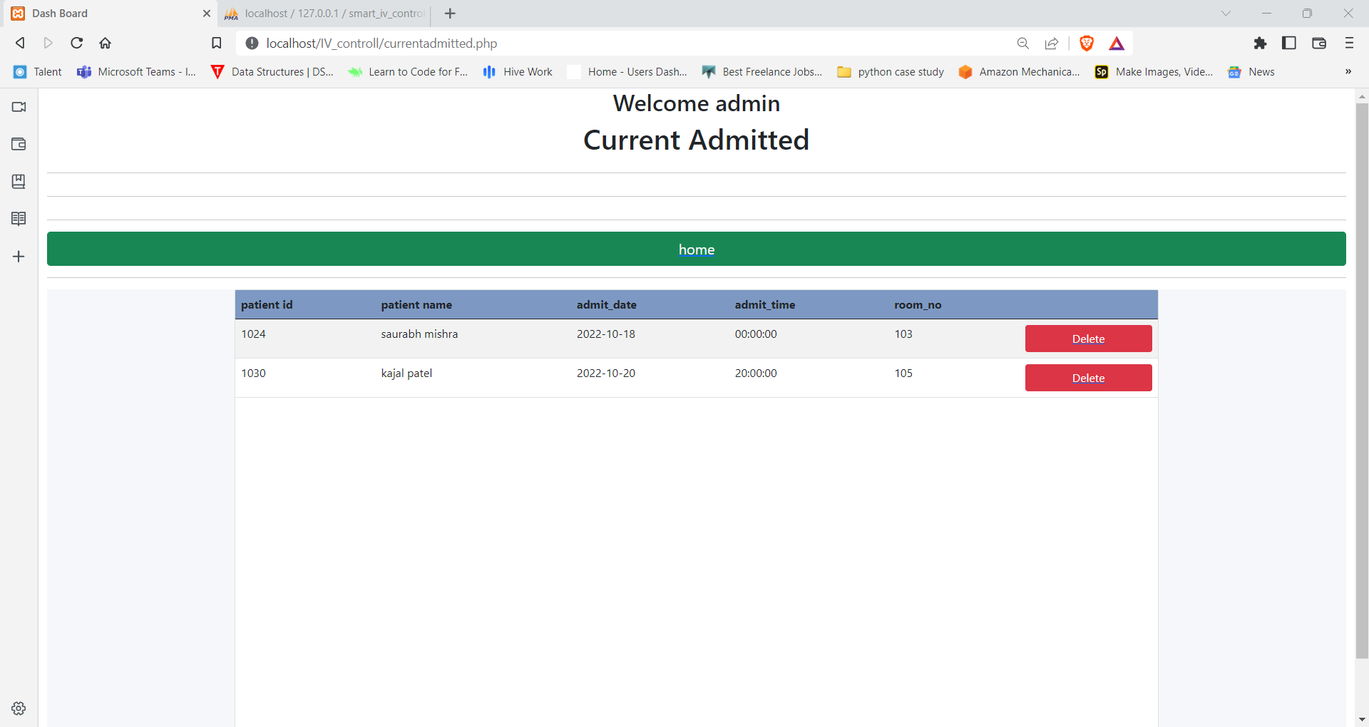
System Design

Slide 29
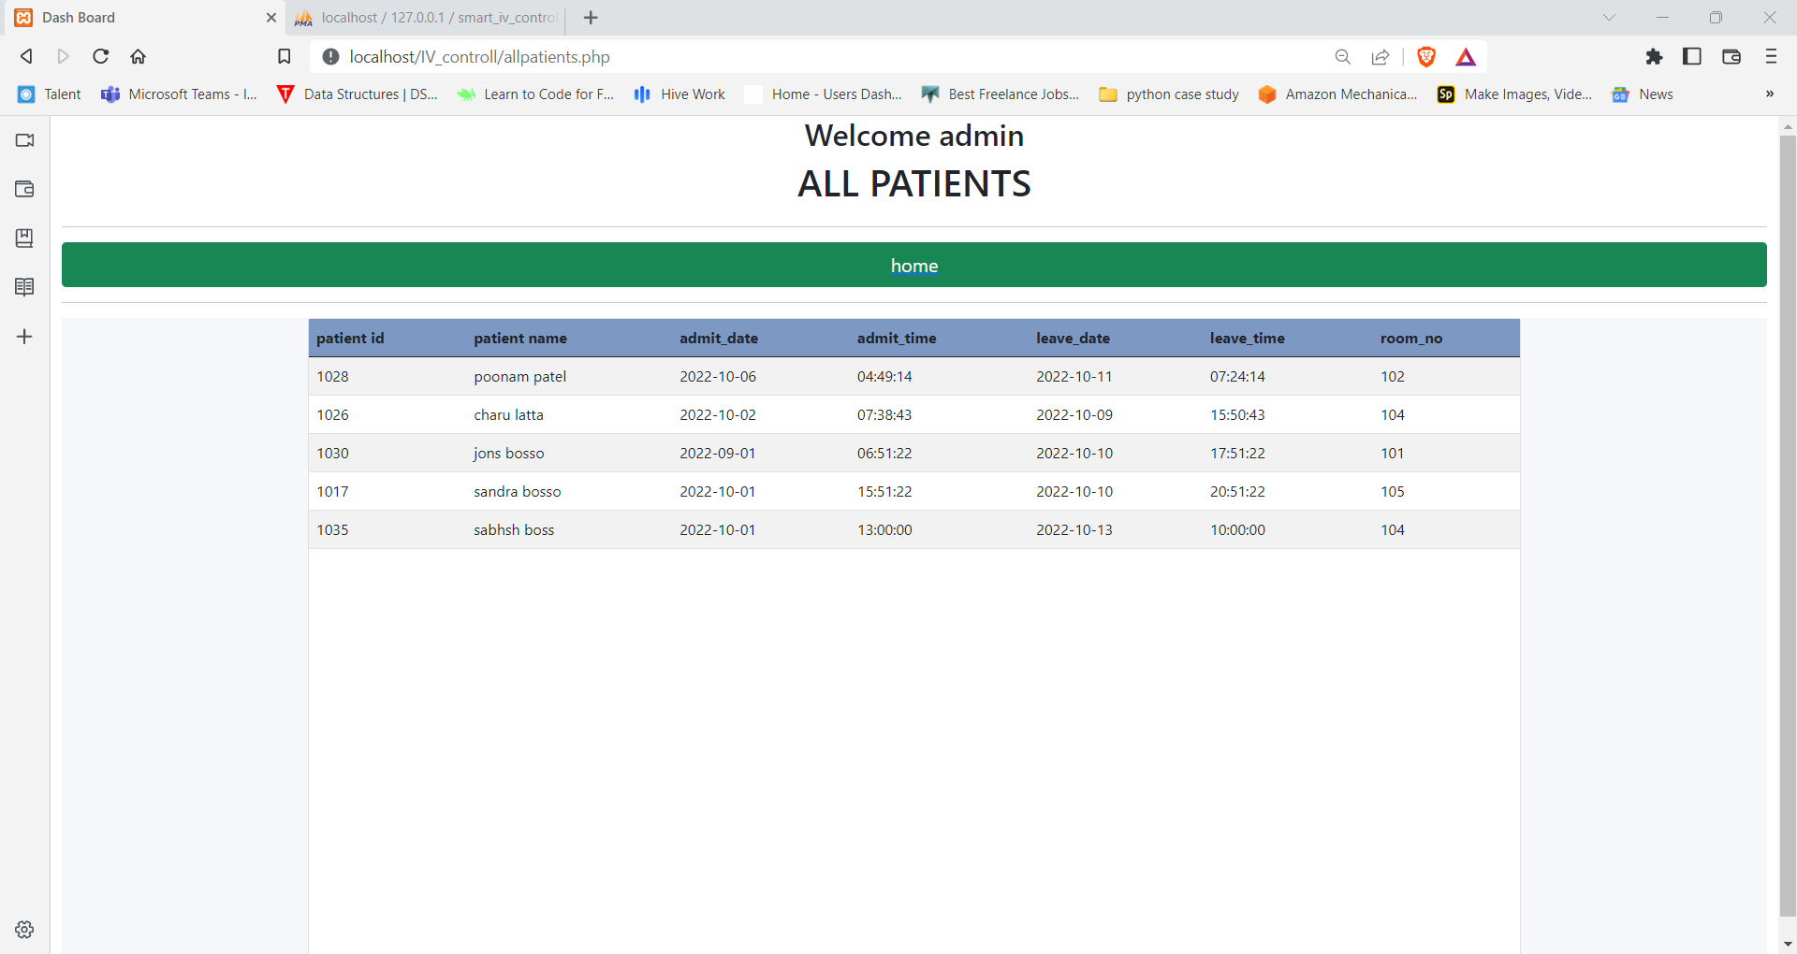
System Design

Slide 30
References
https://www.loadstarsensors.com/I.V.-bag-monitoring.html
https://www.ijert.org/intravenous-I.V.-drip-rate-controlling-and-monitoring-for-risk-free-I.V.-delI.V.ery
https://www.youtube.com/watch?v=u5MbIsqMieU

Slide 31
Thank You

