Slide 1
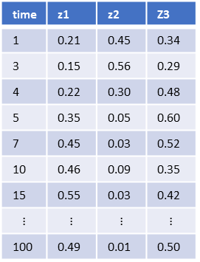
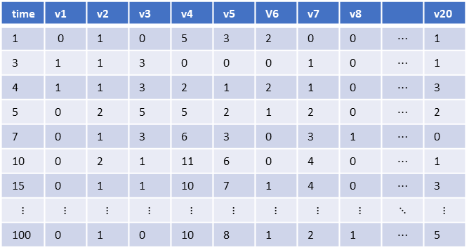
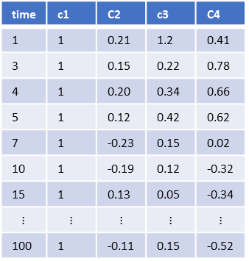
Term counts
time | v1 | v2 | v3 | v4 | v5 | V6 | v7 | v8 |  | v20
1 | 0 | 1 | 0 | 5 | 3 | 2 | 0 | 0 | $$⋯$$ | 1
3 | 1 | 1 | 3 | 0 | 0 | 0 | 1 | 0 | $$⋯$$ | 1
4 | 1 | 1 | 3 | 2 | 1 | 2 | 1 | 0 | $$⋯$$ | 3
5 | 0 | 2 | 5 | 5 | 2 | 1 | 2 | 0 | $$⋯$$ | 2
7 | 0 | 1 | 3 | 6 | 3 | 0 | 3 | 1 | $$⋯$$ | 0
10 | 0 | 2 | 1 | 11 | 6 | 0 | 4 | 0 | $$⋯$$ | 1
15 | 0 | 1 | 1 | 10 | 7 | 1 | 4 | 0 | $$⋯$$ | 3
$$⋮$$ | $$⋮$$ | $$⋮$$ | $$⋮$$ | $$⋮$$ | $$⋮$$ | $$⋮$$ | $$⋮$$ | $$⋮$$ | $$⋱$$ | $$⋮$$
100 | 0 | 1 | 0 | 10 | 8 | 1 | 2 | 1 | $$⋯$$ | 5
Topic Proportions
Latent Dirichlet Allocation
Time Series Models
Topic Proportions
time | z1 | z2 | Z3
1 | 0.21 | 0.45 | 0.34
3 | 0.15 | 0.56 | 0.29
4 | 0.22 | 0.30 | 0.48
5 | 0.35 | 0.05 | 0.60
7 | 0.45 | 0.03 | 0.52
10 | 0.46 | 0.09 | 0.35
15 | 0.55 | 0.03 | 0.42
$$⋮$$ | $$⋮$$ | $$⋮$$ | $$⋮$$
100 | 0.49 | 0.01 | 0.50
Covariates
time | c1 | C2 | c3 | C4
1 | 1 | 0.21 | 1.2 | 0.41
3 | 1 | 0.15 | 0.22 | 0.78
4 | 1 | 0.20 | 0.34 | 0.66
5 | 1 | 0.12 | 0.42 | 0.62
7 | 1 | -0.23 | 0.15 | 0.02
10 | 1 | -0.19 | 0.12 | -0.32
15 | 1 | 0.13 | 0.05 | -0.34
$$⋮$$ | $$⋮$$ | $$⋮$$ | $$⋮$$ | $$⋮$$
100 | 1 | -0.11 | 0.15 | -0.52
Change Point Location
Distribution
Time

