Slide 1
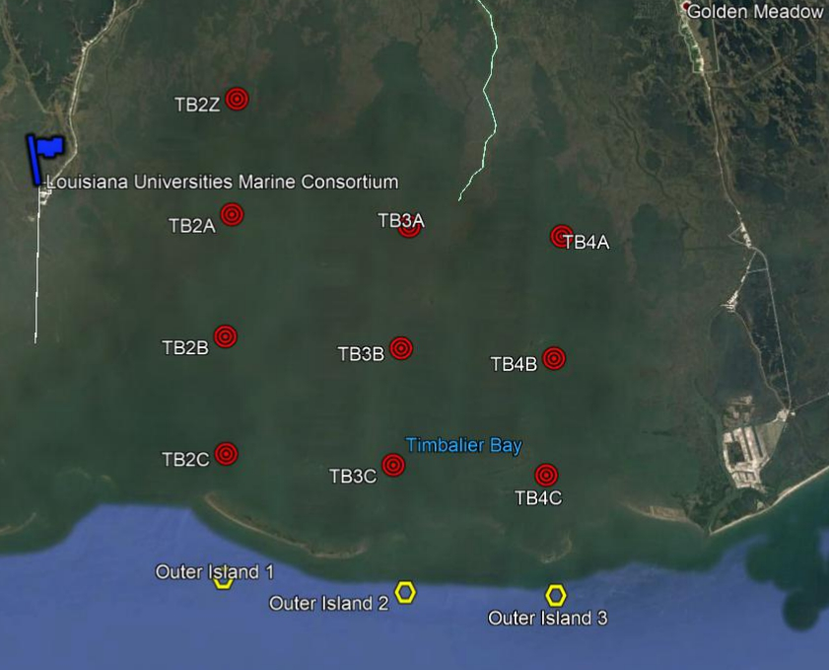
First tier: Spatial variability (2A-2C) & Inter-annual (Jun/2018 – Jun/2019)
Second tier: Post disturbance (Barry; Jul/2019 vs Jun/2018-19)
Third tier: Seasonal variability ( Jul/2019 vs Jun/2018-19)

