Slide 1
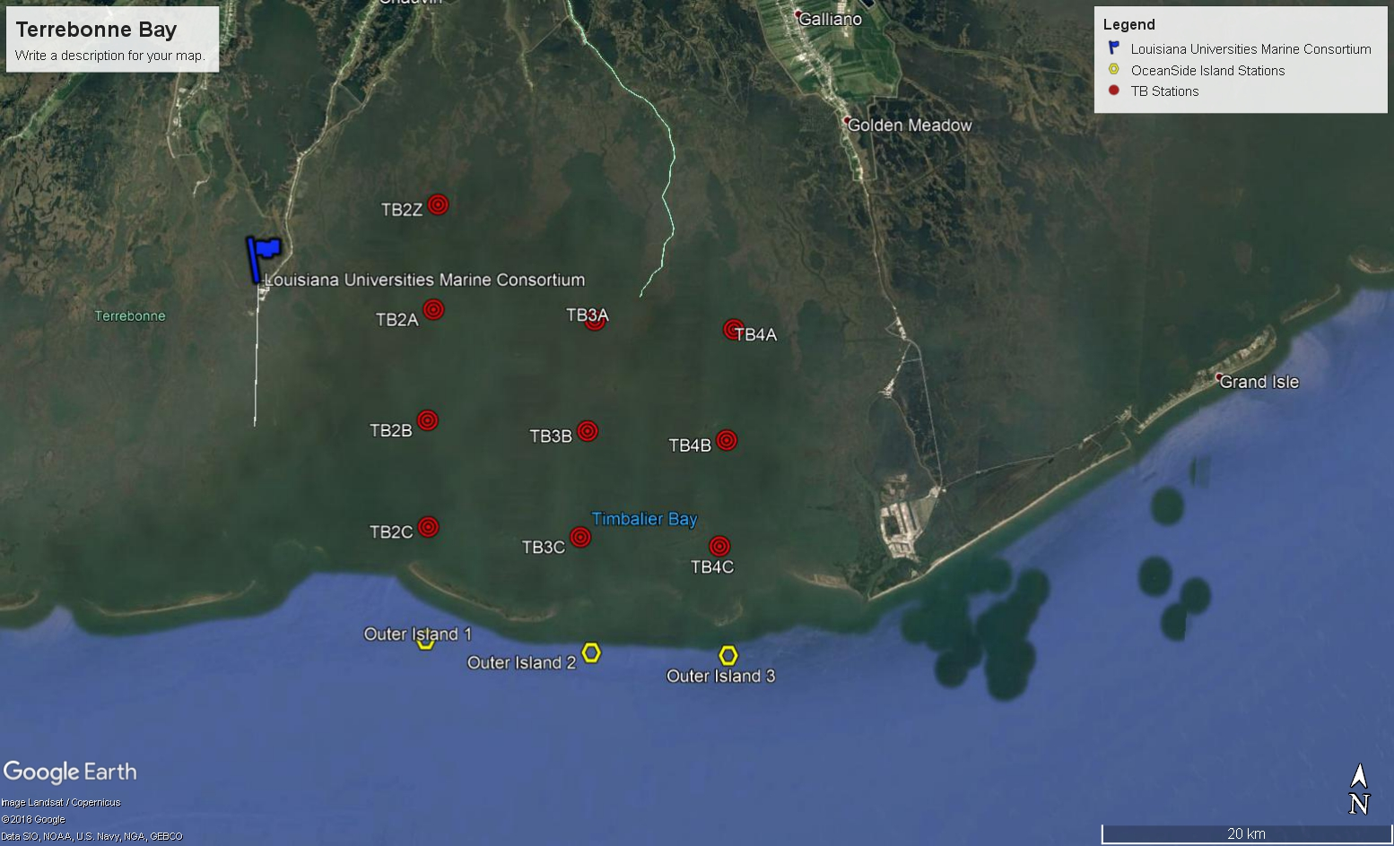
Station Designation | Depth | Lat | Long (-) | Lat | Long
TB2A |  | 29.246417° | 90.541518° | 29° 14.785' | 90° 32.491'
TB2B |  | 29.178333° | 90.540500° | 29° 10.700' | 90° 32.430'
TB2C |  | 29.113150° | 90.534983° | 29° 06.789' | 90° 32.099'
TB2Z |  | 29.310777° | 90.543336° | 29° 18.647'N | 90° 32.600'W
TB3A |  | 29.246417° | 90.427929° | 29° 14.785' | 90° 25.676'W
TB3B |  | 29.178333° | 90.427929° | 29° 10.700' | 90° 25.676'W
TB3C |  | 29.113150° | 90.427929° | 29° 06.789' | 90° 25.676'W
TB4A |  | 29.246417° | 90.330025° | 29° 14.785' | 90° 19.802'W
TB4B |  | 29.178333° | 90.330025° | 29° 10.700' | 90° 19.802'W
TB4C |  | 29.113150° | 90.330025° | 29° 06.789' | 90° 19.802'W

