Slide 1
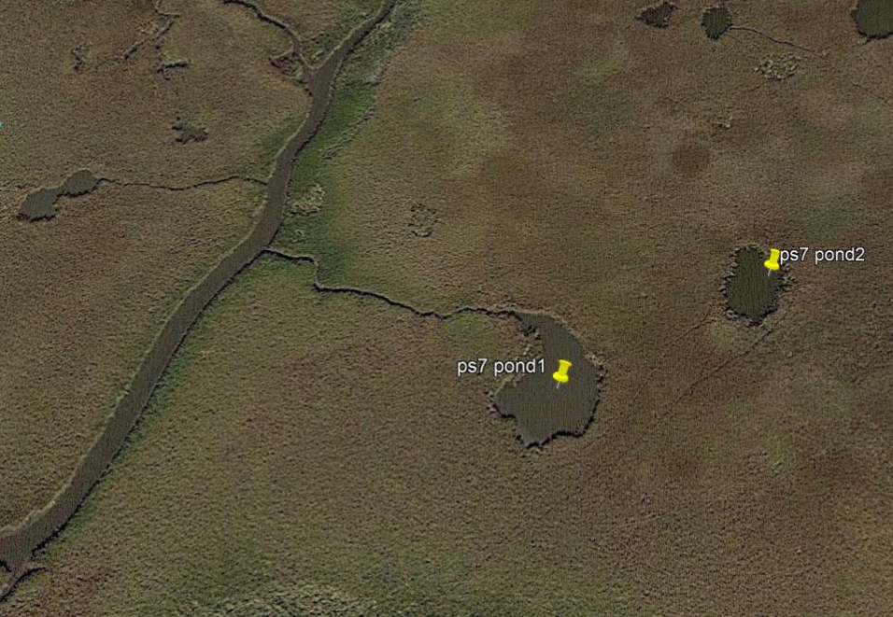
Species coexistence
“Isolated”pond
High connectivity pond

Slide 2
Species exclusion
x
“Isolated”pond
High connectivity pond

Slide 3
Initial matching
- Based on literature database (GoMexSI, mangal, etc.)
6
2
3
4
5
6
5
1
4
2
2
3
3
1
4
5

Slide 4
Trait-matching
-Based Gravel et al. 2013 (or similar, e.g., Morales-Castilla et al. 2015)
trait database morphology (fishbase)
Body size data
6
2
3
4
5
6
5
1
4
2
2
3
3
1
4
5

Slide 5
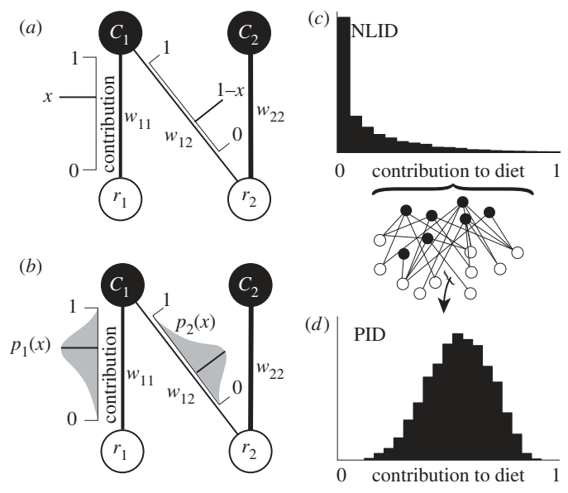
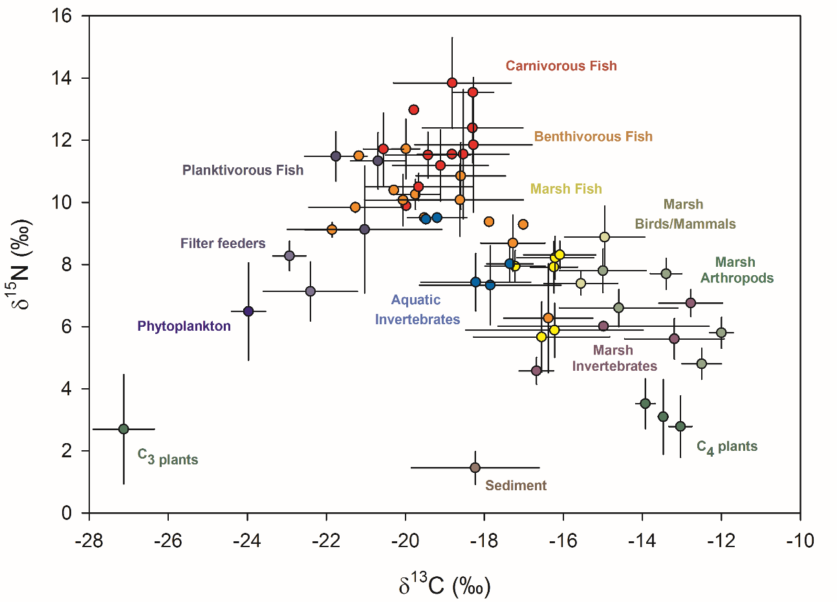
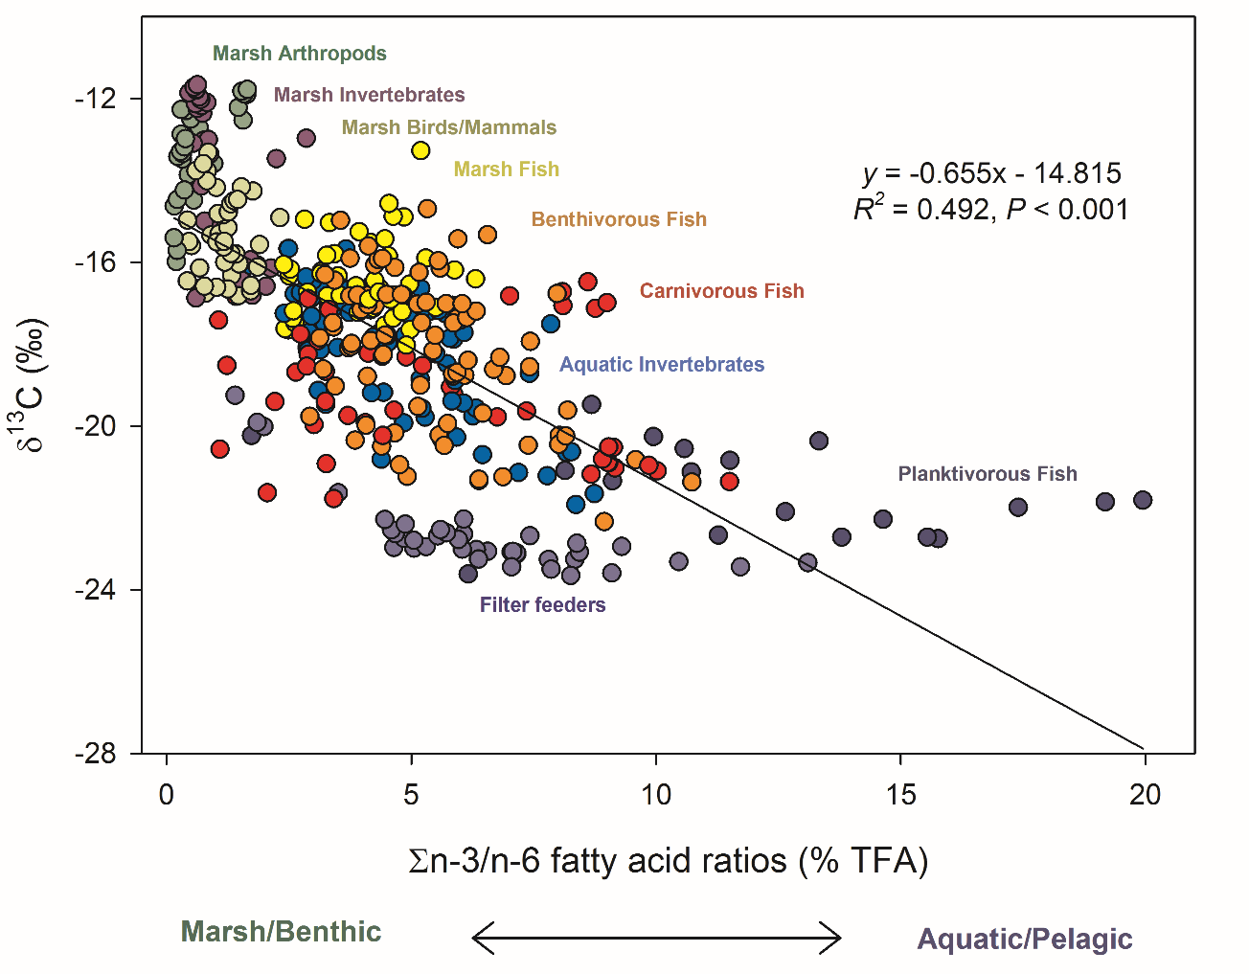
6
5
4
+
2
3
1

Slide 8
