Slide 1
Opensource your Quant Strategy
As of Oct 24, 2026
aiInvesting: an AI investment team
you can run on your own laptop
No API keys. Free data. A free open-weight model. Everything open source.
Seven agents do the judgment. Plain Python does the schedule, the arithmetic and the bookkeeping.
A coach reviews every quarter and the dashboard shows whether the team is getting better.
Code, spec and slides: https://github.com/jimkliew/aiInvesting MIT license
Teaching lab for agent engineering and honest evaluation. Not investment advice.
1

Slide 2
The question we are asking
A lab, not a product
How well can an AI investment team trade, and does it get better with feedback?
1
Can it do quant research?
2
Can it trade with judgment?
3
Does coaching help?
Agents propose hypotheses, write strategy code, backtest it, and critique the result. Measured against buy-and-hold and a moving-average crossover.
A trader persona makes weekly BUY, SELL or HOLD calls from a point-in-time snapshot and must state its reason in one sentence.
After each quarter a Review Agent studies the results and recommends changes. The next quarter shows whether they helped.
Success is measured one way: the team's out-of-sample track record against SPY, season by season.
SPY is the benchmark the team must beat. It never holds SPY.
The team trades twelve large-cap US names: AAPL, MSFT, NVDA, AMZN, GOOGL, META, TSLA, AVGO, AMD, CRM, ORCL, NFLX.
2

Slide 3
Assumptions: free, local, and keyless
Everything a student needs is a laptop and one download
$0
0
13
16 GB
to run the whole lab, end to end
API keys, accounts or subscriptions
tickers: 12 traded, plus SPY as the benchmark
of laptop RAM runs the default model
WHAT WE RELY ON
1
Data: yfinance, daily bars
2
Model: Ollama with qwen3:8b
Free, no key. Daily open, high, low, close and volume from 2015. Adjusted for splits and dividends. The Data Agent checks gaps and short histories and writes a report.
Open weights under Apache 2.0, runs fully offline. Supports tool calling and JSON-schema output. Swap any Ollama model with one flag; qwen3:4b fits 8 GB laptops.
3
Compute: your own machine
4
Market model: deliberately simple
About 2 to 5 seconds per model call on Apple Silicon. A six-season campaign is roughly 300 calls, 20 to 30 minutes. Replay mode shows a recorded run in class.
US large caps, daily closes, long only, monthly desk rebalance (weekly is a coach lever), 5 basis points per unit of weight traded. No shorting, leverage, options or intraday data.
yfinance is an unofficial interface to Yahoo Finance; use it for personal and educational purposes and expect occasional gaps. Not investment advice.
3

Slide 4
The team: seven roles and one orchestrator
Each agent has one prompt file, one output schema, and at most four tools
The model does the judgment. Plain Python does the arithmetic, the schedule and the bookkeeping.
1
Data Agent
2
Idea Agent
3
Coder Agent
4
Critic Agent
Turns a one-line brief into a checked, cached dataset with a manifest hash and a short report.
Reads the lab notebook and proposes distinct strategy hypotheses across families.
Writes generate_signals() for one hypothesis and fixes it when the sandbox objects.
Reads train and validation metrics and votes Keep or Discard, naming its concerns.
5
Trader personas
6
PM Agent, optional
7
Review Agent, the coach
py
Orchestrator, plain code
Momentum, contrarian, risk-averse. Weekly calls from a snapshot with one sentence of reasoning.
Combines the three personas' votes into one allocation each week. The committee pattern.
Studies each season and recommends changes, but only from a fixed menu of levers.
A state machine, not a model. Runs the phases in order and enforces every budget.
Only the Data Agent uses tool calling. The other six get everything they need in the prompt, which is cheaper and more reliable for an 8B model.
4

Slide 5
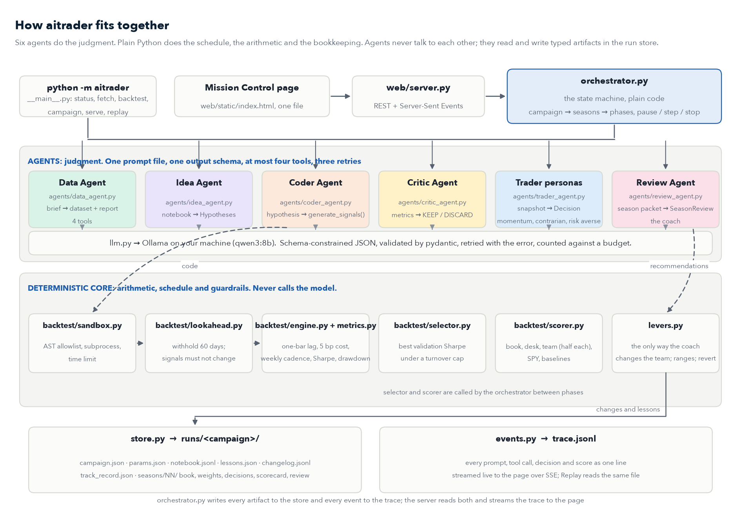
How it all fits together
Agents do the judgment; plain Python does the schedule, the arithmetic and the bookkeeping
docs/architecture.png in the repo, drawn by docs/draw_architecture.py. docs/ARCHITECTURE.md adds the agent table, the on-disk layout and where to change things.
5

Slide 6
How a season runs
One calendar quarter the team has never seen, traded once
Research on the past, trade the sealed quarter, score it, get coached, repeat.
1
Research
2
Select
3
Trade
4
Score
5
Review
6
Apply
Idea, Coder and Critic loop over hypotheses using only data from before the quarter.
Code, not a model, picks the best validation Sharpe under a turnover cap. That is the quant book.
The quant book trades mechanically. The desk persona makes a discretionary call per stock at each rebalance.
Quant book, desk, team (half each), SPY and baselines. The track record grows by one quarter.
The coach reads the season packet and writes an assessment with 1 to 3 recommendations.
Levers are applied automatically, or wait for you to click Accept. The next season begins.
Default campaign: 6 seasons from 2025 Q1 to 2026 Q2, about 300 model calls, 20 to 30 minutes on a laptop.
Season 1 also runs the Data Agent and a second research round. Later seasons reuse the cached data and carry the notebook forward.
Budgets, not patience, end every loop: calls per season, minutes per season, strategies per round.
6

Slide 7
Why seasons: walk-forward testing stops the loop from peeking
A fixed test set would be burned the first time the coach saw it
Each quarter is traded exactly once, out of sample. Only then does it become history the team may learn from.
2015
2020
2025
2026
Train
Val
Season 1, 2025 Q1
Train
Val
Season 2, 2025 Q2
Train
Val
Season 3, 2025 Q3
Navy block: the sealed quarter. It moves one step right each season.
TRAIN
VALIDATION
SEASON
2015 up to twelve months before the season. Every backtest runs here. The Idea, Coder and Critic agents see only this and the validation year.
The twelve months before the season. The Critic judges here, and the selector picks the quant book here. Nothing from the season influences the choice.
The next quarter. Sealed until traded, scored once, then handed to the coach as history. The next season starts a quarter later.
What to watch: did validation Sharpe predict season Sharpe? With six seasons noise dominates. The lab teaches the measurement, not a guarantee.
7

Slide 8
Data Agent
Phase 0. Runs once per campaign; later seasons reuse the cache
Lesson one: do not use a model where a function will do. The fetch is code; the judgment around it is the agent.
ROLE
Prompt, excerpt
Turn a plain-English brief into a validated, cached dataset and a short written report.
You assemble datasets for a long-only equity lab.
Turn the brief into a ticker list with propose_tickers, fetch with
fetch_prices, then read check_quality. Replace any name with under
8 years of history or unexplained gaps. Finish with a short report:
what was fetched, what you changed, and why. Never invent tickers;
only use names the tools return.
INPUT
A brief such as "12 large-cap US tech names plus SPY, 2015 to today", plus a bundled list of candidate tickers. No web search.
OUTPUT
Code running
data/raw/*.parquet, data/features/*.parquet, manifest.json with a SHA-256 of the prices, and REPORT.md in plain English.
plan = llm.structured(DATA_PROMPT, brief, schema=DataPlan)
# -> tickers=[AAPL, MSFT, NVDA, ...], benchmark="SPY"
prices = fetch_prices(plan.tickers + [plan.benchmark],
start="2015-01-01") # yfinance, parquet cache
report = check_quality(prices) # gaps, NaNs, zero volume
manifest.write(prices, notes=plan.rationale) # sha256 -> 3f9c...
# the tool loop underneath (aitrader/agent.py)
for step in range(max_steps):
reply = ollama.chat(model, messages, tools=schemas(tools))
if not reply.message.tool_calls: return reply.message.content
for call in reply.message.tool_calls:
messages.append(tool_result(tools[call.function.name](**call.function.arguments)))
TOOLS AND LIMITS
propose_tickers, fetch_prices, check_quality, replace_ticker. At most 12 tool calls. The only agent that uses tool calling.
8

Slide 9
Idea Agent
Phase 1. One call per research round, no tools
Everything it needs is in the prompt: a 40-line feature catalog and one line per strategy already tried.
ROLE
Prompt, excerpt
Propose K distinct hypotheses across families: trend, mean reversion, volatility, cross-sectional momentum.
You are the research lead of a small quant team. Propose {K} distinct
strategy hypotheses using only the features listed. Do not repeat or
lightly vary anything in the notebook. Cover different families.
Focus: {family_focus}. Each idea must be testable as a daily, long-only
weighting rule. Answer in the JSON schema provided.
INPUT
The feature catalog, the lab notebook summary, the family focus set by the coach, and its own lessons.
OUTPUT
Code running
A list of Hypothesis objects: name, family, idea, features_used, why_it_might_work. JSON enforced by schema.
hyps = llm.structured(
system=prompts.load("idea", lessons=store.lessons("idea")),
user=f"Features:\n{features.catalog()}\n\nNotebook:\n{notebook.summary()}",
schema=list[Hypothesis],
temperature=0,
)
# under the hood, one Ollama call with schema-constrained output
ollama.chat(model="qwen3:8b", messages=[...],
format=Hypothesis.schema(), options={"temperature": 0})
# a Hypothesis, as returned
{"name": "breakout_20d_volscale", "family": "trend",
"idea": "Buy closes above the prior 20-day high; hold while above sma20",
"features_used": ["close", "ret_1d"]}
TOOLS AND LIMITS
No tools, temperature 0. For an 8B model, putting the information in the prompt is more reliable than letting it fetch.
9

Slide 10
Coder Agent
Phase 1. One function per hypothesis, at most three attempts
Every strategy, written by a person or a model, implements the same one-function interface.
ROLE
Prompt, excerpt
Translate one hypothesis into generate_signals() and repair it when the sandbox or the lookahead guard rejects it.
Write the body of generate_signals(prices, features) in pandas.
Use only past data at each row. No imports, no file or network
access, no shift with a negative number. Return weights between 0
and 1 for every ticker and date. Keep it under 40 lines and comment
each indicator. If you receive an error, fix only what it names.
INPUT
One Hypothesis. On a retry, the exact error text and line number from the sandbox or the backtester.
OUTPUT
What it wrote: breakout_20d_volscale
StrategyCode: the function body and a note. Weights between 0 and 1, one row per date, one column per ticker.
def generate_signals(prices: pd.DataFrame, features: pd.DataFrame) -> pd.DataFrame:
"""Target weights in [0, 1], indexed like prices. Past data only."""
high20 = prices.rolling(20).max().shift(1) # yesterday's 20-day high
sma20 = prices.rolling(20).mean()
entry = prices > high20 # breakout
exit_ = prices < sma20 # trend lost
held = entry.where(entry | exit_).ffill().fillna(False)
vol20 = features["ret_1d"].rolling(20).std() * 252 ** 0.5
raw = held.astype(float) / vol20 # inverse-vol sizing
w = raw.div(raw.sum(axis=1), axis=0).fillna(0.0)
return w.clip(upper=0.30) # no name above 30%
TOOLS AND LIMITS
No tools. Three attempts, then the hypothesis is marked failed in the notebook and the loop moves on.
10

Slide 11
Critic Agent
Phase 1. Reads numbers, not prices, and never sees the season
Keep or Discard, with the concern named: overfitting, turnover, concentration.
ROLE
Prompt, excerpt
Review each backtested strategy on its train and validation metrics; flag overfitting and churn; suggest what to try next.
You are a skeptical risk reviewer. Compare train and validation
Sharpe: a gap above 0.5 suggests overfitting. Discard validation
turnover above {max_turnover} percent per year. Flag any single-name
weight above 30 percent. Say what evidence would change your mind.
Lessons from the coach: {lessons}
INPUT
The code, train metrics, validation metrics, the notebook summary, and lessons from the coach such as the turnover limit.
OUTPUT
Code running
Review: verdict KEEP or DISCARD, a list of concerns, and one suggestion. Written to the notebook with the metrics.
review = llm.structured(
system=prompts.load("critic", lessons=store.lessons("critic")),
user=f"Code:\n{code}\n\nTrain: {m_train}\nValidation: {m_val}\n\n"
f"Notebook:\n{notebook.summary()}",
schema=Review, # verdict, concerns[], suggestion
)
notebook.add(hyp, code, m_train, m_val, review)
# a Review, as returned
{"verdict": "KEEP",
"concerns": ["top position averages 28% of the book"],
"suggestion": "test a 25% cap; turnover 140%/yr is inside the limit"}
TOOLS AND LIMITS
No tools. The season window is still sealed when it runs, so it cannot grade on the answer.
11

Slide 12
Trader personas, and the optional PM
Phase 2. One call per ticker at each rebalance, from a point-in-time snapshot
The persona sees only what existed on the decision date, about 300 tokens, and answers in a fixed JSON shape.
ROLE
Prompt, excerpt
Make a discretionary BUY, SELL or HOLD call with a target weight, a confidence, and one sentence grounded in the snapshot.
You are a momentum trader managing one sleeve of a long-only
portfolio. ... Decide one action: BUY, SELL or HOLD, with a target
weight between 0 and the maximum allowed, a confidence from 0 to 1,
and one sentence grounded in the numbers shown. Never reference
information not in the snapshot.
## Lessons from the coach
1. (after S1) Do not call a stock oversold unless RSI 14 is below 30
and it sits below its 50-day average.
INPUT
Snapshot: last 20 closes, price against the 20, 50 and 200-day averages, RSI 14, returns over 1, 3 and 12 months, realized volatility, current weight.
OUTPUT
One decision, in full
Decision: action, target_weight, confidence, reason. The engine fills at the next open and charges the cost.
# what the model saw (features.snapshot("AAPL", as_of="2025-10-20"))
ticker: AAPL as_of: 2025-10-20
closes_20d: 227.1 229.4 ... 236.8
vs_sma20: +1.9% vs_sma50: +4.2% vs_sma200: +9.8% rsi14: 58
ret_1m: +3.1% ret_3m: +11.0% ret_12m: +19.4% vol_20d_ann: 21%
current_weight: 0.20 max_weight: 0.30
# what it returned (schema-constrained, temperature 0)
{"action": "BUY", "target_weight": 0.25, "confidence": 0.66,
"reason": "Broke above the 20-day high on rising volume; 3-month +11%; RSI 58."}
engine.queue("AAPL", 0.25, fill="next_open") # filled 21 Oct, cost 0.6 bp
TOOLS AND LIMITS
No tools. Three personas share the code and differ only by prompt file. With --committee a PM Agent merges their votes into one allocation.
12

Slide 13
Review Agent, the coach
Phase 4. One call per season. The only agent allowed to change the team
It may recommend, but only from a fixed menu of levers, and every change is logged with a condition for reverting it.
ROLE
Prompt, excerpt
Assess the season in plain words, say what worked and what failed, and recommend one to three changes grounded in numbers.
You coach an AI investment team. Read the season packet. Explain the
result in plain words, grounded in the numbers. Recommend at most
three changes, each using one lever from the menu, with the metric
you expect to move and the condition for reverting it. Prefer
removing a bad lesson over adding a new one. Never touch the
universe, costs, data or model.
INPUT
The season scorecard, the track record, the changelog, the notebook summary, and the desk's three best and three worst decisions. About 1,500 tokens.
OUTPUT
Apply, then the lesson appears in the prompt file
SeasonReview: assessment, what_worked, what_failed, recommendations, each with lever, target, change, rationale, expected_effect, revert_if.
review = llm.structured(system=prompts.load("review"),
user=packet.as_text(), schema=SeasonReview)
for rec in review.recommendations:
change = LEVERS[rec.lever].apply(rec) # raises if outside menu or range
changelog.append(change, season=s)
# one recommendation, as returned
{"lever": "add_lesson", "target": "trader_momentum",
"change": "After a drawdown over 8% reverses above the 20-day for two
weeks, re-enter rather than wait for the 50-day.",
"rationale": "Waiting for the 50-day cost 7.1 points on SPY in April.",
"expected_effect": "earlier re-entry", "revert_if": "two losing re-entries"}
TOOLS AND LIMITS
No tools. Levers: add_lesson, remove_lesson, set_param within a range, set_family_focus, retire_strategy, reinstate_strategy, revert. Universe, costs, data and model are frozen.
13

Slide 14
The deterministic core never calls the model
Engine, sandbox, lookahead guard, selector, scorer: plain Python you can unit-test
If it can be a function, it is a function. The model only fills the gaps that need judgment.
Engine: tonight's signal trades tomorrow
Sandbox: model code never runs as-is
Lookahead guard, selector, scorer
def run(weights, prices, cost_bps=5):
w = weights.clip(0, 1).shift(1) # lag 1 bar
w = w.fillna(0)
ret = prices.pct_change().fillna(0)
turn = w.diff().abs().sum(axis=1)
cost = cost_bps / 1e4 * turn
pnl = (w * ret).sum(axis=1) - cost
equity = (1 + pnl).cumprod()
return Result(equity, pnl, turn.sum())
# per window: CAGR, vol, Sharpe,
# Sortino, max drawdown, turnover, hit rate
tree = ast.parse(code)
for node in ast.walk(tree):
if is_import(node):
raise Rejected("no imports")
if is_call(node, "shift") and neg_arg(node):
raise Rejected(
f"shift(-n) reads the future, "
f"line {node.lineno}")
if is_call(node, ("open", "eval", "exec")):
raise Rejected("no files, no eval")
fn = run_in_subprocess(code, timeout=5)
# allowed: pandas, numpy, math
full = fn(prices, features)
cut = fn(prices.iloc[:-60],
features.iloc[:-60])
assert full.iloc[:-60].equals(cut)
# selector: validation only
book = max((s for s in notebook.kept()
if s.val.sharpe >= 0.5
and s.val.turnover <= 300),
key=lambda s: s.val.sharpe)
# scorer: half book, half desk
team = 0.5 * book.pnl + 0.5 * desk.pnl
WHAT THE TESTS PROVE
Engine
Sandbox
Lookahead guard
A five-bar example worked by hand gives the exact equity curve, including the one-bar lag and the cost.
Must reject import os, open(), and shift(-1), and must time out an infinite loop at five seconds.
Must catch a strategy that deliberately peeks, and must pass every baseline.
14

Slide 15
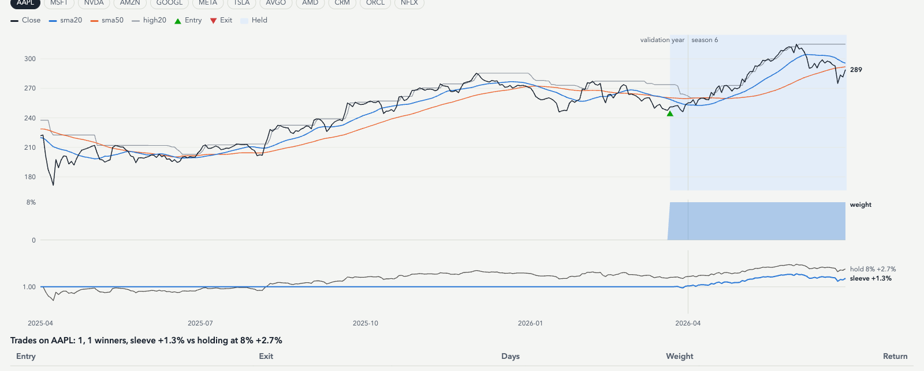
A strategy the Coder wrote, shown on one ticker
Price, indicators, entries, exits and position size, straight from the dashboard's Strategy tab
READ THE CHART
Black is the close; blue and orange are the 20 and 50-day averages; grey steps are the previous 20-day high. Green triangles mark where the book entered, red where it exited. Shaded bands are days it held the name.
BELOW THE PRICE
The weight the book assigned to this name, then the sleeve's growth against simply holding the stock at the book's maximum weight.
WHY IT MATTERS IN CLASS
Whatever the code says, students can check it against prices day by day, switch tickers, and open the trade list to see each entry and exit.
What the tab shows: the season's quant book on one ticker. In this run the equal-weight baseline won validation every season, so the book held each of the 12 names at 8%, rebalanced weekly. Cost: 5 bp per unit of weight traded. Fill: next open, never the same close.
Strategy tab of the live page. The chart is drawn from the book's actual weights and the cached prices.
15

Slide 16
Eight rules that keep a swarm in hand
Enforced in code, not by convention
A swarm here means separation of concerns, not a free-for-all. On one laptop it is not even faster.
1
Fixed roster
2
The orchestrator is code
3
No agent-to-agent chat
4
One prompt, one schema
Seven roles, declared in code. No agent can spawn another agent.
A Python state machine runs the phases in order. No model decides who speaks next.
Agents read and write typed pydantic artifacts on a shared run store. No conversation loops.
Per agent: one prompt file, one output schema, at most four tools, at most three retries.
5
Budgets everywhere
6
Sequential by default
7
Everything replayable
8
The coach has a menu
Calls, minutes and strategies per season and per campaign. Hitting a budget stops cleanly with partial results.
One laptop serves one model. A --parallel flag exists to prove that it buys nothing.
Every event is appended to a JSONL trace. The dashboard replays any run at 1x, 5x or instant.
The Review Agent can only pull fixed levers inside allowed ranges. Universe, costs, data and model stay frozen.
Budget math on a laptop: about 50 model calls and 4 minutes per season, so 6 seasons take 20 to 30 minutes. Three personas triple the desk calls, which is why Replay exists.
16

Slide 17
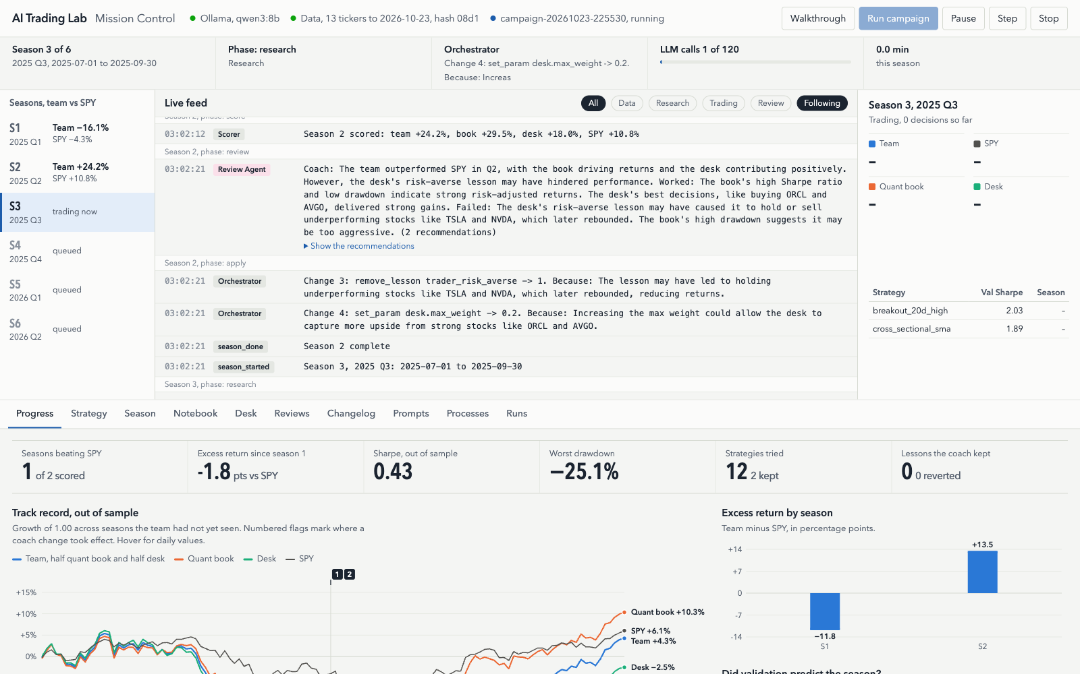
Mission Control: the dashboard students run in the browser
One local page, no login. Press Walkthrough for the 17-step guided tour
WALKTHROUGH
17 steps. Each Next reveals the agent events for that stage, highlights the panel, and shows the Python running at that moment plus the background processes.
LIVE FEED AND STEP MODE
Every agent turn, tool call, decision and reason, colour-coded by agent. Pause and step one turn at a time while you narrate.
TABS FOR EVERYTHING
Progress, Strategy, Season, Notebook, Desk, Reviews, Changelog, Prompts, Processes, Runs. Deep links such as #reviews jump straight there.
Served by FastAPI with Server-Sent Events; one static HTML file, no build step, works offline. Start with: uv run python -m aitrader serve
Live page during a real campaign on Oct 23, 2026, qwen3:8b on a Mac Studio.
17

Slide 18
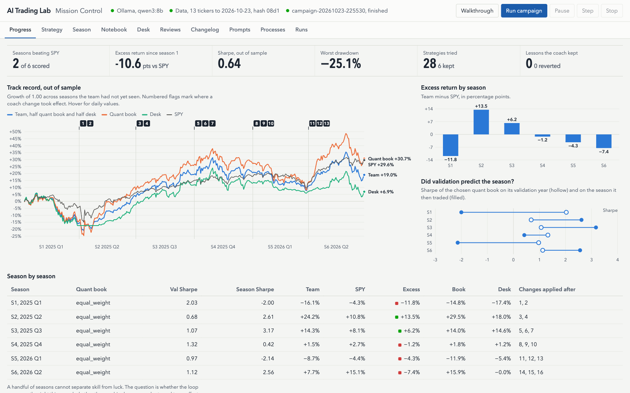
Is the team improving? The Progress tab
Track record, excess return by season, and whether validation predicted the season
TRACK RECORD
Growth of 1.00 across seasons the team had not seen, for team, quant book, desk and SPY. Numbered flags mark where each coach change took effect.
DID VALIDATION PREDICT THE SEASON?
Hollow dot: Sharpe on the validation year. Filled dot: Sharpe on the quarter it then traded. The gap is the overfitting lesson.
THE CLEANEST TEST
Run the same seasons with the coach switched off and overlay the two campaigns. The Runs tab does this with one click.
Scorecard: seasons beating SPY, excess return since season 1, out-of-sample Sharpe, worst drawdown, strategies tried, lessons the coach kept.
Real run, Oct 23, 2026. A handful of seasons cannot separate skill from luck. The lab teaches the measurement and the honest question, not a result.
18

Slide 19
Agent engineering practices you can point to in the code
Each one is named in a comment and in the README
The repo is as much about how to build agents as about trading.
1
Tools compute, the model reasons
2
Small, typed tools
3
Schema-enforced outputs
The model never does arithmetic or touches a DataFrame.
At most four per agent, documented, returning compact text.
JSON shape fixed by the model's schema mode, validated by pydantic, retried with the error.
4
Bounded loops
5
Observability
6
No lookahead by construction
Max steps, wall-clock budget, tool-call cap, call budget per season.
Every prompt, call and decision in a JSONL trace; replayable in the dashboard.
Data sliced as-of the cutoff, one-bar execution lag, perturbation test.
7
Sandboxed code
8
Evaluation first
9
Reproducibility
AST allowlist, no imports or files, subprocess with a time limit.
Train, validation, sealed season. Strategies tried are counted and shown.
Temperature 0, pinned model tag, dataset hash, prompts stored with results.
10
Memory
11
Human in the loop
12
Workflows over free-form agents
A lab notebook and per-agent lessons persist across seasons.
Step mode, approve mode for coach changes, editable prompts.
The orchestrator is code; agents do judgment inside fixed phases.
19

Slide 20
What actually happened: the first full run
6 quarterly seasons, qwen3:8b, one momentum persona, coach on, Oct 23, 2026
Out of sample, season by season. Read it as a measurement of the loop, not as a verdict on AI trading.
2 of 6
+19.0%
+29.6%
+30.7%
seasons the team beat SPY
team, compounded over the run
SPY over the same quarters
quant book alone
Season
Quant book
Val Sharpe
Season Sharpe
Team
SPY
Excess
Desk
Changes after
S1, 2025 Q1
equal_weight
2.03
-2.00
−16.1%
−4.3%
−11.8%
−17.4%
1, 2
S2, 2025 Q2
equal_weight
0.68
2.61
+24.2%
+10.8%
+13.5%
+18.0%
3, 4
S3, 2025 Q3
equal_weight
1.07
3.17
+14.3%
+8.1%
+6.2%
+14.6%
5, 6, 7
S4, 2025 Q4
equal_weight
1.32
0.42
+1.5%
+2.7%
−1.2%
+1.2%
8, 9, 10
S5, 2026 Q1
equal_weight
0.97
-2.14
−8.7%
−4.4%
−4.3%
−5.4%
11, 12, 13
S6, 2026 Q2
equal_weight
1.12
2.56
+7.7%
+15.1%
−7.4%
−0.0%
14, 15, 16
Questions for the room: did validation Sharpe predict the season? Did the coach's changes do what they expected? Would a run with the coach switched off look different?
Research tried 28 strategies; the coach applied 16 changes. Costs 5 bp per unit of weight traded. Partial seasons use data up to the last available day.
20

Slide 21
Run it yourself
Everything is public. Clone it, pull one model, open the page
Three commands
WHICH MODEL FOR WHICH LAPTOP
ollama pull qwen3:8b
git clone https://github.com/jimkliew/aiInvesting.git && cd aiInvesting
uv run python -m aitrader serve # http://localhost:8000, click Run campaign
# or the command line
uv run python -m aitrader campaign --quick # 2 short seasons, ~2 min
uv run python -m aitrader campaign --personas momentum,contrarian --apply approve
uv run python -m aitrader replay runs/<campaign> --speed 5
uv run pytest # 52 offline tests
8 GB
qwen3:4b
slower; run 3 seasons; use Replay in class
16 GB
qwen3:8b
the default, verified
32 GB+
qwen3:14b
better code, about twice as slow
IN THE REPO
docs/superpowers/specs/
docs/mockups/mission-control.html
The full design: roles, phases, schemas, lever menu, budgets, error handling, test plan, two-day build schedule.
The dashboard you just saw. One file, open it in any browser, no server needed.
aitrader/
No secrets, by design
The package: orchestrator, agents, prompts, levers, sandbox, engine, web server. 52 tests run offline with a fake model.
Nothing in the repo needs a key, so there is nothing to leak. The .gitignore excludes data and run folders. MIT license.
https://github.com/jimkliew/aiInvesting open source under the MIT license
Published Oct 24, 2026: design spec, dashboard and the Python package are in the repo. 52 offline tests; verified end to end against Ollama with real data.
21

Slide 22
Questions for the room
Argue from the numbers the dashboard shows
Six seasons of data, seven agents, one coach. What would convince you the team is skilled rather than lucky?
1
Did validation predict the season?
2
Would you let the coach apply changes automatically?
Look at the hollow and filled dots. If a strategy's validation Sharpe does not predict its season Sharpe, what is the selector actually selecting?
Auto mode closes the loop. Approve mode makes you the risk committee. Which would a real fund choose, and why?
3
Where could lookahead still sneak in?
4
Is a 50/50 team blend fair?
The engine lags one bar, the sandbox blocks negative shifts, the perturbation test withholds 60 days. What did we miss?
The headline number is half quant book, half discretionary desk. Should the headline be whichever did better, or neither?
Open the dashboard at any point. Every number on these slides is one click away in Mission Control.
22

