Slide 1

EXECUTIVE BRIEFING
Honeywell
Front Office
Transformation
The Path to an Agentic,
Customer-Centric Enterprise
May 2026

Slide 2
THE OPPORTUNITY CONTEXT
CONTENTS IN THIS DECK
02
Why this conversation is happening now
01
Opportunity Context
01
Leadership Mandate
Why this conversation is happening now
Focus from Senior Executives (CCO / CCEX Tech VP) on need for front office modernization
Aspirations to create an Agentic front office vision for Honeywell
Need to optimize commercial technology stack that drives value across distinct SBGs
AI-first policy: cleaner data, smarter decisioning
02
One Honeywell Vision
The North Star guiding transformation
03
Problem Statement
Fragmented, manual, and misaligned
04
Current State Journey Map
02
The S/4HANA Window
What customers & teams live with today
S/4HANA 2–4 years out — design decisions being made NOW
38 cataloged integrations at risk in ECC → S/4 migration
Business partner model changes ripple across all front-office systems
Lift-and-shift will replicate today's failure modes
05
Lead-to-Cash Optimization
Where to act, what to build
06
Architectural Decisions
Three choices that define the next 5 years
07
Agentic Front Office Journey
03
PwC's Unique Position
32 activities across 4 lifecycle stages
08
High-Level Roadmap
Active PoC: headless commerce platform (SBG 1, $450K signed)
S/4 impact assessment — 38 integrations cataloged & risk-mapped
LTC Visioning Workshop completed December 2025
Deep relationships: CX, SAP, and Digital Commerce
Three horizons to an Agentic front office
09
Where PwC Plays
Engagements & recommended next steps

Slide 3

ONE HONEYWELL VISION
03
"We deeply understand our customers, solve meaningful problems with an integrated portfolio of solutions, and create outcomes that drive lasting growth and foster partnerships."
LTC Guiding Principles
A Consistent Experience
We show up to customers as one unified enterprise—with consistent messaging, seamless handoffs, and an integrated account experience across all SBGs, solutions, and services.
No internal friction should be visible to the customer.
Customer tiering, account ownership, and coverage models must be aligned enterprise-wide.
Solutioning and value articulation must feel cohesive, not fragmented.
One Honeywell, One Customer Experience
Simplify & Standardize
We ruthlessly simplify and standardize the internal operations and commercial policies that enable speed, repeatability, and scale while differentiating only in the areas that create true market advantage.
Standard SKUs, pricing rules, contracts, payment terms, and policies.
Minimize exceptions, customization, and local variations.
Focus differentiation on strategic verticals, customer value propositions, and solution offerings.
Standardize the Core, Differentiate Where It Matters
Build an Insights-Driven, Integrated Solutions GTM Model
Integrated Portfolio Selling
Our GTM engine must shift from product selling to customer outcomes, lifecycle value, and proactive integrated engagement powered by unified data and analytics.
Data-driven customer segmentation and tiering.
Value-based pricing and commercial decision-making.
End-to-end account management that prioritizes solutions and partnerships over transactions.
Enable High-Performance Behaviors
Solution Selling & Partnerships
We design the operating model, incentives, and roles to reinforce the behaviors needed for integrated solution selling and enterprise growth.
Clear ownership across sales, channel, service, and delivery teams.
Incentives that reward enterprise-wide outcomes (pull-through mindset).
Cross-SBG collaboration, not internal competition.
Source: LTC visioning session with Eric Seidel, Aisha Florida, SBG CCOs and PwC S/4 and Commercial team in January 2026.

Slide 4
THE PROBLEM STATEMENT
04
The front office today: fragmented, manual, and misaligned
52+
4–5
38
6
Friction points
Inquiry → Order
Salesforce
instances
Integrations at
S/4 risk
Marketo
instances
Fragmented Data & Systems
Broken Integration Architecture
Multiple Salesforce instances — no unified customer record across SBGs
6 Marketo instances at varying maturity and integration levels
No CDP: e-commerce blocked by disparate customer entitlements
Swivel-chair activities across ERP, CRM, and customer portals
38 cataloged integrations — many siloed and undocumented
ECC → S/4HANA migration will break critical front-office connections
Business partner model change ripples across all downstream systems
Lift-and-shift will replicate today's failure modes into S/4
Customer Experience Failures
Commercial Misalignment
Credit limits not set at onboarding → downstream order blocks
No touchless process flow from customer inquiry to order fulfillment
Account hierarchy disconnected → manual patching required at order time
52+ undesirable observations in inquiry-to-order value stream map
SBGs operating in silos — competing rather than cross-selling
No pull-through incentive model for integrated solution selling
Adobe analytics broken: hit-level data missing, tracking inconsistent
No person-centric analytics — browser-level only, no individual identity

Slide 5
CURRENT STATE — DUAL PERSPECTIVE JOURNEY MAP
05
The current Honeywell customer experience is fragmented while business teams are disconnected
JOURNEY
STAGE
01
02
03
04
05
DISCOVER
CONFIGURE
PRICE / QUOTE
PURCHASE
POST PURCHASE
CUSTOMER
VOICE
“
“
“
“
“
"Help me find the right product — does Honeywell serve my need?"
"Can Honeywell guide me through complex options with accurate pricing?"
"I need an accurate quote fast — with my contract terms and lead times."
"Let me place my order without re-entering data or hitting unexpected holds."
"Where is my order? Resolve my issue and help me get more value."
CUSTOMER
PAIN POINTS
No personalization or relevancy
Fragmented click to quote.
Manual pricing & compliance.
No guided selling for complex engineered products.
Approval flows disconnected from ERP.
Credit limits not set which leads to order blocks.
No standard contracts.
Manual order re-entry.
Account hierarchy not linked.
No touchless checkout.
Fragmented billing.
Reactive-only support.
No 360° cross-SBG view.
Manual warranty.
No NPS or CLV tracking.
CUSTOMER LENS
TEAM
FRICTION
HONEYWELL INTERNAL LENS — Sales · Marketing · CX
MKT
6 Marketo instances; campaigns can't be consolidated/measured
SALES
No CPQ tool — reps manually build quotes in Excel; error-prone
SALES
4–5 Salesforce instances — reps switch between orgs to see full customer picture
CX
Swivel-chair between SAP, SFDC, and portal — order entry done in 3+ systems
CX
No single customer record — agents open 3 tabs to answer one question
MKT
Adobe analytics broken — marketers blind on content engagement and lead intent
SALES
Pricing rules in spreadsheets per SBG — reps can't self-serve accurate pricing
SALES
Quote approvals routed by email — no visibility into status, cycle takes days
CX
Account hierarchy wrong → order assigned to wrong sold-to; manual correction
CX
Returns and warranty fully manual — no case tracking, no SLA visibility
SALES
No unified lead handoff — SQLs arrive without account context or intent signals
MKT
Sales enablement content siloed by SBG — no cross-portfolio selling material
CX
Credit limit issues surface at order stage — CX scrambles to resolve manually
SALES
No visibility into order status after handoff — reps call CX for updates
SALES
No renewal or expansion triggers — reps miss upsell moments across SBG portfolio
TECHNOLOGY PAIN POINTS
Adobe Analytics (broken)
No enterprise CPQ
SFDC (4–5 instances)
SAP ECC (ERP)
No CS platform
6× Marketo instances
Disconnected pricing tables
Disconnected SAP ECC
Disconnected SFDC
Fragmented case mgmt
AEM — no pre-fetch
Manual compliance docs
Email-based approvals
Manual A/R & billing
Manual returns process
No CDP / identity layer
No product configurator
No contract standard
Zuora → Brim transition
No CLV / NPS tool
52+ friction points identified in value stream mapping (IA) · Swivel-chair activities across SAP, SFDC, AEM, and manual processes compound both customer and internal pain simultaneously

Slide 6
LEAD-TO-CASH OPTIMIZATION
06
Where to act, what to build, and what good looks like
LTC PROCESS
TODAY — PAIN STATE
OPTIMIZE NOW — 0–18 MONTHS
FUTURE STATE — AGENTIC VISION
Lead
to
Quote
Siloed SBG campaigns
Local pricing rules
No cross-SBG funnel
Manual lead handoffs
Salesforce Sales Cloud — unified pipeline, shared forecasting across SBGs
Salesforce Einstein / AI Sales Coach — AI-guided next best action for reps
Marketo Engage consolidation — single instance, common lead scoring & MQL routing
Adobe AEP + Real-Time CDP — unified customer profile, predictive segmentation
Adobe Analytics (fixed) — hit-level tracking, person-centric attribution
Dynamic pricing engine — AI-driven offers and bundled cross-SBG proposals
Demandbase ABM — account intent signals for targeted outreach
Agentic lead qualification — automated enrichment, routing, and MQL scoring
Standard pricing playbook & CPQ lite for consistent quoting rules
Self-serve partner portal with guided selling and dynamic catalog access
Contract
to
Order
Disconnected order tools
No standard contracts
Margin managed ad hoc
Credit set-up failures
Salesforce CPQ — guided configure-price-quote replacing Excel-based quoting
SAP S/4HANA Order Management — near-touchless order orchestration at scale
DocuSign CLM — standardized contract templates with approval workflows
AI contract analysis — clause risk flagging, automated approval routing
SAP Credit Management — automated credit limit checks at account creation
Outcome-based agreements — flexible billing structures for XaaS and projects
MuleSoft / Apigee API layer — SFDC ↔ SAP ECC order sync, eliminate re-entry
Agentic order agent — validates, books, and confirms orders without human touch
Standard order booking rules across all SBGs (products, projects, software)
Embedded compliance checks — automated trade compliance, sanctions screening
Planning
&
Execution
Reactive local planning
No capacity visibility
Disconnected from margin
Siloed project delivery
Salesforce PSA / FinancialForce — integrated project planning, resource mgmt
SAP S/4HANA + SAP IBP — real-time integrated business planning, supply sync
SAP PS (Project System) — scope-schedule-cost plans linked to ERP actuals
AI resource optimizer — match skills, availability, and margin targets automatically
Common milestone governance framework across ESS, IA, BA delivery teams
Digital project twin — live performance dashboard with EAC and risk alerts
Connected ISC demand signals — link sales pipeline to supply and capacity plans
Predictive delay alerts — ML models flag schedule and cost risk weeks in advance
Standardized delivery playbooks and reusable templates by business model
Agentic PM co-pilot — automates status reporting, milestone tracking, escalations
Invoice
to
Cash
Manual billing & posting
Fragmented collections
Inconsistent terms
Limited DSO visibility
SAP BRIM / Subscription Billing — replace Zuora, unify recurring and project billing
SAP S/4HANA Finance — predictive cash flow, working capital optimization
GetPaid / HighRadius — AI-assisted collections, dispute management, cash app
AI cash application — auto-match remittances, reduce unapplied cash to near-zero
Standard payment terms policy across all SBGs with defined exceptions process
Dynamic terms engine — risk-based payment terms tied to customer credit profile
Automated dunning workflows — segmented by customer tier and invoice age
Frictionless B2B checkout — embedded payment, PO-to-pay automation for buyers
Consolidated billing portal — single invoice experience across all Honeywell SBGs
Agentic A/R agent — proactive dispute resolution, auto-escalation, cash posting
Support
&
Success
Reactive case handling
No installed base view
Manual warranty & returns
No CLV or NPS data
Salesforce Service Cloud — unified case management across all SBGs
AEP + Connected Assets — usage data and telemetry to predict issues before they occur
ServiceMax — field service, warranty, and installed base tracking
Einstein for Service — AI case classification, auto-resolution, agent assist
Gainsight CS — customer health scores, renewal triggers, expansion alerts
Agentic support bot — resolves tier-1 cases without human agent involvement
Salesforce Knowledge — shared knowledge base, deflection for common issues
Proactive lifecycle alerts — AI flags renewal risk, upsell moments, churn signals
NPS and CSAT measurement embedded in post-case and post-delivery workflows
Cross-SBG 360 view — single pane of glass: all orders, cases, and value delivered
Technology recommendations are directional and subject to Honeywell's vendor landscape, S/4 program scope, and architecture governance decisions

Slide 7
ARCHITECTURAL DECISION POINTS(DRAFT)
07
Three critical choices that will define the next 5 years
01
Customer Data Architecture
02
Adobe Stack Migration
03
S/4HANA Integration Strategy
CDP vs. Fragmented Salesforce
Web SDK & AEP Enablement
Re-architect vs. Rebuild
How do we unify customer identity across 4–5 Salesforce instances?
When and how do we migrate to Web SDK and enable Adobe Experience Platform?
How are 38 cataloged integrations treated in the ECC → S/4 migration?
Option A — CDP as Central Hub (Recommended)
Option A — Fix & Stabilize First (Required)
Option A — Re-architect & Consolidate (Recommended)
Single source of truth for customer data. Enables unified e-commerce, personalization, and segmentation without forcing Salesforce consolidation. Delivers unification benefits without blocking on S/4 timeline.
Web SDK is strict — malformed data is dropped entirely. Must audit and remediate Adobe Tags, rules, and server calls before any migration. Non-optional foundational work, ~3–4 months.
Rationalize overlapping integrations into a unified API layer. Align to business partner model. Design integration patterns for all SBGs — not just PT. High effort, lasting benefit.
Option B — Salesforce Consolidation First
Option B — AEP + Privacy Shield (Phase 2)
Option B — Point-to-Point Rebuild
Long-horizon, high-risk consolidation of all SBG instances. Blocked until business processes harmonize. Not feasible during S/4 window per Sheila Jordan's direction.
Identity graph, OneTrust UCPM, Marketo integration — person-centric analytics and audience activation. Requires Fix & Stabilize as prerequisite before beginning.
Replicates existing logic in new S/4 data model. Faster short-term but perpetuates fragmentation. Will require full rework when other SBGs follow PT into S/4.
→ CDP as near-term hub — unification without S/4 dependency
→ Approve Fix & Stabilize immediately — required regardless of future-state
→ Re-architect now — PT is first, but design must scale to all SBGs

Slide 8
FUTURE STATE AGENTIC FRONT OFFICE JOURNEY
08
The Future State Agentic Front Office Journey
⚡ 32 ACTIVITIES MAPPED
Agentic commerce gives us the opportunity to orchestrate humans, platforms, and intelligent agents in new ways—reshaping the business and amplifying the value we deliver to customers.
A unified view of the customer lifecycle with Operations and AI-Assisted activities mapped across each stage.
01
02
03
04
DISCOVERY
EVALUATION
COMMITMENT
EXPANSION
KEY METRICS
KEY METRICS
KEY METRICS
KEY METRICS
Lead Generation Rate
Time to First Engagement
Lead Scoring Accuracy
Configuration Completion Rate
Quote-to-Order Conversion
Cart Abandonment Rate
Net Promoter Score (NPS)
Repeat Purchase Rate
Content Engagement Score
Search Success Rate
CPQ Error Rate
Time to Valid Config
Avg. Time to Purchase
SQL Handoff Success Rate
Support Ticket Volume
Customer Lifetime Value
👤
OPERATIONS
👤
OPERATIONS
👤
OPERATIONS
👤
OPERATIONS
Content taxonomy management
Product configuration rules maintenance
Quote approval workflows
Order status communication
SEO & landing page optimization
Pricing table updates
Contract management
Returns & warranty processing
Campaign tracking setup
Compliance documentation
Payment processing
Account management
Product catalog enrichment
Sales enablement content
Order validation & entry
Loyalty program administration
✦ AI ASSISTED
✦ AI ASSISTED
✦ AI ASSISTED
✦ AI ASSISTED
AI-powered content personalization
AI configuration validation agent
Automated quote generation agent
Automated order status agent
Intent-based product matching
Guided configure-price-quote (CPQ)
SQL-to-sales handoff automation
Proactive exception notifications
Conversational needs assessment
Real-time lead scoring & MQL triggers
Agentic purchase orchestration
CRM + ERP bidirectional sync
Automated lead capture & enrichment
Regulatory compliance checks (auto)
Contract-aware checkout rules
Predictive reorder recommendations

Slide 9
HIGH-LEVEL ROADMAP
09
Three horizons to an Agentic, customer-obsessed front office
0–12 Months
1–3 Years
3–5 Years
NOW
Fix, Stabilize & Assess
NEXT
Modernize & Connect
LATER
Scale the Agentic Front Office
CUSTOMER EXPERIENCE
CUSTOMER EXPERIENCE
CUSTOMER EXPERIENCE
Unified customer voice — Adobe Analytics fixed, hit-level & person-centric tracking
Unified customer profile via CDP — personalized journeys across all SBGs
Cross-SBG 360 view — single pane: all orders, cases, contracts and value delivered
Salesforce Service Cloud — consistent case & warranty experience across SBGs
Gainsight CS — customer health scores, renewal triggers, expansion alerts
Proactive lifecycle alerts — AI flags renewal risk, upsell moments, churn signals
NPS and CSAT measurement embedded in post-case and post-delivery workflows
ServiceMax — installed base tracking, proactive field service & warranty management
AEP + Connected Assets — telemetry predicts issues and triggers service before failure
Single consolidated billing portal — one invoice experience for all SBGs
Frictionless B2B checkout — consolidated billing, PO-to-pay automation for buyers
Self-serve partner portal with guided selling and dynamic catalog access
BUSINESS ENABLEMENT
BUSINESS ENABLEMENT
BUSINESS ENABLEMENT
Standard commercial policies — contracts, pricing, payment terms, returns
End-to-end account management and incentive model for cross-SBG pull-through
Outcome-based agreements — flexible XaaS and project billing structures
Customer segmentation model and SBG go-to-market playbook
Salesforce PSA / FinancialForce — integrated project planning and resource management
Digital Commerce Strategy and Operating Model Transformation
Common sales process, shared demand funnel, standard pricing playbook & CPQ lite
Connected ISC demand signals — link sales pipeline to supply and capacity plans
Customer Journey Analytics — person-centric, cross-device identity stitching
Standard order booking rules across products, projects, services and software
Standard payment terms and automated dunning workflows by customer tier
AI personalization and commerce intelligence ($400K–$800K)
TECHNOLOGY
TECHNOLOGY
TECHNOLOGY
Salesforce Sales Cloud — unified pipeline, shared forecasting across SBGs
Adobe Web SDK + AEP — Identity Graph, Privacy Shield, OneTrust UCPM
SAP S/4HANA — Order Management, Finance, IBP (supply sync, working capital)
Marketo Engage consolidation — single instance, common lead scoring & MQL routing
CDP deployment as unified customer data hub (Demandbase, ABM integration)
Salesforce Einstein / AI Sales Coach — next best action, dynamic pricing engine
Salesforce CPQ — guided CPQ replacing Excel-based quoting
SAP BRIM / Subscription Billing — replace Zuora, unify recurring & project billing
Adobe AEP Real-Time CDP — predictive segmentation, audience curation & activation
DocuSign CLM — standardized contract templates with approval workflows
GetPaid / HighRadius — AI-assisted collections, dispute management, cash app
Einstein for Service + Agentic bots — tier-1 auto-resolution, A/R agent, PM co-pilot
SAP Credit Management — automated credit checks at account creation
SAP PS (Project System) — scope-schedule-cost plans linked to ERP actuals
CPQ & intelligent product configuration at scale ($1.5M–$2.5M)
MuleSoft / Apigee API layer — SFDC ↔ SAP ECC order sync
B2B Commerce Transformation across 4 SBGs ($2.5M–$4.0M)
AI cash application — auto-match remittances, near-zero unapplied cash
S/4 Integration Impact Assessment — 38 integrations cataloged and remediated
SBG Commerce Rollout — SBGs 2–4 ($1.2M–$1.7M)
Agentic orchestration — touchless quote-to-cash and predictive reorder
Headless Commerce PoC — SBG 1 production-ready

Slide 10
WHERE PwC PLAYS & RECOMMENDED NEXT STEPS
10
From trusted delivery partner to long-term strategic advisor
CURRENT PwC ENGAGEMENT AT HONEYWELL
RECOMMENDED NEXT STEPS
Headless Commerce PoC
ACTIVE
1
Approve Adobe Fix & Stabilize
$450K signed · SBG 1 · 13-week build
Non-negotiable foundation (~3–4 months). Required before Web SDK or AEP. Start immediately regardless of future-state decisions.
SRE & Performance Retainer
NOW
2
Align on CDP Strategy
$35K–55K/mo · Start in parallel with PoC
Convene CX, SAP, and Digital Commerce to decide: CDP as central hub vs. SFDC consolidation. This decision gates e-commerce unification.
S/4 Impact Assessment
ACTIVE
38 integrations cataloged · ECC→S/4 risk mapped
3
Expand S/4 Integration Scope
Evolve impact assessment from PT-only to all SBGs. Establish re-architecture principles before PT build bakes in patterns that won't scale.
LTC Visioning Workshop
COMPLETE
Dec 2025 · GTM guiding principles aligned
4
Engage SBG Business Owners & CFO
Headless SBG Rollout (SBGs 2–4)
Introduce SBG owners and CFO/VP Finance to PwC before the PoC demo. Every engagement after requires buyers not in the original conversation.
NEXT
$1.2M–$1.7M · Initiate at PoC Week 8
5
Commission Agentic Vision Workshop
B2B Commerce Transformation
PIPELINE
Align Honeywell leadership on the Agentic Front Office: 32 mapped activities, 4 journey stages, AI-assisted vs. operations model.
$2.5M–$4.0M · Q1 2027

Slide 11
Appendix

Slide 12
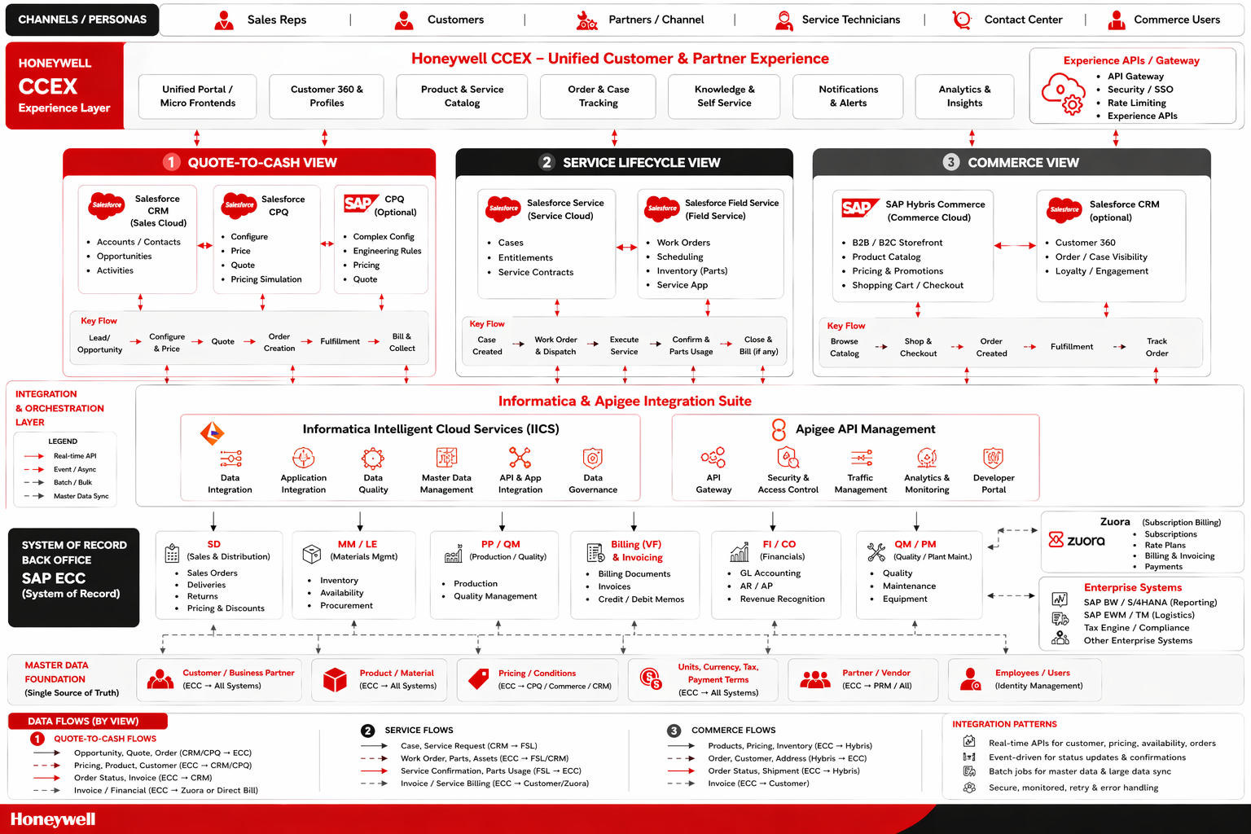
Enterprise Context
Notes:
quote to cash - at high level is in line with waht they heard
fulfill / build connect happen in back end, not where we have them now
quote to cash and service lifecycle is not showing the right apps. statement is accurate but order creation, fulfillment, bill and collect wont happen in the application shown. remove from that bucket.
once quote is created it is converted to an order in the backend via integration.
PT doesnt use CPQ at all. keep this as generic overview, then double click by each SBG and duplicate and make specific for PT, IA, BA, XX?
- talk to EA team at honeywell - they would give a lot more information as well. -- actually, EA has yet to draw out each architecture -- say we need to understand CPQ and SF in terms of how it impacts the business. SAP well go to PwC for. we can ask client for the top part since they've spend less time on that.

Slide 13
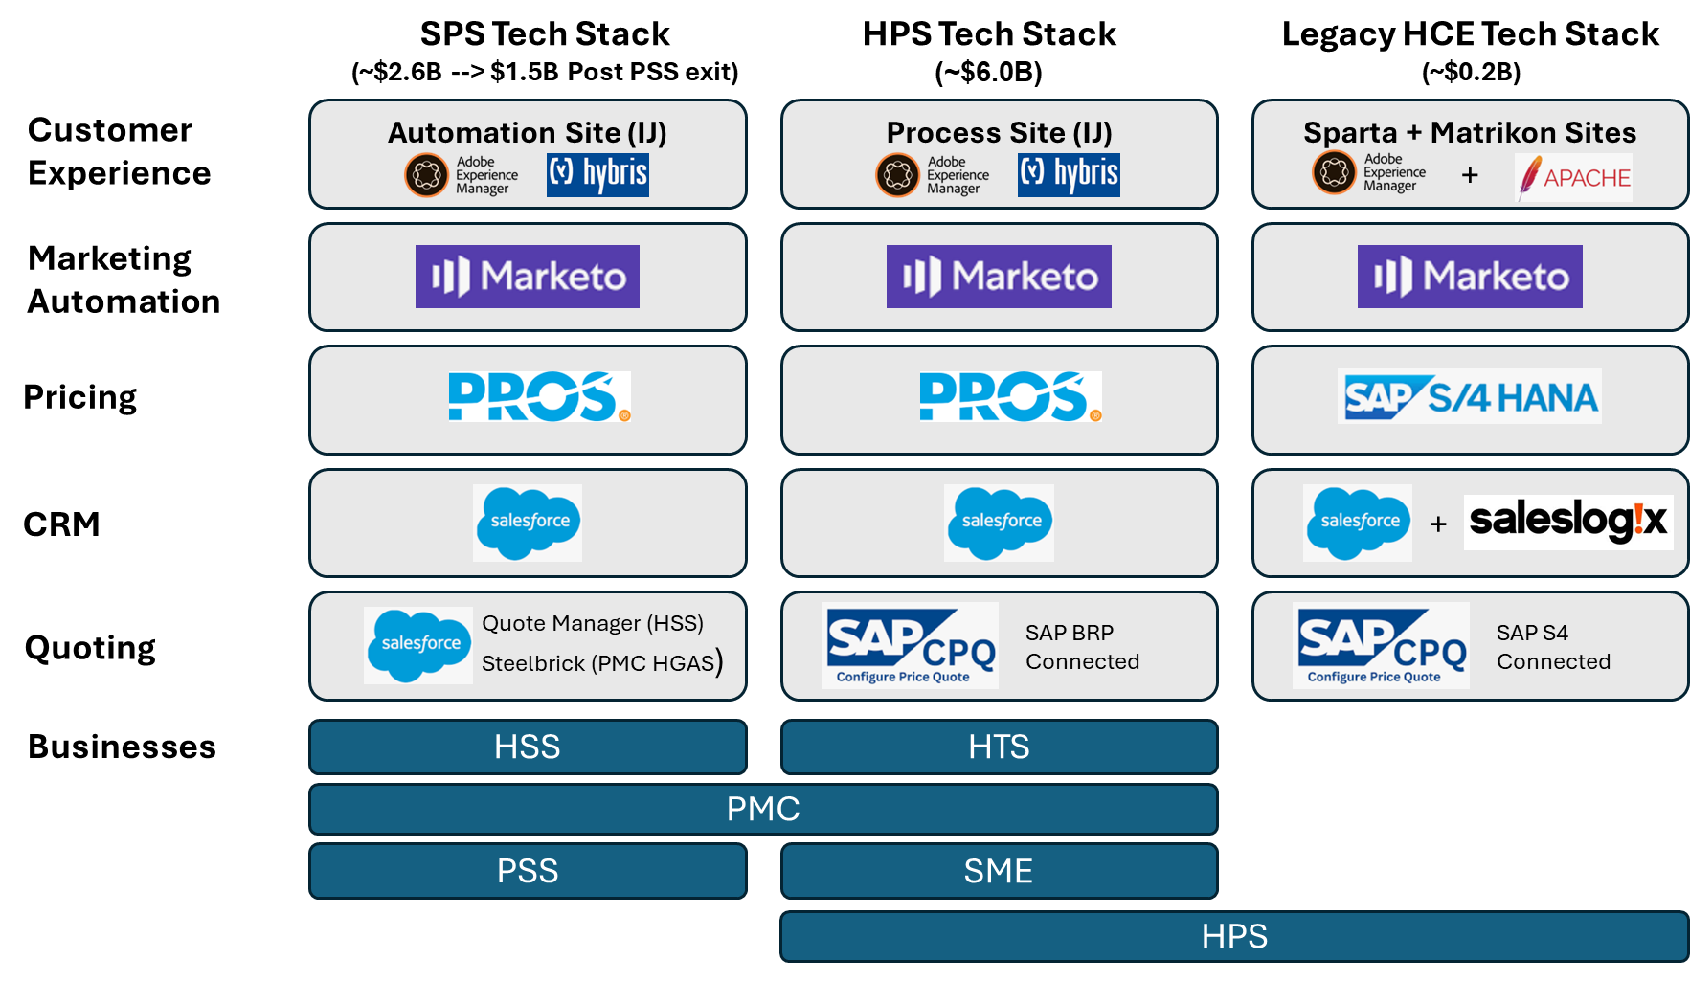
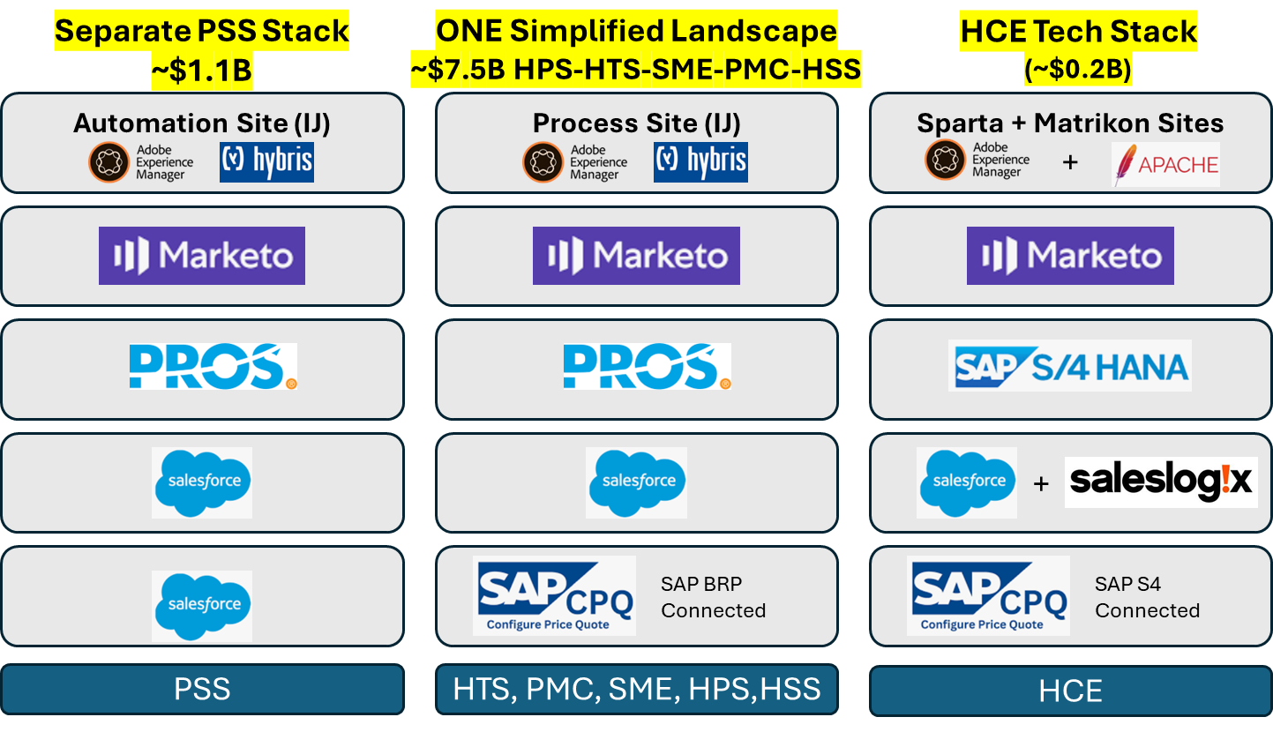
HON IA-HPS Commercial System Landscape
Future State
Complex System Landscape
GBEs across multiple landscapes
Lack of Standardized processes
PSS systems Physically separated
IA/HPS within a single landscape
Standardized Sales processes
Notes:
Clarify "legacy SPS/HPS" and 2025 revenue numbers
Add PSS

