Slide 1

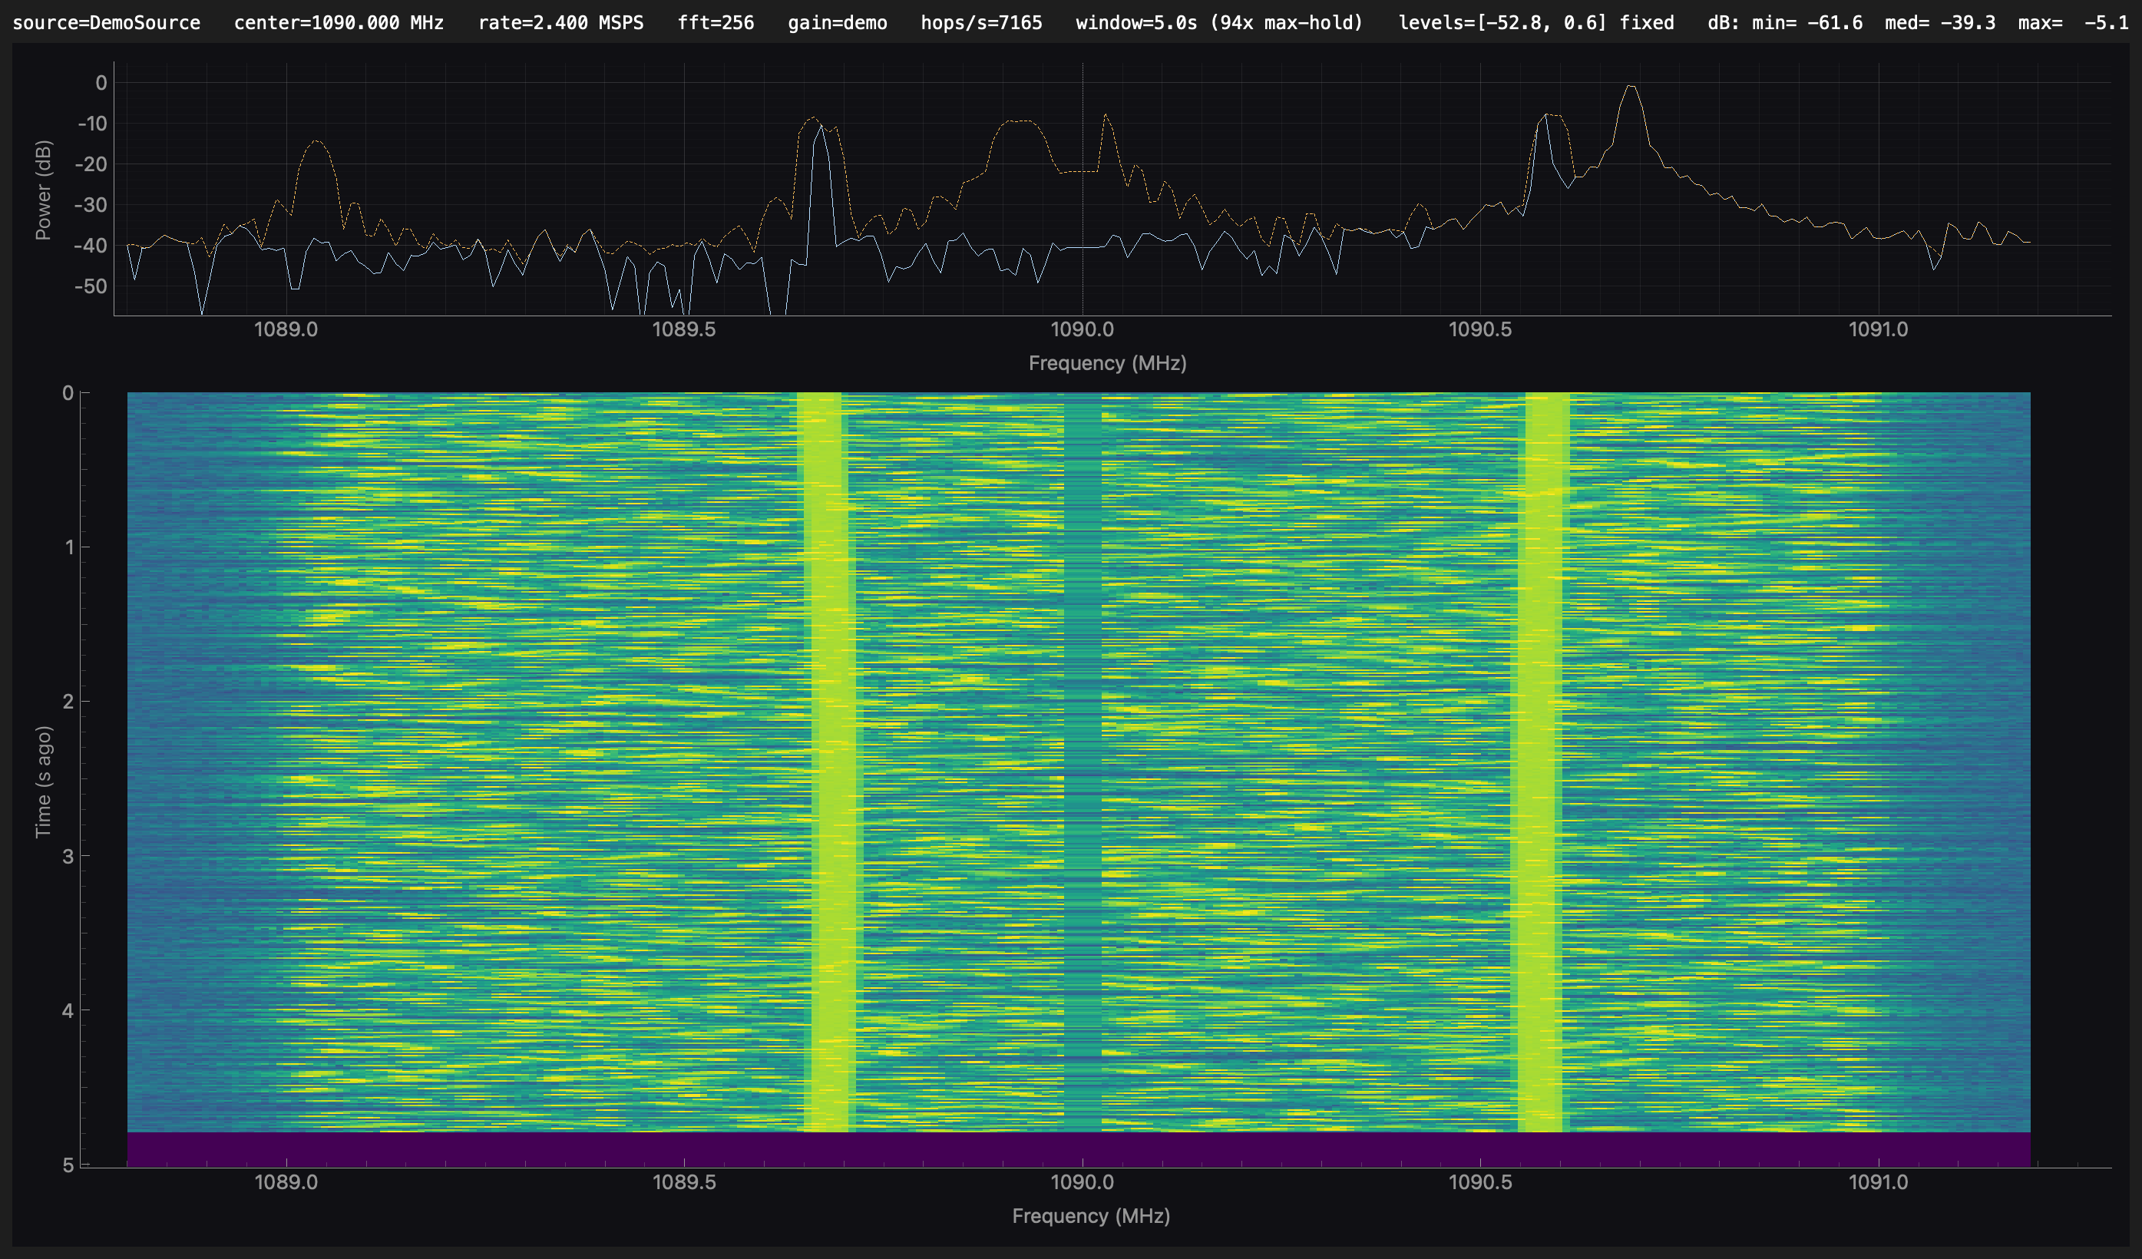
DESKTOP RF TOOL
adsb-live
Watch live 1090 MHz ADS-B spectrum from an
RTL-SDR, then decode the aircraft.
SPECTRUM
Live PSD and a max-hold waterfall —
verify antenna, gain, and RF.
DECODE
Feed the same live signal into
dump1090 for a table, polar map, and
telemetry.
RECORD / REPLAY
Demo window: power spectrum on top, 5-second waterfall below.
Save SQLite snapshots and replay later
without a dongle.
Local desktop app for macOS, Linux, and Windows
Notes:
adsb-live is a local Qt desktop app. Default view is a 1090 MHz PSD plus max-hold waterfall from a FlightAware / RTL-SDR dongle. Pass --decode to demodulate Mode-S/ADS-B via a child dump1090 process; add --lat/--lon for the receiver-centered polar map and selected-aircraft telemetry. --record writes SQLite snapshots; --replay plays them back without hardware. Only one program can hold the dongle at a time. Demo mode (shown) uses a synthetic source so the waterfall still scrolls without a radio.
[Sources]
- adsb-live README and architecture notes; demo-mode window capture.

