Slide 1
VA API (Video Acceleration)

Slide 2
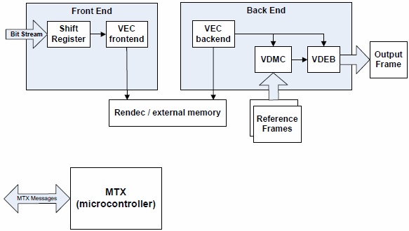
Hardware decode processes

Slide 3
VAAPI(libva)
硬體編/解碼效率高，功耗低。但局限性較大
Intel為了Linux 環境下開發的其中一種利用 GPU 加速視訊播放(硬解播放)的程式介面。
Operarting systems(GNU/Linux,FreeBSD,Solaris) and android
Video devoding/encoding, subpicture blending, rendering
VDPAU(Video Decode and presentation API for Unix) designed by NVIDIA

Slide 4
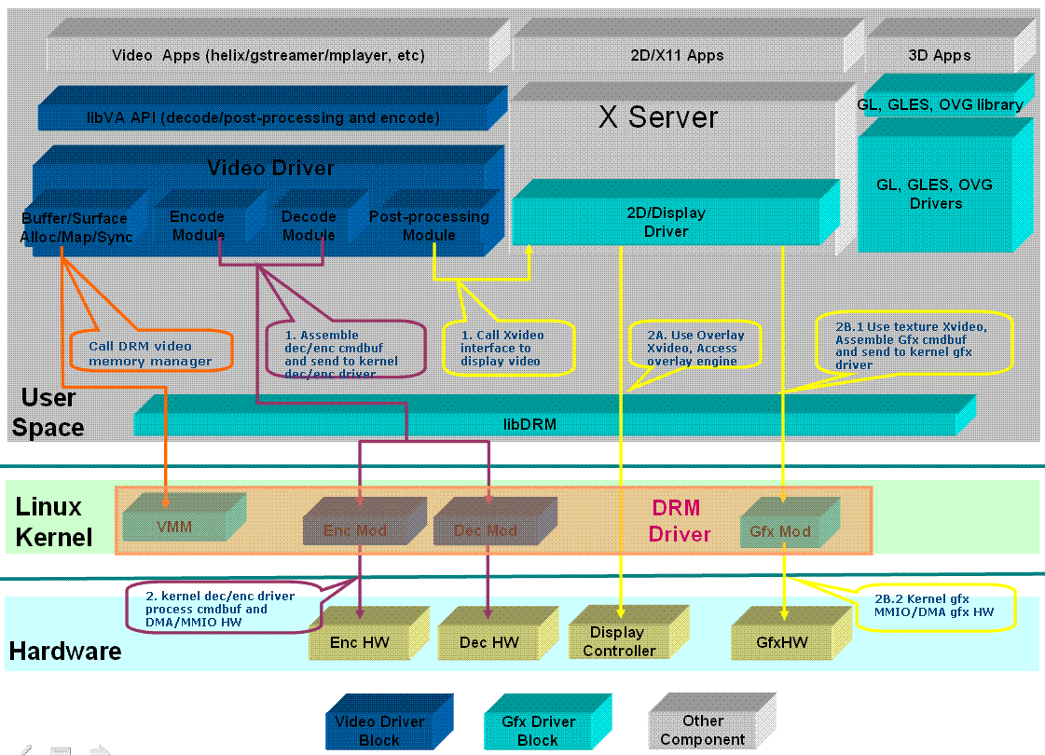
LibVA Location
Here

Slide 5
Validation Hardware(GPU)
- 繪圖規格
處理器繪圖 ‡ | Intel® HD Graphics
5th Intel® Core™ processors with Intel® HD Graphics 6000/5500
4th Intel® Core™ processors with Intel® HD Graphics 5000/4600
4th Intel® Core™ processors with Intel® Iris Pro Graphics 5200
3rd Intel® Core™ processors with Intel® HD Graphics 4000/2500
2nd Intel® Core™ processors with Intel® HD Graphics 3000/2000
Intel® Core™ processors with Intel® HD Graphics
Intel® Celeron® N2820 processor with Intel® HD Graphics (Bay Trail)
Intel® Atom™ N450 with Intel® Graphics Media Accelerator 3150 (Pine Trail)
Mobile Intel® GM45 Express Chipset
AMD/ATI Radeon GPU

Slide 6
Supported video codecs
Supports MPEG-2 decode acceleration Main Profile
Supports VC-1 / WMV3 decode acceleration Advanced Profile
Supports MPEG-4 Part 2 (H.263) (a.k.a. MPEG-4 SP / MPEG-4 ASP, more commonly known as Xvid) decode acceleration
Supports H.264 AVC H.264 AVC encode acceleration Main Profile
Supports H.264 AVC decode acceleration High Profile
H.264 / AVC Hardware Variable Length Decoding (VLD) - CABAC
H.264 / AVC Hardware Variable Length Decoding (VLD) - CAVLC
H.264 / AVC Hardware Inverse Transform (IT)
H.264 / AVC Hardware Motion Compensation (HWMC)
H.264 / AVC Hardware In-Loop Deblocking (ILDB)
In Libva-intel-driver 1.5.0 supproted
Decoding: H.264/MPEG-2/VC-1/JPEG/VP8/HEVC
Encoding: H.264/MPEG-2/JPEG
VPP: CSC/scaling/NoiseReduction/Deinterlacing{Bob, MotionAdaptive,MotionCompensated}/ColorBalance/STD

Slide 7
Processes can be accelerated with VA API
Motion compensation (mocomp)
Inverse discrete cosine transform (iDCT)
In-loop deblocking filter
Intra-frame prediction
Variable-Length Decoding (VLD)
Bitstream processing (CAVLC/CABAC)

Slide 8
Software Supporting VA API
VLC media player
Gstreamer
Helix media player
Clutter
Gnash Flash/SWF player
Fluendo
Mplayer
XBMC Media Center
XBMC Live
Myth TV

Slide 9
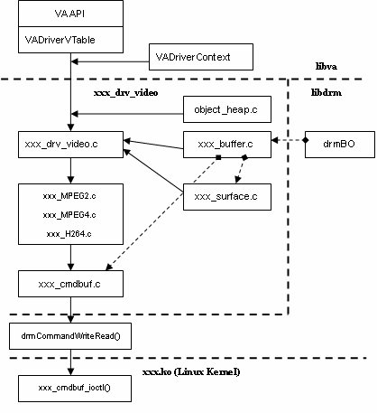

Slide 10
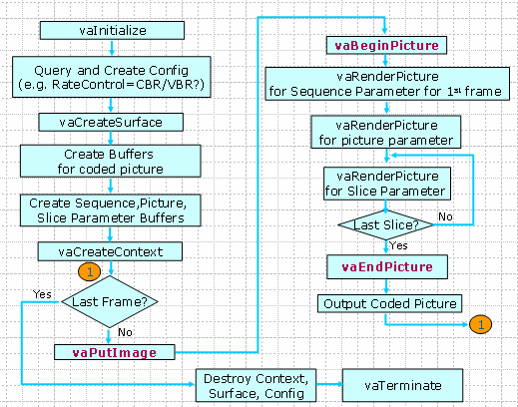
Flow chart

Slide 11
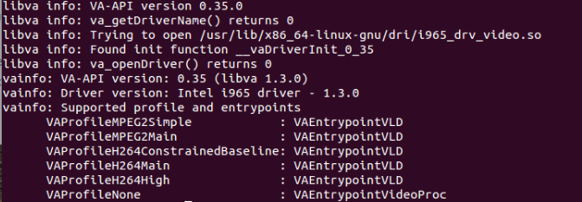
PC specs
Lenovo Thinkpad X201i
Intel® Core™ i3-370M Processor (3M cache, 2.40 GHz)

Slide 12
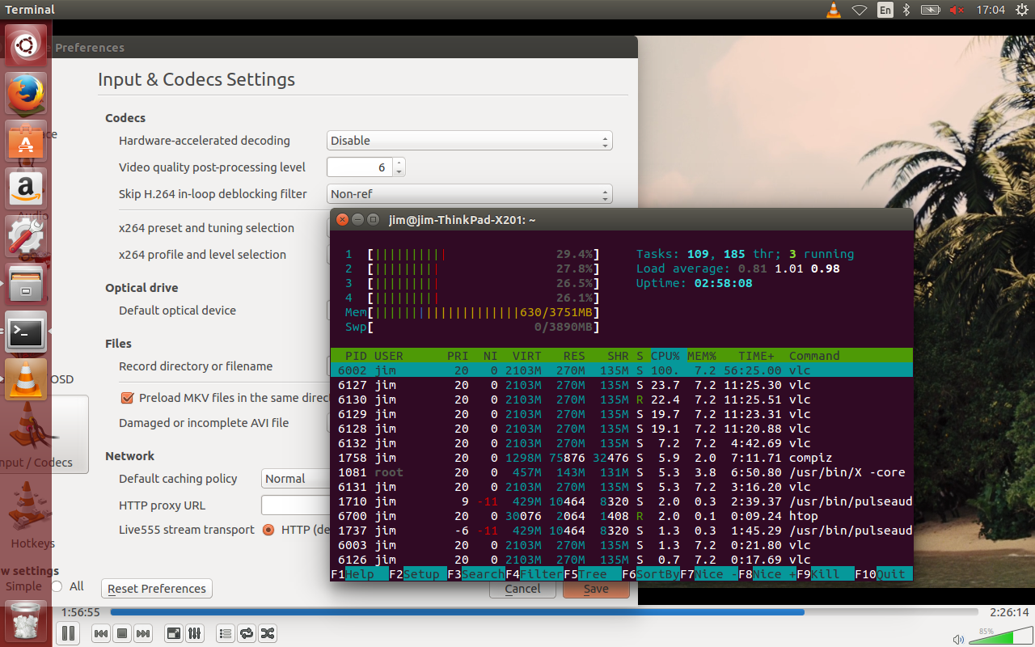
Without VA API

Slide 13
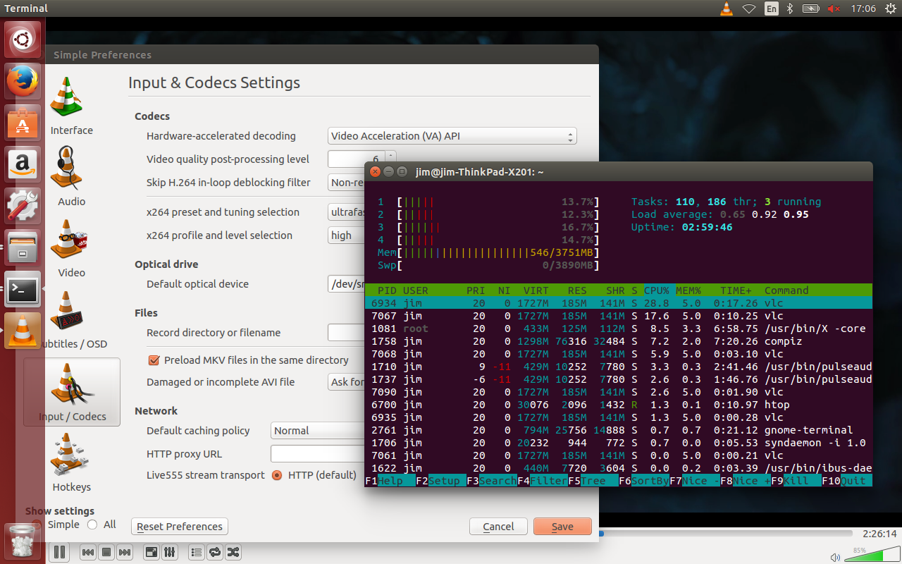
Using VA API

