Slide 1
Microservice

Slide 2
Agenda
Monolithic vs. Microservice
Ex1
Ex2
Stateless Service
Sharing Info Between Services
Service Discovery
Tool : Redis
DIY 1 - Sharing Session Data
DIY 2 - Who is online (Service Discovery)
DIY 3 - Who is online/offline (Service Discovery)
Tool : Message Queue (TBD…)
Tool : Serverless Service (TBD…)

Slide 3
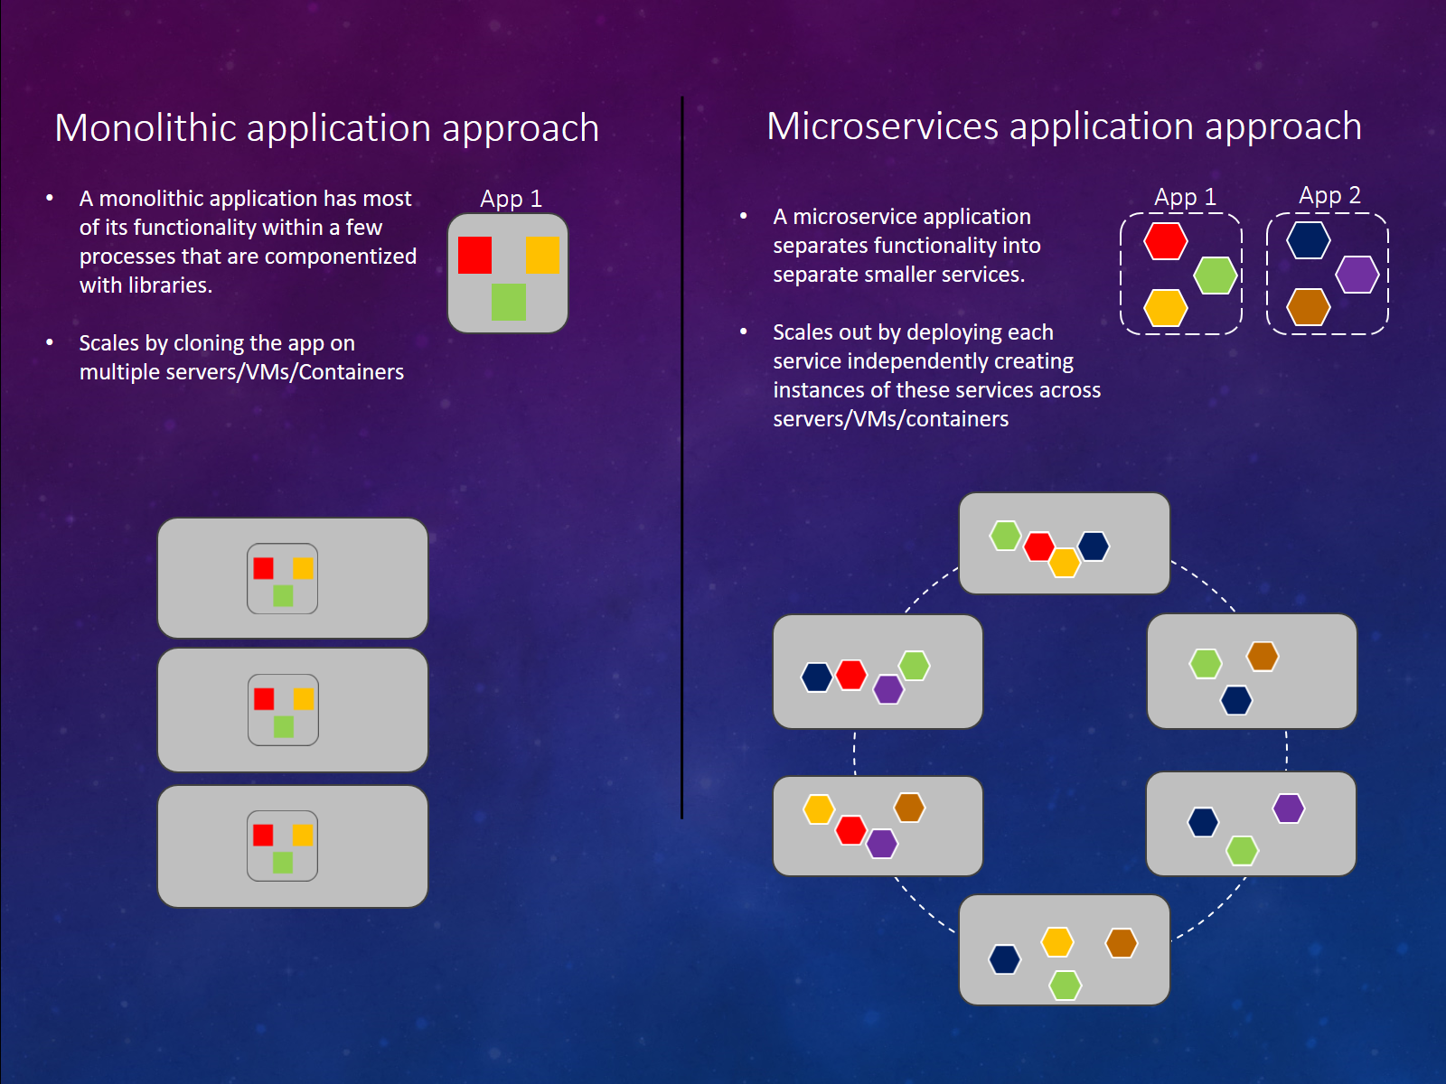
Monolithic v.s. Microservice

Slide 4
Monolithic v.s. Microservice
Develop : Reuse of Codes
Source Code
Binary Code
Service => Microservice
Operating : Application Maintainess
Scale-Up vs. Scale-Out
Notes:
微服務架構下給維運團隊的彈性就大很多。維運團對開始有機會個別監控每個獨立的 services, 可以個別升級，備分，維護等。碰到問題也能個別 restart, 甚至也能在修復時關閉部分功能，分區維修，將使用者的影響降到最低。
效能不足時，也能視個別服務的 loading 不同，只針對特定的 service 做 scale out. 維運團隊對 application 的狀況掌握的精確程度，可以遠高於單體式的 application.
不過，相對於 application 的佈署，微服務架構也相對的複雜。最傳統的 application, 你可能只需要搞定 web + database, 改成微服務架構你要裝的 東西就多了

Slide 5
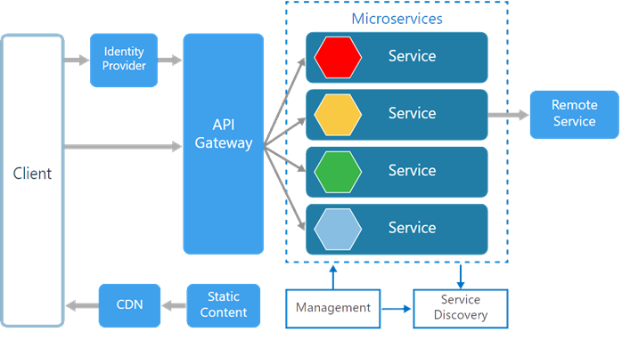
Example 1

Slide 6
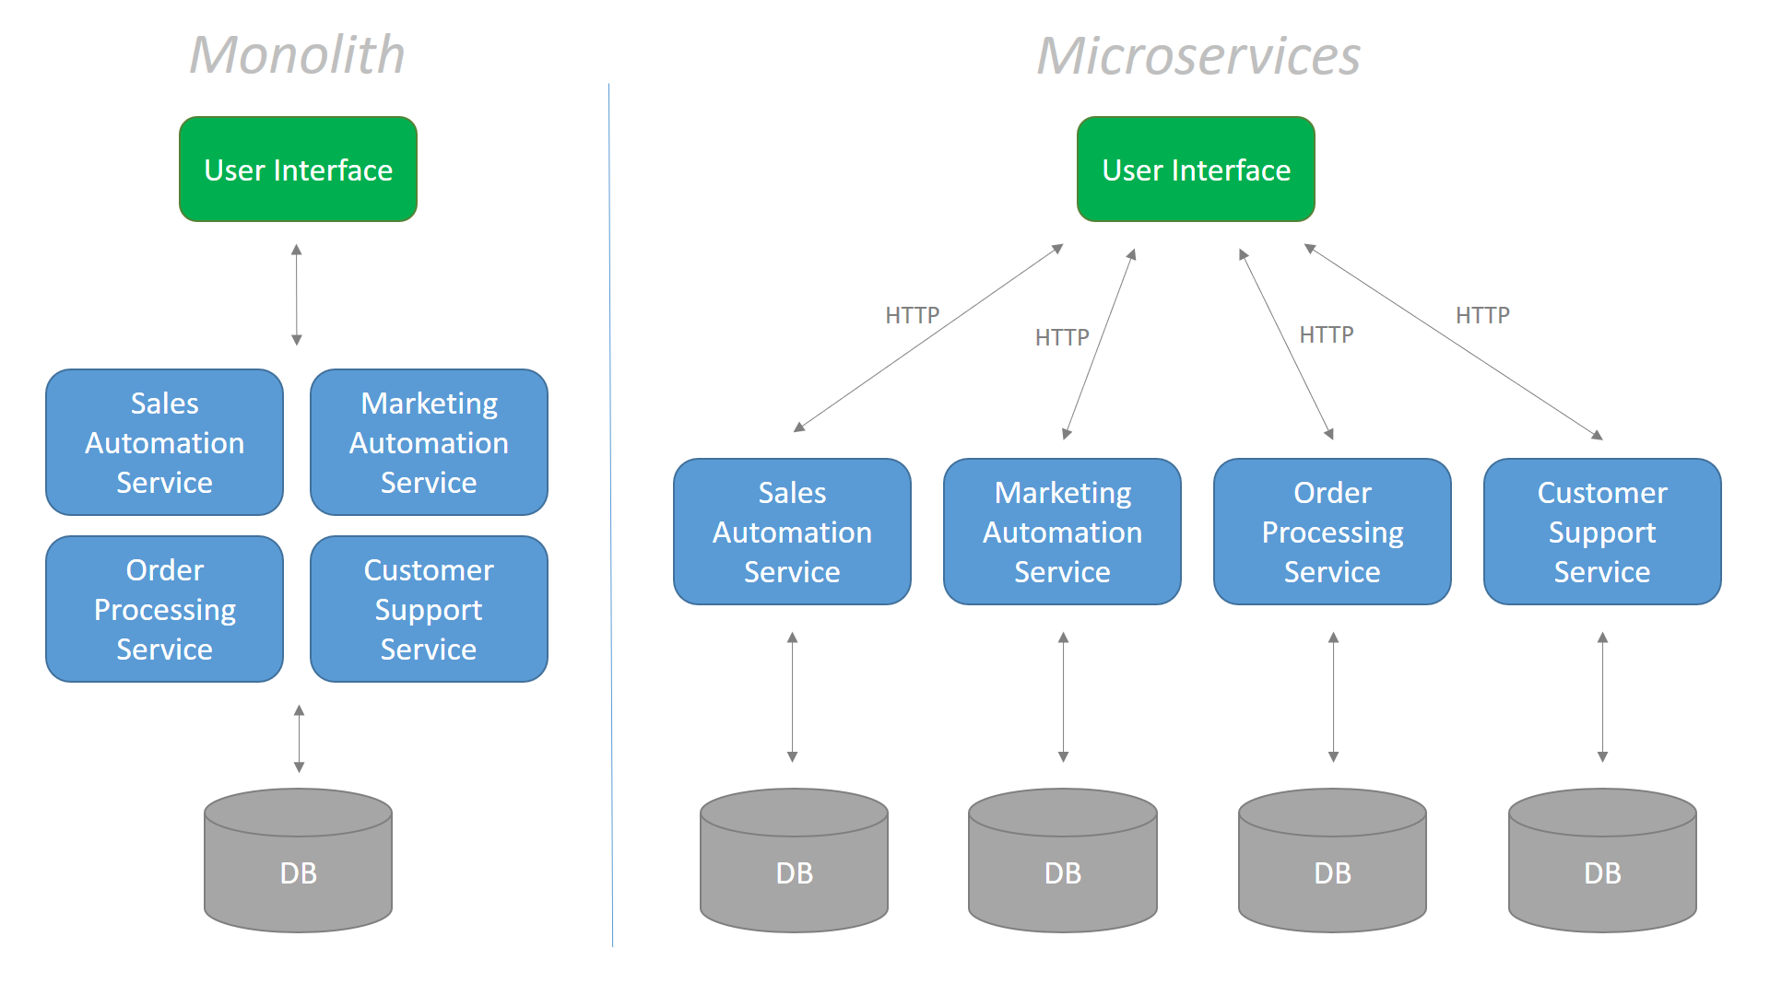
Example 1

Slide 7
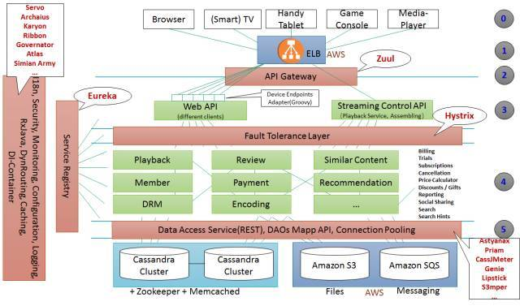
Example 2

Slide 8
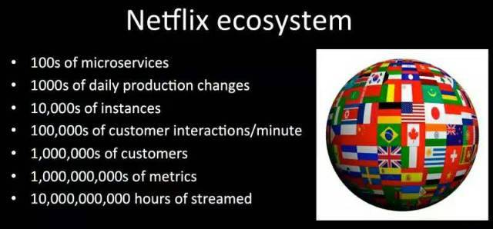
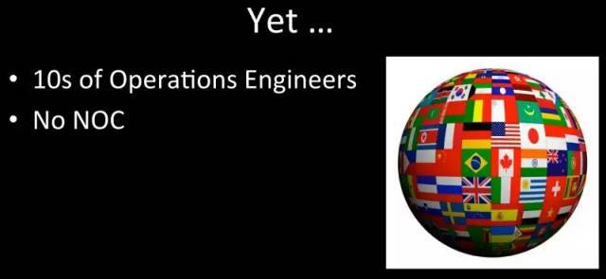
Example 2

Slide 9
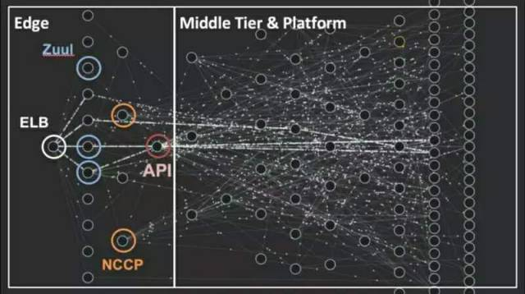
Example 2

Slide 10
Stateless Service
When Service crashed => Turn off & Start new
Service have to be STATELESS (pure , functional) to prevent data-losing
Outside Storage : No info in in-app-memory
Outside Storage HA
Using ACK
GOOD PRACTICE but not MUST

Slide 11


Sharing info between services?
Sync : Restful, gRPC, Websocket, Socket
Async : RabbitMQ, Kafka,….
Both : Redis, Memcached …

Slide 12
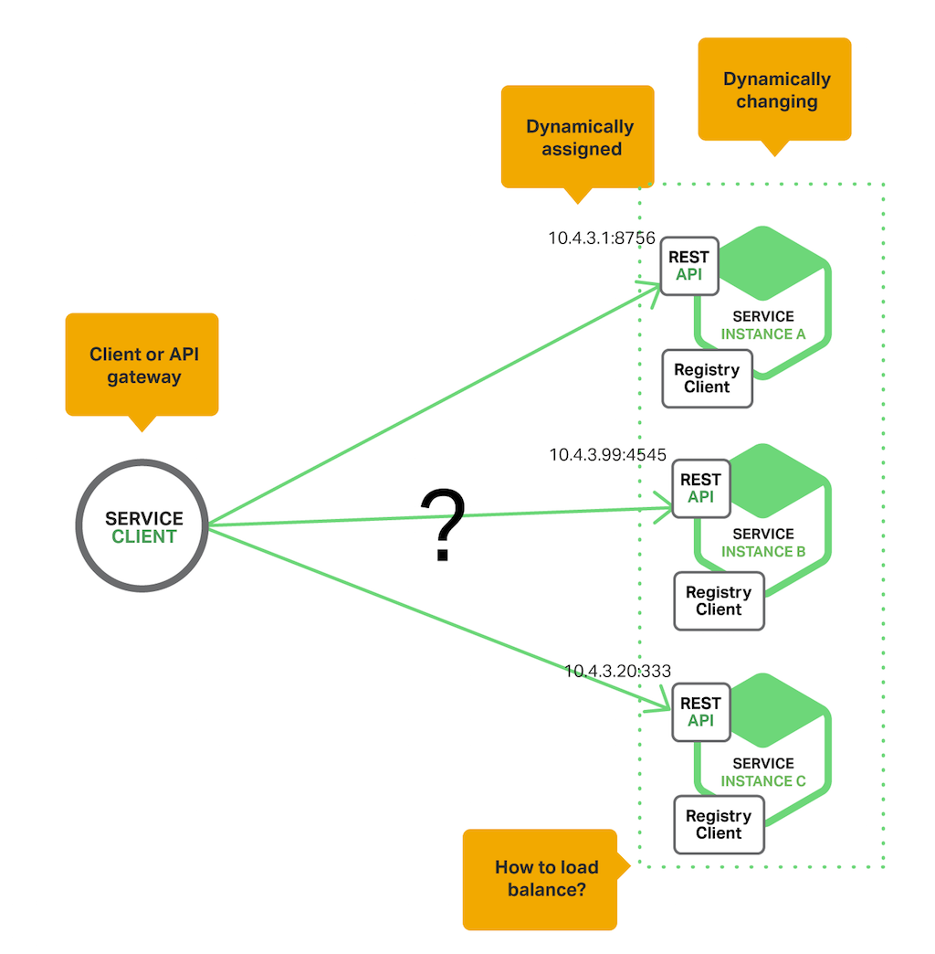
Service Discovery
Where is XXX service ? What’s the IP ?
Who is online ?

Slide 13
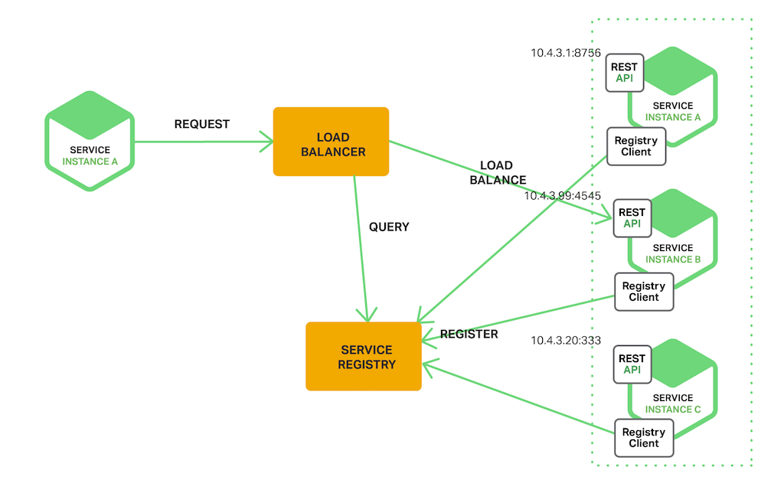
Service Discovery
Register：Registering when service started
Query：Query which IP is available
Healthy Check： Any service unavailable ?

Slide 14
DIY - Session Server
Github: https://github.com/jimliu7434/microservice-sample

Slide 15
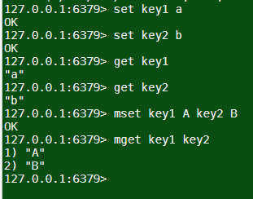
DIY 1 – Sharing Session Data
http://www.tutorialspoint.com/redis_terminal_online.php
Using Redis Type : Strings
set key1 a
set key2 b
get key1
get key2
mset key1 A key2 B
mget key1 key2

Slide 16
DIY 1 – Sharing Session Data
Using In-App Memory
https://github.com/jimliu7434/microservice-sample/blob/master/model/session_local.js
Using Redis
https://github.com/jimliu7434/microservice-sample/blob/master/model/session_redis.js

Slide 17
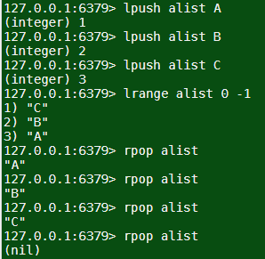
DIY 2 – Who is online (Service Discovery)
http://www.tutorialspoint.com/redis_terminal_online.php
Using Redis Type : Lists
lpush alist A
lpush alist B
lpush alist C
lrange alist 0 -1
rpop alist
rpop alist
rpop alist

Slide 18
DIY 2 – Who is online (Service Discovery)
Using Redis
Using setInterval to get List
https://github.com/jimliu7434/microservice-sample/blob/master/service/pods1.js

Slide 19
DIY 3 – Who is online/offline (Service Discovery)
Using Redis Pub/Sub
Without setInterval in code
Only be triggered when someone go Up or Down
https://github.com/jimliu7434/microservice-sample/blob/master/service/pods2.js

Slide 20
Ref.
https://columns.chicken-house.net/2016/09/15/microservice-case-study-01/#operating-team-application-maintainess
https://docs.microsoft.com/zh-tw/dotnet/standard/microservices-architecture/architect-microservice-container-applications/microservices-architecture
https://www.codeproject.com/Articles/1276639/Microservice-using-ASP-NET-Core
https://www.carlrippon.com/scalable-and-performant-asp-net-core-web-apis-microservices/
https://36kr.com/p/5104897
https://redis.io/

