Slide 1
Microservice 02 Redis
Github: https://github.com/jimliu7434/microservice-sample

Slide 2
Agenda
Redis
BTW - Docker
Session Data
DIY 1 - Sharing Session Data
Service Discovery
DIY 2 - Who is online
DIY 6 – Leaderboard with Time range
Reference

Slide 3

In-Memory Key-Value DB
Data persisting
HA (Replication & Cluster) Ready
Multi-Types
Transaction (Atomic Operation) Ready
LUA Script programming

Slide 4
Redis
Type:
strings
hashes
lists
sets
sorted sets
bitmaps
geo
Pub/Sub
streams
To JS Type:
strings
object
arrays
sets
maps + sort
bitwise
-
-
-
Usage:
Caching
Queues
Leaderboards
Counting
Pub/Sub

Slide 5
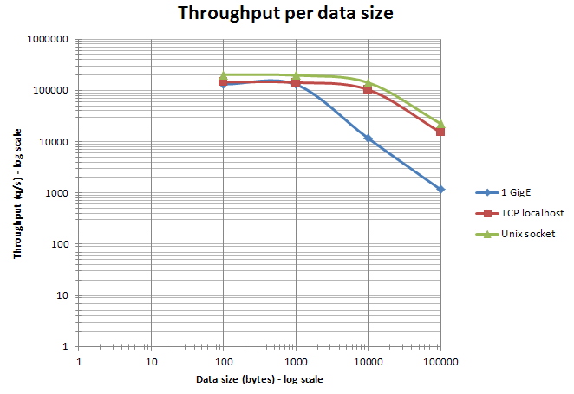
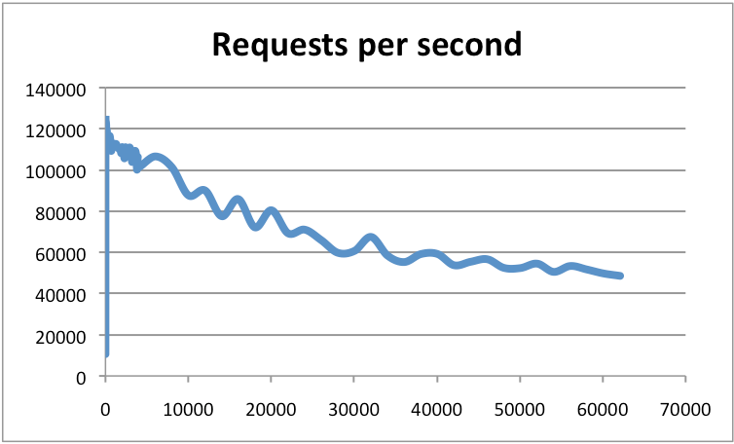
Performance:

Slide 6
BTW - Docker
Cross Platform
Infra as Code
Docker : 1 Image @ 1 Machine
Docker-Compose : N Images @ 1 Machine
Docker-Swarm : N Images @ N Machines
Kubernetes (K8S) : N Images @ N Machines

Slide 7
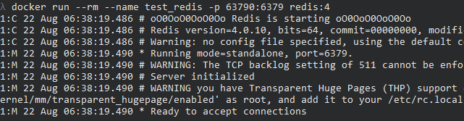
BTW - Docker
Create a Redis DB by Docker
docker run --rm --name test_redis –p 63790:6379 redis:4

Slide 8
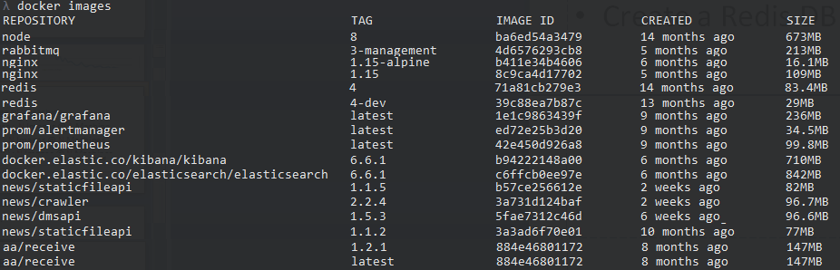
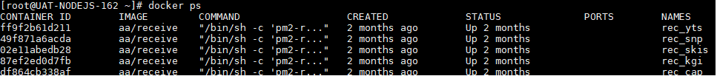
BTW - Docker

Slide 9
Session Data
Session : User/Connection Server-side Data
Cookie-Based Session
Token-Based Session
Using In-App Memory
https://github.com/jimliu7434/microservice-sample/blob/master/model/session_local.js

Slide 10
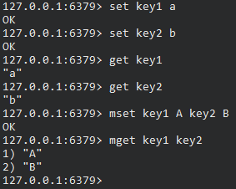
DIY 1 – Sharing Session Data
https://try.redis.io
Using Redis Type : Strings
set key1 a
set key2 b
get key1
get key2
mset key1 A key2 B
mget key1 key2

Slide 11

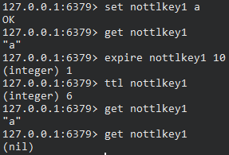
DIY 1 – Sharing Session Data
https://try.redis.io
Set TTL data
setex ttlkey1 5 a
get ttlkey1
### after 5 sec ###
get ttlkey1
set nottlkey1 a
get nottlkey1
expire nottlkey1 5
ttl nottlkey1
### after 5 sec ###
get nottlkey1

Slide 12
DIY 1 – Sharing Session Data
Using Redis
https://github.com/jimliu7434/microservice-sample/blob/master/model/session_redis.js

Slide 13
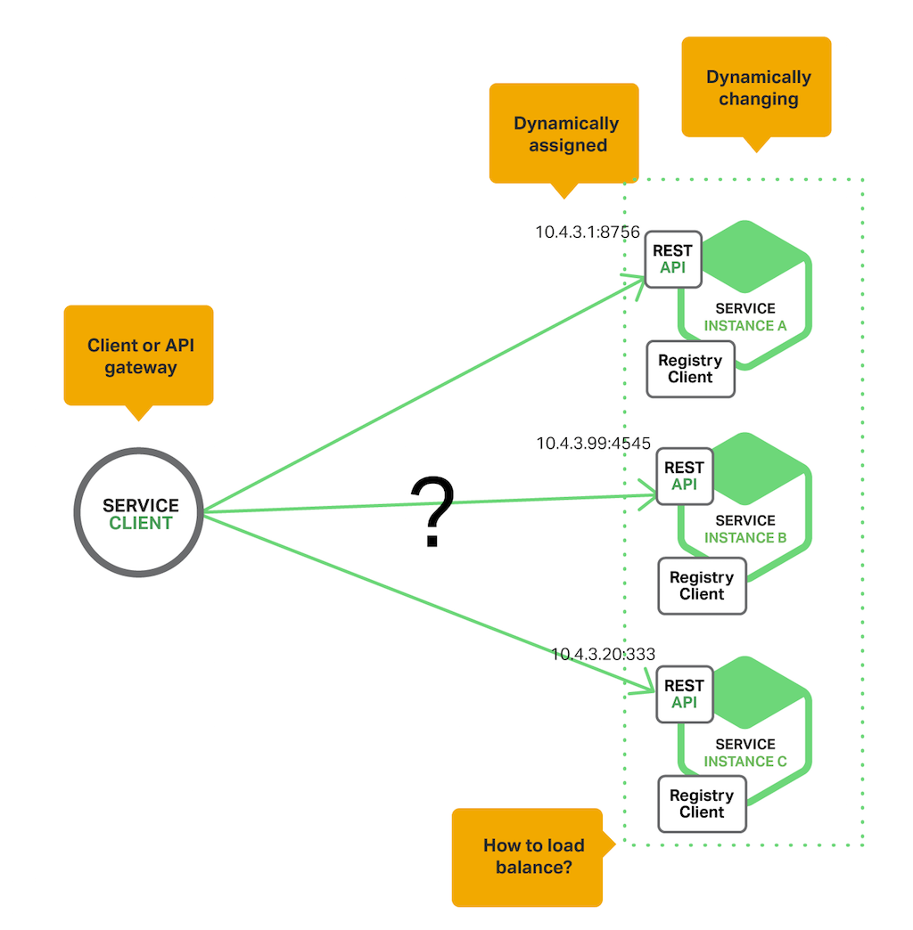
Service Discovery
Where is XXX service ?
Who is online ?

Slide 14
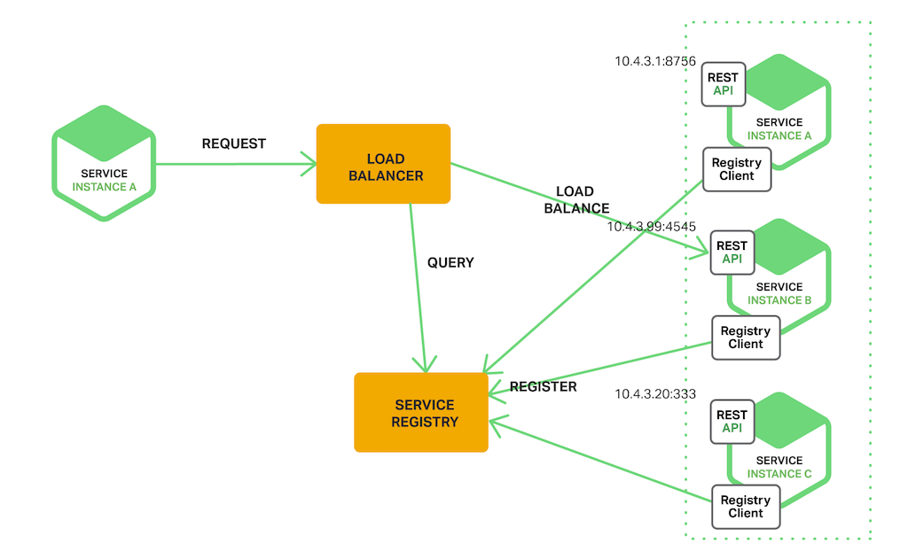
Service Discovery
Register：Registering when service started / leaved
Query：Query which IP lists
Healthy Check：Any instance unavailable / slow ?

Slide 15
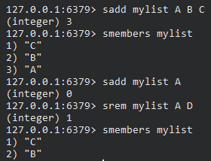
DIY 2 – Who is online (Service Discovery)
https://try.redis.io
Using Redis Type : Sets
sadd mylist A B C
smembers mylist
sadd mylist A
srem mylist A D
Smembers mylist

Slide 16
DIY 2 – Who is online (Service Discovery)
Using Redis
Using setInterval to get List
https://github.com/jimliu7434/microservice-sample/blob/master/service/example02.js

Slide 17
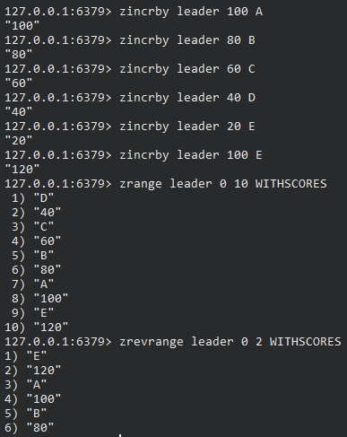
DIY 6 – Leaderboard with Time range
Using Redis Type : Sorted Sets
zincrby leader 10 A
zincrby leader 20 B
zrange leader 0 10
zrevrange leader 0 3

Slide 18
DIY 6 – Leaderboard with Time range
With Local Code
Using UnionStore
Using setTimeout
https://github.com/jimliu7434/microservice-sample/blob/master/service/example06.js

Slide 19
Ref.
https://www.carlrippon.com/scalable-and-performant-asp-net-core-web-apis-microservices/
https://redis.io/
https://redis.io/topics/benchmarks
https://try.redis.io
我的腦袋

