Slide 1
Microservice 03 Rabbit MQ
Github: https://github.com/jimliu7434/microservice-sample

Slide 2
Agenda
Message Queue
RabbitMQ
Message Dispatching
DIY 3 - Who is a volunteer?
DIY 4 – Logging Service
Service Discovery
DIY 5 - Who is online/offline
Leaderboard
DIY 6 – Leaderboard with Time range
DIY 7 – Leaderboard with Time range
Reference

Slide 3
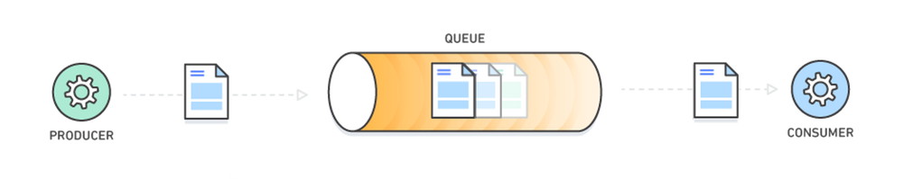
Message Queue
Message queues allow different parts of a system to communicate and process operations asynchronously.
Notes:
消息队列（Message Queue）是一种应用间的通信方式，消息发送后可以立即返回，由消息系统来确保消息的可靠传递。消息发布者只管把消息发布到 MQ 中而不用管谁来取，消息使用者只管从 MQ 中取消息而不管是谁发布的。这样发布者和使用者都不用知道对方的存在。

Slide 4
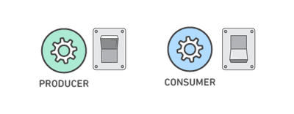
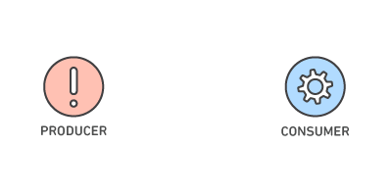
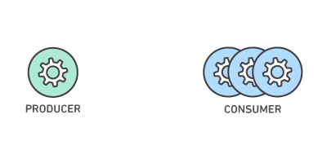
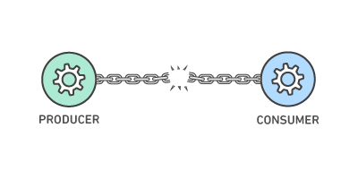
Why using Message Queue
Better Performance 更佳的效能
Increased Reliability 提升可靠性
Granular Scalability 精細可擴展性
Simplified Decoupling 簡化去耦

Slide 5

AMQP(Advanced Message Queuing Protocol)
By Erlang
Advantages:
Reliability
Flexible Routing
Clustering
Highly Available
Management UI
Many Clients Support
Tracing

Slide 6
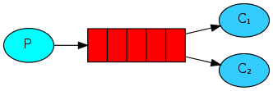
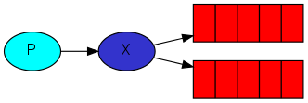
RabbitMQ
Work Queues
Publish / Subscribe

Slide 7
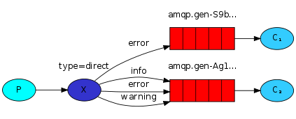
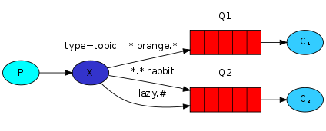
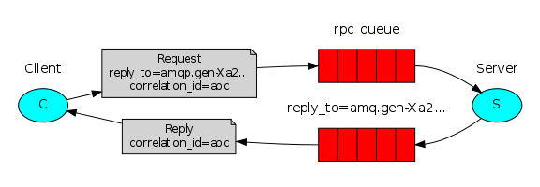
RabbitMQ
Routing
Topics
RPC

Slide 8
DIY 3 – Who is a volunteer?
Using RabbitMQ Queues
Without setInterval in code
Only be triggered when task is coming
https://github.com/jimliu7434/microservice-sample/blob/master/service/example03.js

Slide 9
DIY 4 – Logging Service
Using RabbitMQ Pub/Sub
https://github.com/jimliu7434/microservice-sample/blob/master/service/example04.js

Slide 10
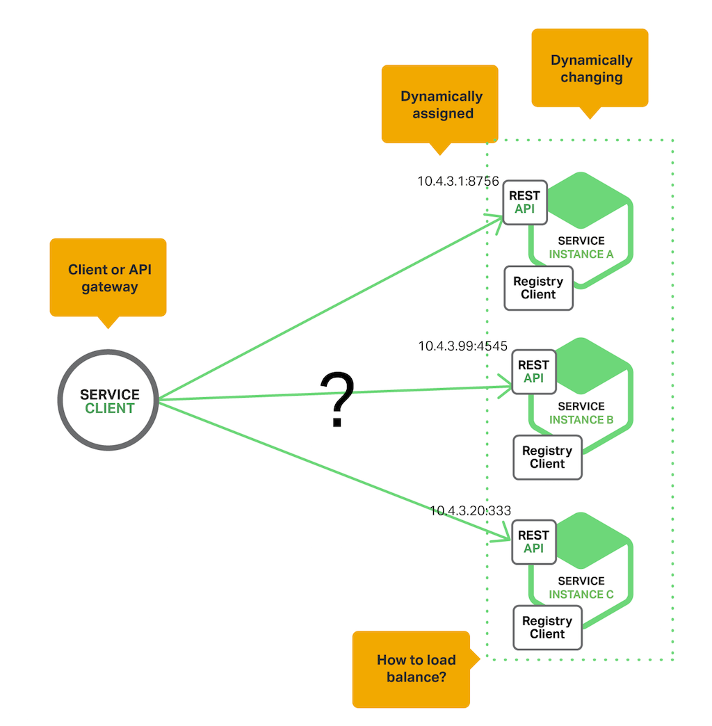
Service Discovery
Where is XXX service ?
Who is online ?

Slide 11
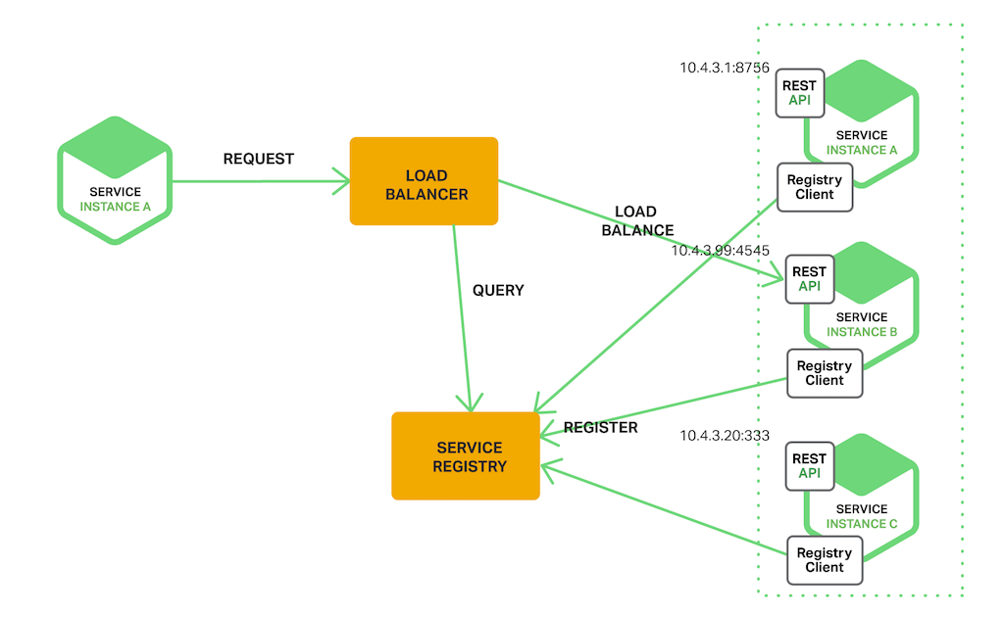
Service Discovery
Register：Registering when service started / leaved
Query：Query which IP lists
Healthy Check：Any instance unavailable / slow ?

Slide 12
DIY 5 – Who is online/offline
Using RabbitMQ Pub/Sub + Queue
Without setInterval in code
Only be triggered when service go Up or Down
https://github.com/jimliu7434/microservice-sample/blob/master/service/example05.js

Slide 13
DIY 6 – Leaderboard with Time range
With Local Code
https://github.com/jimliu7434/microservice-sample/blob/master/service/example06.js

Slide 14
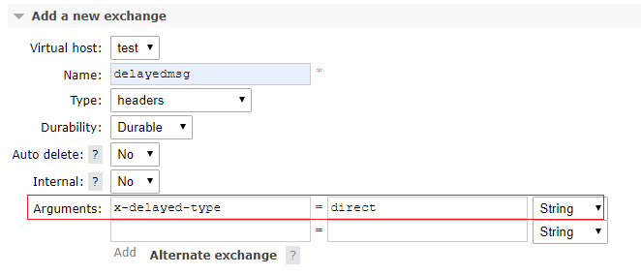
DIY 7 – Leaderboard with Time range
With RabbitMQ
plugin rabbitmq_delayed_message_exchange
https://github.com/jimliu7434/microservice-sample/blob/master/service/example07.js

Slide 15
Ref.
https://aws.amazon.com/tw/message-queue/benefits/
https://www.rabbitmq.com
https://www.jianshu.com/p/79ca08116d57
我的腦袋

