Slide 1
Microservice
Jim Liu

Slide 2
Agenda
Monolithic vs. Microservice
Stateless Service
Sharing Info Between Services
Service Discovery
DIY:
Memory DB : Redis
DIY 1 - Sharing Session Data
DIY 2 - Who is online (Service Discovery)
DIY 3 - Who is online/offline (Service Discovery)
Message Queue : RabbitMQ (TBD…)
Serverless Function : AWS Lambda (TBD…)
Container : Docker (TBD…)
Container Manager : K8S (TBD…)
Reference

Slide 3
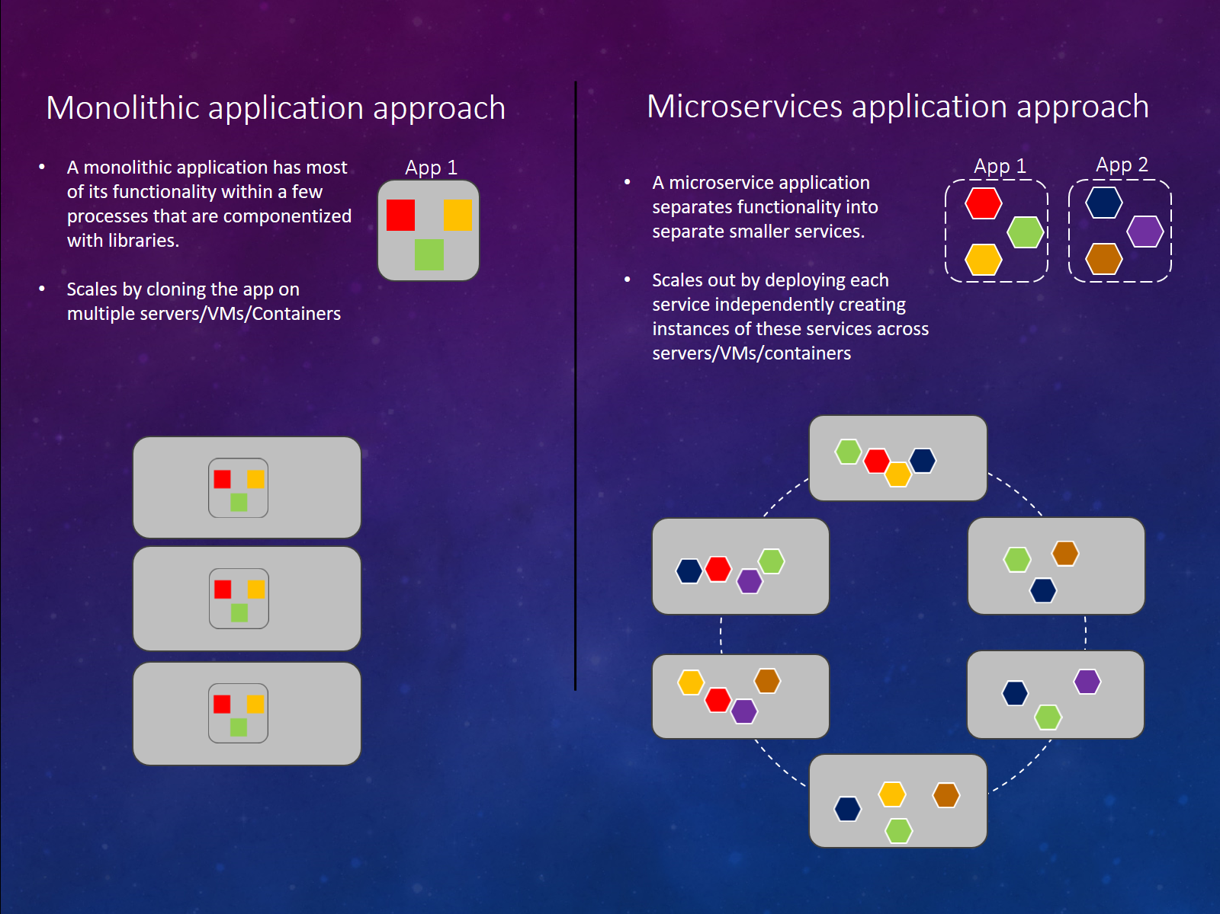
Monolithic vs. Microservice

Slide 4
Monolithic vs. Microservice
Develop : Reuse of Codes
Source Code => Monolithic
Binary Code
Service => Microservice
Operating : Application Maintainess
Simple vs. Complex
Scale-Up vs. Scale-Out
Notes:
微服務架構下給維運團隊的彈性就大很多。維運團對開始有機會個別監控每個獨立的 services, 可以個別升級，備分，維護等。碰到問題也能個別 restart, 甚至也能在修復時關閉部分功能，分區維修，將使用者的影響降到最低。
效能不足時，也能視個別服務的 loading 不同，只針對特定的 service 做 scale out. 維運團隊對 application 的狀況掌握的精確程度，可以遠高於單體式的 application.
不過，相對於 application 的佈署，微服務架構也相對的複雜。最傳統的 application, 你可能只需要搞定 web + database, 改成微服務架構你要裝的 東西就多了

Slide 5
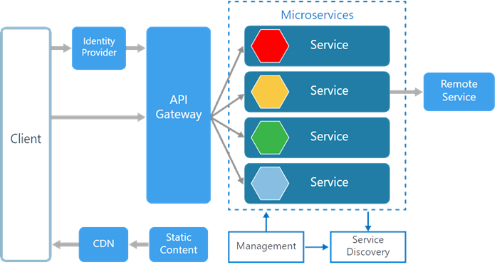
Example 1

Slide 6
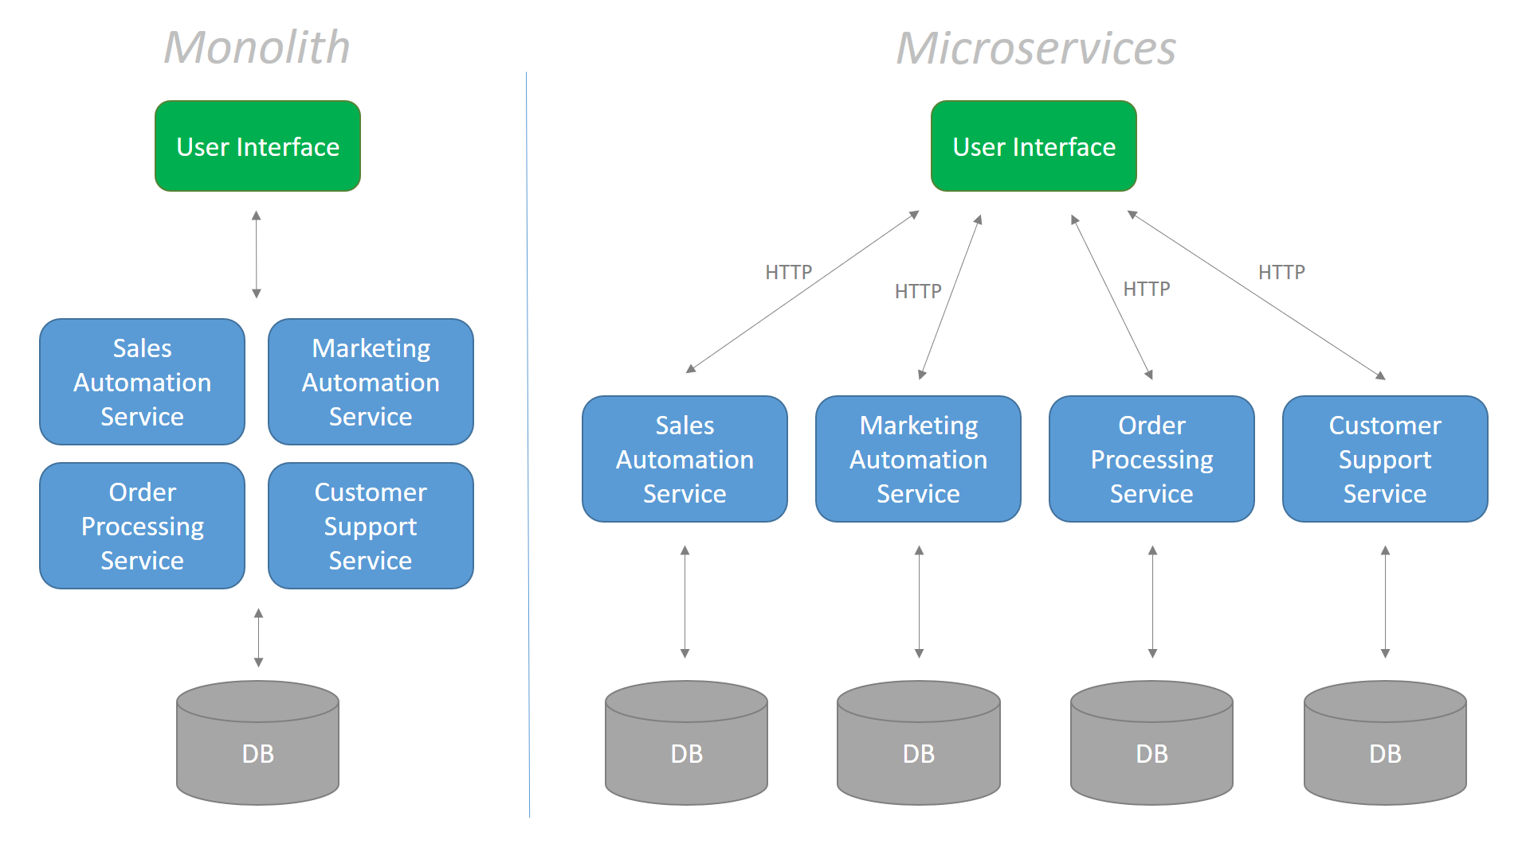
Example 1

Slide 7
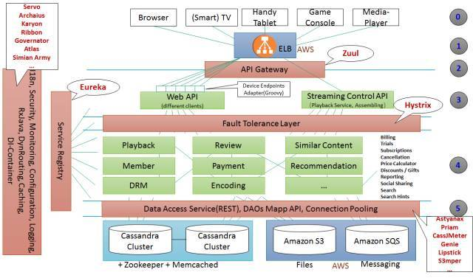
Example 2

Slide 8
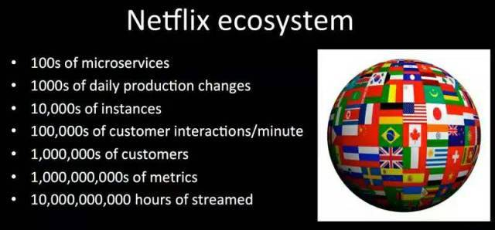
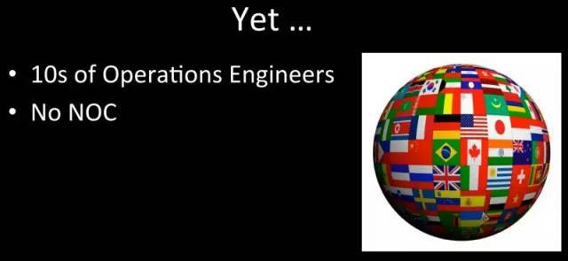
Example 2

Slide 9
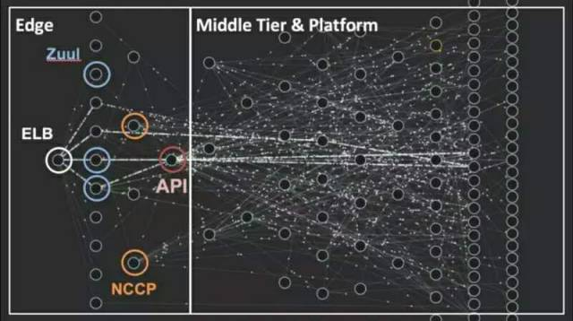
Example 2
Notes:
Chaos Monkey：可以随机关闭生产环境中的实例，确保网站系统能够经受故障的考验，同时不会影响客户的正常使用。
Latency Monkey：在 RESTful 服务的调用中人为引入延迟来模拟服务降级，测量上游服务是否会做出恰当响应。通过引入长时间延迟，还可以模拟节点甚至整个服务不可用。
Conformity Monkey：查找不符合最佳实践的实例，并将其关闭。例如，如果某个实例不在自动伸缩组里，那么就将其关闭，让服务所有者能重新让其正常启动。
Doctor Monkey：查找不健康实例的工具，除了运行在每个实例上的健康检查，还会监控外部健康信号，一旦发现不健康实例就会将其移出服务组。
Janitor Monkey：查找不再需要的资源，将其回收，这能在一定程度上降低云资源的浪费。
Security Monkey：这是 Conformity Monkey 的一个扩展，检查系统的安全漏洞，同时也会保证 SSL 和 DRM 证书仍然有效。
10-18 Monkey：运行本地化及国际化的配置检查，确保不同地区、使用不同语言和字符集的用户能正常使用 Netflix。
Chaos Gorilla：Chaos Monkey 的升级版，可以模拟整个 AWS Availability Zone 故障，以验证在不影响用户，且无需人工干预的情况下，能够自动进行可用区的重新平衡。

Slide 10
Stateless Service
When Service crashed => Turn off & Start new
When Auto-Scaling => Start new | Turn off
Service must be STATELESS (pure , functional) to prevent data-losing
No info in in-app-memory : Outside Storage
ACK (Queue)
Status Flag (DB)
Outside Storage Data-persisting & HA

Slide 11


Sharing info between services?
Sync : Socket, Restful, gRPC, Websocket
Async : RabbitMQ, Kafka,….
Both : Redis, Memcached …

Slide 12
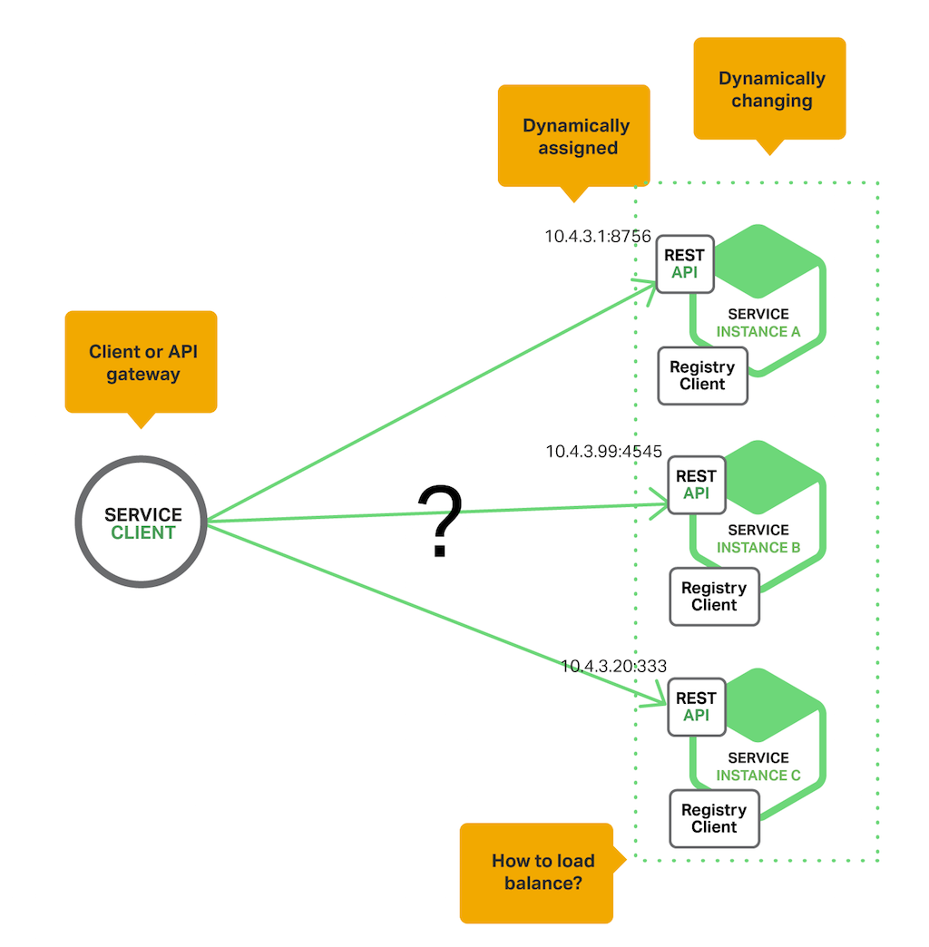
Service Discovery
Where is XXX service ?
Who is online ?

Slide 13
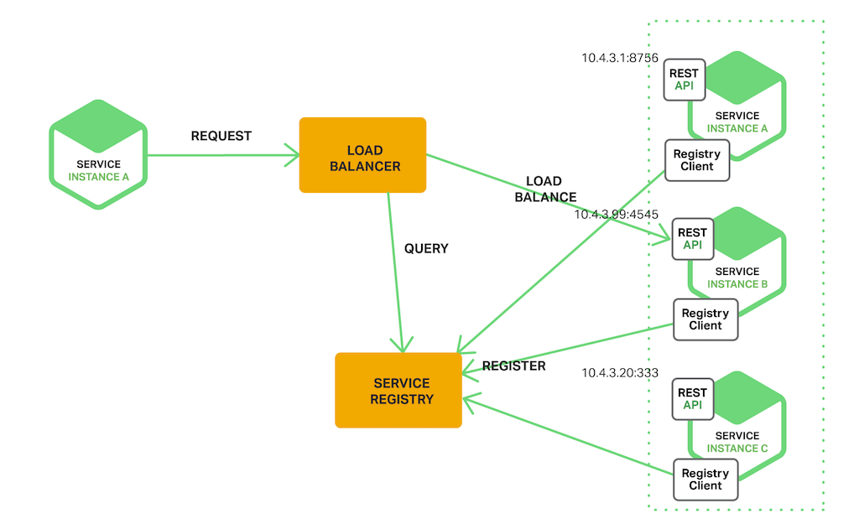
Service Discovery
Register：Registering when service started / leaved
Query：Query which IP lists
Healthy Check：Any instance unavailable / slow ?

Slide 14
DIY - Redis
In-Memory Key-Value DB
Data persisting
HA (Replication & Cluster) Ready
Multi-Types
Transaction (Atomic Operation) Ready
LUA Script programming

Slide 15
DIY - Redis
Type:
strings
hashes
lists
sets
sorted sets
bitmaps
geo
Pub/Sub
streams
Usage:
Caching
Queues
Leaderboards / Counting
Pub/Sub

Slide 16
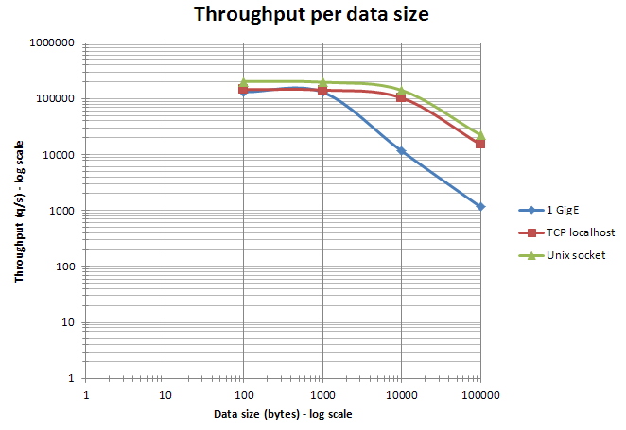
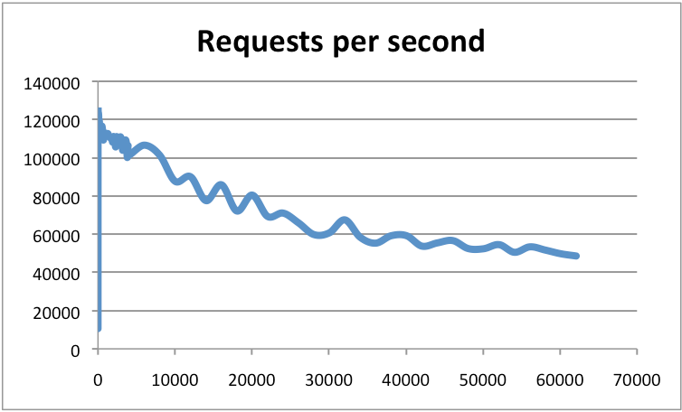
Performance:

Slide 17
DIY - Redis
Github: https://github.com/jimliu7434/microservice-sample

Slide 18
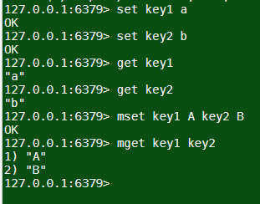
DIY 1 – Sharing Session Data
http://www.tutorialspoint.com/redis_terminal_online.php
Using Redis Type : Strings
set key1 a
set key2 b
get key1
get key2
mset key1 A key2 B
mget key1 key2

Slide 19
DIY 1 – Sharing Session Data
Using In-App Memory
https://github.com/jimliu7434/microservice-sample/blob/master/model/session_local.js
Using Redis
https://github.com/jimliu7434/microservice-sample/blob/master/model/session_redis.js

Slide 20
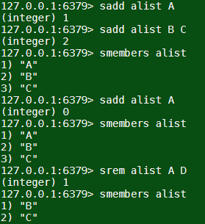
DIY 2 – Who is online (Service Discovery)
http://www.tutorialspoint.com/redis_terminal_online.php
Using Redis Type : Sets
sadd alist A
sadd alist B C
smembers alist
sadd alist A
smembers alist
srem alist A D
smembers alist

Slide 21
DIY 2 – Who is online (Service Discovery)
Using Redis
Using setInterval to get List
https://github.com/jimliu7434/microservice-sample/blob/master/service/pods1.js

Slide 22
DIY 3 – Who is online/offline (Service Discovery)
Using Redis Pub/Sub
Without setInterval in code
Only be triggered when something HAPPENED
( ex: service go Up or Down )
https://github.com/jimliu7434/microservice-sample/blob/master/service/pods2.js

Slide 23
Ref.
https://columns.chicken-house.net/2016/09/15/microservice-case-study-01/#operating-team-application-maintainess
https://docs.microsoft.com/zh-tw/dotnet/standard/microservices-architecture/architect-microservice-container-applications/microservices-architecture
https://www.codeproject.com/Articles/1276639/Microservice-using-ASP-NET-Core
https://www.carlrippon.com/scalable-and-performant-asp-net-core-web-apis-microservices/
https://36kr.com/p/5104897
https://redis.io/
https://redis.io/topics/benchmarks

