Slide 1
Deep Dive In JBossMSC
Jim Ma

Slide 2
What is JBossMsc
JBoss Modular Service Container
Start/stop a service
Resolve the service dependency
Handle injection in service(store dependency in service)
It's the core element in AS7/WFLY8
It makes start/stop faster and dynamic.

Slide 3
What's it for
Each server will do bunch of things before it says I am ready to handle things.
Each server has the pre/post condition to do things : think about the ftp server/http server
Read con -> start listener-> start authentication
Service Dependency/start/stop

Slide 4
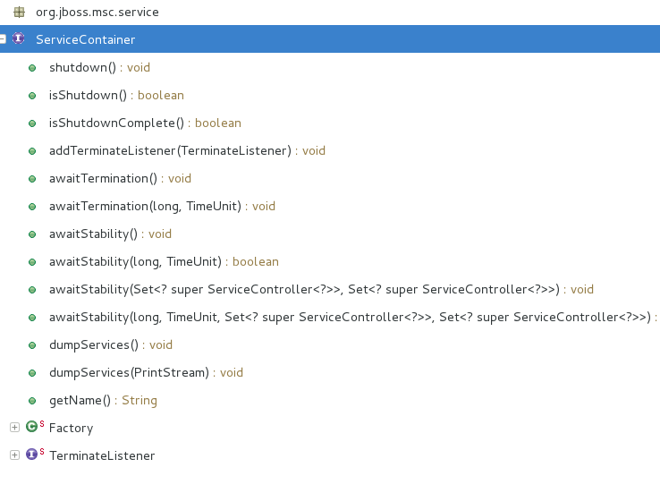
The classes/api you should know
ServiceContainer

Slide 5
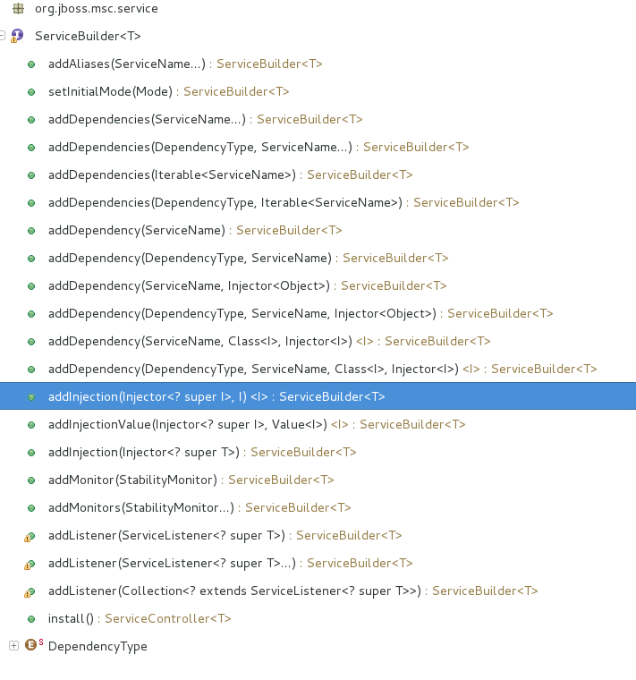
ServiceBuilder

Slide 6
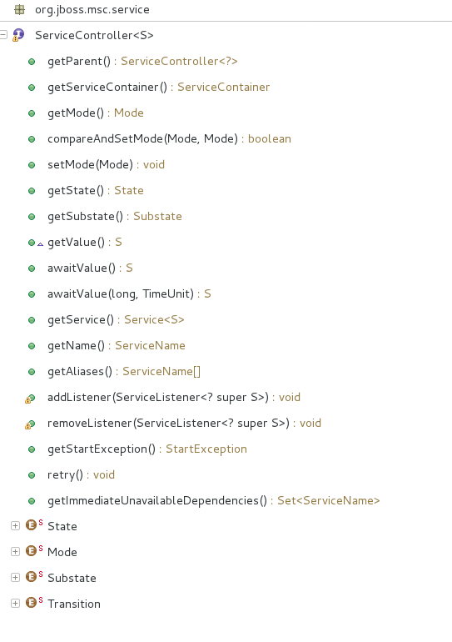
ServiceController

Slide 7
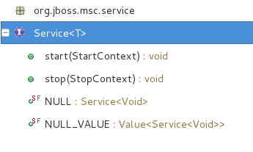
Service

Slide 8
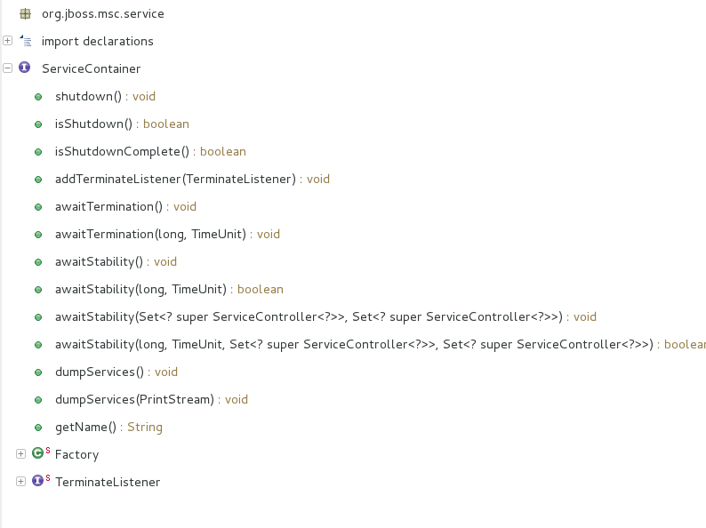
ServiceContainer

Slide 9
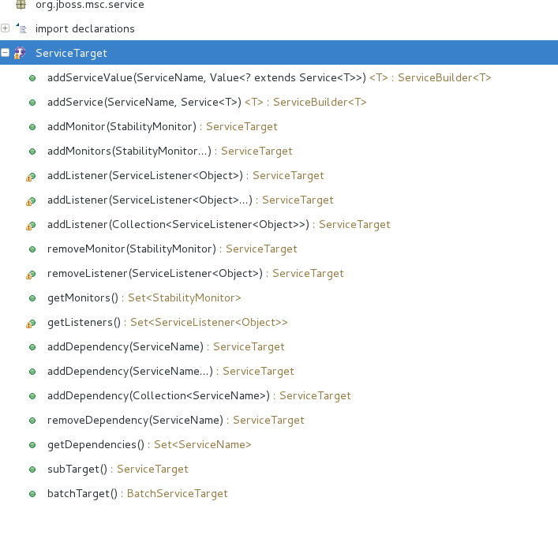
ServiceTarget

Slide 10
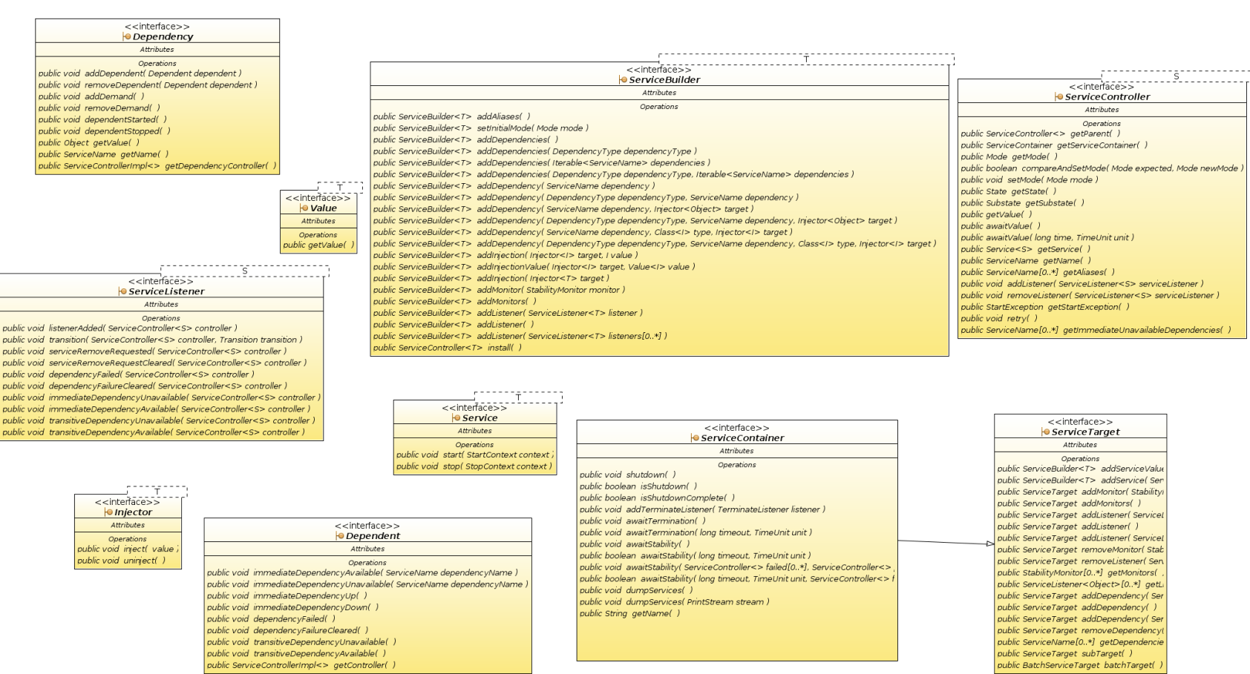
Class Diagram

Slide 11
Think about Morning thing example and make it concurrent
Make Coffee with coffee maker
Grind coffee beans
Toast bread with toaster
Eat Breakfeast
Brush tooth

Slide 12
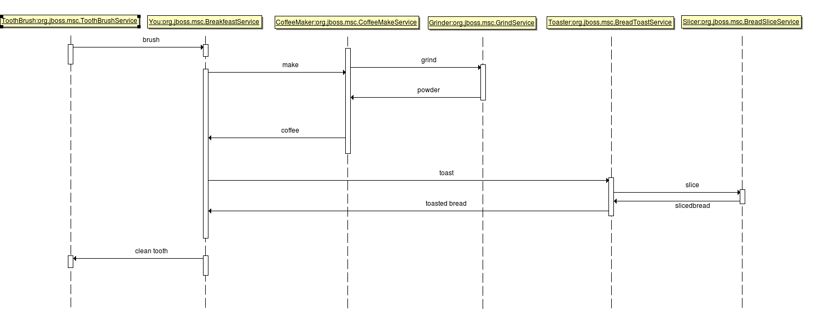
Morning thing...

Slide 13
JBossMsc Way to think
Make Coffee service depends Grinder provides coffee
Grind service depends on coffee bean provides powder
Toast service depends on sliced bread provides toasted bread
Slice service depends on bread provide sliced bread
Breakfeast service depends on coffee, toasted bread
provide tooth to brush
Brush service depends tooth to brush provides clean tooth

Slide 14
A Demo/Test

Slide 15
How it works
Concept/Basic things
-Service State
-Transition
-Task
-Injection
-Dependency/Dependant
Start a service

Slide 16
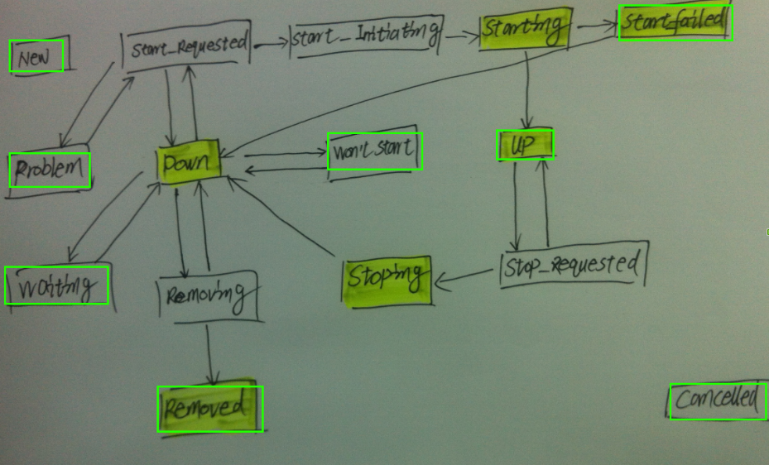
Service State
Transition
Servicesubstate
Rest state
Servic state

Slide 17
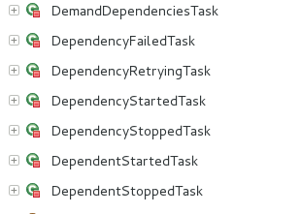
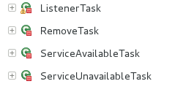


Task

Slide 18
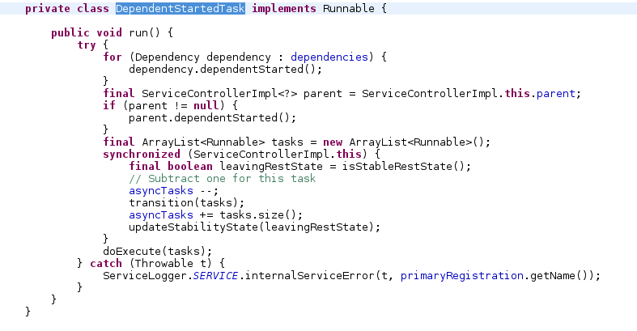
What a typical task does

Slide 19
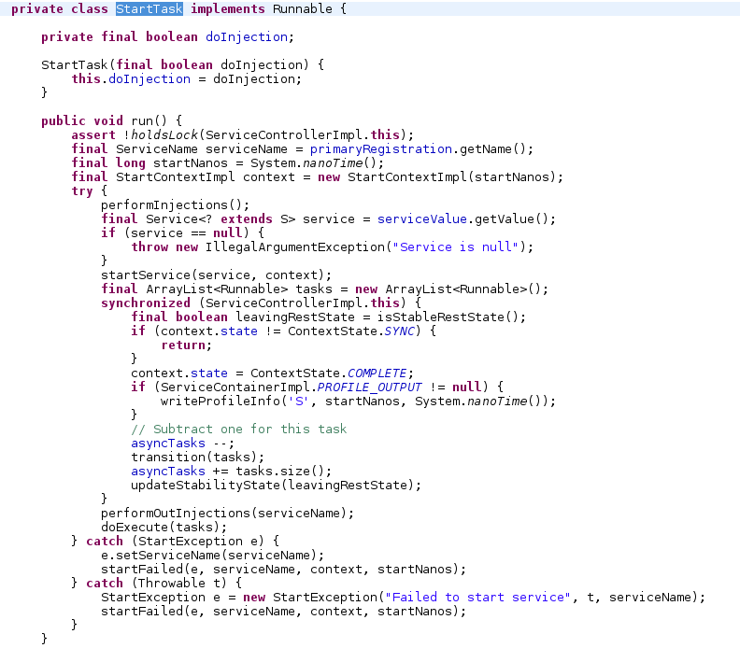
Another task- StartTask

Slide 20
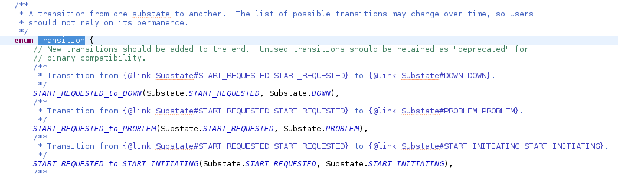
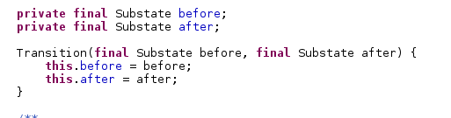
Transition

Slide 21
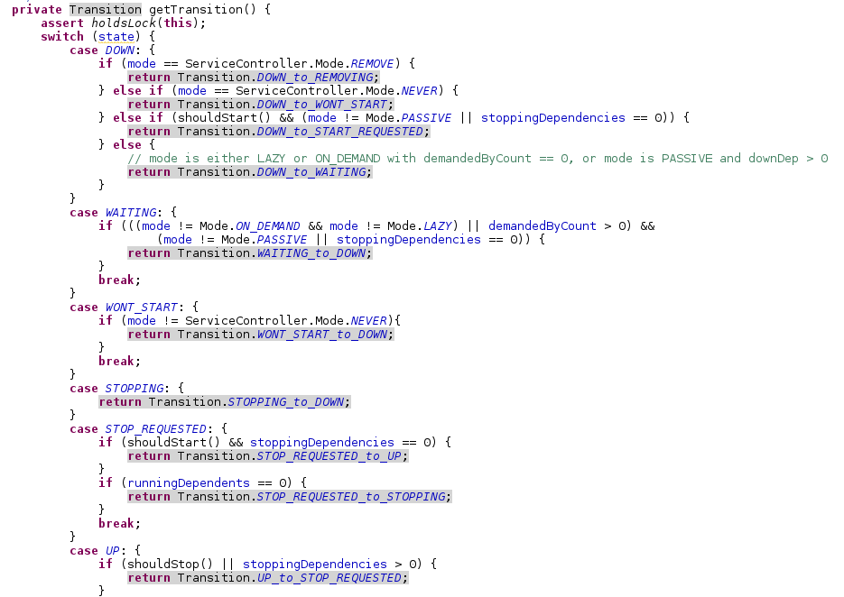
Transition(Cont.)

Slide 22
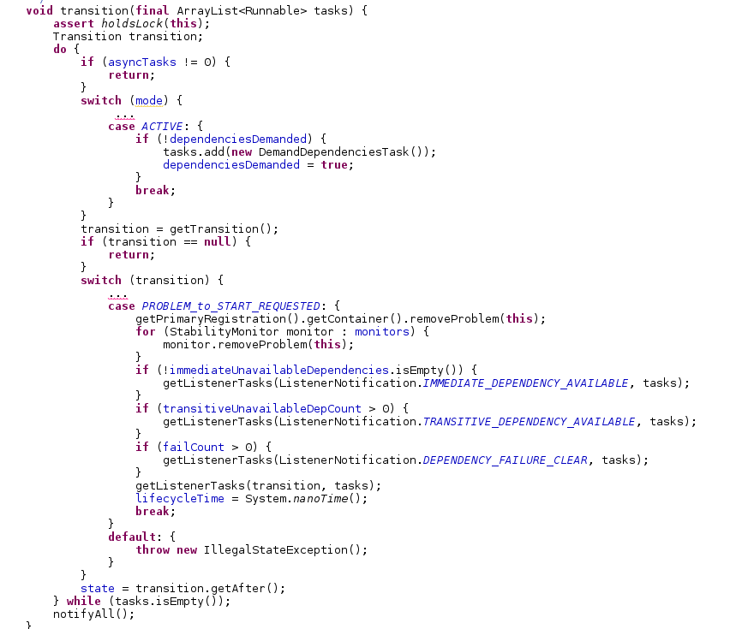
Transition(Cont.)

Slide 23
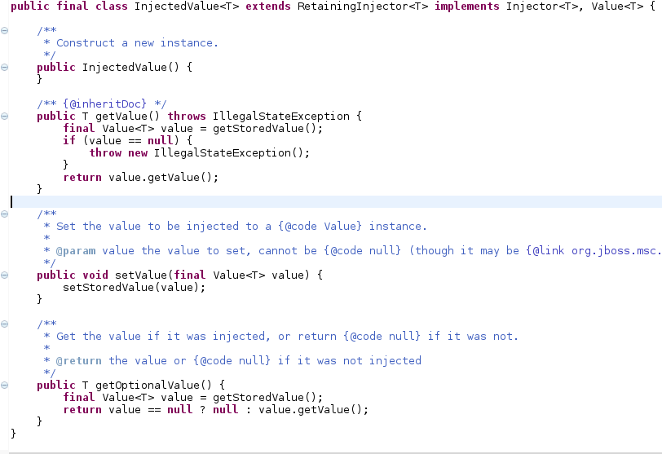
Injection
StartTask set value from service in the InjectedValue. Not powerful, but fast!

Slide 24
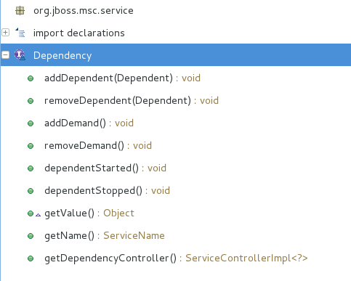
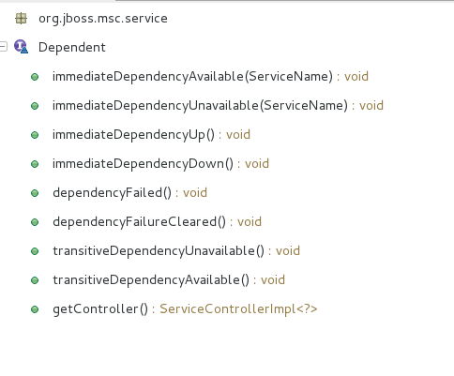
Dependency/Dependant
CoffeeMakeService
(dependant)
depends
CoffeeGrindService
(dependency)

Slide 25
Start a service
service Toast | Mode:ACTIVE | Transition :transition from DOWN to START_REQUESTED
---- Task :DemandDependenciesTask Start -- ---------------
service Toast | Mode:ACTIVE | Transition :transition from START_REQUESTED to START_INITIATING
-----Task :DemandDependenciesTask Complete-----------------
-------------Task :DependentStartedTask Start - ---------------
service Toast | Mode:ACTIVE | Transition :transition from START_INITIATING to STARTING
-----Task :DependentStartedTask Complete-----------------
-------------Task :StartTask ---------------
service Toast | Mode:ACTIVE | Transition :transition from STARTING to UP
-----Task :StartTask Complete-----------------
-------------Task :DependencyStartedTask Start---------------
service Toast | Mode:ACTIVE | Transition :null
-----Task :DependencyStartedTask Complete-----------------
start/commit install
Add
Add
Add
End

Slide 26
Start a service with dependency
service Coffee Mode:ACTIVE transition :transition from DOWN to START_REQUESTED
-----Task :DemandDependenciesTaskThread : Thread[MSC service thread 1-1,5,main] Start---------------
service Coffee Mode:ACTIVE transition :transition from START_REQUESTED to PROBLEM
service Coffee Mode:ACTIVE transition :null
-----Task :DemandDependenciesTask Complete-----------------
********************************************************************************************************************************
service Coffee Mode:ACTIVE transition :transition from PROBLEM to START_REQUESTED
service Coffee Mode:ACTIVE transition :null
service Grind Mode:ACTIVE transition :transition from DOWN to START_REQUESTED
-------------Task :DemandDependenciesTask Thread : Thread[MSC service thread 1-2,5,main] Start---------------
service Grind Mode:ACTIVE transition :transition from START_REQUESTED to START_INITIATING
-----Task :DemandDependenciesTask Complete-----------------
-------------Task :DependentStartedTask Thread : Thread[MSC service thread 1-3,5,main] Start---------------
service Grind Mode:ACTIVE transition :transition from START_INITIATING to STARTING
-----Task :DependentStartedTask Complete-----------------
-------------Task :StartTask Thread[MSC service thread 1-4,5,main] Start---------------
service Grind Mode:ACTIVE transition :transition from STARTING to UP
-----Task :StartTask Complete-----------------
-------------Task :DependencyStartedTask Thread : Thread[MSC service thread 1-5,5,main] Start---------------
service Coffee Mode:ACTIVE transition :transition from START_REQUESTED to START_INITIATING
service Grind Mode:ACTIVE transition :null
-----Task :DependencyStartedTask Complete-----------------
-------------Task :DependentStartedTask Thread : Thread[MSC service thread 1-6,5,main] Start---------------
service Coffee Mode:ACTIVE transition :transition from START_INITIATING to STARTING
----Task :DependentStartedTask Complete-----------------
-------------Task :StartTaskThread Thread[MSC service thread 1-7,5,main] Start---------------
service Coffee Mode:ACTIVE transition :transition from STARTING to UP
-----Task :StartTask Complete-----------------
-------------Task :DependencyStartedTask Thread : Thread[MSC service thread 1-8,5,main] Start---------------
service Coffee Mode:ACTIVE transition :null
-----Task :DependencyStartedTask Complete-----------------
before/after Dependecy Start
Dependant can start now
trigger dependant to start

