Slide 1
caTissue Development Project
C3PR Integration
June 9, 2011
By Patrick McConnell & Denis Krylov

Slide 2
Use Cases
Application | Event | Data | Description
C3PR | Subject Created/Updated | Subject record. | caTissue needs to obtain subject data via Subject Management service.
C3PR | Subject Registration Created/Updated | StudySubject record. | caTissue needs to obtain study subject data via Subject Registration service.
caTissue | Protocol Registration Created. | Collection Protocol Registration | caTissue needs to use a Registration service.

Slide 3
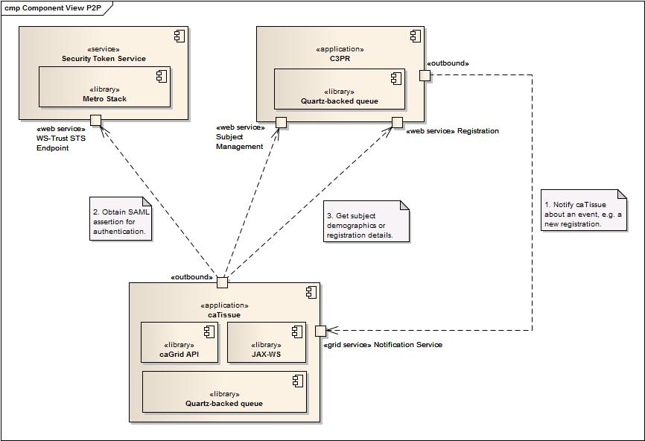
Component View

Slide 4
C3PR Changes
New configuration property
Location of caTissue’s notification service
Notification delivery component (DONE)
Intercepts events of interest in C3PR
Sends notifications to caTissue’s grid service
Implements reliable messaging and ordered delivery
Registration Service
Not implemented at all by C3PR (though they have provided the interface)
Will implement minimal functionality required by caTissue
This means that the service will not be usable by all registration consumers, just tissue banking (e.g. no stratification, randomization, etc.)

Slide 5
Challenges
No reliable way to cross-link consent answers
Decided to keep out of the scope
Registration service is very conservative and needs a lot of information before a registration can become “On-Study”, while caTissue is liberal
Decided to go with partial (unfinished) registrations in C3PR
Long-term goal is to change the service specifications
Issues in cross-linking protocols across C3PR, CTRP, and caTissue
Different apps may identify a protocol differently
Exploring our options, such as matching by IRB ID/PI

