Slide 1









Slide 2







Instructions (remove or hide this slide)
I like to have fun with my slides and layouts. I made a few based on different IDEs. You can use one of those, make your own, or whatever.
We do ask that do the following:
Keep the “Thanks to our sponsors!” slide.
Include the schedule slide. This is especially important first sessions of the day, but in later time slots it is worth mentioning the app link. Remember someone may have come just for your talk, so this is their first session.
Display feedback slide while you do Q&A, or right before it.
Update it with your session specific QR code
https://sessionize.com/boise-code-camp-2026/dashboard#_tab-feedback
Make sure you give everyone a chance to scan it
Be aware of your time and the schedule. There is only 10 minutes between sessions, so you need to be ready to set, and clear out quickly.
Windows Clock has an always on top timer, or there is a timer script with the slides.
You can also set a timer on your phone.
If Q&A goes over, you can keep talking in the hall or common area.
Have fun! Code Camp is really about connecting with other developers .

Slide 3







Some fun ideas for slides (all optional)
Label the sections of your slides with
Header / Imports: The Agenda (What libraries/concepts are we bringing in?).
The Main Loop: The core content of your talk.
The REPL (Read-Eval-Print Loop): The live demo or interactive section.
Garbage Collection: The "Wrap Up" or summary (cleaning up the concepts).
Exit Code 0: The final slide (Success/Finished).
Syntax Highlighting Headers: <h3>The Power of Async</h3> or const topic = "The Power of Async";
The "To-Do" Slide: Use a code-comment style for sections that are "under construction" or for "Next Steps" slides: // TODO: Refactor this strategy.
Font-Family: Use Monospace for all data points and Sans-Serif for storytelling
Semantic Versioning: Instead of "Version 1," name your slide deck v1.0.4-beta.
Use code comments for speaker notes and easter eggs. /* Fix this before the talk */ or // This slide intentionally left blank.
Error Codes: For the Q&A slide, use a 418 I'm a Teapot or 200 OK header.
Git Commits: Label your section transitions as "Commits."
Intro: Initial Commit
Body: Feature: Adding Business Logic
Conclusion: Merge branch 'presentation' into 'master'

Slide 4

Notes:
Keep this slide

Slide 5
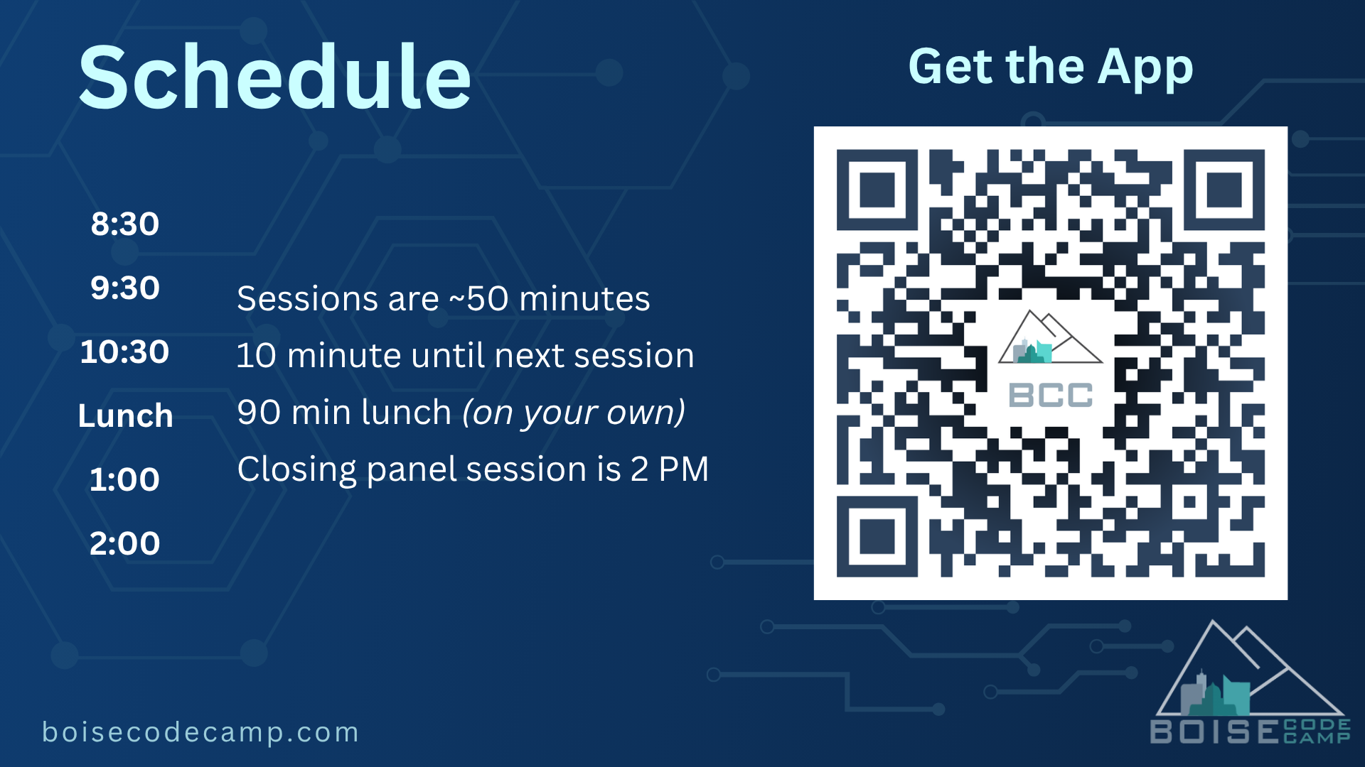
Notes:
Keep this slide

Slide 6






Main session content here

Slide 7







Slide 8





Slide 9






Slide 10







Slide 11





Slide 12



Slide 13



// This slide intentionally left blank.
The comment text was accident.

Slide 14
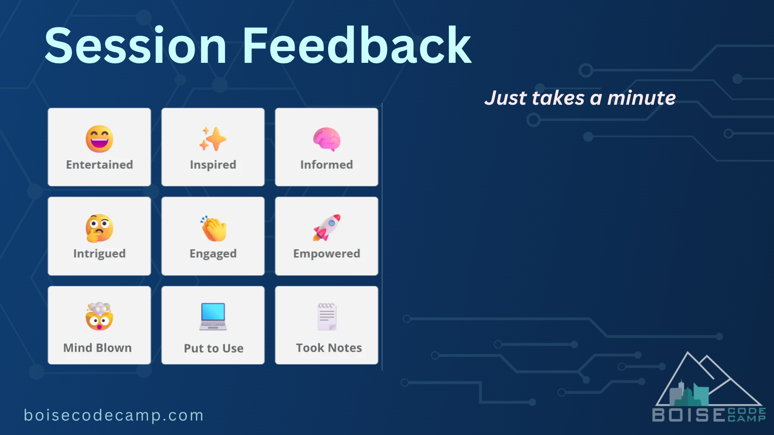
Place your session
specific QR code here! https://sessionize.com/boise-code-camp-2026/dashboard#_tab-feedback
Notes:
Keep this slide

