Slide 1



GitHub Copilot Dev Days
CLI FTW!
Jim McKeeth
BSDG.dev - BoiseCodeCamp.com jim@mckeeth.org
Notes:
Welcome everyone to GitHub Copilot Dev Days. My name is (Insert name), and I’m so excited to be here this is just one of hundreds of global events that GitHub and the development community partnered with to show off the latest and greatest and agentic development with GitHub Copilot.

Slide 2
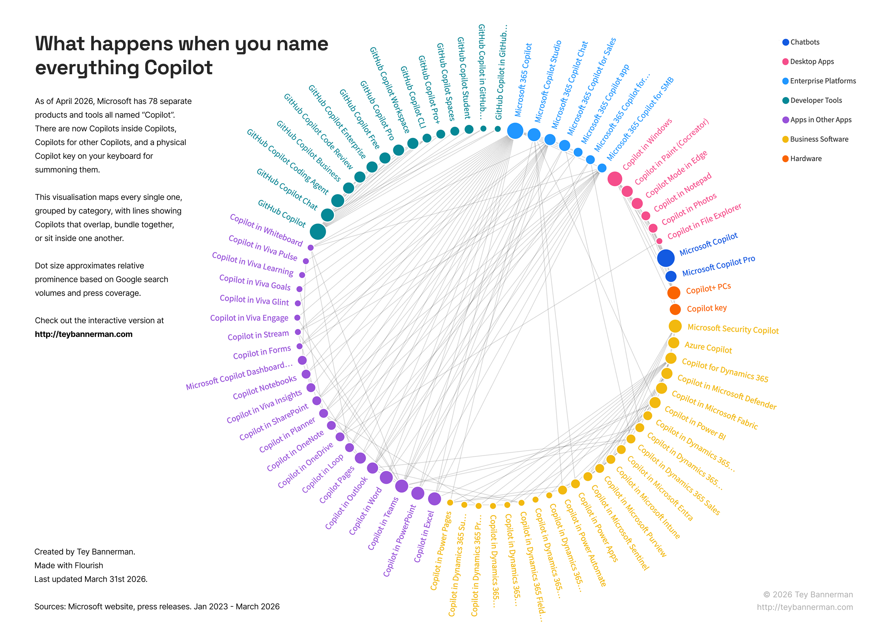

Notes:
There are currently 78 different :Copilots. I’m going to talk about GitHub Copilot CLI [click]

Slide 3
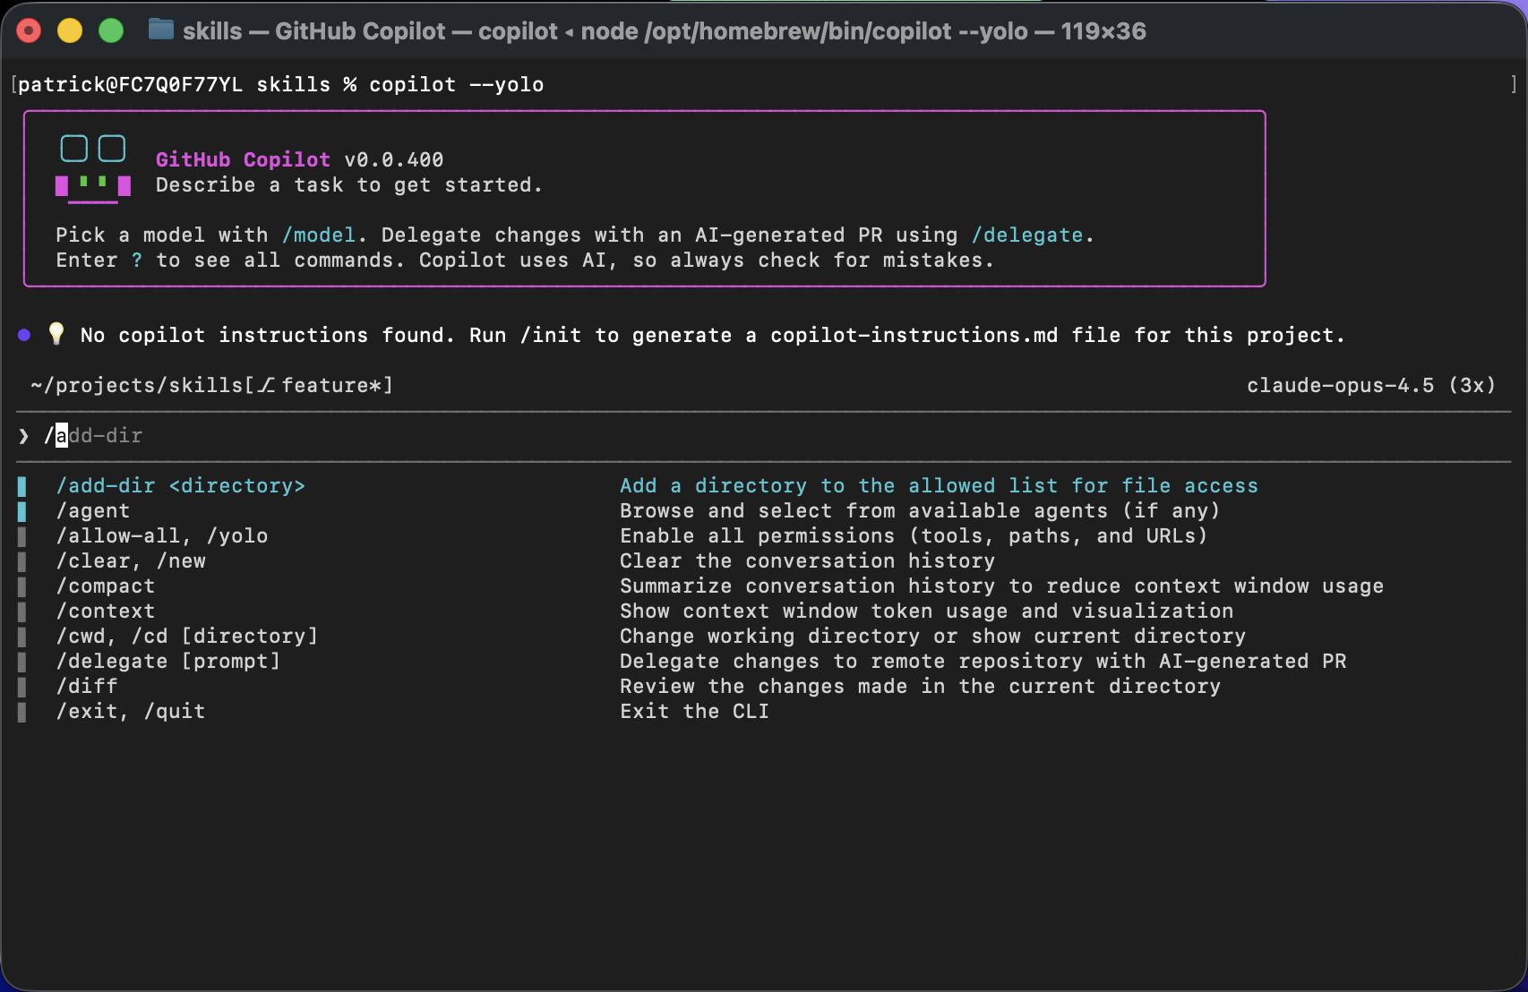
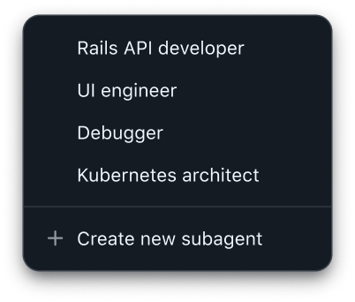
Core Features
What’s in the box
Interactive Assistance
Headless Automation
Code Generation & Modification
Tool Execution & Shell Commands
Multi-file context awareness
Lifecycle event hooks
Modes for multiple situations
MCP server integration
Notes:
This is the “official” list from Microsoft for their “core features,” but it is really just scratching the surface. For quite a while now I’ve been all in on using Copilot Cli, logging between 6 to 8 hours everyday. Technically I’m using running multiple instances at the same time, so it is a real productivity multiplier for me.

Slide 4



Installation
GitHub Copilot CLI
macOS / Linux (Homebrew)
brew install copilot-cli
Windows (WinGet)
winget install GitHub.Copilot
Any OS (npm, Node.js ≥ 22)
npm install –g @github/copilot
This Photo by Unknown Author is licensed under CC BY-SA-NC
Notes:
the get up copilot CLI is available across windows Mac and Linux you can install it with common tools like winget or homebrew and of course you can install it with NPM as well. Once you have it installed the CLI will automatically update or you can run copilot update and check for updates manually

Slide 5





Many modes. Many use cases.
Interactive
Headless
Server
copilot
copilot –p
copilot --server
User runs CLI locally on their machine with full interactive UI and prompts
Non-interactive execution for automation pipelines and CI/CD workflows
Exposes JSON-RPC port for external clients to drive CLI functionality remotely via the Copilot SDK
Notes:
it can work directly in an interactive mode by just typing in copilot and that's going to allow you to interact with your mouse and keyboard just as you would with any terminal. But you can also run it completely and non interactive mode and that’s really great for automating pipelines or running scripts for example. And then finally there’s a server mode which actually exposes a JSON RPC port and this is actually heavily used with the GitHub copilot SDK which I mentioned a little bit previously in the opening but definitely is worth going deeper into later on

Slide 6


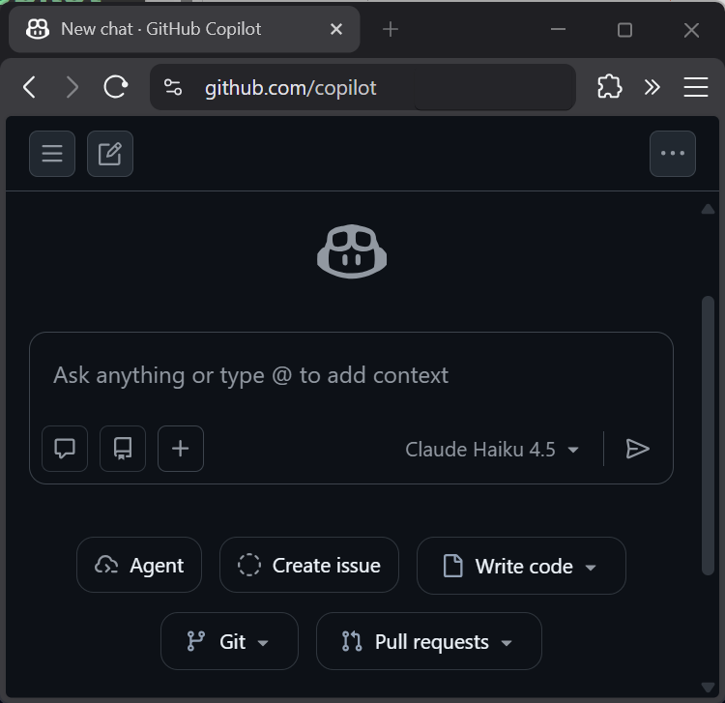


Effort
Power & Flexibility
SDK, etc.
Web
IDE
CLI
Notes:
I am going to argue that you should go with CLI FTW. It is nice that you can use it all these different places, but I do 90% of my AL work in CLI. Technically the SDK or using a model directly is more powerful and flexible, but that has a significant jump in effort. So CLI is the sweet spot.

Slide 7
Which LLM To use?
They are very similar.
Frequent updates changes ranking.
Skill.md and Agents.md are standards.
Use what works for you.

Slide 8


SSH to remote
machine
Configure a
Database
Start, Stop, Create,
Revert a VM
Run a Program
Layout a Document
Start or Stop
A service

Slide 9




Powershell
Linux via WSL
Anything you can do
From the Terminal
Git Bash

Slide 10
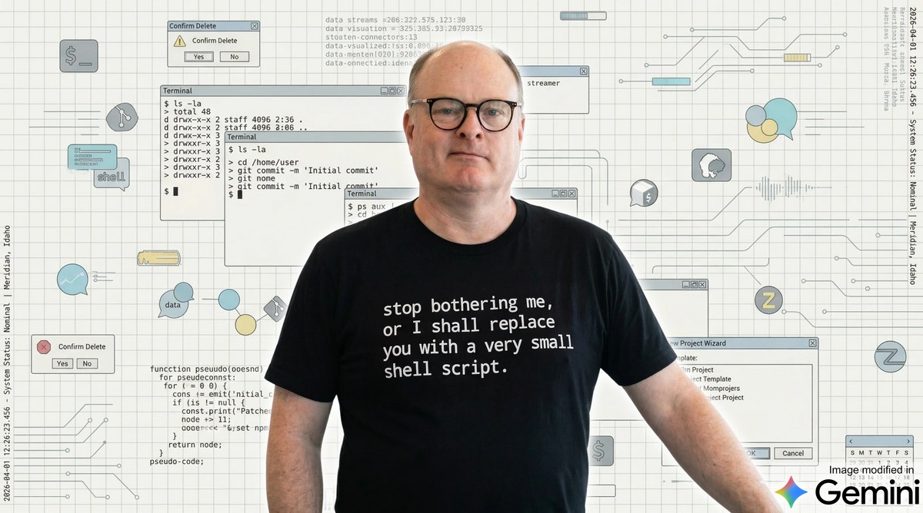

Slide 11


Slide 12

Terminals
Microsoft’s github.com/microsoft/terminal
Cross-platform wezterm.org
PowerShell 7
github.com/PowerShell/PowerShell
learn.microsoft.com/powershell/scripting
Git Bash gitforwindows.org
TUI Editors
github.com/microsoft/edit
getFresh.dev
github.com/sharkdp/bat
PowerShell Upgrades
OhMyPosh.dev
NerdFonts.com
github.com/PSModule/NerdFonts
A Shell runs in a Terminal
CLI: Command Line Interface
TUI: Terminal User Interface
REPL: Read–eval–print loop

Slide 13

Getting to know
Copilot Cli

Slide 14
MENTAL MODEL
The agent is the sum of its controls
agent
role
mode
skills
initiative
playbooks
sandbox
tools
blast radius
actions
Mode + sandbox + tools + skills + agent
Notes:
This is the mental model for the rest of the talk.
Mode controls initiative. Sandbox controls where the agent may act. Tools control what actions the model can take. Skills encode a repeatable way of working. Agents bundle role, instructions, tools, and sometimes skills into a selectable profile.
The key message: behavior is not just a model choice. The operating envelope around the model matters just as much.

Slide 15

Slash commands
/agent
/plan
Switch to a custom agent
Plan out an implementation before writing any code
/model
/cwd or /cd
View all available models and choose which to use
Change working directory mid-session
/mcp
/reset-allowed-tools
Manage your MCP servers
Reset Copilot’s tool permissions
the control panel
/yolo
/context
Enable all permissions
Info on token usage & context window
/diff
/review
Review changes made in directory
Run a code review to analyze changes
/skills
/plugin
?
Manage & call skills
Manage and install plugins
/help
the source of truth
Notes:
one thing that you'll use all the time inside of the CLI are slash commands these are things such as switching the agent or model that you want to use going into and out of plan mode or review agent and loading up skills or doing a diff for example. This is just a subset of them there are so many being added all the time to handle different scenarios when working in the CLI

Slide 16
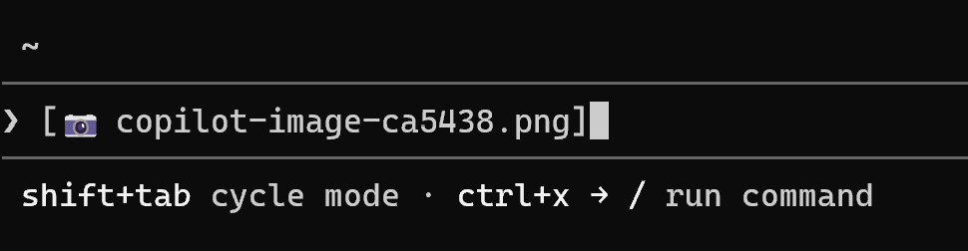
@ to mention files
GitHub Copilot CLI
Provide Copilot context by @-mentioning files directly in your prompt
@-mention multiple files at once, including images
Alternatively drag and drop or paste the file or image to provide context
ALT+V / CMD+V to paste images into CLI
Notes:
another thing that you can do is specifically mention code files that you may want to be working on directly inside of a specific prompt and you can even give it images by dragging and dropping it or pasting it in directly into the CLI and then it can use vision API to understand that image and of course it can read those files directly it’s a nice way to guide the agent into what you need to have done

Slide 17

MODE
[Shift+Tab]
Choose the amount of initiative
cycles modes
🫣
⌨️
🤔
Plan
Normal
Autopilot
think first
pair loop
continue
Modes: standard, plan, autopilot
Notes:
Start with the three driving modes.
Plan mode is for thinking before touching files. Use it when the task is ambiguous, architectural, risky, or when you want the audience to see the reasoning path.
Normal or standard mode is the pair-programming loop. The agent works, but you keep approving and steering at natural checkpoints.
Autopilot is for scoped tasks where the guardrails are already clear. It keeps continuing instead of pausing after each step. The important line is that autopilot is not a substitute for boundaries; it works best when the sandbox and tools are chosen deliberately.
Keyboard anchor: Shift+Tab cycles between standard, plan, and autopilot mode in the interactive interface.

Slide 18
SAFETY
Sandbox = blast radius
workspace write
read + plan
urls + network
tools
/add-dir
--allow-tool
--deny-url
/allow-all
Widen access intentionally, then narrow it again
Notes:
Sandboxing is the blast radius dial.
In a conservative setup, keep the agent close to the repository and require approvals for broader actions. Then widen only what the task needs: add a directory, allow specific tools, allow URLs or domains, or temporarily use allow-all for a trusted environment.
Talk track: autonomy is safest when the boundary is explicit. If the job is review-only, use a narrow surface. If the job is a local feature implementation, workspace write access plus test commands may be right. If the job needs network or external services, make those permissions deliberate.
Useful controls include /add-dir, /list-dirs, --add-dir, --allow-all-paths, --allow-url, --deny-url, --allow-tool, --deny-tool, --available-tools, --excluded-tools, /allow-all, and /reset-allowed-tools.

Slide 19
PERMISSIONS
Tools are what the agent can touch
👉
👈
GitHub
files
👈
👉
shell
MCP
👈
👉
browser
tests
--available-tools
--excluded-tools
--allow-tool
--deny-tool
Mission profile: review-only, docs-only, test-only, PR-ready
Notes:
Tools are the agent's hands.
The model can reason about a task, but tools decide whether it can read files, edit files, run shell commands, call GitHub, use MCP servers, or run tests. Enabling a tool expands capability and risk at the same time.
This slide is a good place to say: disabling tools is not a limitation. It is how you match the agent to the mission profile. A reviewer should not need the same tools as a feature implementer. A docs-only task does not need broad shell access.
Useful controls include --available-tools, --excluded-tools, --allow-tool, --deny-tool, --disable-builtin-mcps, --disable-mcp-server, /mcp, /reset-allowed-tools, and permission approval keys.

Slide 20
Built-in tools via MCP servers
GitHub Copilot CLI
github
edit
Provides access to GitHub API operations
Provides file editing capabilities through the filesystem MCP server
bash
web-fetch
Provides shell command execution
Provides HTTP request capabilities for fetching web content

Slide 21
CUSTOMIZATION
Skills make habits repeatable
review
bugs / risk / tests
release
changelog / docs
security
secrets / deps
team style
local conventions
/skills
SKILL.md
Add new skills with /skills add
Skills package instructions, examples, scripts, templates
Notes:
Skills are repeatable ways of working.
A skill is a playbook the agent can load: how to do a code review, how to prepare release notes, how to audit security, how to produce a deck, or how your team wants migrations handled.
Custom skills are where a team can encode taste and process. Instead of re-prompting the same standards every time, put the workflow into a skill and let the CLI load it when relevant.
Useful commands: /skills list, /skills info, /skills add, /skills remove, /skills reload. The concrete artifact is usually a SKILL.md file plus any supporting scripts, templates, or references.

Slide 22

ROLES
Agents package a job-shaped teammate
agent = role + instructions + tools + skills
/agent
--agent
/fleet
/tasks
builder
reviewer
planner
shipper
Use roles to narrow behavior before work starts
Notes:
Agents are role profiles.
Where skills are playbooks, agents are specialists. A custom agent can combine instructions, model choice, tool permissions, and skills to fit a job. The same repository can be approached by a planner, builder, reviewer, or release assistant.
This is also where parallelism fits. A main session can delegate work to subagents for separate areas of a task, while the user still owns the final integration and review.
Useful controls: /agent to browse and select available agents, --agent to start with a specific custom agent, /fleet for parallel subagent execution, /tasks to view background tasks, and /review to invoke a review-oriented agent flow.

Slide 23







Powerful
Built-in Agents
Personalized
Custom Agents
The built-in agents are designed to support a wide range of needs with performance and generalization in mind.
Create an .agent.md file in .github/agents/ or ~/.github/agents/ to get started.
---
name: Display Name
description: What the agent does (required)
tools: ["*"] # Optional - defaults to all tools
mcp-servers: # Optional
server-name:
command: npx
args: ["@some/mcp-server"]
---
# Agent Instructions
General | Research | Plan | Autopilot
Full-featured agent using all CLI tools for complex multi-step tasks. | Run deep research investigation using GitHub search and web sources | Create a full implementation plan before coding by specify requirements and answering questions | Works through a task without waiting for your input after each step autonomously until it determines the task is complete.
Frontmatter Fields
Field | Required | Description
name | No | Display name (defaults to filename)
description | Yes | Describes when to invoke the agent
tools | No | Array of allowed tools (default: all)
mcp-servers | No | MCP server configuration
infer | No | Whether agent can be auto-invoked (default: true)
* More details on our Custom Agents docs page.
Notes:
what's really unique about the CLI is that there are powerful agents Built in directly to the CLI the general agent is your coding agent and you give it a prompt and it will go ahead and use the tools and tasks to go off and execute them.
The research agent is set up to do deep research to help you really investigate issues or problems or understand potential features that you might be adding into your code base through GitHub search and also web sources as well and this is really great as it provides full huge documentation on the research topic that you’re giving it
one of the more commonly used is plan agent this will create a full implementation plan it will ask you questions I’ll clarify requirements O once it’s done it’s ready to fully implement exactly to your specification
and something that combines this together is the autopilot mode for these agents which works through all of the tasks without waiting for input every single step and does it all autonomously it’ll automatically figure out the additional steps and tasks that it needs to do to fully complete it
and best of all you can create your own custom agents to specify exactly how you want the specific agent to work what tools are available to it and what MCC servers as well O for example you could create your own code reviewer or your own GitHub expert that you work with directly inside of the CLI

Slide 24
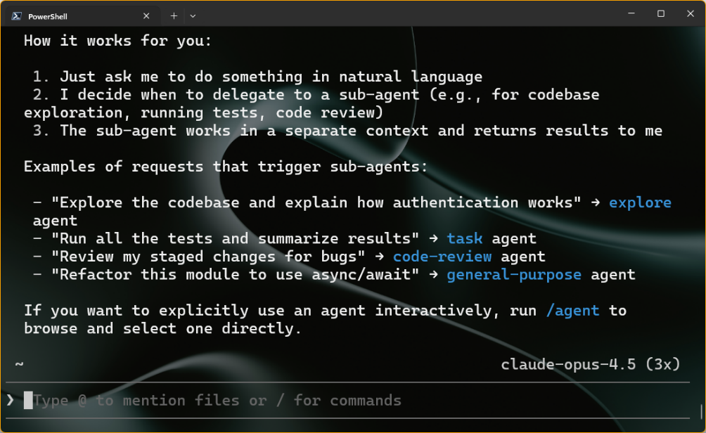
Subagents
Built-in tasks to delegate to specialized AI agents explore
Fast codebase exploration, finding files, answering code questions
task
Executing commands like tests, builds, lints
general-purpose
Complex multi-step tasks requiring full toolset
code-review
High-signal code review for bugs and security issues
Notes:
There are a bunch of sub agents that are built to directly into the CLI that can run asynchronously and we’ll provide isolated contacts back to the main agent things like exploring the code base executing commands like testing doing builds and linting there’s a general purpose sub agent that will understand complete complex tasks that require the full tool set and there’s even a code review sub agent that’ll identify bugs and security issues as well

Slide 25
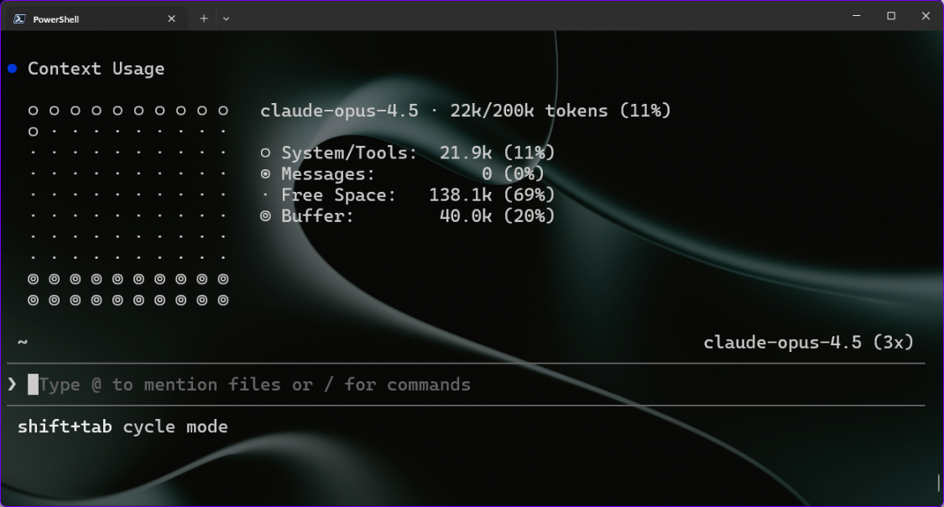
Context
GitHub Copilot CLI
Infinite Sessions (a CLI exclusive) means you likely never have to worry about these, but when you want to manage your context more directly, you can:
/context
/compact
Visualize what is in your context window.
Summarizes current context and compacts to smaller size.
Notes:
the CLI also has powerful context awareness it has this concept of infinite sessions which means you never really have to worry about the context it automatically managed it for you at anytime you can say slash context to visualize the current context and where things are at or do you compact to automatically compact and summarize the current context but because of infinite sessions it does it for you automatically

Slide 26
HOTKEYS
Keyboard survival cheat sheet
Shift+Tab
Ctrl+T
Ctrl+Enter
change mode
Reasoning visiblity
queue while busy
Ctrl+G
Ctrl+X then /
?
edit in editor
slash after prompt
quick help
@ file
# issue
! command
add file context
add issue or PR
local shell
Ctrl+C
Ctrl+R
Tab
cancel or clear
history search
accept completion
Keep the controls visible while the live demo moves
Notes:
This is the quick-reference slide users can photograph.
The highest-value hotkeys for a live demo are Shift+Tab for mode switching, Ctrl+T for reasoning visibility, Ctrl+Enter or Ctrl+Q to queue a message while the agent is busy, Ctrl+G or Ctrl+X then e to edit a prompt in the external editor, and ? for quick help on an empty prompt.
Context shortcuts matter too: @ FILENAME includes file contents in context, # NUMBER includes a GitHub issue or pull request, and ! COMMAND runs a local shell command outside Copilot's agent flow.
Other useful controls: Esc cancels the current operation, Ctrl+C cancels or clears input, Ctrl+D shuts down, Ctrl+L clears the screen, Ctrl+R searches history, Ctrl+V pastes clipboard content as an attachment, Shift+Enter inserts a newline, and Tab accepts inline completion.

Slide 27


GitHub Copilot Dev Days Sweepstake
All completed surveys are eligible for our sweepstakes to win a GitHub Copilot Pro+ one-year subscription.
https://aka.ms/githubcopilotdevdays/sweepstakes

