Slide 1
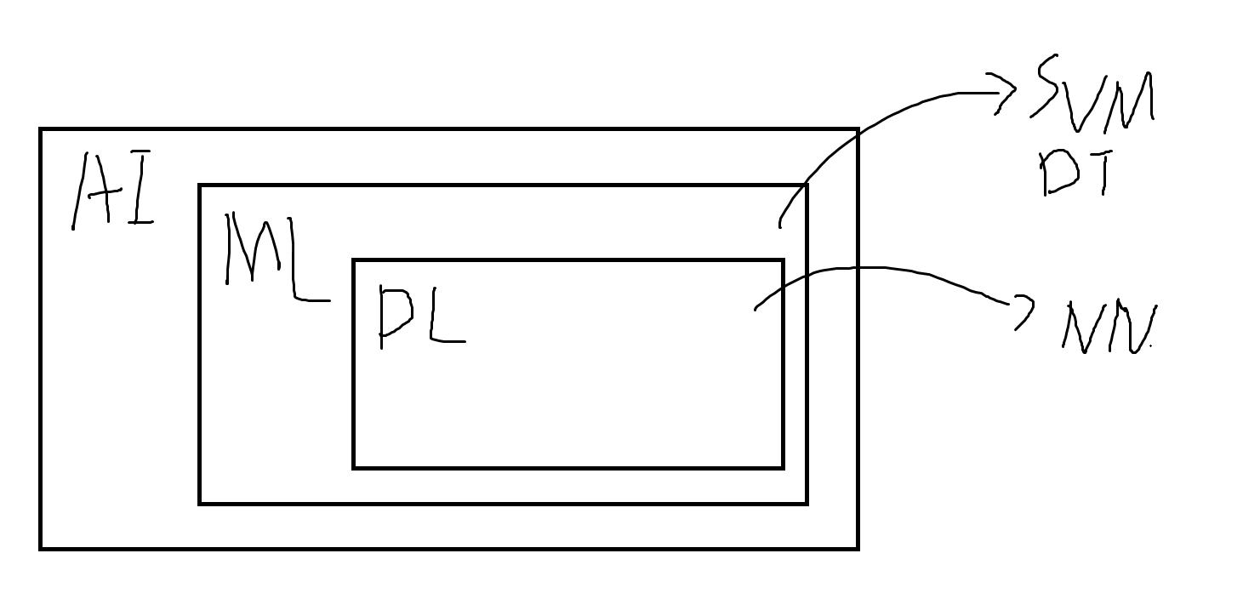

Slide 2
監督式學習 (Supervised learning)
非監督式學習(Unsupervised learning)

Slide 3
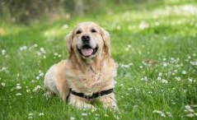
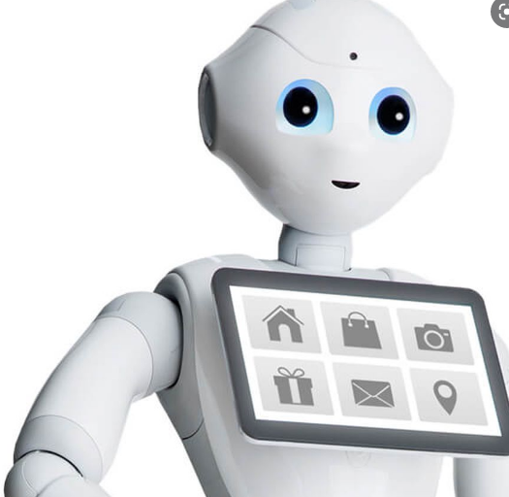
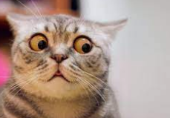
監督式學習 (Supervised learning)
這是狗
這是貓
3 * 3 = 9
2 * 2 = 4
藍色是訓練資料
紅色是解答(Ground truth)
分類(Classification) -> Discrete
回歸(Regression) -> Continuous

Slide 4
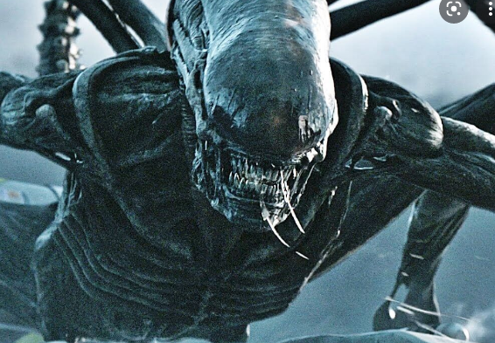
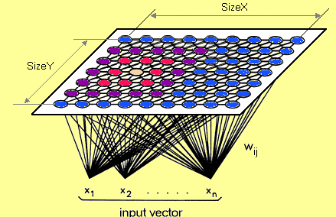
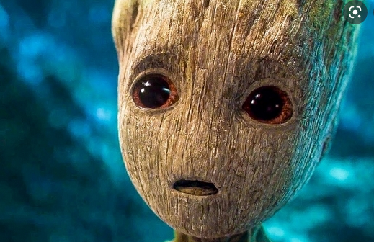
非監督式學習(Unsupervised learning)
群落(Clustering)

Slide 5
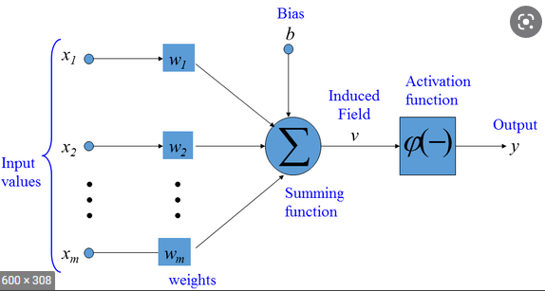
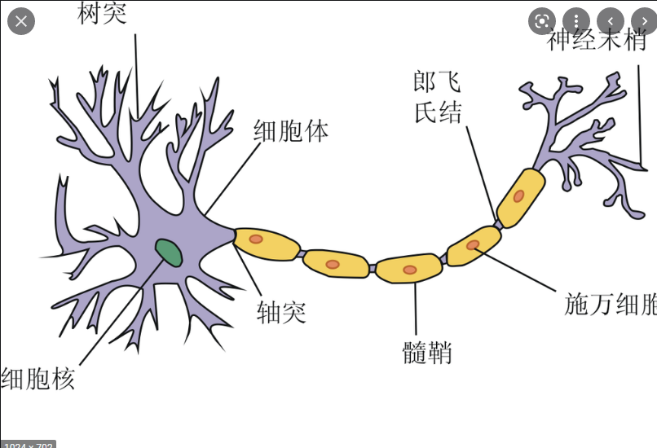

How supervised learning works?
$$x1 ∗w1$$
ax + b = y

Slide 6
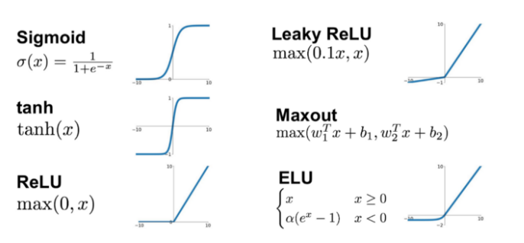



Activation function (激發函數)
$$f\left(x\right)=2x$$
$$f\left(a\right)+f(b)=f(a+b)$$
$$cf\left(a\right)=f(ca)$$

Slide 7
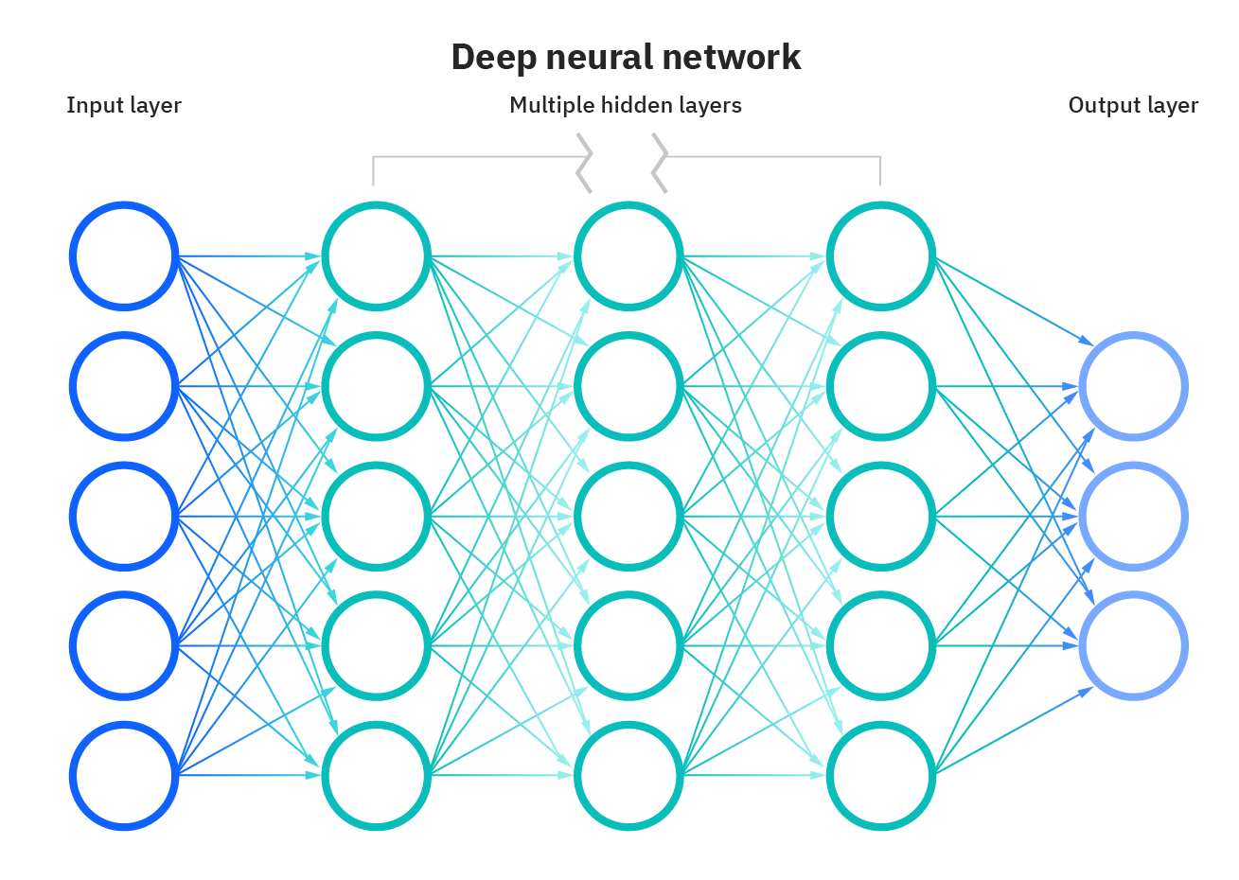
The structure of nn
Dense Layer -> Fully Connected Layer

Slide 8
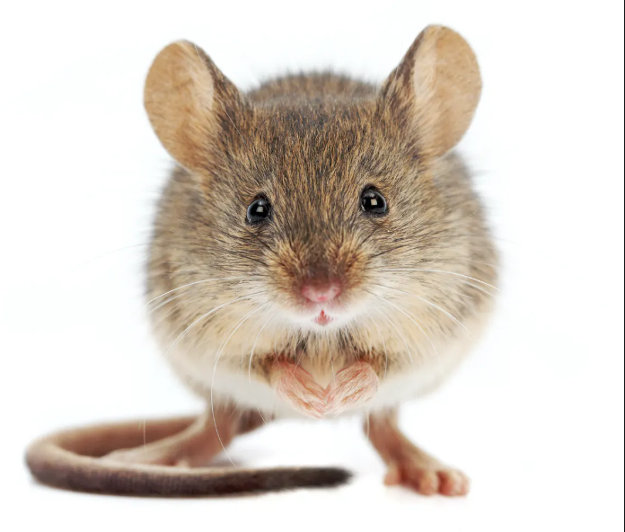
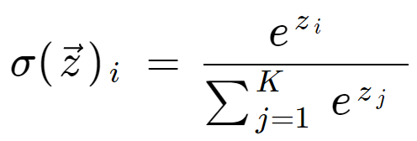
Back probagation( 反向傳播 )
If we are performing multi-class classification task, we usually apply softmax function to last hidden layer

Slide 9
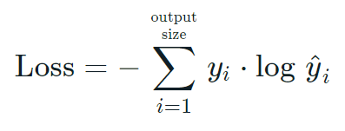
Back probagation( 反向傳播 )
0.8
0.1
0.1
0
1
0
權重是隨機的

Slide 10
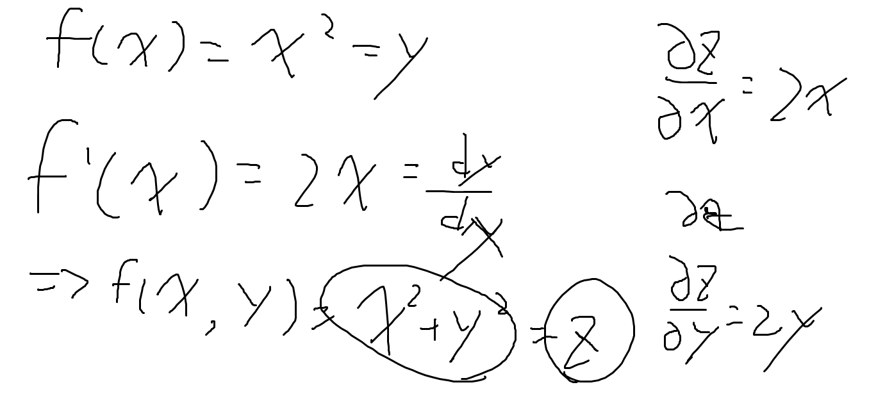
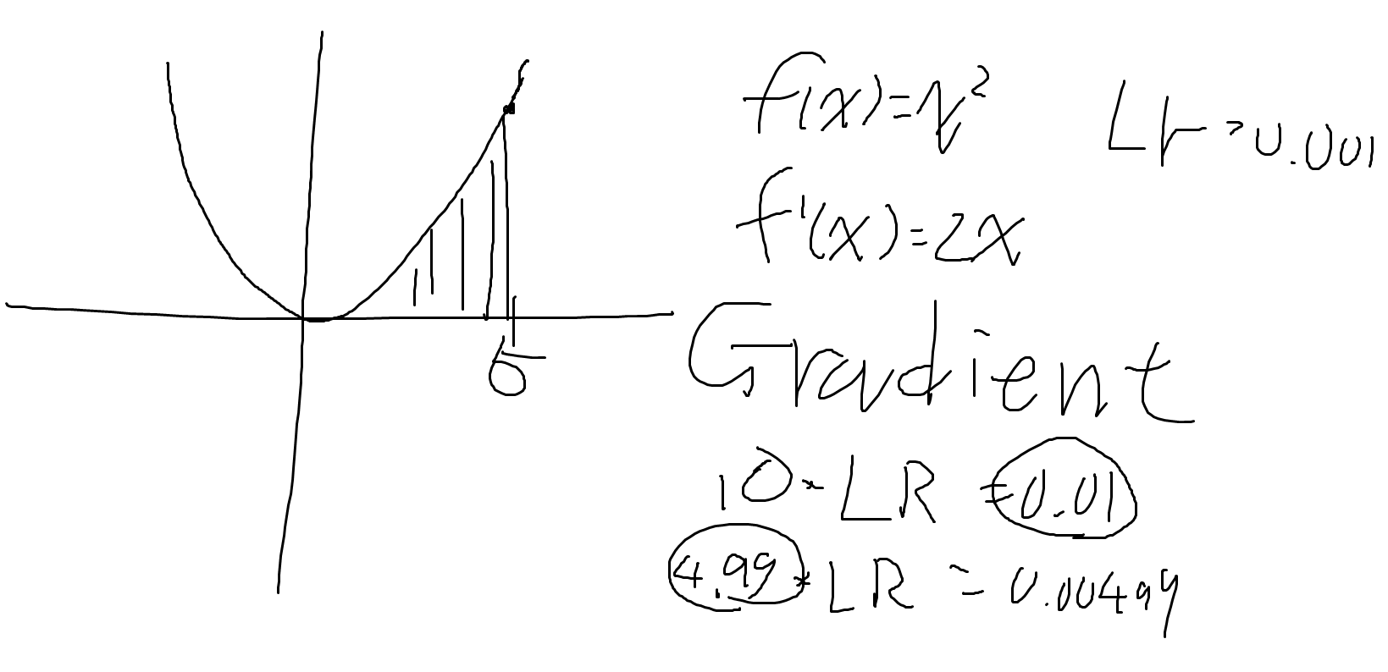
Back probagation( 反向傳播 )
微分(verb)
導數(derivative)

Slide 11
