Slide 1

Generative Adversarial Networks
Dr. Praisan Padungweang, Collage of Computing, KKU
Credit: Steve Elston

Slide 2
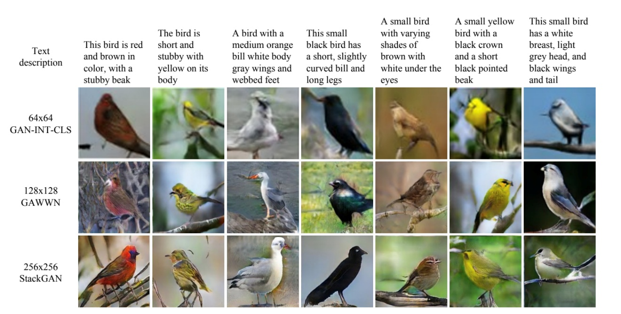
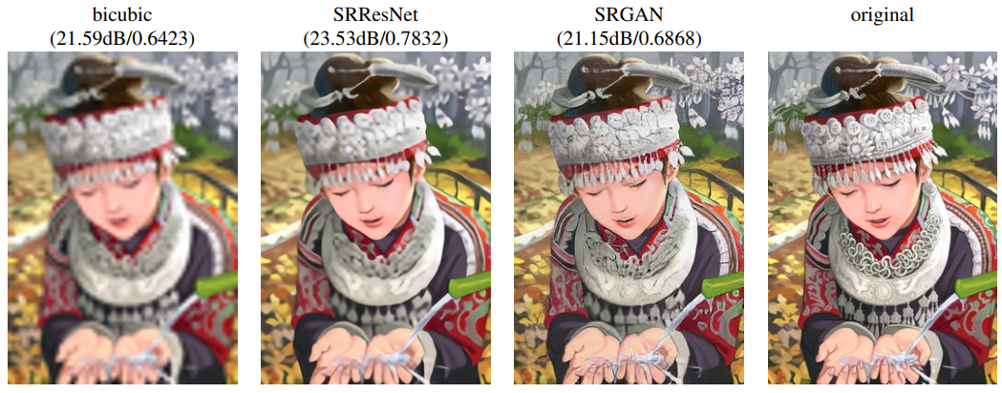
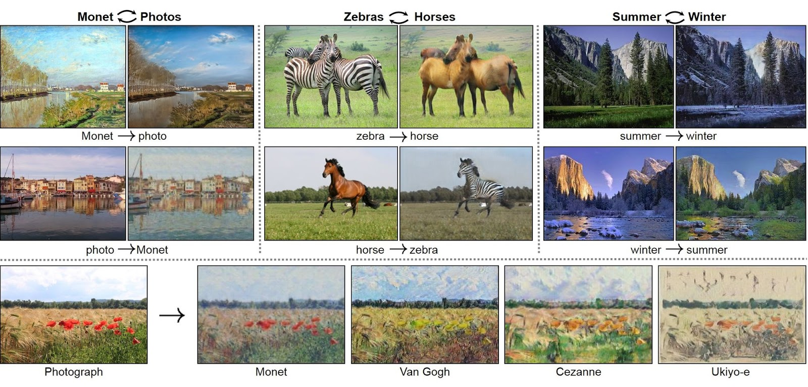
Generative Adversarial Networks (Gan)

Slide 3
Generative Adversarial Networks
GANs algorithms are used in some applications as algorithms have advanced including:
Create ‘skins’ for skeletons of design tools
Text to image generation
Super resolution
Data augmentation
Scene in-painting
GAN algorithm proposed by Goodfellow, et.al. 2014

Slide 4
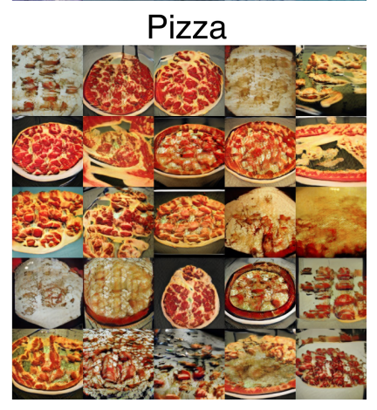
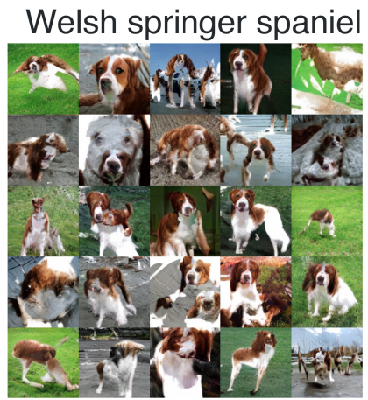
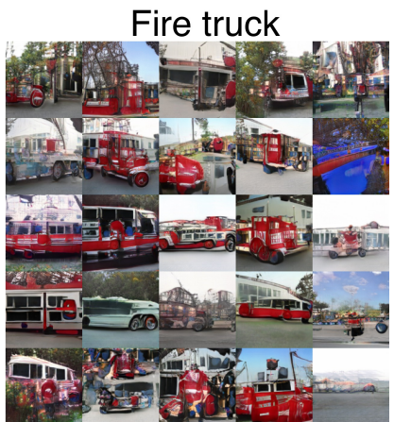
Introduction to GANs
Images generated by SN-GAN model, Miyato, et. al., 2018
128x128 color images

Slide 5
Generative Models and GANs

Slide 6
Introduction to GANs
Generative adversarial networks (GANs) comprise two models which work in opposition to each other
A generator creates new data instances starting from random noise
A discriminator attempts to differentiate between actual data instances and generated data
The generator and discriminator engage in a two player non-cooperative zero sum game
The generator attempts to fool the discriminator and the discriminator attempts to identify the output of the generator

Slide 7
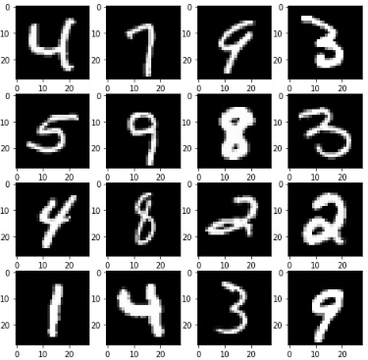
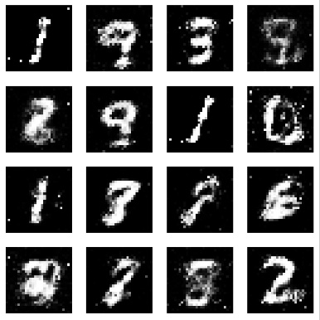
Basic GAN architecture
Discriminator
Loss
Training Data
Real Images
Generator
Noise
Generated Images

Slide 8
Introduction to Game Theory for GAN Training

Slide 9

A bit of game theory
The generator and discriminator engage in a two player non-cooperative zero sum game
In a zero sum game the cost to one player has the same magnitude but opposite sign of the other player
If the cost the the discriminator is $J^{(D)}$ and the cost to the generator is $J^{(G)}$, then:
$$J^{(D)}=−J^{(G)}$$

Slide 10
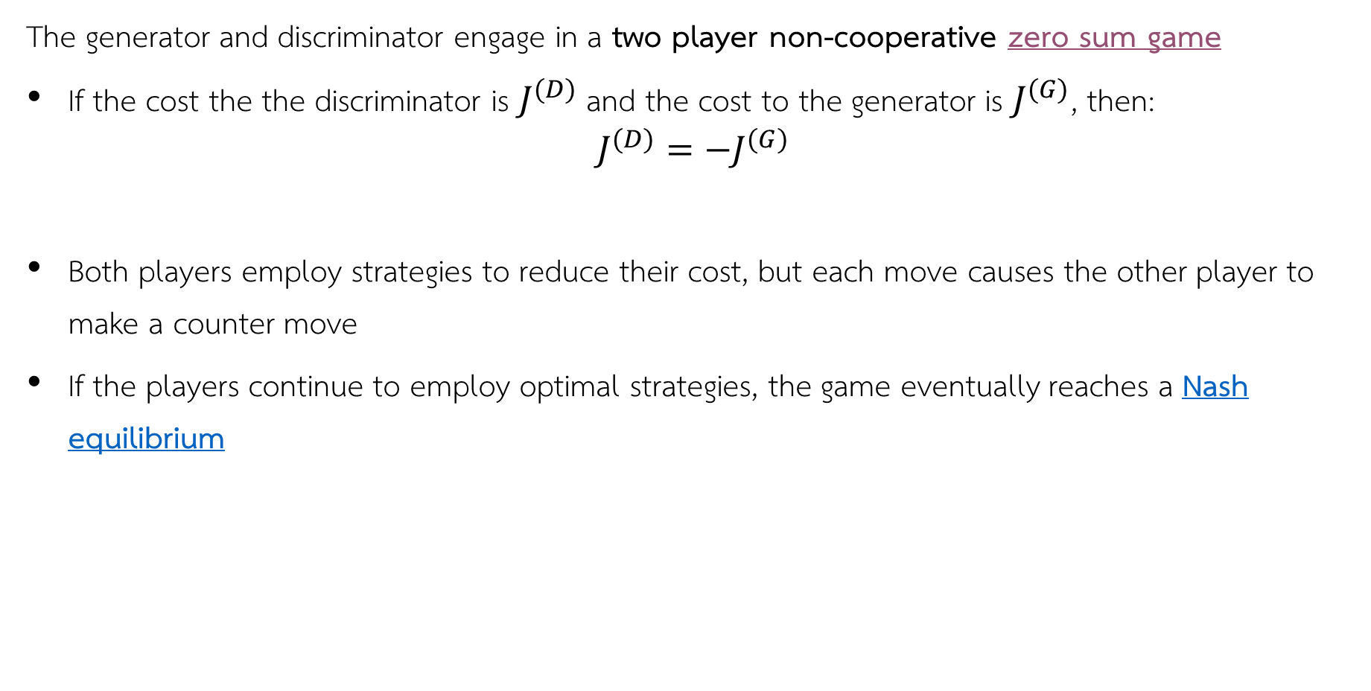
A bit of game theory
The generator and discriminator engage in a two player non-cooperative zero sum game
If the cost the the discriminator is $J^{(D)}$ and the cost to the generator is $J^{(G)}$, then:
$$J^{(D)}=−J^{(G)}$$
Both players employ strategies to reduce their cost, but each move causes the other player to make a counter move
If the players continue to employ optimal strategies, the game eventually reaches a Nash equilibrium

Slide 11
A bit of game theory
The generator and discriminator engage in a two player non-cooperative zero sum game
If the players continue to employ optimal strategies, the game eventually reaches a Nash equilibrium
At Nash equilibrium, the players are deadlocked
A first player makes an optimal move to reduce costs
The other player to make an optimal counter move to reduce cost
Counter move increases cost of the first player
A subsequent optimal counter-counter move of first player increases cost of the second player
etc…

Slide 12
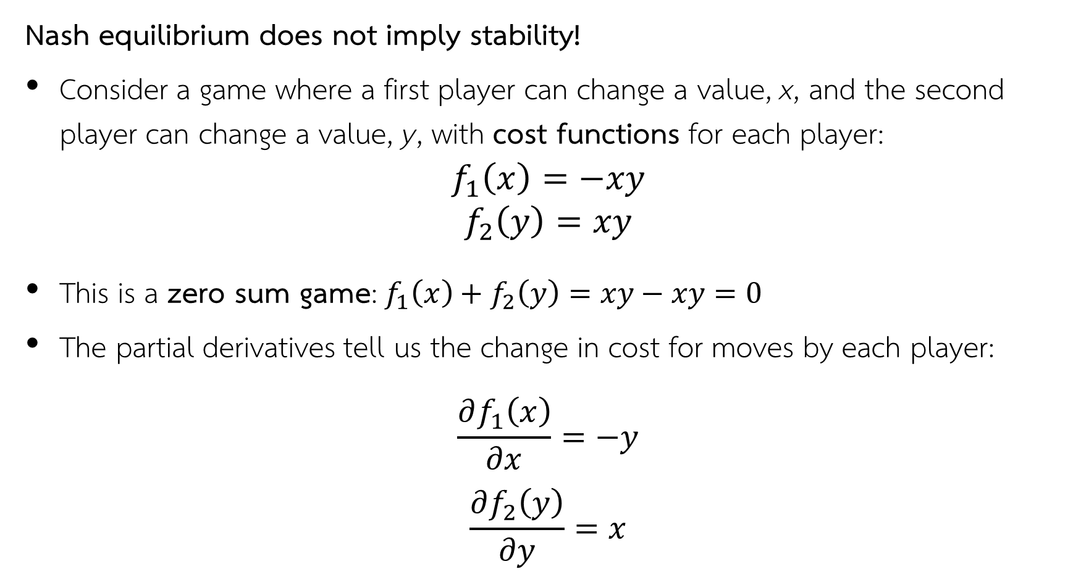
A bit of game theory
Nash equilibrium does not imply stability!
Consider a game where a first player can change a value, x, and the second player can change a value, y, with cost functions for each player:
$$f_{1}\left(x\right)=−xy$$
$$f_{2}\left(y\right)=xy$$
This is a zero sum game:$f_{1}\left(x\right)+f_{2}\left(y\right)=xy−xy=0$
The partial derivatives tell us the change in cost for moves by each player:
$$\frac{∂f_{1}\left(x\right)}{∂x}=−y$$
$$\frac{∂f_{2}\left(y\right)}{∂y}=x$$

Slide 13
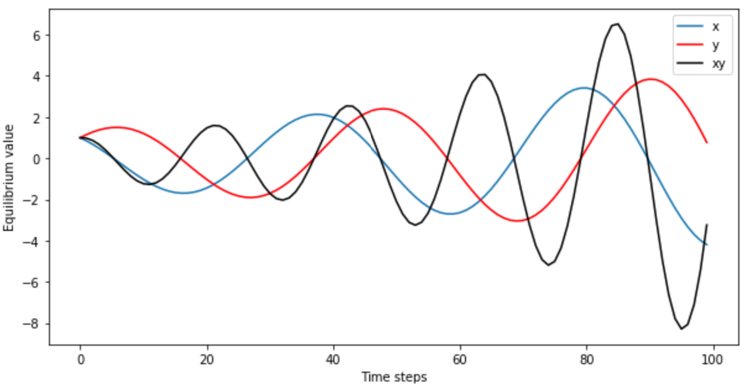

A bit of game theory
Nash equilibrium does not imply stability!
Consider a game with cost functions for each player:
$$f_{1}\left(x\right)=−xy$$
$$f_{s}\left(y\right)=xy$$
At Nash equilibrium the costs to the players are not stable with time:
Cost for each player grows without bounds!

Slide 14
Training a Model using Game Theory

Slide 15
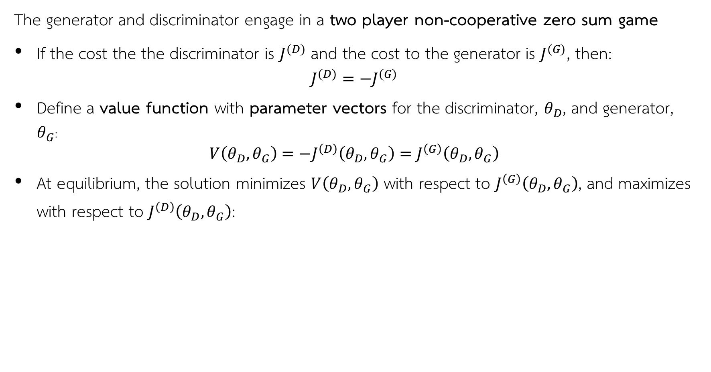
Game theory and GAN training
The generator and discriminator engage in a two player non-cooperative zero sum game
If the cost the the discriminator is $J^{(D)}$ and the cost to the generator is $J^{(G)}$, then:
$$J^{(D)}=−J^{(G)}$$
Define a value function with parameter vectors for the discriminator, $θ_{D}$, and generator, $θ_{G}$:
$$V\left(θ_{D},θ_{G}\right)=−J^{\left(D\right)}\left(θ_{D},θ_{G}\right)=J^{\left(G\right)}\left(θ_{D},θ_{G}\right)$$
At equilibrium, the solution minimizes $V\left(θ_{D},θ_{G}\right)$ with respect to $J^{\left(G\right)}\left(θ_{D},θ_{G}\right)$, and maximizes with respect to $J^{\left(D\right)}\left(θ_{D},θ_{G}\right)$:

Slide 16
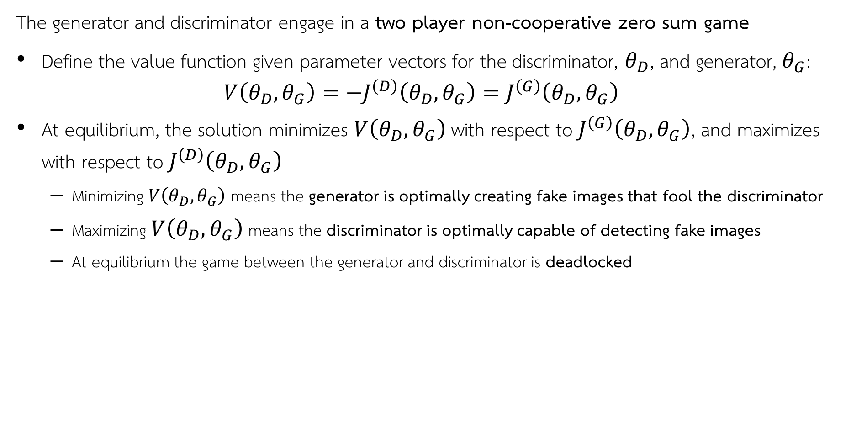
Game theory and GAN training
The generator and discriminator engage in a two player non-cooperative zero sum game
Define the value function given parameter vectors for the discriminator, $θ_{D}$, and generator, $θ_{G}$:
$$V\left(θ_{D},θ_{G}\right)=−J^{\left(D\right)}\left(θ_{D},θ_{G}\right)=J^{\left(G\right)}\left(θ_{D},θ_{G}\right)$$
At equilibrium, the solution minimizes $V\left(θ_{D},θ_{G}\right)$ with respect to $J^{\left(G\right)}\left(θ_{D},θ_{G}\right)$, and maximizes with respect to $J^{\left(D\right)}\left(θ_{D},θ_{G}\right)$
Minimizing $V\left(θ_{D},θ_{G}\right)$ means the generator is optimally creating fake images that fool the discriminator
Maximizing $V\left(θ_{D},θ_{G}\right)$ means the discriminator is optimally capable of detecting fake images
At equilibrium the game between the generator and discriminator is deadlocked

Slide 17
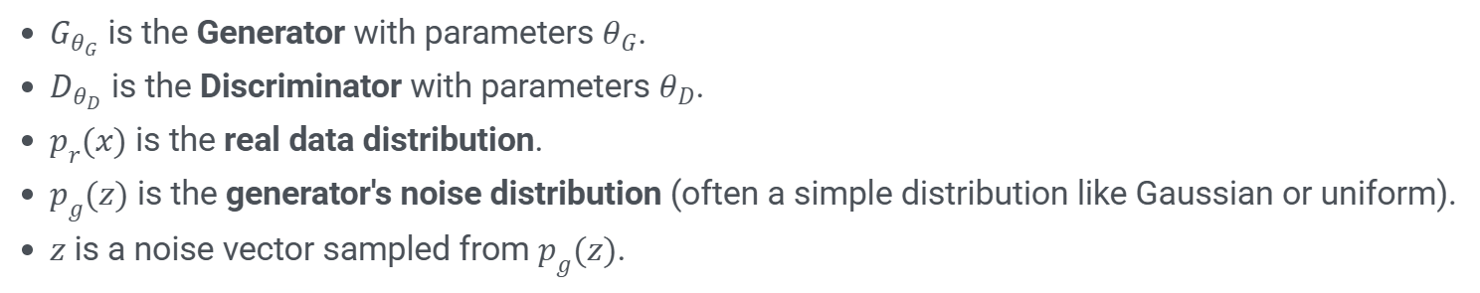
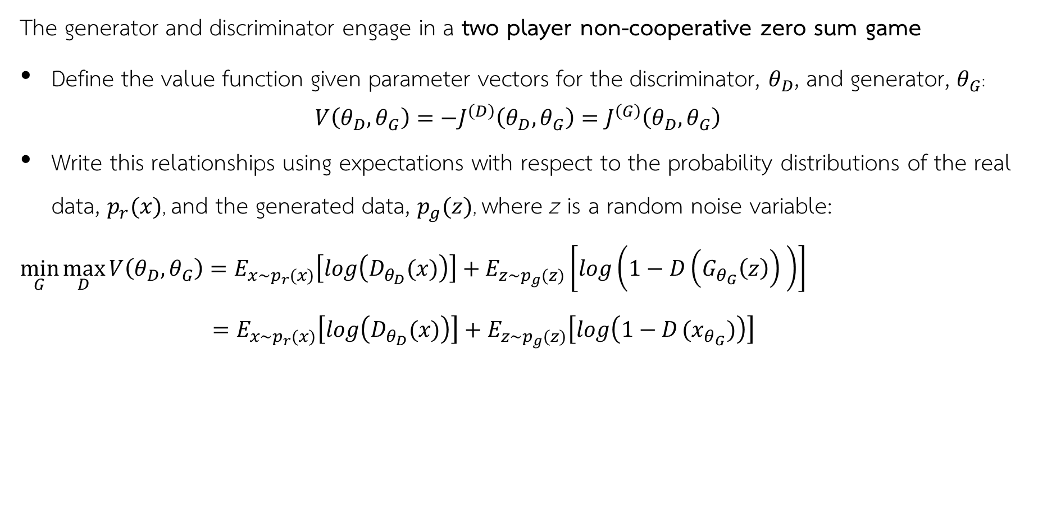
Game theory and GAN training
The generator and discriminator engage in a two player non-cooperative zero sum game
Define the value function given parameter vectors for the discriminator, $θ_{D}$, and generator, $θ_{G}$:
$$V\left(θ_{D},θ_{G}\right)=−J^{\left(D\right)}\left(θ_{D},θ_{G}\right)=J^{\left(G\right)}\left(θ_{D},θ_{G}\right)$$
Write this relationships using expectations with respect to the probability distributions of the real data, $p_{r}(x)$, and the generated data, $p_{g}(z)$, where z is a random noise variable:
$$\min_{G}{\max_{D}{V\left(θ_{D},θ_{G}\right)=E_{x\sim p_{r}(x)}\left[log\left(D_{θ_{D}}(x)\right)\right]+E_{z\sim p_{g}(z)}\left[log\left({1−D\left(G_{θ_{G}}\left(z\right)\right)}_{ }\right)\right] \underset{ }{}{{ =E_{x\sim p_{r}(x)}\left[log\left(D_{θ_{D}}(x)\right)\right]+E_{z\sim p_{g}(z)}\left[log\left({1−D}_{ }(x_{θ_{G}})\right)\right]}}}}$$

Slide 18
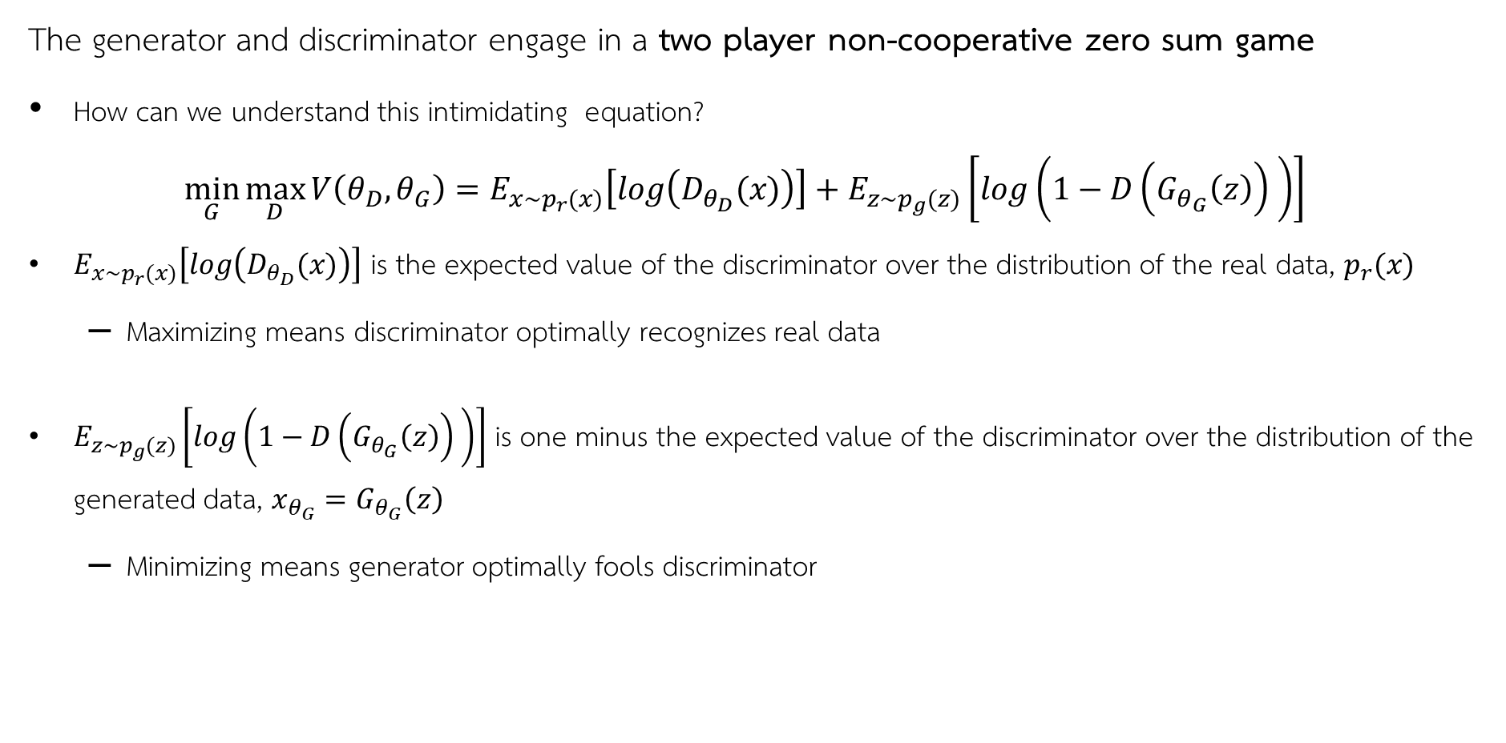
Game theory and GAN training
The generator and discriminator engage in a two player non-cooperative zero sum game
How can we understand this intimidating equation?
$$\min_{G}{\max_{D}{V\left(θ_{D},θ_{G}\right)=E_{x\sim p_{r}(x)}\left[log\left(D_{θ_{D}}(x)\right)\right]+E_{z\sim p_{g}(z)}\left[log\left({1−D\left(G_{θ_{G}}\left(z\right)\right)}_{ }\right)\right] }}$$
$E_{x\sim p_{r}(x)}\left[log\left(D_{θ_{D}}(x)\right)\right]$ is the expected value of the discriminator over the distribution of the real data, $p_{r}(x)$
Maximizing means discriminator optimally recognizes real data
$E_{z\sim p_{g}(z)}\left[log\left({1−D\left(G_{θ_{G}}\left(z\right)\right)}_{ }\right)\right]$ is one minus the expected value of the discriminator over the distribution of the generated data, $x_{θ_{G}}=G_{θ_{G}}\left(z\right)$
Minimizing means generator optimally fools discriminator

Slide 19

Game theory and GAN training
The generator and discriminator engage in a two player non-cooperative zero sum game
How can we understand this intimidating equation?
$$\min_{G}{\max_{D}{V\left(θ_{D},θ_{G}\right)=E_{x\sim p_{r}(x)}\left[log\left(D_{θ_{D}}(x)\right)\right]+E_{z\sim p_{g}(z)}\left[log\left({1−D\left(G_{θ_{G}}\left(z\right)\right)}_{ }\right)\right] }}$$
At equilibrium the discriminator cannot tell the difference between real and generated data so:
$$D\left(G_{θ_{G}}\left(z\right)\right)=D_{θ_{D}}(x)$$

Slide 20
Game theory and GAN training
How do we train a discriminator and generator?
Need to train both models together
Discriminator is a regression model
Large value for fake image
0 for real image
Generator uses discriminator to compute loss function
Complete algorithm alternates between training discriminator and generator

Slide 21

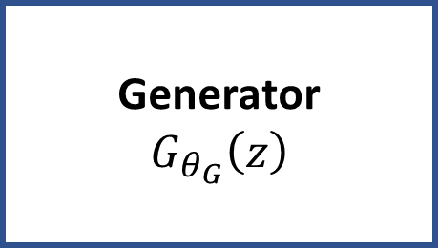

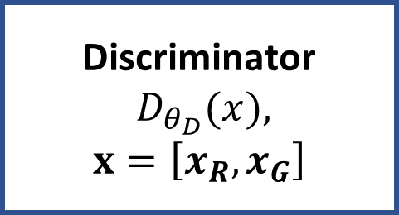

Basic GAN architecture
Alternately train generator and discriminator
$$V\left(θ_{D},θ_{G}\right)$$
Discriminator
$${D_{θ_{D}}(x}),$$
$$x=\left[x_{R},x_{G}\right]$$
Loss
Training Data
$$x_{R}$$
Real Images
$$x_{G}$$
Generator
$$G_{θ_{G}}\left(z\right)$$
Noise, z
Generated Images

Slide 22

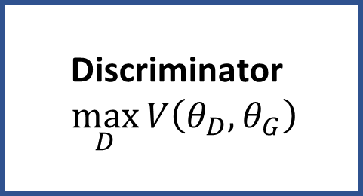
Basic GAN architecture
Alternately train generator and discriminator
Discriminator
$${\max_{D}{V\left(θ_{D},θ_{G}\right)}}$$
Loss
Training Data
Real Images
Generator
$$\min_{G}{{V\left(θ_{D},θ_{G}\right)}}$$
Noise
Generated Images

Slide 23
Failure Modes of GAN Training
GANs consist of a generator and a discriminator in a competitive game.
Training instability is common, leading to two primary failure modes
Two Common Failure Modes:
Mode Collapse: Limited variety in generated samples.
Convergence Failure: Training does not lead to meaningful outputs.
Early detection by monitoring generated samples and loss metrics is key.
Why is GAN Training Unstable?
GANs operate as a two-player zero-sum game.
Balance between the generator and discriminator is critical.
Achieving Nash Equilibrium in a non-convex, high-dimensional space is challenging.
Small changes in one network can adversely affect the other.

Slide 24
Mode collapse
Mode collapse is a common problem that prevents GANs from learning
Mode collapse is a dead lock in the two-player game
Example: discriminator becomes too good at recognizing fake image and stops generator from learning
Example: discriminator and generator alternate between modes of the loss function
Example: gradient of loss function becomes nearly zero – typically for generator

Slide 25
Mode Collapse in GANs
Definition:
The generator produces a narrow range of outputs instead of diverse samples.
Detection:
Repeatedly similar or identical generated samples.
Impact:
Limits the usefulness of the GAN for generating varied data.
Reasons Behind Mode Collapse
The generator fails to learn proper representations.
The discriminator may get stuck in a local minimum, providing poor feedback.
The output becomes nearly independent of the input noise (z).

Slide 26
Solving Mode Collapse
Use Wasserstein GAN with a new loss function to mitigate vanishing gradients.
Apply Unrolled GANs to provide feedback from multiple discriminator states.
Increase the dimensionality of the input noise vector (z).
Enhance the generator's complexity and adjust network depth.
Randomly assign false labels to challenge the discriminator.

Slide 27
Convergence Failure in GANs
Definition:
GAN training fails to converge, resulting in poor-quality outputs.
Indicators:
Discriminator loss drops to near zero and stays there.
Generator loss remains high or increases continuously.
Generated samples are trivial and easily flagged as fake.
Reasons Behind Convergence Failure
Scenario 1: A weak discriminator allows the generator to dominate despite poor quality outputs.
Scenario 2: An overly strong discriminator prevents the generator from learning by rejecting almost all outputs.
Both scenarios indicate a lack of balance between the networks.

Slide 28
Solving Convergence Failure
Balancing the Networks:
If the Generator Dominates:
Deepen the discriminator to better reject fake samples.
Add dropout layers to the generator to slow its learning.
Simplify the generator by removing some layers.
If the Discriminator Dominates:
Impair the discriminator by assigning false labels to real images.
Apply regularization techniques (e.g., dropout) to the discriminator.
Enhance the generator’s architecture to learn more complex representations.
Simplify the discriminator if it is learning too quickly.

Slide 29
Loss Functions for GANs

Slide 30

Loss Functions for Training Neural Networks
Need the distribution of the generated data be the same the real data
The Kullback-Leibler divergence between two the distributions $p_{r}\left(x\right)$ and $p_{g}\left(x\right)$ is such a measure:
4
4
3
3
P(x)
Q(x)
2
2
1
1
0
1
2
3
4
0
1
2
3
4

Slide 31
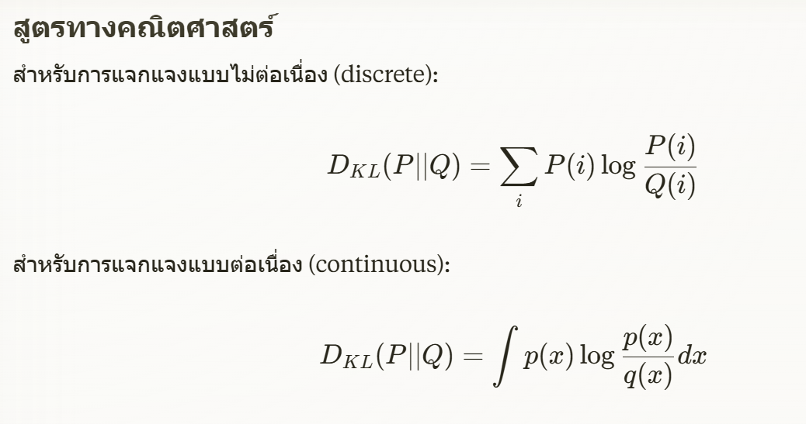
Kullback-Leibler Divergence (KL Divergence)
KL Divergence คือการวัดความแตกต่างระหว่างสองการแจกแจงความน่าจะเป็น (probability distributions) P และ Q โดยวัดว่า Q แตกต่างจาก P มากเพียงใด

Slide 32
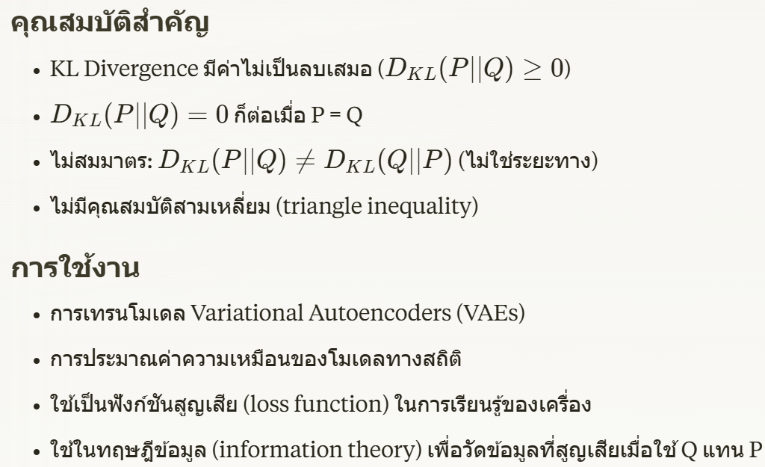
Kullback-Leibler Divergence (KL Divergence)

Slide 33
The Wasserstein distance metric
The Wasserstein distance metric is symmetric and intuitive
The Wasserstein distance metric symmetric with bounded gradients
Wasserstein GAN, or W-GAN (Arjovsky, et. al. 2017) uses the Wasserstein distance as a loss function
Using the Wasserstein loss helps W-GANs avoid mode collapse

Slide 34
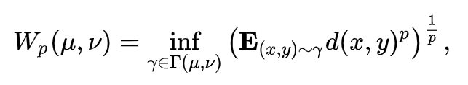
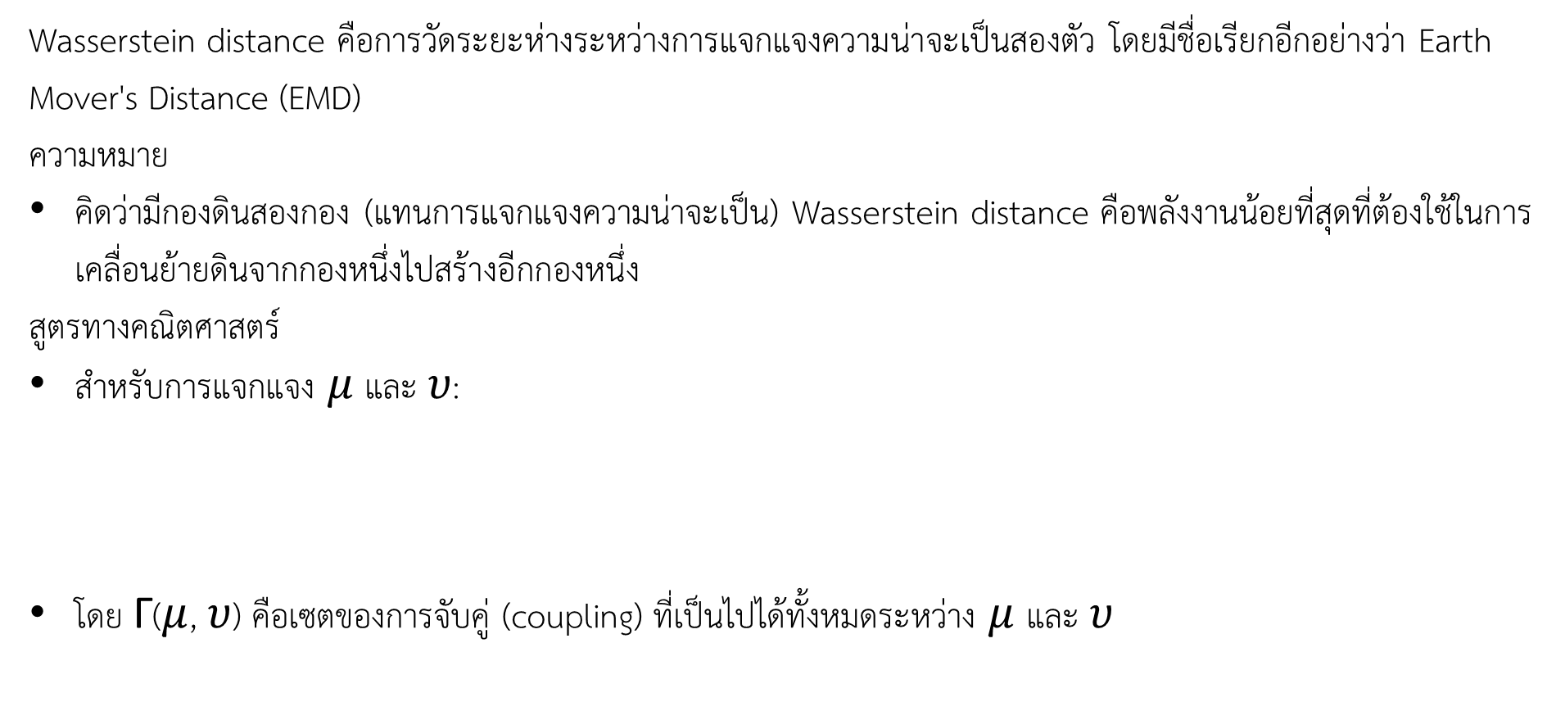
The Wasserstein distance metric
Wasserstein distance คือการวัดระยะห่างระหว่างการแจกแจงความน่าจะเป็นสองตัว โดยมีชื่อเรียกอีกอย่างว่า Earth Mover's Distance (EMD)
ความหมาย
คิดว่ามีกองดินสองกอง (แทนการแจกแจงความน่าจะเป็น) Wasserstein distance คือพลังงานน้อยที่สุดที่ต้องใช้ในการเคลื่อนย้ายดินจากกองหนึ่งไปสร้างอีกกองหนึ่ง
สูตรทางคณิตศาสตร์
สำหรับการแจกแจง $μ$ และ $υ$:
โดย Γ($μ$, $υ$) คือเซตของการจับคู่ (coupling) ที่เป็นไปได้ทั้งหมดระหว่าง $μ$ และ $υ$

Slide 35
The Wasserstein distance metric
คุณสมบัติสำคัญ
เป็น metric จริงๆ (มีคุณสมบัติสมมาตรและสามเหลี่ยม)
วัดระยะห่างได้แม้การแจกแจงไม่ทับซ้อนกัน
ให้การเทียบเคียงที่สมเหตุสมผลระหว่างการแจกแจงที่มีลักษณะคล้ายกันแต่ไม่ทับซ้อน
การประยุกต์ใช้
Wasserstein GAN (WGAN) - ปรับปรุงเสถียรภาพการเทรนโมเดล GAN
การเทียบความคล้ายของภาพและเสียง
ใช้วัดระยะห่างระหว่างการแจกแจงในข้อมูลที่มิติสูง
ใช้ในปัญหา domain adaptation

Slide 36
The Wasserstein distance metric
How many earthmover loads are required to equalize the distributions?
4
4
4
4
Q(x)
3
3
3
3
2
2
2
2
1
1
1
1
0
1
2
3
4
0
1
2
3
4
0
1
2
3
4
0
1
2
3
4
4
4
4
4
3
3
3
3
P(x)
2
2
2
2
1
1
1
1
0
1
2
3
4
0
1
2
3
4
0
1
2
3
4
0
1
2
3
4
0 loads
1 load
2 loads
3 loads

Slide 37
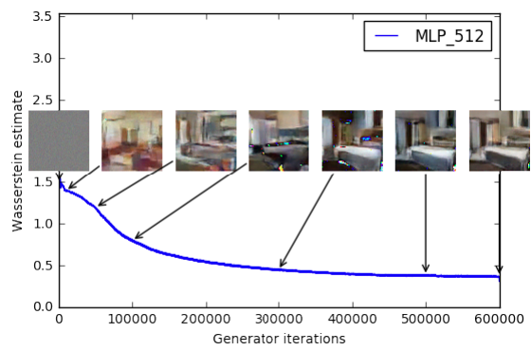
The Wasserstein distance metric
The loss of the Wasserstein GAN is linear and symmetric
Image generation starts with random noise
As generator loss is reduced, the images create improve
Notice that learning continues as loss function continues to decrease

Slide 38
Advances in GAN Models

Slide 39
Approaches to improved GAN training
A great deal of research has focused on improving the convergence and preventing mode collapse
An very incomplete list of key advances:
Method | Approach | Year
Deep Convolutional GANs - DC-GANs | Use fully convolutional representation | 2014
Conditional GAN | Use conditional distribution to generate specific images | 2014
Multiple ad-hoc methods, Salimans, et. al., 2016 | Minibatch mixing, virtual batch normalization, and feature matching – Rarely used now days, beyond inception score | 2016
Wasserstein GAN | Use Wasserstein loss for training | 2017
Two-time scale updates | Use different time scales for generator and discriminator training | 2018
Spectral Normalization – SN-GANs | Scale weights so largest eigenvalue to 1.0 | 2018
Self Attention GAN - SAGAN | Use an self attention mechanism to train latent space | 2019
Style-based GAN | Generator uses attention on specific parts of the latent space to create desired style, see Karras, et.al., 2018 for details | 2018

Slide 40
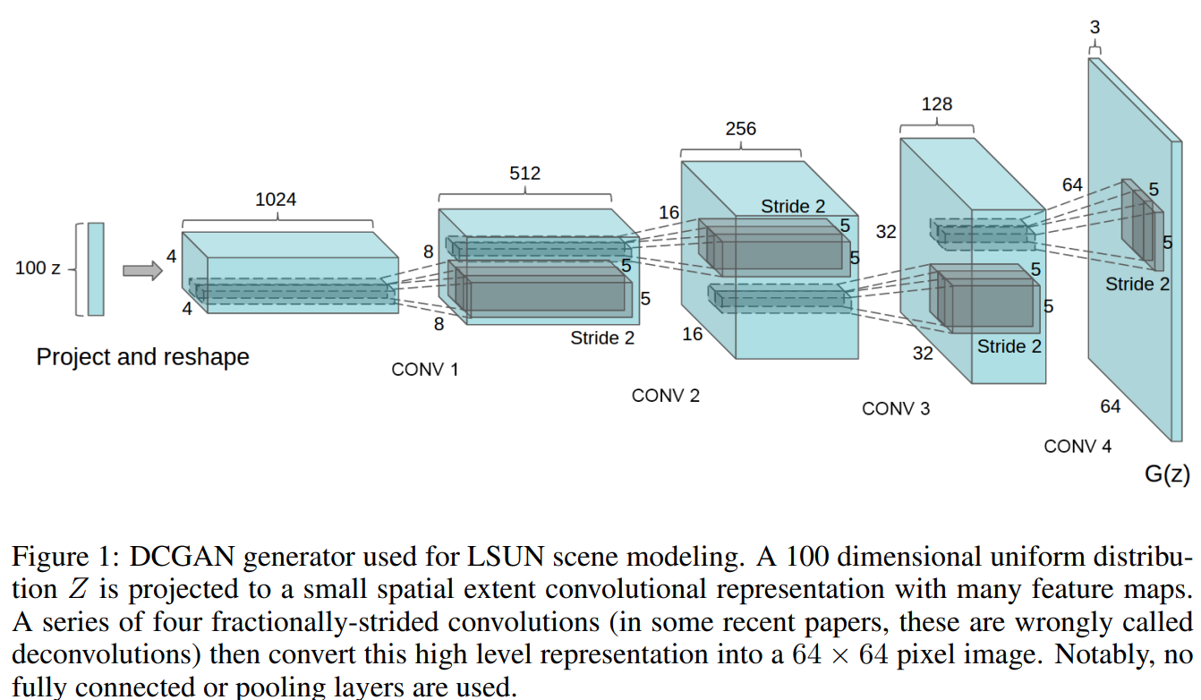
The Convolutional GAN
The deep convolutional GAN is a fully convolutional
The deep convolutional GAN or DCGAN (Radford, et. al. 2015) was a significant breakthrough in creating GAN model with stable training behavior
Fully convolutional architecture – no fully connected layers

Slide 41
The Convolutional GAN
Components of the DCGAN,
Convolutional Embedding Space
Increasing image resolution
Random Input vector

Slide 42
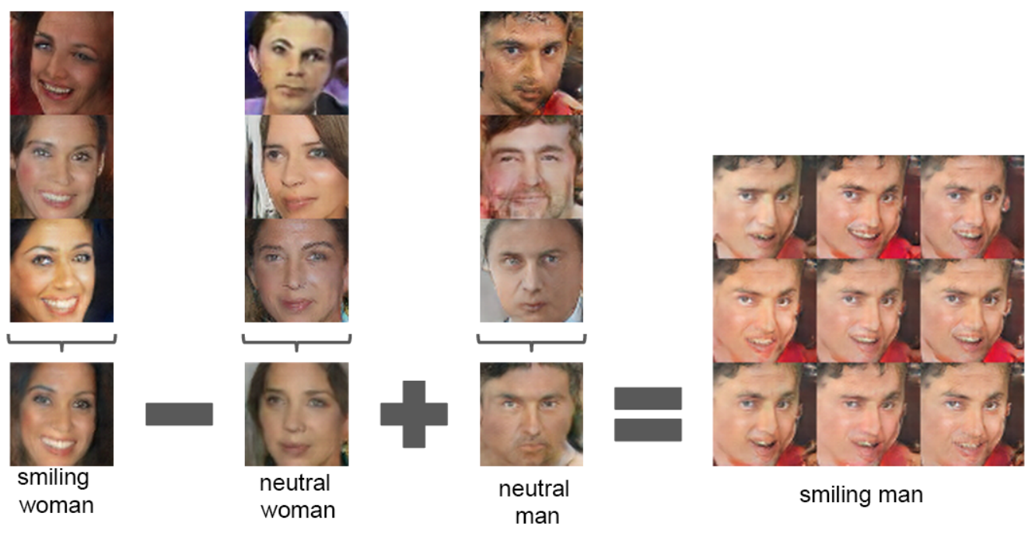
The Convolutional GAN
Can perform linear mathematical operations on convolutional embedding space

