Slide 1

Dynamic BSP: Towards a Flexible Approach to Parallel Computing over the Grid
Jeremy Martin
Alex Tiskin

Slide 2
Topics
The promise of the Grid.
The BSP programming model.
How the grid differs from BSP.
Introducing ‘Dynamic BSP’.
Example: Strassen’s algorithm.

Slide 3
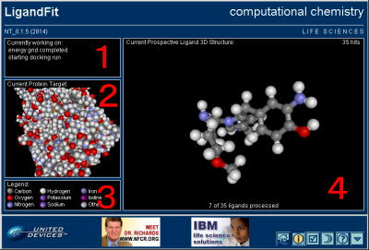
The promise of the Grid
WWW is a vast, distributed information resource.
The Grid will harness the internet’s untapped processing power as well as its information content.
E.g. ScreenSaver LifeSaver computational chemistry project for cancer research.
Affordable supercomputing-on-demand.

Slide 4
The BSP programming model
We need better programming models to utilise the Grid effectively for problems that are not “embarrassingly parallel”.
BSP model (s,p,l,g)
  Set of identical processors, communicating asynchronously by remote memory transfer.
  Global barrier synchronisation ensures data consistency.
  Performance and scalability can be predicted prior to implementation.
BSP is widely used to program supercomputers and NOWs.
Processor 1
Processor 2
Processor 3
Processor 4
Time

Slide 5
How the grid differs from BSP
Processor heterogeneity:
  Time dependent resource sharing.
  Architectural differences;
Network heterogeneity:
  BSP performance is usually constrained by slowest communication link in the network.
Reliability and availability.
  Processors may fail or be withdrawn by service provider.

Slide 6
Introducing ‘Dynamic BSP’
…Building on previous work (e.g. Vasilev 2003, Tiskin 1998, Sarmenta 1999, Nibhanupudi & Szymanski 1996)
The essence of our approach is to use a task farm together with parallel slackness.
A problem is partitioned onto N ‘virtual processors’, such that N >> p (the number of available physical processors).
Virtual processors are scheduled to run on physical processors using a fault-tolerant task farm.
Unlike standard BSP, there is no persistence of data at processor nodes between supersteps.
A fault-tolerant, distributed virtual shared memory is implemented.
Any existing BSP algorithm could be implemented using this approach, but the cost prediction would be different due to the additional communication.
We also allow the dynamic creation of child processes during a superstep.

Slide 7
Standard BSP computation
Processor 1
Processor 2
Processor 3
Processor 4
Processor 5
Processor 6
Time
Dynamic BSP computation
Time out
Master processor
Grid processor 1
VP1
VP4
VP6
VP1
VP4
VP6
Grid processor 2
VP2
VP5
VP2
VP5
VP3
Grid processor 3
VP3
VP3
Processor dies
Time
Not shown: distributed shared memory nodes, dynamic process spawning

Slide 8
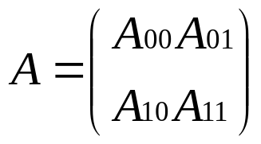

Example: Strassen’s algorithm
Strassen discovered an efficient method for calculating
C = AB
where A and B are square matrices of dimension n by dividing each matrix into four sub-matrices of size n/2, e.g.
The recursive algorithm derived from this spawns eight matrix multiplication subcomputations
Strassen was able to reduce this to seven, by careful use of matrix additions and subtractions.

Slide 9
McColl and Valiant developed a two-tiered, recursive, generalised BSP implementation of Strassen’s algorithm:
Initial data distribution;
Recursive generation of sub-computations;
Recursion stops at a level where there are sufficient sub-computations to utilise all the processors;
Redistribution of data;
Calculation of sub-computations;
Additions to complete recursive steps.

Slide 10
Dynamic BSP would provide a more elegant framework to implement this recursive algorithm.
Master generates the first ‘root’ task, which requests the data server to do some data parallel work without communication.
Child tasks are spawned recursively (all within the master).
Once the number of spawned tasks is big enough, they are distributed across the workers, who download data from the data server, synchronise, compute block-products and write them back to the data server.
Child tasks terminate and suspended parent tasks (at the master) resume by issuing data-parallel computation tasks to the data server.

Slide 11
Summary
We have proposed a modified version of BSP for Grid usage which counteracts problems of resource heterogeneity, availability and reliability.
This would seem much harder to achieve for a message-passing paradigm such as MPI.
Dynamic BSP also provides a more elegant programming model for recursive algorithms.
Now we need a Grid implementation. Note that this would also serve as a vehicle for embarrassingly-parallel problems – which could be implemented with a single ‘huge’ BSP superstep.

