Slide 1
Final project
Jimmy Chen

Slide 2

Database: Airbnb Ratings Dataset
Initial data: airbnb_ratings_new.csv
Business value for my Pipeline:
Build a machine learning model based on KNN (K-Nearest Neighbor) to predict the price of the rent rate a day based on location, rooms, property type and other 16 factors. After that, establishing Auto Scaling Group to build front website to help new property owners to set the right price with the market.
Get the query of average review accuracy, which property types are most common and how they perform across key customer satisfaction metrics—accuracy, communication, location, and value. It helps identify top-performing listings, uncover service gaps, and guide pricing, marketing, and operational decisions.
Get the query of price tier analysis of Airbnb listings. Listing quality and perceived value differ across price segments, offering guidance for pricing and service improvements.

Slide 3
Tools
Lambda: Controls logic and resource automation
Glue (Crawler + ETL): Schema detection & batch ingestion
RDS (MySQL): Stores cleaned tabular data
S3: Source of CSV files and intermediate storage
EC2 + Auto Scaling Group: Hosts inference models
ALB + Target Group: Public model API with health checks
Step Functions: Manages orchestration
SNS: Push notifications after success/failure

Slide 4
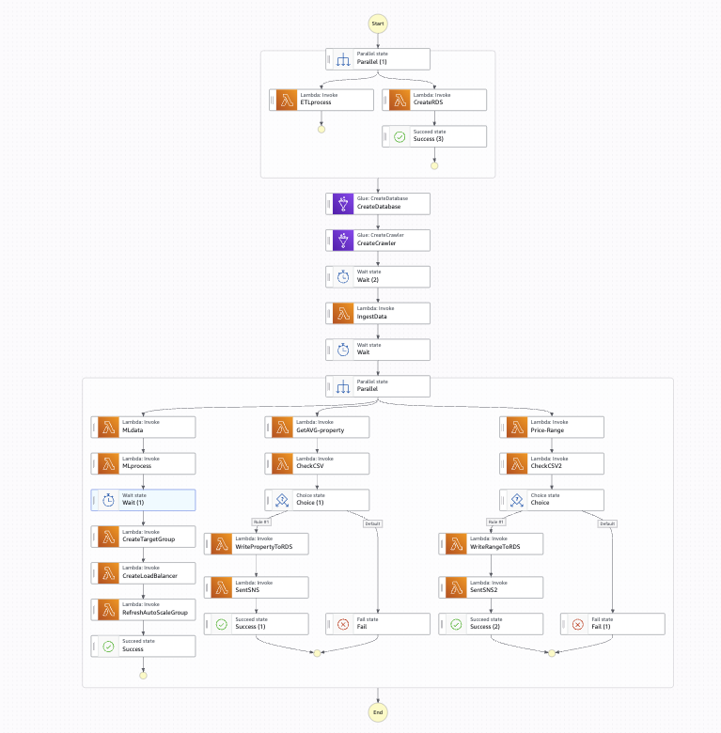
My Workflow

Slide 5
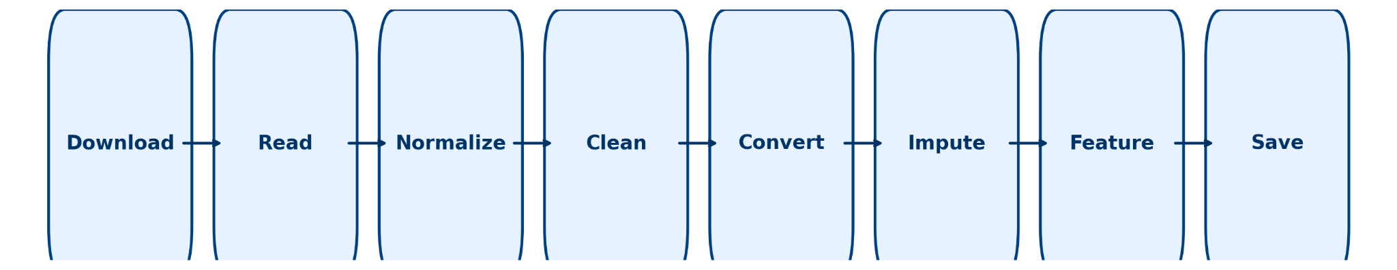
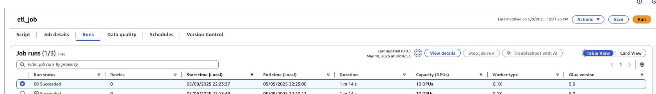
ETL Processing
Processing by python script and uploading to ETL job to make the process

Slide 6
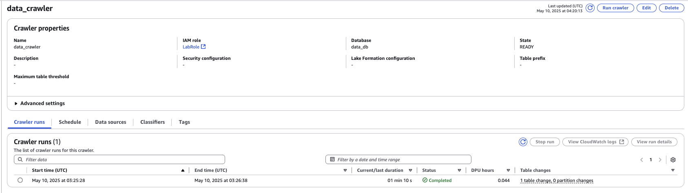
ETL Crawler
Utilzer ETL Crawler to get the latest processed data to build the database schema. Therefore, we can use database to transfer and query data.

Slide 7
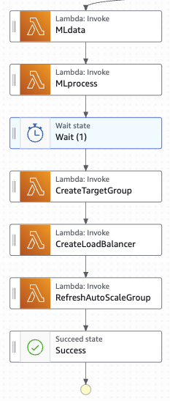
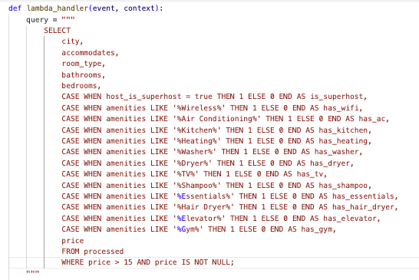
Parallel process flow 1: ML
MLdata Lambda: I transfer the data to specific format to prepare to process the machine learning.

Slide 8
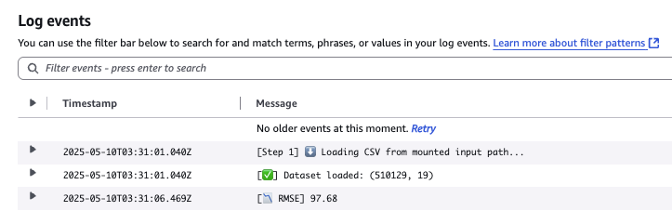
Parallel process flow 1: ML
2. MLprocess Lambda: Trigger my model training code in S3 to SageMaker Processing.
The model ‘s RMSE is 97.68

Slide 9
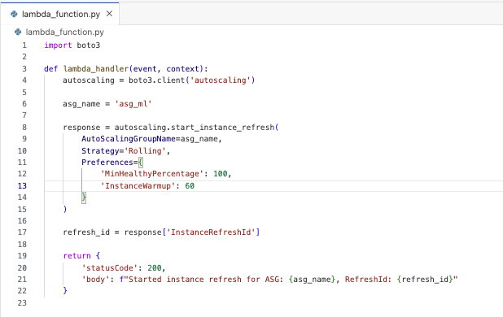
Parallel process flow 1: ML
3. RefreshAutoScaleGroup Lambda: refresh the Auto Scaling Group to deploy the new pkl to EC2 front web.

Slide 10
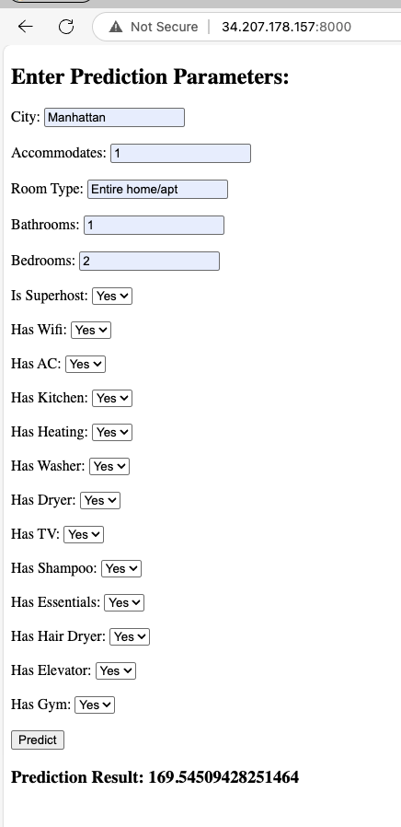
Parallel process flow 1: ML
ML website: client can enter their property information to get the market fair price.

Slide 11
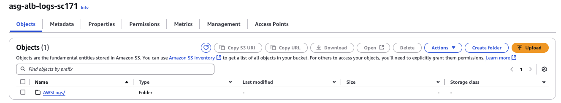
Parallel process flow 1: ML
ML website: later we can get web users’ logs and give them advice on pricing

Slide 12
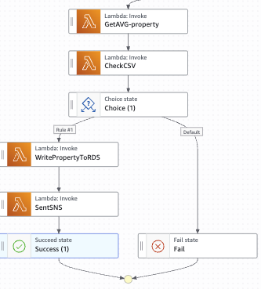
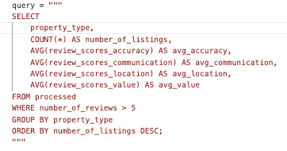
Parallel process flow 2: Query Accuracy of Reviews
GetAVG-property Lambda: Extract transfer data from the cleaned airbnb_ratings_new.csv

Slide 13
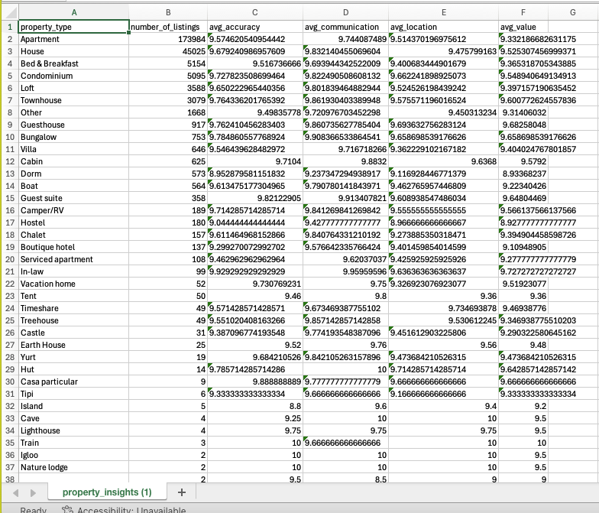
Parallel process flow 2: Query Accuracy of Reviews

Slide 14
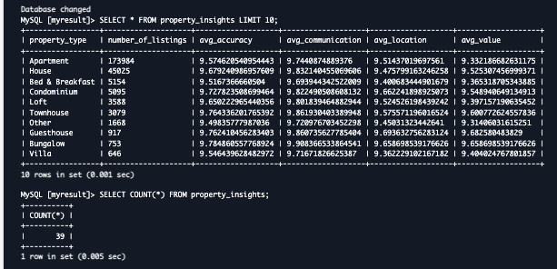
Parallel process flow 2: Query Accuracy of Reviews
Write the query to RDS for long-term analyze

Slide 15
Parallel process flow 2: Query Accuracy of Reviews
Apartments dominate the market with over 173,000 listings, but they offer only average review scores, suggesting their popularity comes from availability and convenience, not exceptional experience.
Guest suites and Villas deliver high scores in accuracy, communication, and value, making them strong candidates for premium recommendations despite being less common.
Treehouses and Castles, while rare, receive exceptionally high overall ratings (value, accuracy, and location all near or above 9.5), suggesting they create memorable guest experiences—ideal for niche marketing or experience-focused promotions.
Boat, Camper/RV, and Dorm listings tend to have lower value scores, potentially reflecting mismatched expectations or limited amenities, indicating a need for better expectation-setting or service improvements.
Boutique hotels and serviced apartments show weaker average scores across the board, despite moderate pricing, which may call for quality control or service redesign in these categories.

Slide 16
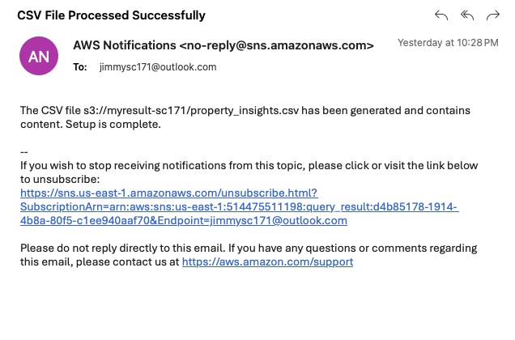
Parallel process flow 2: Query Accuracy of Reviews
SentSNS Lambda: once the data transferred, check if the csv contains the right information, then sent the message to me

Slide 17
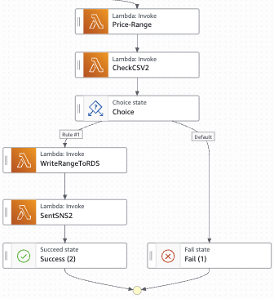
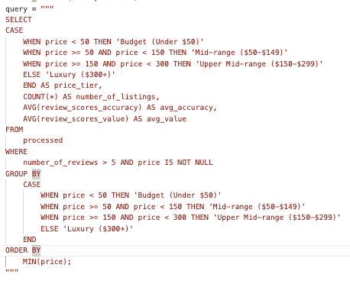
Parallel process flow 3: Query Price Tier Analysis
Price-Range Lambda: Extract transfer data

Slide 18
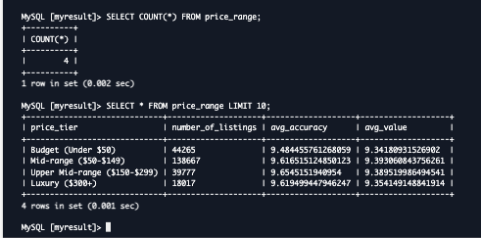
Parallel process flow 3: Query Price Tier Analysis
Write the query to RDS for long-term analyze

Slide 19
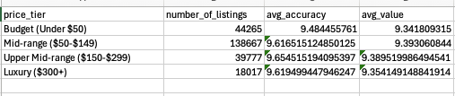
Parallel process flow 3: Query Price Tier Analysis
Price-Range Lambda: Extract transfer data
Upper Mid-range listings ($150–$299) deliver the highest average accuracy (9.65) and highest average value (9.39) among all price tiers, despite representing the smallest segment (3.9% of listings).
This suggests a high-quality niche market with strong customer satisfaction that may be underutilized. It offers a valuable opportunity to expand or promote more listings in this tier.
Meanwhile, the Mid-range ($50–$149) dominates in volume but doesn't outperform in perceived value, indicating a potential optimization area for quality or pricing alignment.

Slide 20
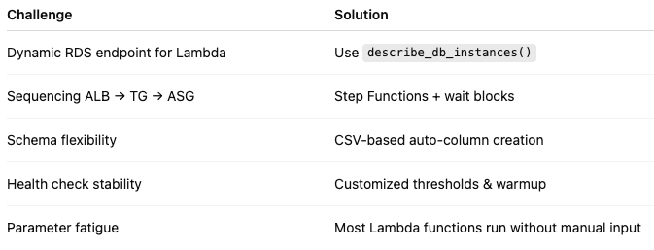
Challenge

Slide 21
Thank you

